Slide 1

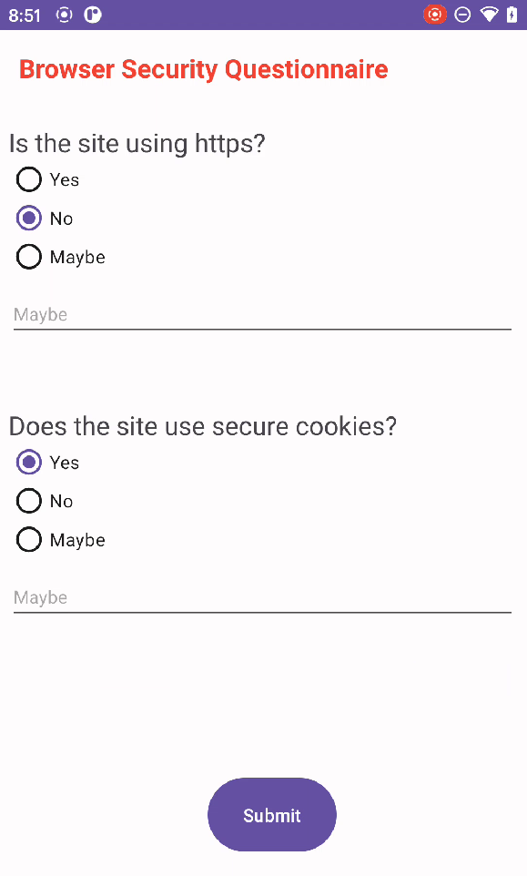





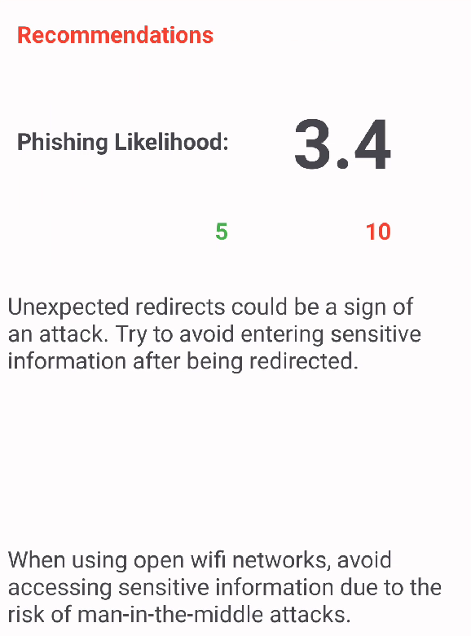

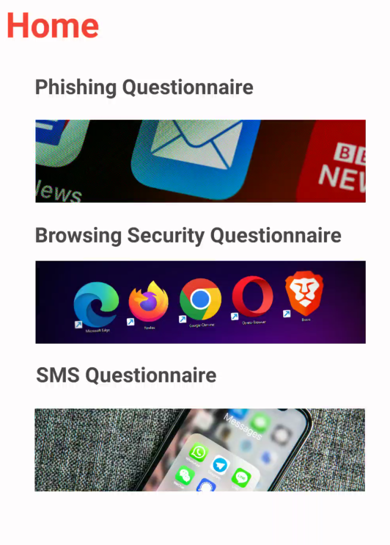
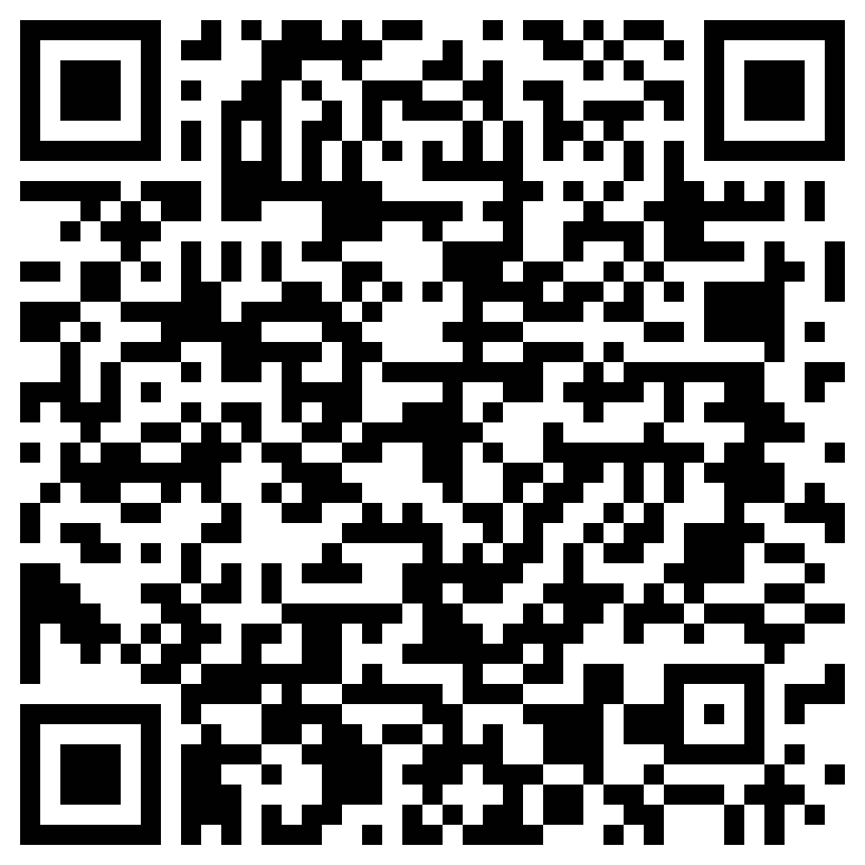


Gamifying Cybersecurity Training Through a Mobile Application to Combat Phishing
Gareth Moodley
Carlos Roque
Mentor: Dr. Sayonnha Mandal
College of Information Science and Technology
Abstract
Technologies
Conclusion
The rapidly evolving digital landscape has triggered a surge in cybersecurity threats, particularly phishing, which demands innovative and accessible countermeasures. This project presents "Cybersafe," a mobile application designed to empower users to identify and combat phishing attempts effectively. The transformative concept behind this initiative aims to reshape traditional cybersecurity training by introducing a gamified, user-friendly platform suitable for all age groups.
- Use is asked a series of questions.
- Answers may vary depending on the user
- Only “Yes”, “No” or “Maybe” can be answered.
- When user selects “Maybe”, he/she provides more context
Android Studio
Apache Tomcat
MySQL Database
Java 8 SDK
Servlets
RESTful APIs in JSON
Cybersafe is meant to serve as a diverse array of needs for the users no matter what platform or technology they are working with. Although we don't have any survey data now, we are working to test it with the public and get feedback on its effectiveness.
Acknowledgements
This work is supported by the National Science Foundation under grant award # 2308741. We would also like to thank the University of Nebraska Omaha for hosting this REU.
Introduction
The paper describes the Cybersafe application's functionality, revolving around interactive quizzes that assess users' ability to identify threats. Each question within the quiz holds a specific score and answering "yes" to a question indicates a potential vulnerability. Once the questionnaire is completed the app gives the user feedback on their behavior as well as an overall risk score.
Figure 4: Example questionnaire for Browser Security
References
R. Zieni, L. Massari and M. C. Calzarossa, "Phishing or Not Phishing? A Survey on the Detection of Phishing Websites," in IEEE Access, vol. 11, pp. 18499-18519, 2023, doi: 10.1109/ACCESS.2023.3247135.
H. Abroshan, J. Devos, G. Poels and E. Laermans, "Phishing Happens Beyond Technology: The Effects of Human Behaviors and Demographics on Each Step of a Phishing Process," in IEEE Access, vol. 9, pp. 44928-44949, 2021, doi: 10.1109/ACCESS.2021.3066383.
Methodology
- Answers determine the score
- The higher the score, the riskier the inquiry
- The app also provides recommendations
- Recommendations depend on answers with “Yes”
Email Phishing, Browser Security, SMS Phishing and Network Security.
Broad + Narrow questions
Recommendations + Phishing score
Related Works
- Cybersafe offers questionnaires
- These questionnaires are for:
- Email Phishing
- Browsing Security
- SMS Phishing
- And Network Security
Demo Video
Figure 1: PhishFort Runs an educational blog, product protects business infrastructure
Figure 5: Example recommendations for Browser Security questions
Figure 2: Phishing Framework to test employees on awareness
Figure 3: Main menu of mobile application, to select type of questionnaire

