Slide 1
Project_4_group_1: ML Base code
Overview
The Alphabet Soup Nonprofit Foundation sought a binary classifier in order to facilitate the selection of applicants for funding.
The binary classifier is designed to assess the likelihood of successful applicants being funded by Alphabet Soup.
Preprocessing, compiling, training, evaluating the model and model optimization have been done all in a single jupyter notebbok file.

Slide 2
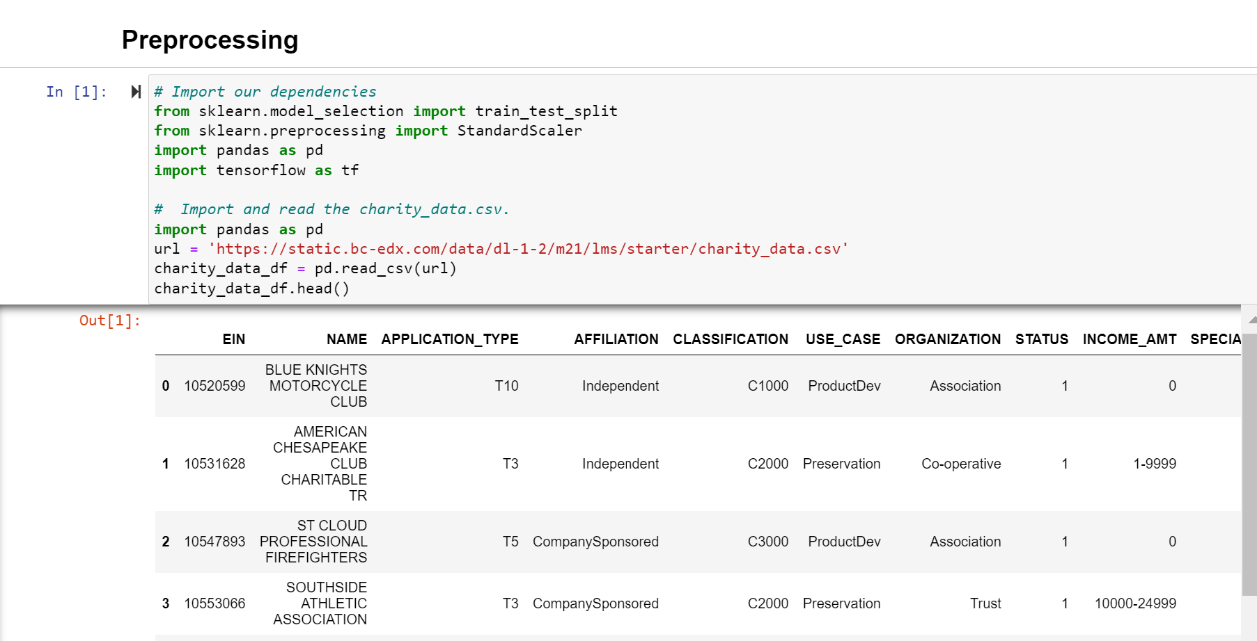
Project_4_group_1: ML Base code
Data processing
EIN and Name were eliminated from the dataset, and all remaining metrics were incorporated into the model. Classification and Application Type are features of the model. The following points have been considered in the data processing.
What variable(s) are the target(s) for your model?
What variable(s) are the features for your model?
What variable(s) should be removed from the input data because they are neither targets nor features?

Slide 3
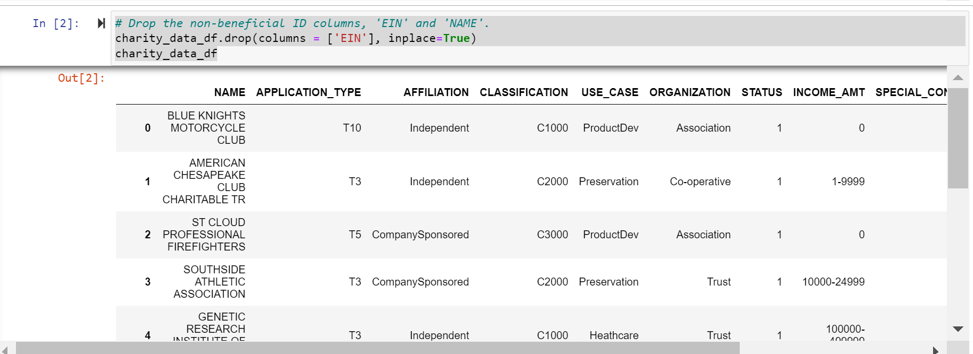
Project_4_group_1: ML Base code
Data processing

Slide 4
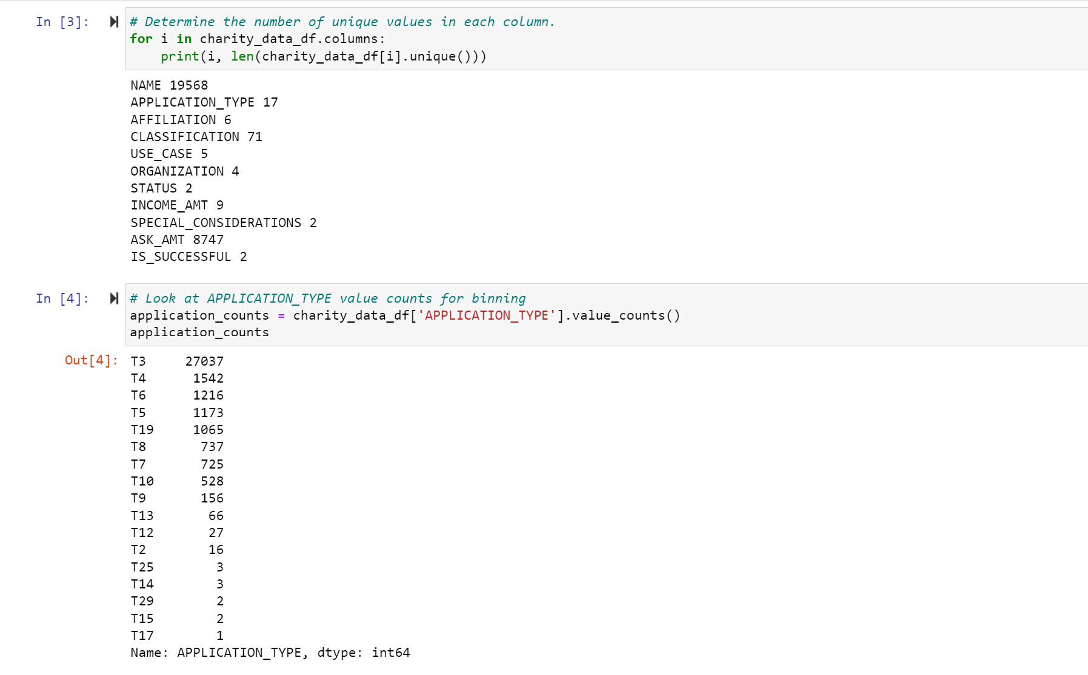
Project_4_group_1: ML Base code
Data processing

Slide 5
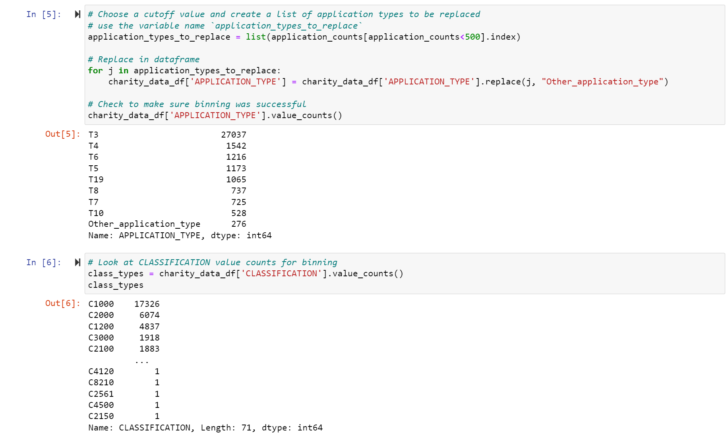
Project_4_group_1: ML Base code
Data processing

Slide 6
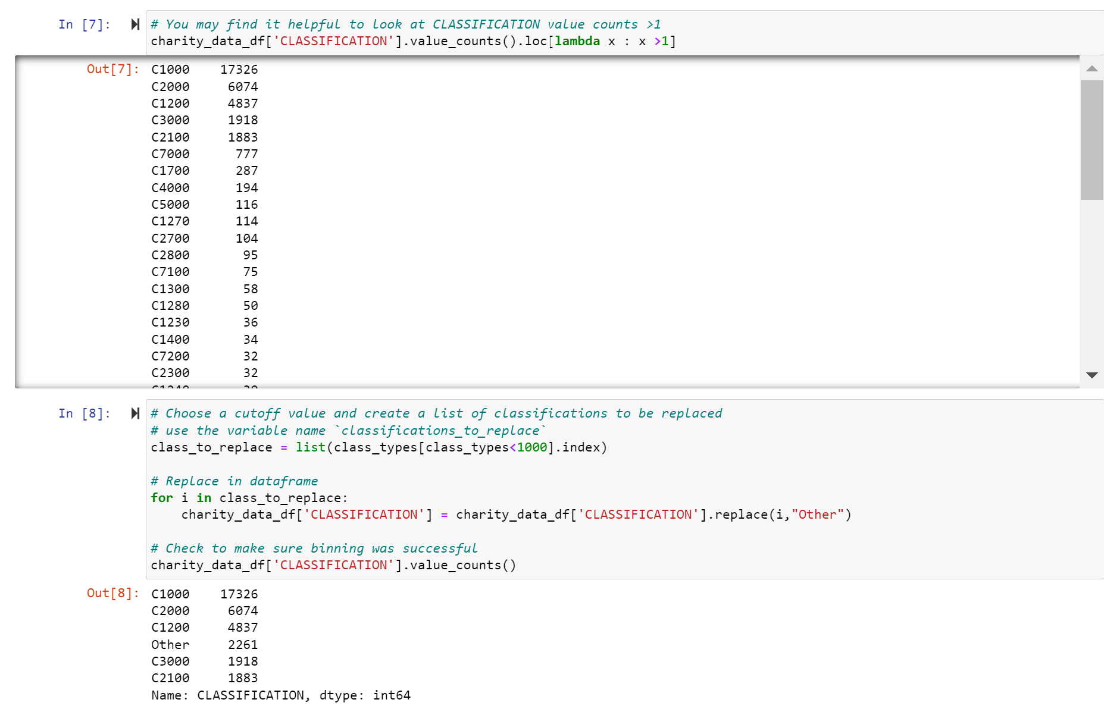
Project_4_group_1: ML Base code
Data processing

Slide 7
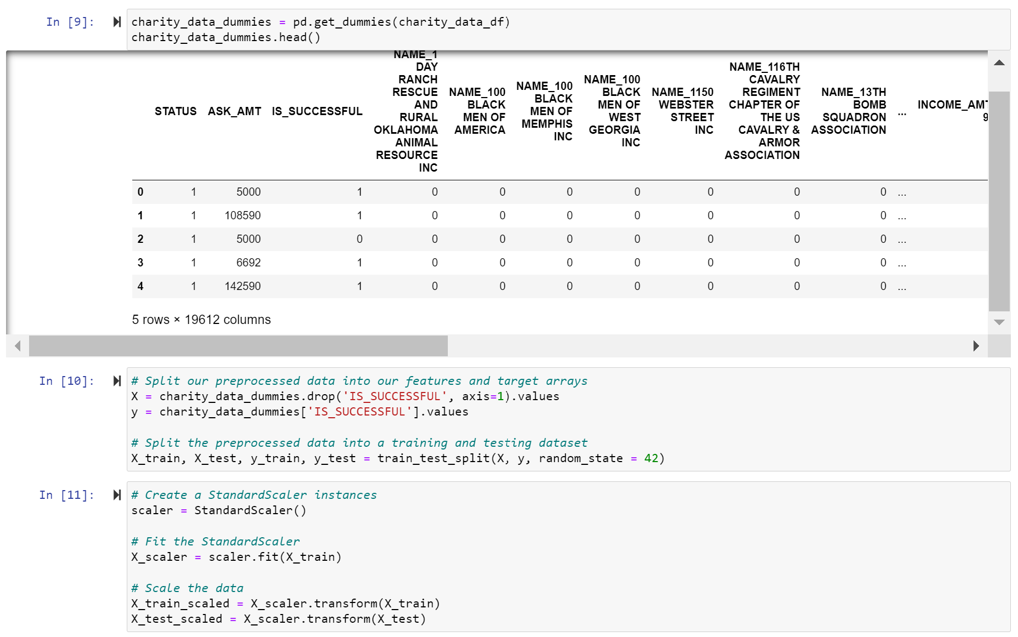
Project_4_group_1: ML Base code
Data processing

Slide 8
Project_4_group_1: ML Base code
2.1 Compiling, Training, and Evaluating the Model and Optimize the Model
Neural Network was used on each model and originally set with 2 hidden layers for first and second attempt using relu function (activation function) to create a threshold and sigmoid function (activation function) for output layer.
For the final model(the third attempt), 3 hidden layers have been used with some changes in number of nodes to acquire the required accuracy.
Hence, the code for defining the models (attempts) which is optimised models to find the optimum model have been shown in the picture below.

Slide 9
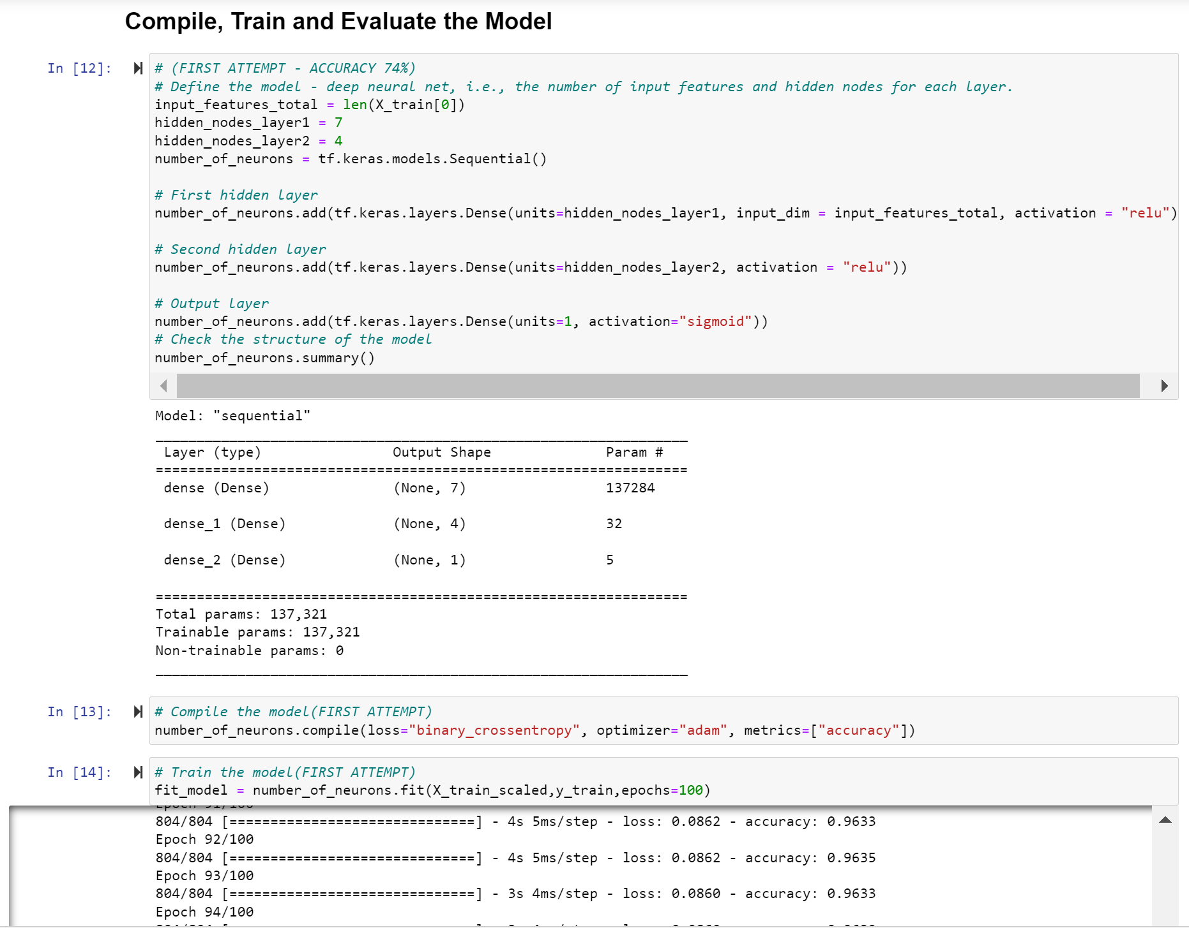
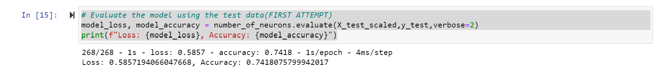
Project_4_group_1: ML Base code
2.1. Compile, Train and Evaluate the Model –First attempt

Slide 10
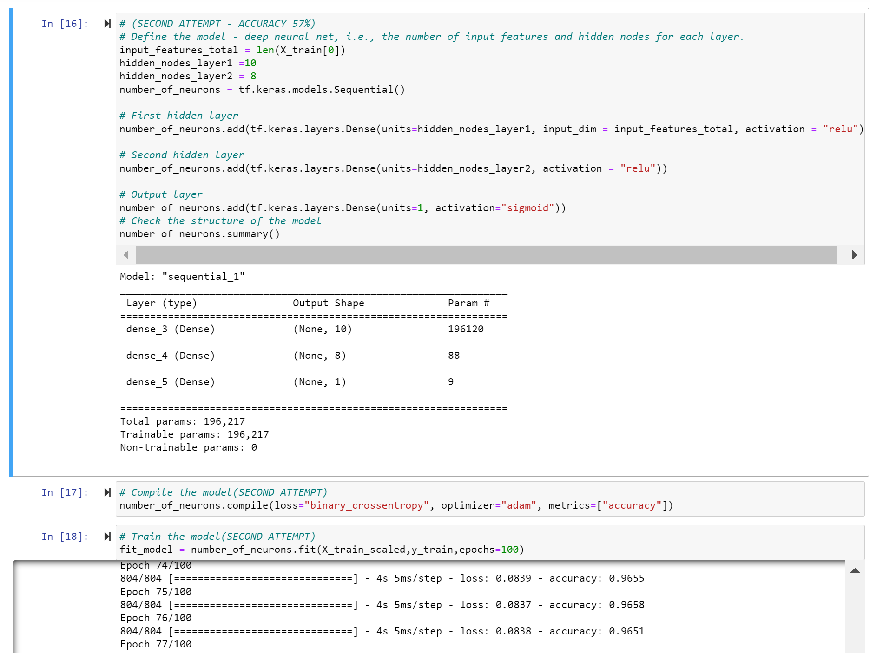
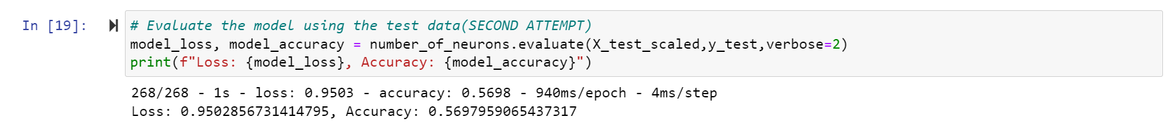
Project_4_group_1: ML Base code
2.1. Compile, Train and Evaluate the Model – Second attempt

Slide 11
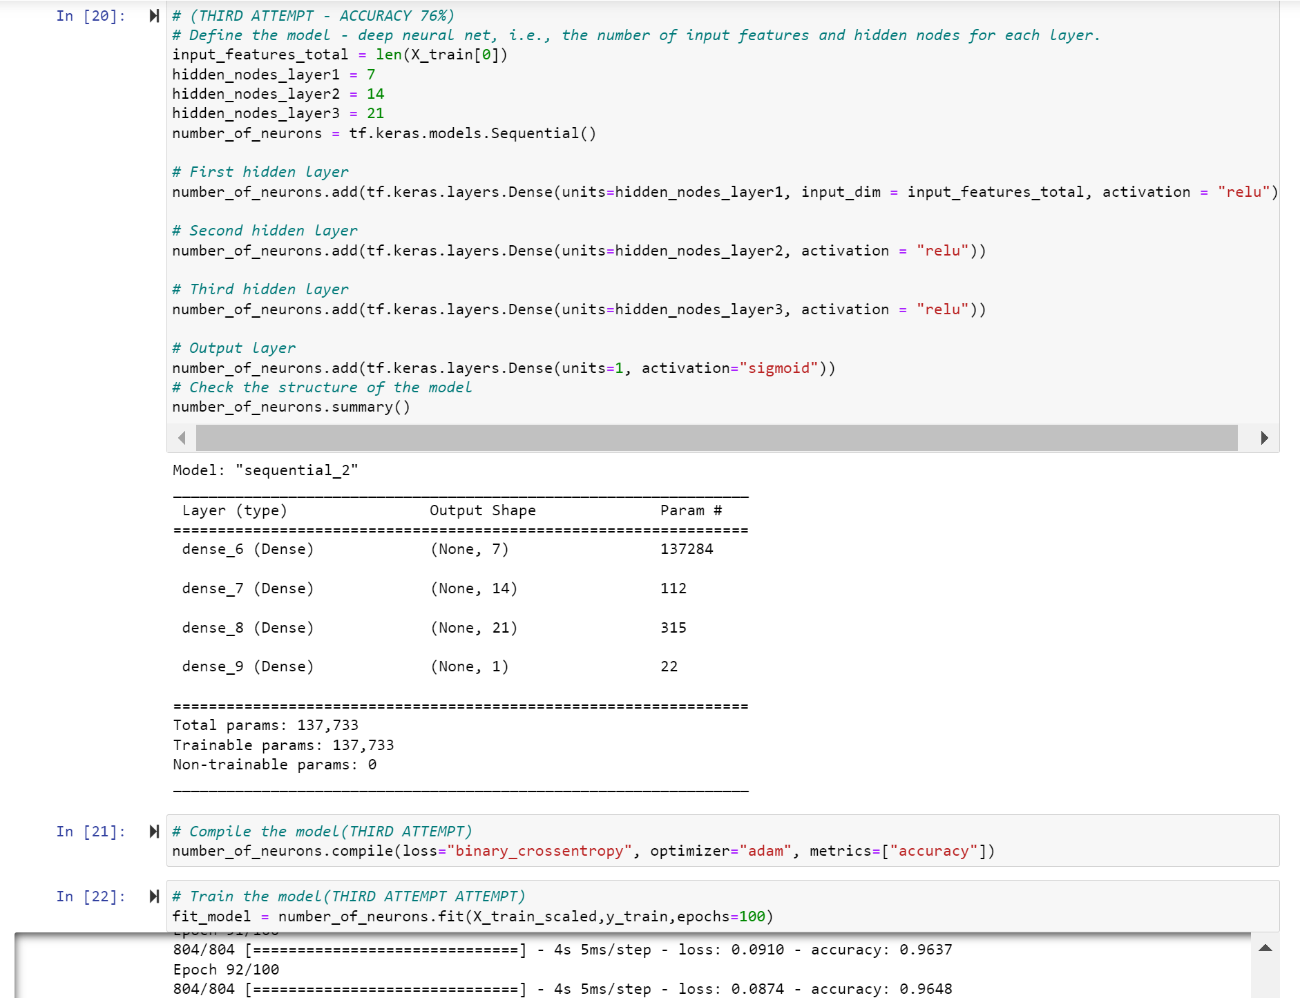
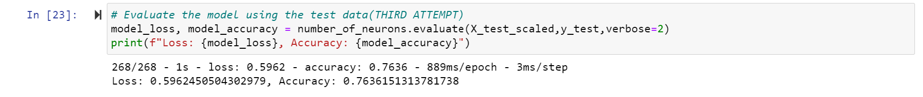
Project_4_group_1: ML Base code
2.1. Compile, Train and Evaluate the Model – Third attempt

Slide 12
Project_4_group_1: ML Base code
3. Summary
From the three optimised deep learning models, the accuracy has been found to be 74, 57 and 76% for first, second and third attempts (models) respectively.
In terms of assessment of each model, the second model is far away (57%) from the target (75%).
Though the first attempt (74%) is close to the target it does not meet the requirement.
However, the third attempt’s result is just above the target value and hence it can be taken as a final optimum model.
For the model to continue to forecast with optimum accuracy, it is necessary to consider multiple hidden layers with an increase of number of nodes(neurons or preceptors) and needs removal of features that does not affect the result.

