Slide 1
INF502
Lecture: Python: Files, Exceptions, and some Modules
Dr. Igor Steinmacher
e-mail: Igor.Steinmacher@nau.edu
Twitter: @igorsteinmacher

Slide 2
Previously…
Language Basics: format, variables
Conditional
Functions
Collections
Loops

Slide 3
From Now On
Input/Output (I/O)
Files
Errors and Exception
Modules

Slide 4
Dealing with Files
A file in Python serves as a link to an actual file from the computer
Read from/write to a file:
Reading from a file:
file_handle = open(‘data.csv’, ‘r’) | Open the file ‘csv’ in read mode
content = file_handle.read() | Read whole file content into a string
content = file_handle.read(N) | Reads N bytes (N >= 1) into a string
line = file_handle.readline () | Read one line from the file
lines = file_handle.readlines() | Returns a list of line strings
file_handle.close() | Close the file

Slide 5
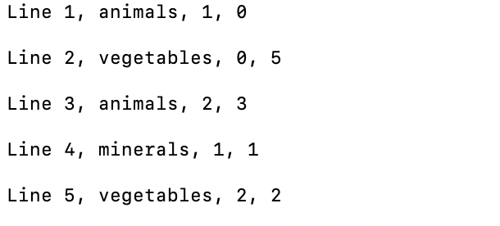
Reading from a file
file_handler = open(‘lines.csv’, ‘r’)
for line in file_handler.readlines():
print (line)
file_handler.close()

Slide 6
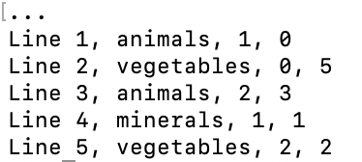
Reading from a file
file_handler = open(‘lines.csv’, ‘r’)
for line in file_handler.readlines():
print (line.rstrip(‘\n’))
file_handler.close()

Slide 7
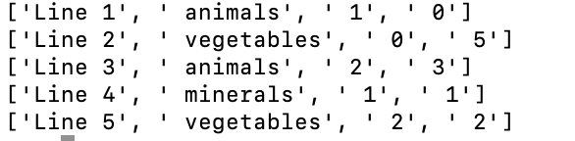
Reading from a file
file_handler = open('lines.csv', 'r')
for line in file_handler.readlines():
line = line.rstrip('\n')
field = line.split(',') #break the string into a list (split – comma)
print (field)
file_handler.close()

Slide 8
Writing to a file
file_handle = open(‘data.csv’, ‘w’) | Open the file ‘data.csv’ in write mode
content = file_handle.write(S) | Write string S to a file
content = file_handle.writelines(L) | Write the strings in the list L to a file
file_handle.close() | Close the file

Slide 9
Writing to a file
file_handler = open('other.csv', 'w')
list_1 = ['banana', 'carrot', 'avocado', 'orange', 'grapefruit']
file_handler.writelist(list_1)
file_handler.close()
file_handler = open('other.csv', 'w')
list_1 = ['banana', 'carrot', 'avocado', 'orange', 'grapefruit']
for item in list_1:
file_handler.write(item + '\n')
file_handler.close()

Slide 10
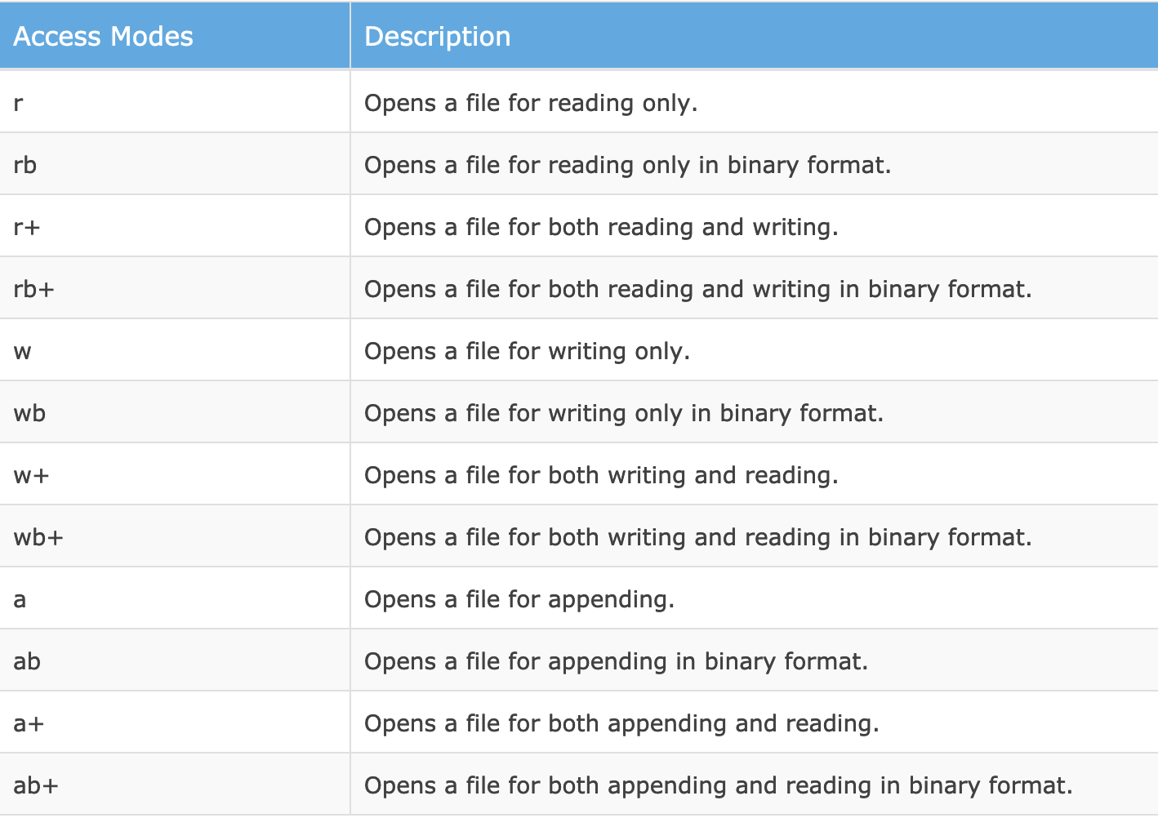
File Open Modes

Slide 11
Hands On: 10 minutes
Create a file called grades.csv, with the following information:
John,9,9,5,9
Peter,7,4.3,6.7
Junior,7,3,2,4
Anthony,3,3,7.5,10
Now write an algorithm that:
For each line in the file, calculates the mean (for each person);
Defines if the person Passed or Failed (Pass with mean >= 6)
Write a report (file named report.txt) in which each line needs to inform:
<NAME> <STATUS> (<MEAN>), for example:
John Passed (8.0)

Slide 12
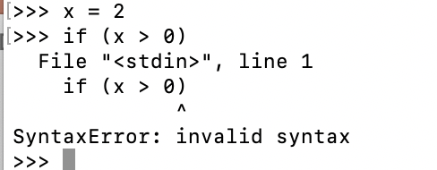
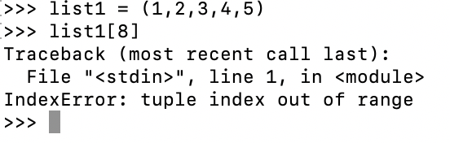
Errors And Exceptions
Syntax errors and exceptions
Syntax Errors occur when the grammar of a Python statement is incorrect
Exceptions are errors that happen in execution time, even with correct Syntax

Slide 13
Errors And Exceptions
Error | Description/example
IOError | e.g. file not found
IndexError | an attempt to access a sequence (such as a list with an index out of range)
TypeError | an operation or function applied to an object of inappropriate type
NameError | a variable name is not recognised
ValueError | an operation or function receives an argument of the right type but an inappropriate value
ZeroDivisionError | a specific type of ValueError raised when an attempt is made to divide by zero.

Slide 14
Exception Hunting
Knowing the potential exceptions is key… Experience (bad ones) help you
Exceptions can be ‘caught’ and handled in Python script:
try … catch … finally
try:
# <do something that might fail>
except (<exception1>, <exception2>, ...):
# <something went wrong: deal with it>
else:
# <what to do if no exception>
finally:
# <statements here are always executed>

Slide 15
Exception Hunting
Knowing the potential exceptions is key… Experience (bad ones) help you
Exceptions can be ‘caught’ and handled in Python script:
try … catch … finally
filename = input("Enter a file name: ")
try:
f = open(filename, "r")
except FileNotFoundError:
print("There is no file named", filename)

Slide 16
Exception Hunting
print ("Are you authorized to drink in AZ?")
try:
age = input ("Type your age: ")
age = int(age)
except (ValueError):
print ("The value typed is not an integer")
else:
if (age < 21):
print ("You cannot drink")
else:
print ("You can drink")
age = int(age)

Slide 17
Raising exceptions
def canDrink (age):
if (age < 0):
#a new ValueError will be raised to who called canDrink
my_error = ValueError("{0} is not a valid age ". format(age))
raise my_error
result = True if (age >= 21) else False
return result

Slide 18
HANDS ON!
Write a function named readposint that uses the input dialog to prompt the user for a positive integer and then checks the input to confirm that it meets the requirements. It should be able to handle inputs that cannot be converted to int, as well as negative ints, and edge cases (e.g. when the user closes the dialog, or does not enter anything at all.)

Slide 19
Some Python Modules
Longer programs can be split up into separate files
Each file, with functions and variables, can be considered a module
Modules are imported using the import statement
The Standard Python Library consists of some modules (and packages of modules)

Slide 20
Some Python Modules
math | Mathematical functions
sys | System-specific parameters and functions
os | Miscellaneous operating system interfaces
random | Generate (pseudo-)random numbers
zlib | A compression library (compatible with gzip)
argparse | Command-line argument parsing
urllib | Open and access resources across the internet by URL
datetime | Basic date and time types
re | Regular expressions

Slide 21
MATH module
sqrt(x)
exp(x)
log(x)
log(x, base)
log10(x)
sin(x), etc.
asin(x), etc.
sinh(x), etc.
hypot(x, y)
pi
e

Slide 22
Sys module
System methods and constants, of which the most useful are:
argv The list of command line arguments passed to a Python script.
argv[0] is the script name. e.g.
$ python my_script.py hello 4
sys.argv[0] = ‘my_script.py’
sys.argv[1] = ‘hello’
sys.argv[2] = ‘4’
exit([n])
Exit from Python. If not provided – n defaults to 0, indicating normal termination.
Different non-zero values are used to indicate to the shell various errors.

Slide 23
Sys module
import sys
try:
x = float(sys.argv[1])
except (IndexError, ValueError):
sys.exit("I need a number, please.")
try:
rx = 1./x
except ZeroDivisionError:
sys.exit("You can't divide by zero!")
print(rx)

Slide 24
OS module
Miscellaneous operating system interfaces
path: Manipulate file and directory names
environ: A mapping object representing the string environment. e.g. os.environ[‘HOME’] is the pathname of your home directory (on some systems)
remove: Delete a file
rename: Rename a file
stat: get information about file read/write permissions, last time of modification, etc.
listdir : Return a list of the entries in a directory

Slide 25
OS module
>>> import os
>>> HOME = os.environ[‘HOME’]
>>> print(os.listdir(HOME))
[‘.bash_history’, ‘.bash_profile’, ‘Desktop’, ‘Documents, ‘Downloads’, ‘Library’, ‘research’, ‘teaching’, ... ]

