Slide 1
ETX-2i-100G Final Test selected topics

Slide 2
ETX-2-100G Dying GASP test
TBD
ETX-2-100G OOB port (10/100M)
Should be reused from ETX-2x products FTI
10x10G Piggy Card Test
TBD
100G Port 3(28) EYE diagram test(for 100st units)
TBD
DDR Test
Should be reused from ETX-2x products FTI
Other tests and procedures except presented in
This document below.
Should be reused from ETX-2x products FTI as possible

Slide 3
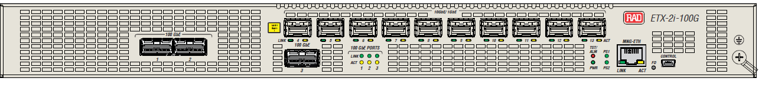
Testing Mainboard LEDs (setup 1)
Enter into debug mode
Activate commands from script led_test_setup1t.txt
Check LEDs as shown in FIG below
PS1 and PS2 LEDs are GREEN
100G Link LEDs are Green
100G activity LEDs are Yellow
Test/Alarm LED is Yellow
Power LED is Green LED is Yellow

Slide 4
Testing Mainboard LEDs (setup 2)
Enter into debug mode
Activate commands from script led_test_setup2t.txt
Check LEDs as shown in FIG below
PS1 and PS2 LEDs are RED
100G Link LEDs are Green
100G activity LEDs are Yellow
Test/Alarm LED is RED
Power LED is Green LED is Yellow

Slide 5

Traffic Functionality Test with internal Ethernet packet generator
Clear all configurations if presented by applying “admin factory-default “. This command is applied on ETX-2I-100G CLI top level
Enter to “debug>mea” CLI level
Connect fibers as shown on Fig 1.
Configure and start Traffic Generator by applying CLI command (from MEA level). During traffic running check port LEDs (Note 1)
MEA test port clear (if required)
MEA test port start
Wait 2 minute
Stop traffic generator by applying following command from CLI mea level:
MEA test port stop
Observe result of Ethernet packets routing for 100G and 10G interfaces by applying CLI command from MEA level:
MEA test port show
Refer to snapshot below for result field description. Transmitted and received packets quantity should be same.
10G IF Transmitted by traffic generator
packet number
10G IF received packet number
100G IF Transmitted by traffic generator
packet number
100G IF received packet number

Slide 6
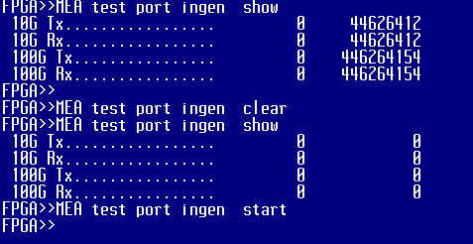
Clear Traffic generator statistics while in stopped state (if required : Apply command from MEA CLI level
mea test port clear
Restart traffic generator again (if required by applying CLI command from MEA level:
MEA test port start
Note 1: Check relevant LEDs functionality on all ports during Ethernet traffic generator active phase: Link Activity GREEN LEDs
Should be Switched ON and LINK ORANGE LEDs should be in blinking state . Refer to Fig.2 for Front panel port LEDs description.

Slide 7
Fig.1 ETX-2-100G Routing Check with internal independent Ethernet Traffic Generator and Checkers
10G Packet
Generator/
Checker
100G Packet
Generator/
Checker
ETX-2-100G
10G VLAN 1
512 bits packet
1G VLAN 2
100G
QSFP28
100G
QSFP28
100G
QSFP28
10G
SFPP
10G
SFPP
10G
SFPP
10G
SFPP
10G
SFPP
10G
SFPP
10G
SFPP
10G
SFPP
10G
SFPP
10G
SFPP
#1
#2
#3
#4
#5
#6
#7
#8
#9
#10
#11
#12
#13
(#30)
(#31)
(#28)

Slide 8
Fig.2 ETX-2-100G Front Panel LEDs view (for checking LEDs operation during traffic as shown in Note 1 above)
10G Ethernet ports LED
Should be checked on all SFPP ports with traffic running
100G Ethernet ports LED
Should be checked with traffic running

Slide 9
Power Supplies Hot Swap Test During Ethernet Data traffic running
(first 100 units)
1. Clear Traffic generator statistics while in stopped state (if required) : Apply command from MEA CLI level
mea test port clear
2. Restart traffic generator again by applying CLI command from MEA level:
MEA test port start
Switch OFF input power 220V on Power Supply 1 (PS1) . Check that relevant Front Panel LED will be switched to RED
Extract Power Supply 1 from ETX-2-100G system and check that relevant Front Panel LED will be switched to OFF state
Reinsert Power Supply 1 to ETX-2-100G system . Check that relevant LED will again switch to RED and after switching input
power to ON this LED should be switched to GREEN normal state.
6. Switch OFF input power 220V on Power Supply 1 (PS2) . Check that relevant Front Panel LED will be switched to RED
7. Extract Power Supply 2 from ETX-2-100G system and check that relevant Front Panel LED will be switched to OFF state
8. Reinsert Power Supply 2 to ETX-2-100G system . Check that relevant LED will again switch to RED and after switching input
power to ON this LED should be switched to GREEN normal state.
9.Stop traffic generator : Apply command from MEA CLI level
Mea test port stop
10. Verify that no any traffic corruption occurred during Power Supply Units insertion/Extraction procedure by applying command from
MEA CLI level
Mea test port show
Refer to snapshot below for result field description. Transmitted and received packets quantity should be same.
10G IF Transmitted by traffic generator
packet number
10G IF received packet number
100G IF Transmitted by traffic generator
packet number
100G IF received packet number

Slide 10
Mainboard Manual Final Tests
Voltage level tests
TP49 (mainboard) VDD (3.3V+/- 5%)
TP22(mainboard) 12V_MAIN(12V+/- 5%)
TP8(mainboard) VDD_1.5V(1.5V +/- 5%)
TP25(mainboard) VDD_1.0V (1.0V+/-5%)
TP55,TP31 GND
Power Supply Identification test:
Check that both power supplies are inserted
Turn ON all power supplies by applying AC
On the top CLI level type :
Configure chassis
show environment
Check that both power supplies are AC type and are having status OK
Check that PS1 and PS2 LEDs on front panel are switched ON Green
FANs test:
Verify that all FANs are rotate
Check status of all FANs by applying “show environment “ (refer to p.2)command . All 8 FANs should to be reported with OK status

