Slide 1
BlockChain P2P Network Guide
This representation is an introduction to Block Chain’s P2P Network Guide by Dr Jafari’s Block Chain Lab for Network Class November 2018 semester Sharif University of Technology , Tehran, Iran.

Slide 2
Index
Introduction
Connecting To Peers
Peer Discovery
Initial Block Download

Slide 3
Index
Block Broadcasting
Misbehaving Nodes & Alerts
Transaction Broadcasting
Conclusion

Slide 4
Introduction
DESCRIPTION
The Bitcoin network protocol allows full nodes (peers) to collaboratively maintain a peer-to-peer network for block and transaction exchange.

Slide 5
Peer Discovery
DESCRIPTION
When started for the first time, programs don’t know the IP addresses of any active full nodes.

Slide 6
Connecting To Peers
DESCRIPTION
Connecting to a peer is done by sending a version message, which contains your version number, block, and current time to the remote node.

Slide 7
Initial Block Download
DESCRIPTION
Before a full node can validate unconfirmed transactions and recently mined blocks, it must download and validate all blocks.

Slide 8
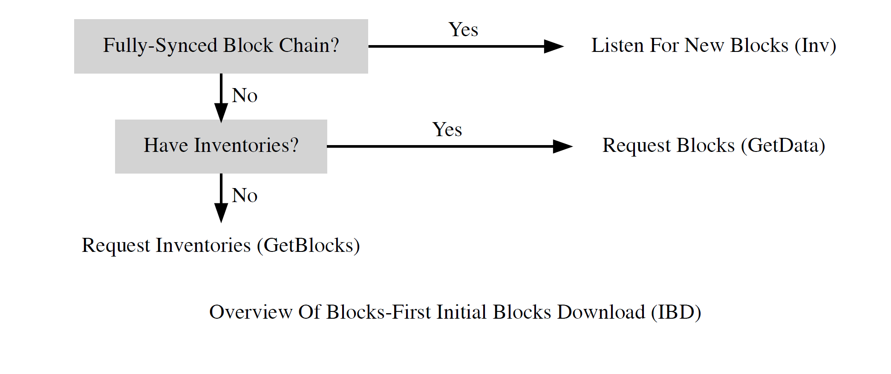
Block-First Method

Slide 9
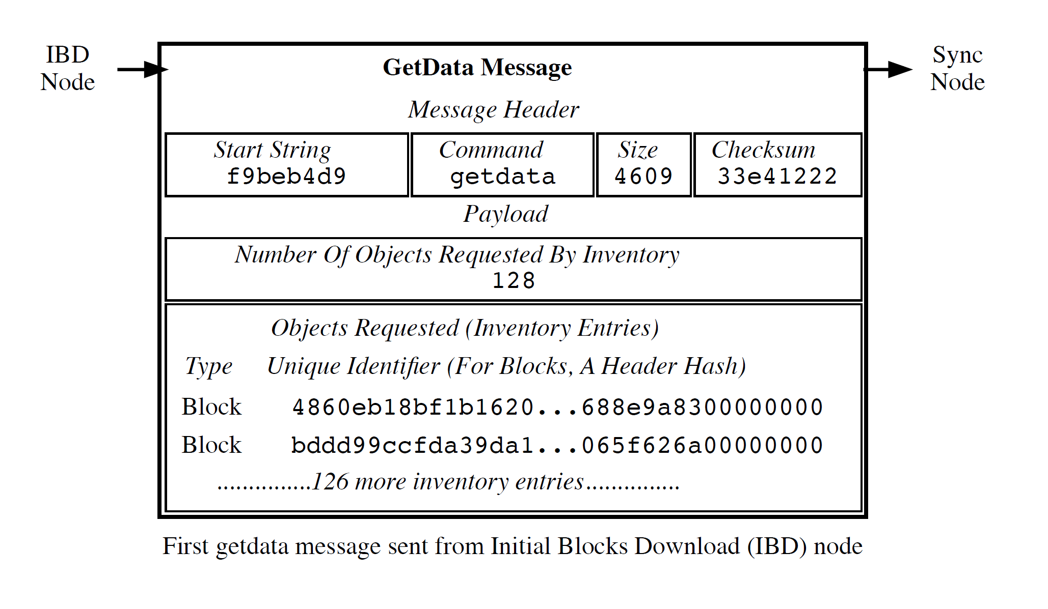
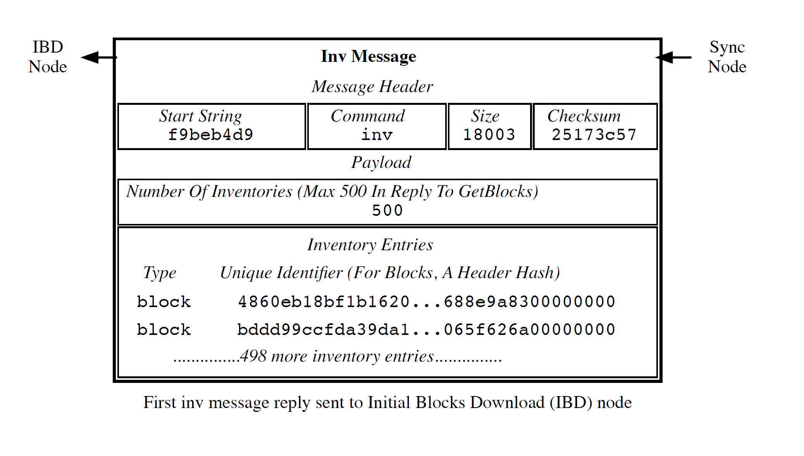
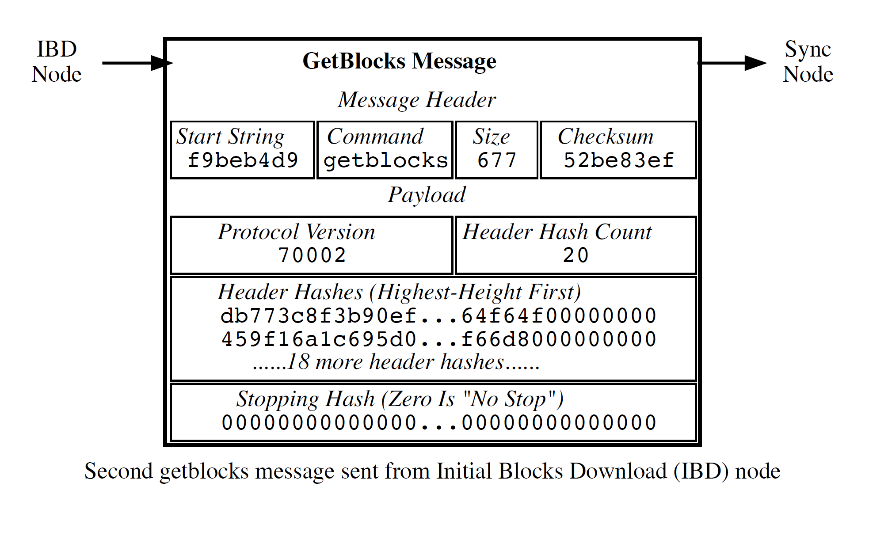
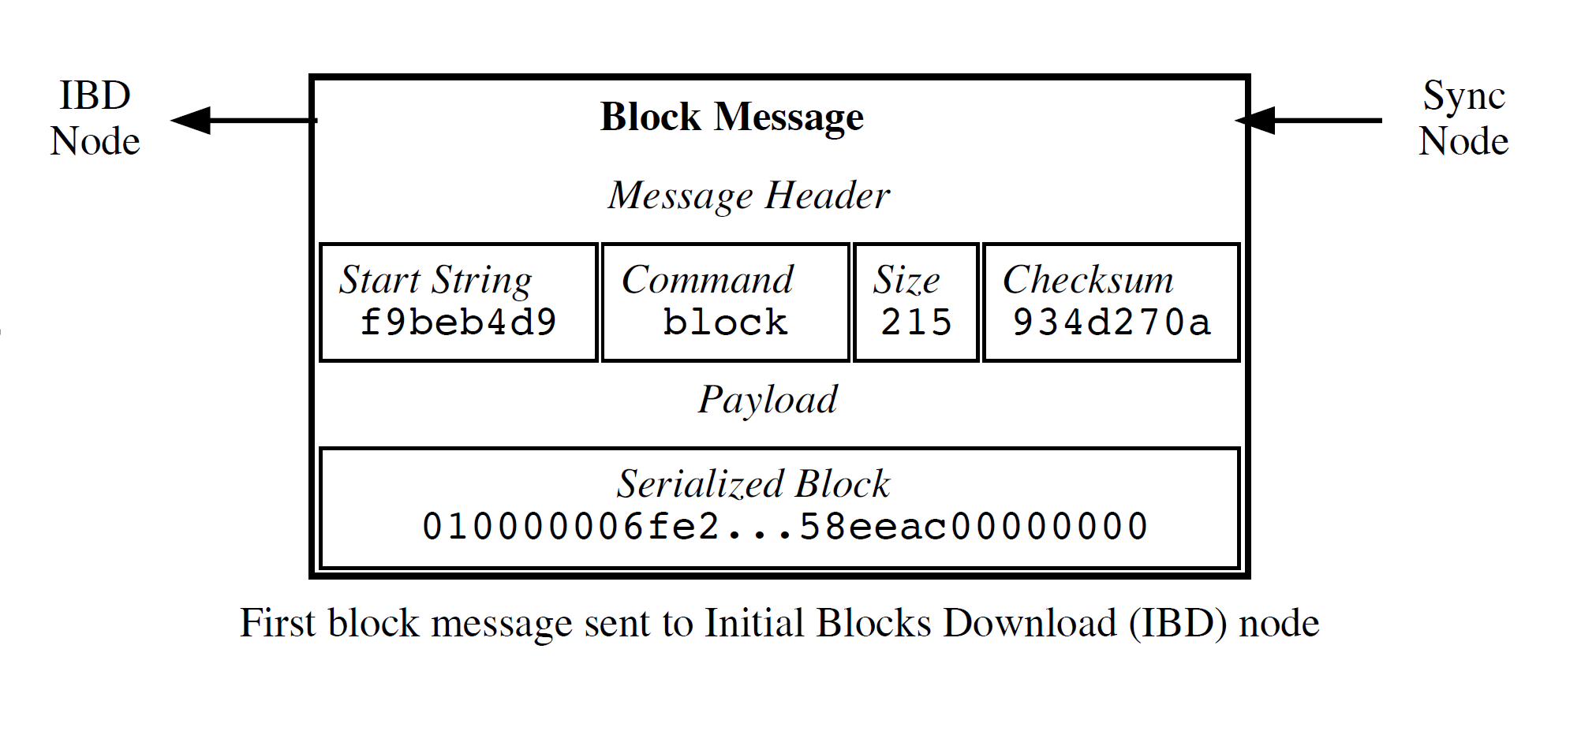
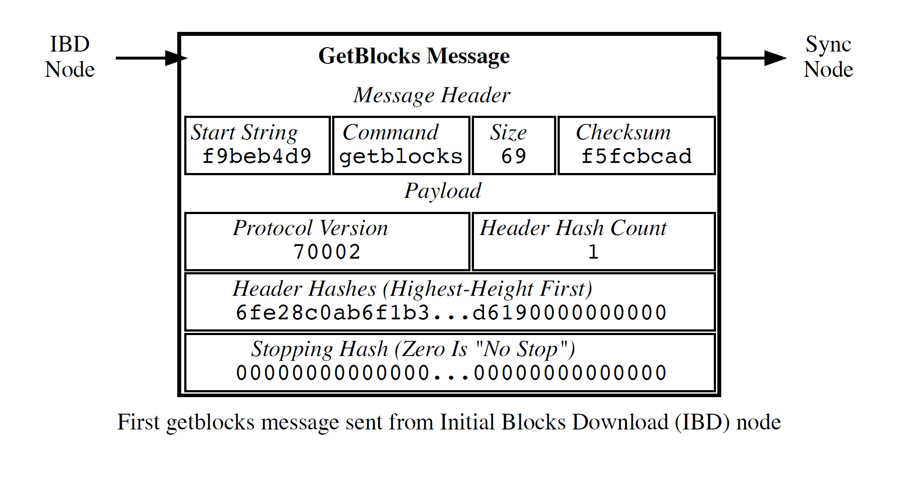

Slide 10
BLOCK-FIRST DISADVANTAGES
SPEED LIMITS
DOWNLOAD RESTARTS
DISK FILL ATTACKS
HIGH MEMORY USE

Slide 11
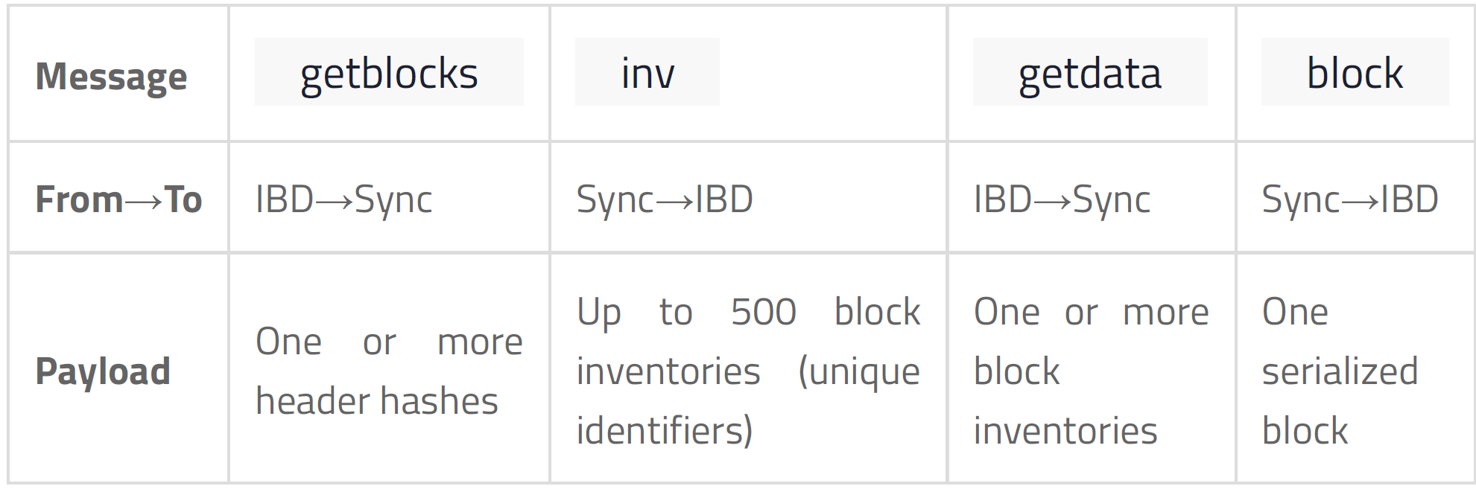

Slide 12
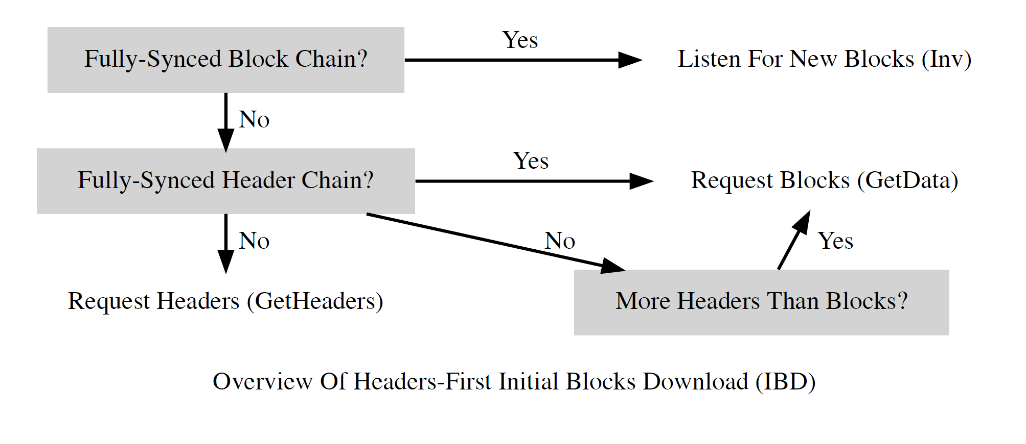
Headers-First Method

Slide 13
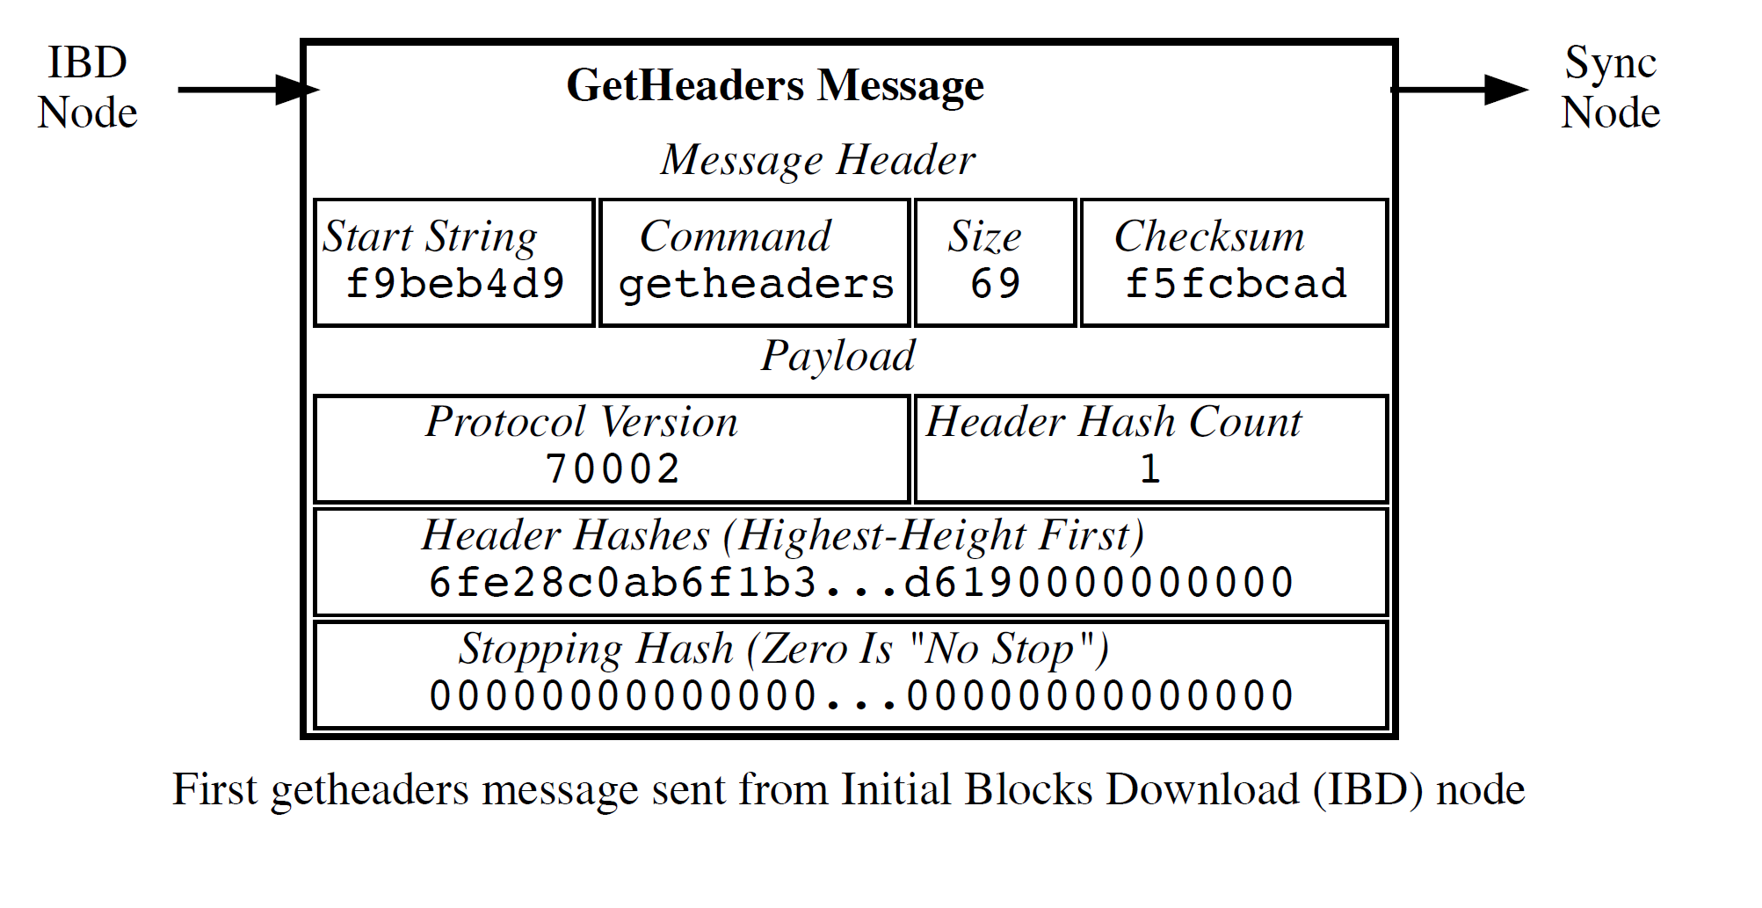
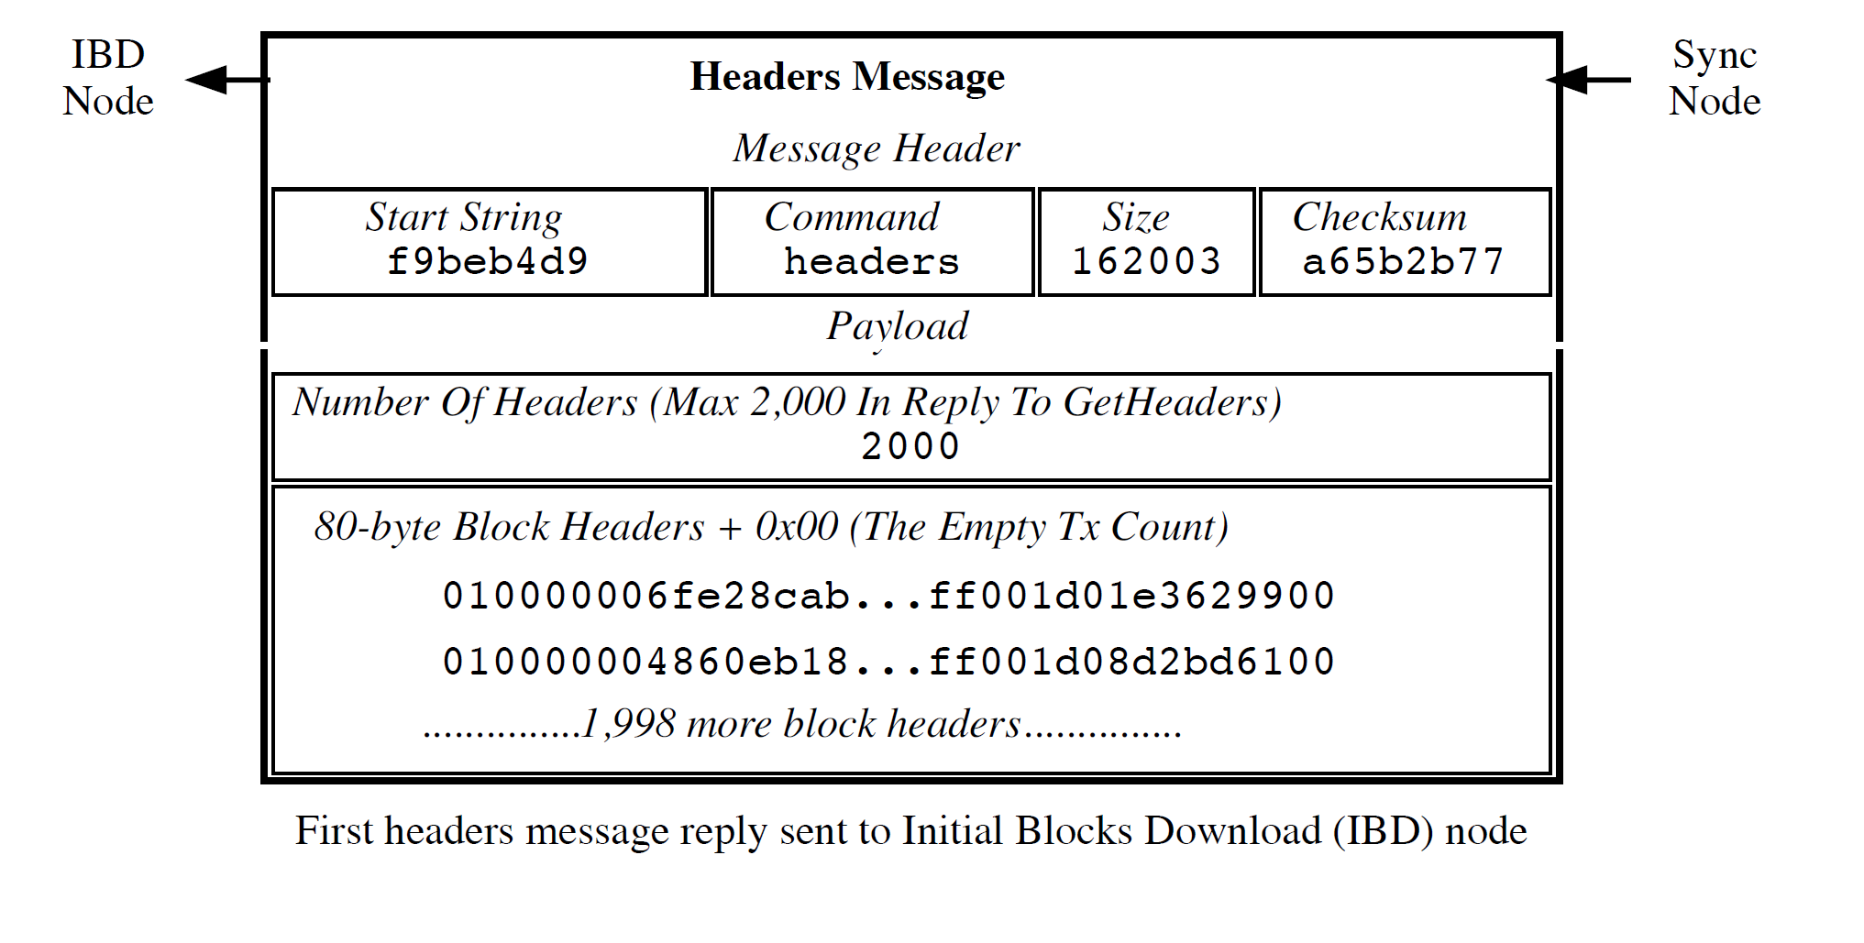

Slide 14
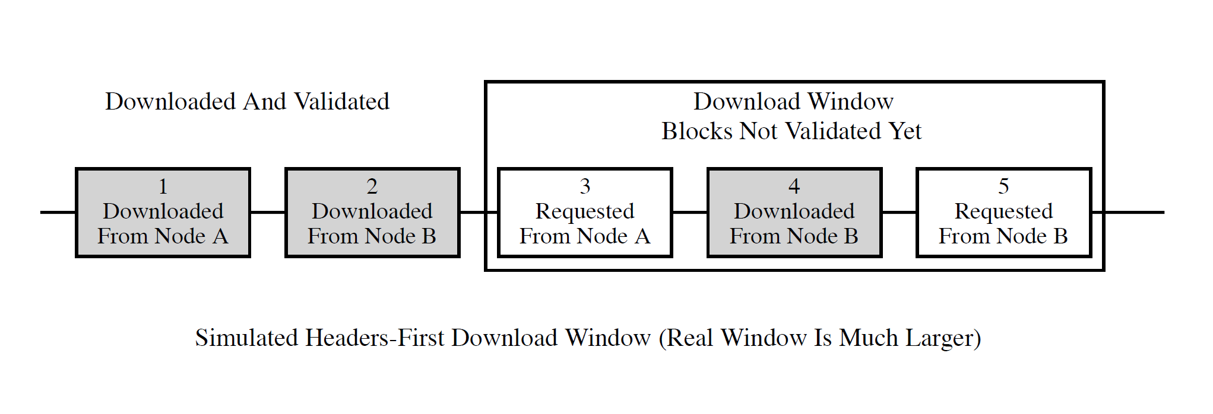

Slide 15
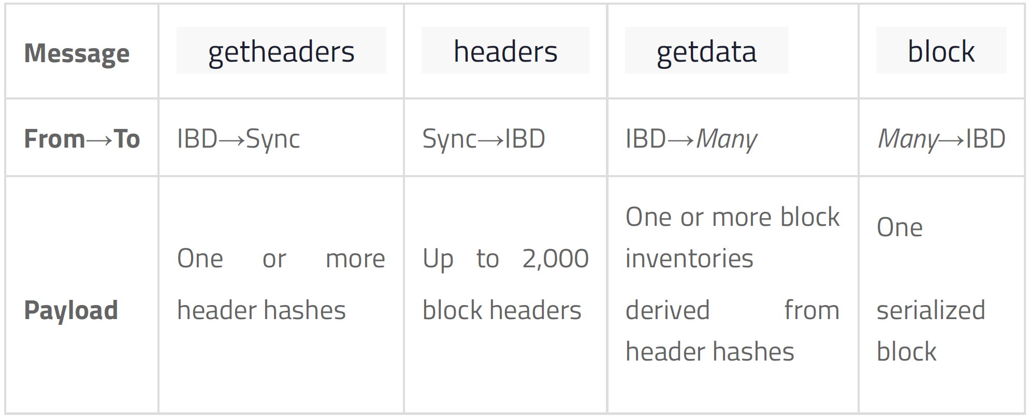

Slide 16
Block Broadcasting
UNSOLICITED BLOCK PUSH
STANDARD BLOCK RELAY
DESCRIPTION
DIRECT HEADERS ANNOUNCEMENT
When a miner discovers a new block, it broadcasts the new block to its peers using one of the following methods:

Slide 17
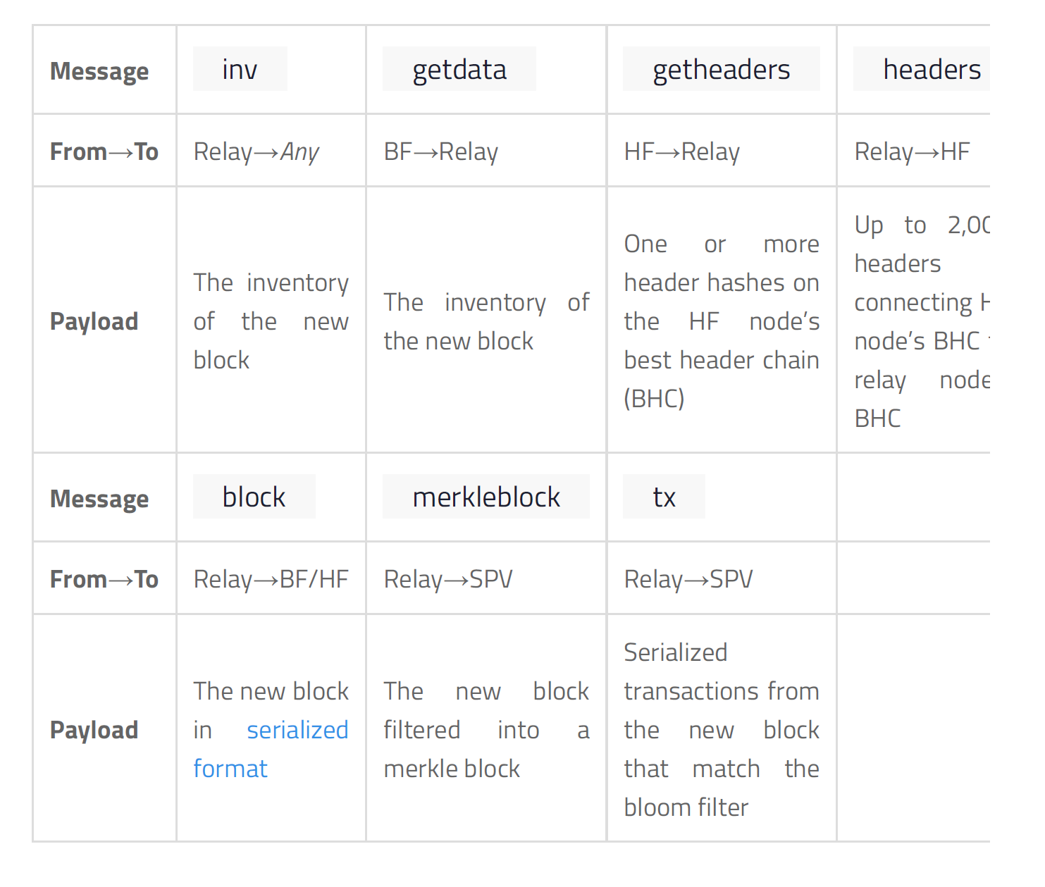

Slide 18
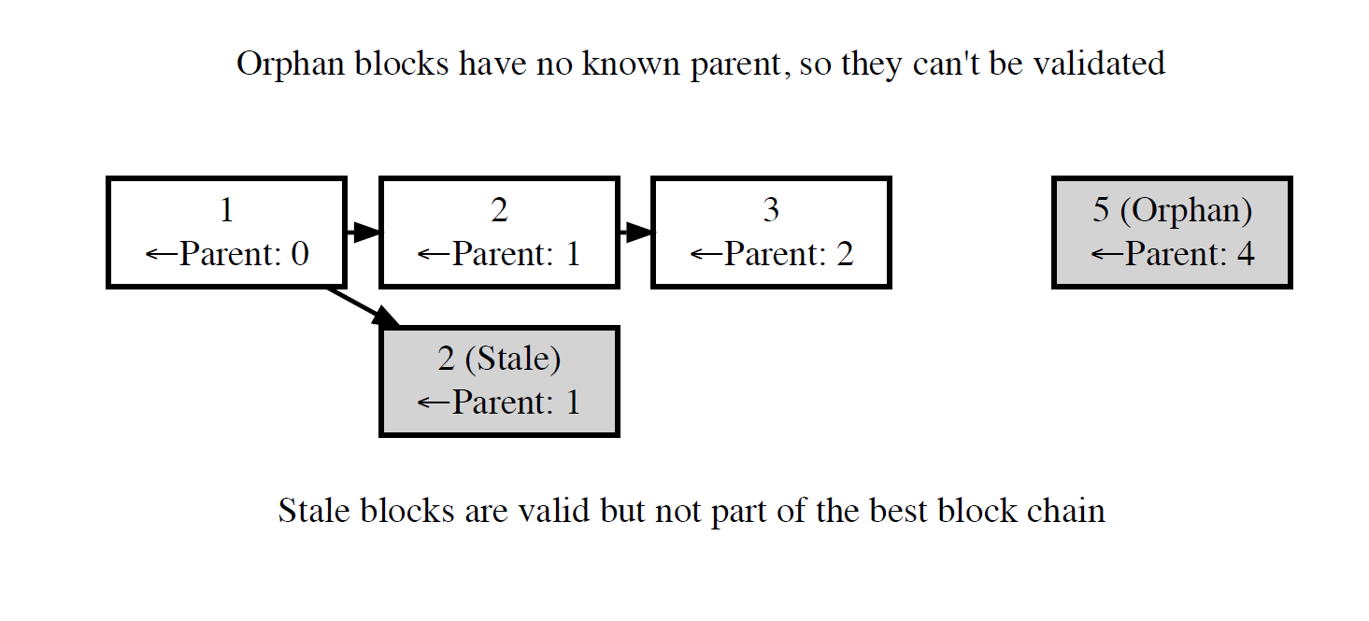
ORPHAN BLOCKS

Slide 19
Transaction Broadcasting
DESCRIPTION
The purpose of the controls modules is to gather data from sensors, perform calculations and determine the appropriate action to initiate.

Slide 20
Misbehaving Nodes
& Alerts
DESCRIPTION
The purpose of the controls modules is to gather data from sensors, perform calculations and determine the appropriate action to initiate.

Slide 21
Conclusion

Slide 22
Implementation Challenges
Propulsion Module
Dynamic Module
Power
Controls
Structure
Software Systems

