Slide 1
Mouse Minder
Conrad Farnsworth

Slide 2
Requirements
Activate when a trap trips
Audible for 1 week
Replaceable battery
Clips on to any spring driven mouse trap
Resettable
Testable

Slide 3
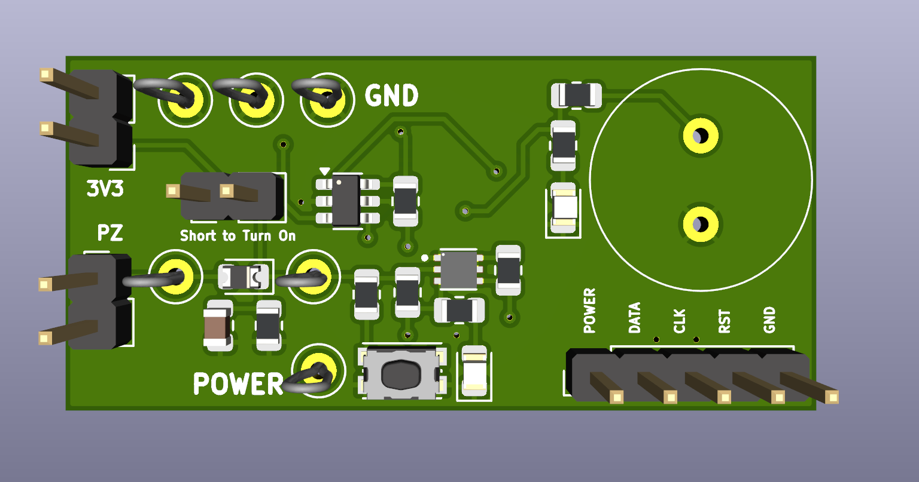
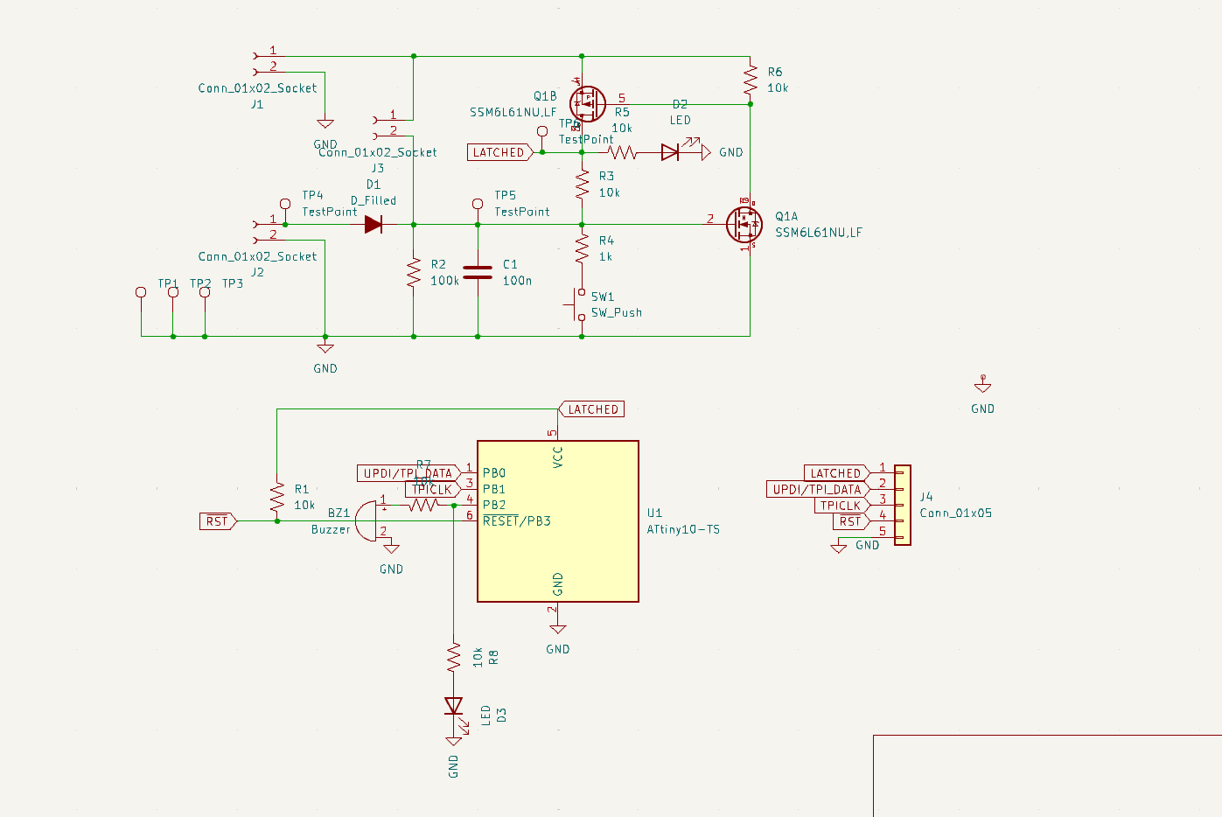
First Prototype

Slide 4
Prototype Notes
That just worked. My circuits never just work.
Things I want in V2
A louder buzzer (optional)
Looking at charge pumps/voltage doublers
Buzzer as a sensor
Bypass/isolate for just buzzer
Separate input for another sensor
1M pot for testing
Test button
I already had that but I want it as a button next
Battery holder
And pads for ext power
Buttons should be hard plastic so you can use a paper clip for reset/test
Mounting holes/extra clearance for mounting into a 3D print

Slide 5
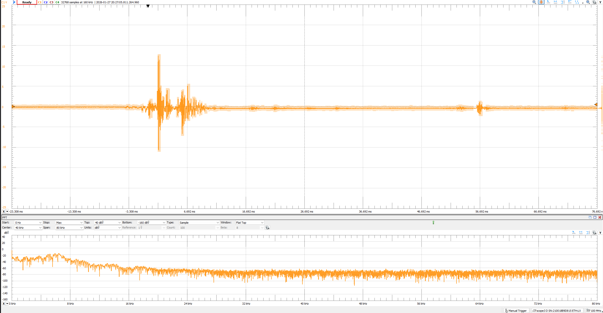
Plan
Buzzer as a sensor
Do not use the charge pump on this version, too many complications
Data looks good!

Slide 6
Schematic
We could put a charge pump between the micro and driver but I am scared about increasing complexity.
Isolation*
Push-Pull Driver
Micro
Buzzer/Sensor
Sensing CKT
Coin Cell
*Preserves signal from the buzzer as a sensor. May not be required

Slide 7
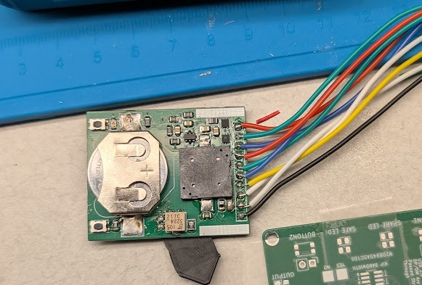
Second Prototype
Very promising 4/5 detections.
Piezo as sensor. Extra mosfet to drive the piezo buzzer.

Slide 8
Third Prototype Plan
In progress as of writing this.
Pared down a lot of the schematic.
Sent to JLC for QTY5 fab. Probably should have waited. Oh well.
Need to test a few things:
100k pull-down on ngate
With & without R7
330k pull-down on ngate
With & without R7
Tap Test
Mosfet bypass (attiny) buzzer
Is R7 necessary here?
Is D4 necessary?
Can R4 be bypassed?

Slide 9
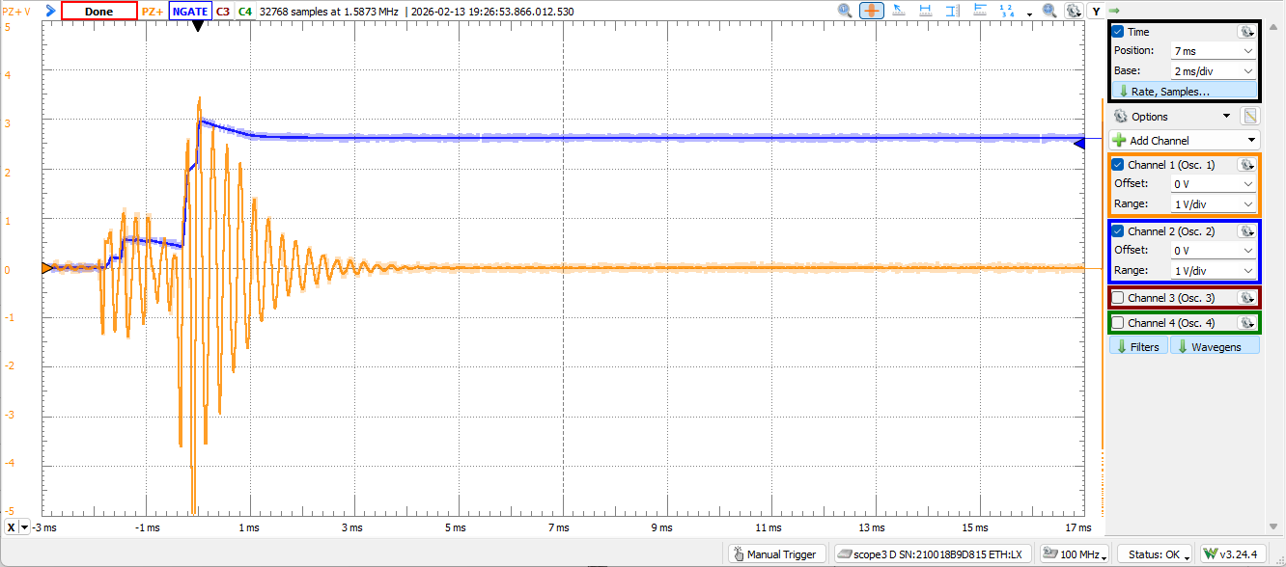
1) Electrical Tests On 2nd Prototype
100k R8, RV1 Removed, R7=1k
Measure PZ+ and NGATE
Tap Test

Slide 10
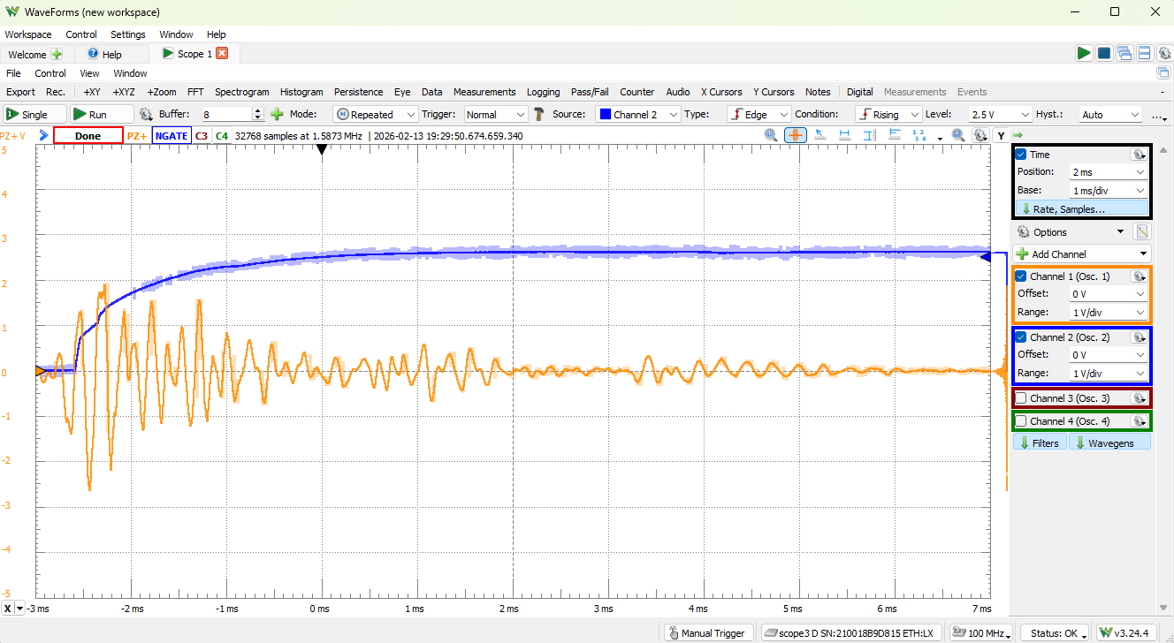
1) Electrical Tests On 2nd Prototype
100k R8, RV1 Removed, R7=1k
Measure PZ+ and NGATE
Trap Test

Slide 11
2) Electrical Tests On 2nd Prototype
100k R8, RV1 Removed, R7=DNP
Measure PZ+, NGATE, and sound.
No Sound with DNP and me pressing test button.

Slide 12
3) Electrical Tests On 2nd Prototype
100k R8, RV1 Removed, R7=DNP, Bodge ATTINY pin 4 onto PZ+
Measure PZ+, NGATE, and sound.
Sound is good, can’t turn it off (idles high)
Tap test and mouse trap test won’t trigger
Piezo is going through protection diodes
Sensor is less sensitive than with R7 installed ☹
What if we make R7 Bigger?...

Slide 13
4) Electrical Tests On 2nd Prototype
100k R8, RV1 Removed, R7=10k, Bodge ATTINY pin 4 onto PZ+
Measure PZ+, NGATE, and sound.
Buzzer is 15nf±30% (10.5n-19.5n)
Want 5Tau of bleed at 4khz = 1.2k. Shit.
It’ll just be quieter. Not super interested in that.

Slide 14
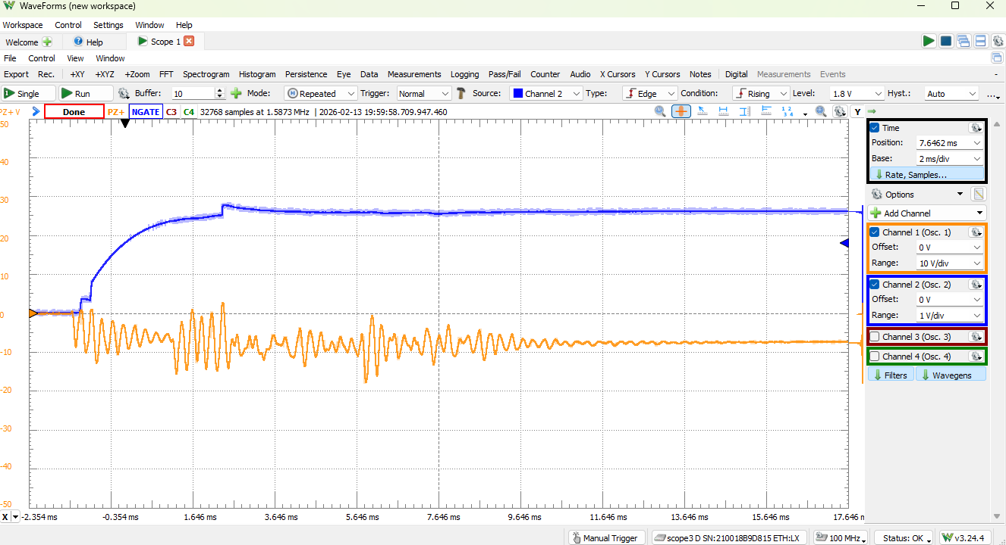
5) Electrical Tests On 2nd Prototype
100k R8, RV1 Removed, R7=DNP
Measure PZ+ and NGATE
Trap Test. Won’t be able to hear anything but Let’s see how much signal that R7 was stealing away….

Slide 15
5) Electrical Tests On 2nd Prototype
Oh wow. 2 big learnings from that one:
Piezo is backwards.
R7 is stealing a LOT of signal.
Notice PZ+ Had to be changed to 10V/div.
Couldn’t get a trig on mouse trap. Will try again with reversed piezo

Slide 16
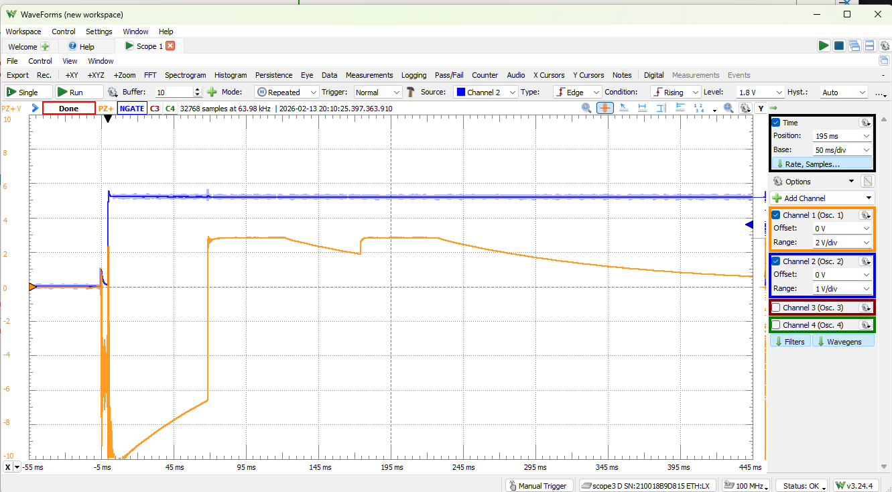
6) Electrical Tests On 2nd Prototype
Piezo flipped around.
Measure PZ+ and NGATE
Piezo doesn’t seem to have a polarity
Piezo is also collapsing to zero…it should have 3V on it at all times….

Slide 17
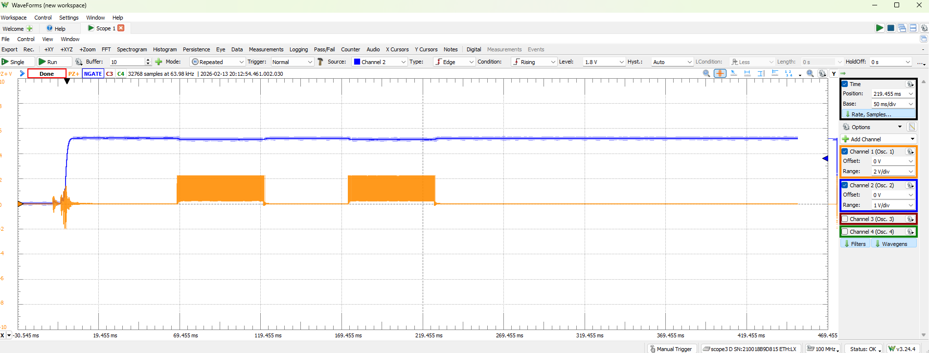
7) Let’s put R7 Back
R7=1k
Signal Comes back

Slide 18
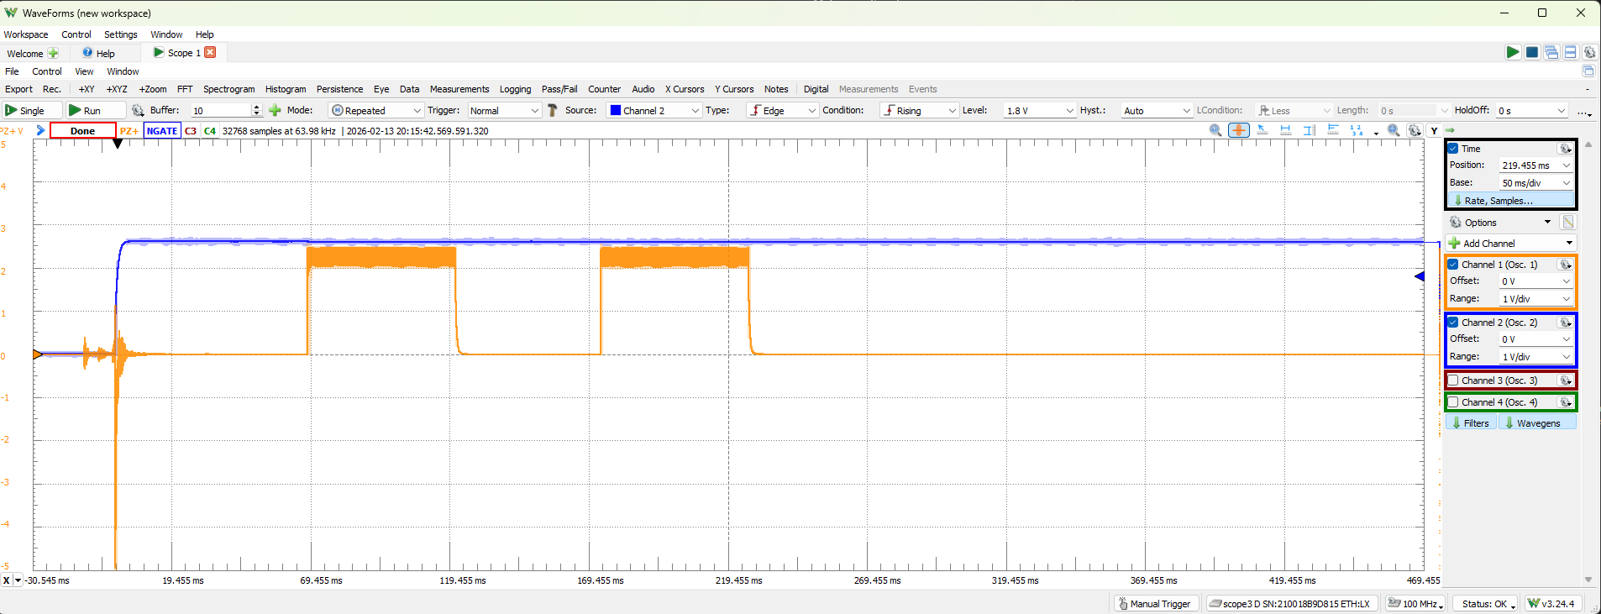
7) Let’s put R7 Back
R7=10k
Much quieter but much more sensitive.
I think a large R7 is necessary for good sensitivity. I also think we should move Q2A (Nmos) down in parallel to give max sound.
This trigger was a light tap by the way.

Slide 19
What do I do?
REV3 is in PROD right now.
It’ll WORK but I NEED(?) to test the H-bridge before I can send it out to fab.
I should make a 3.5 change and ask JLC to prod
Can’t cancel after it’s in prod
Use the LPKF to proto this one out?
N/P, some resistors, header, buzzer should be a super small board…
Keep Rev2 as-is and take mouse measurements

Slide 20
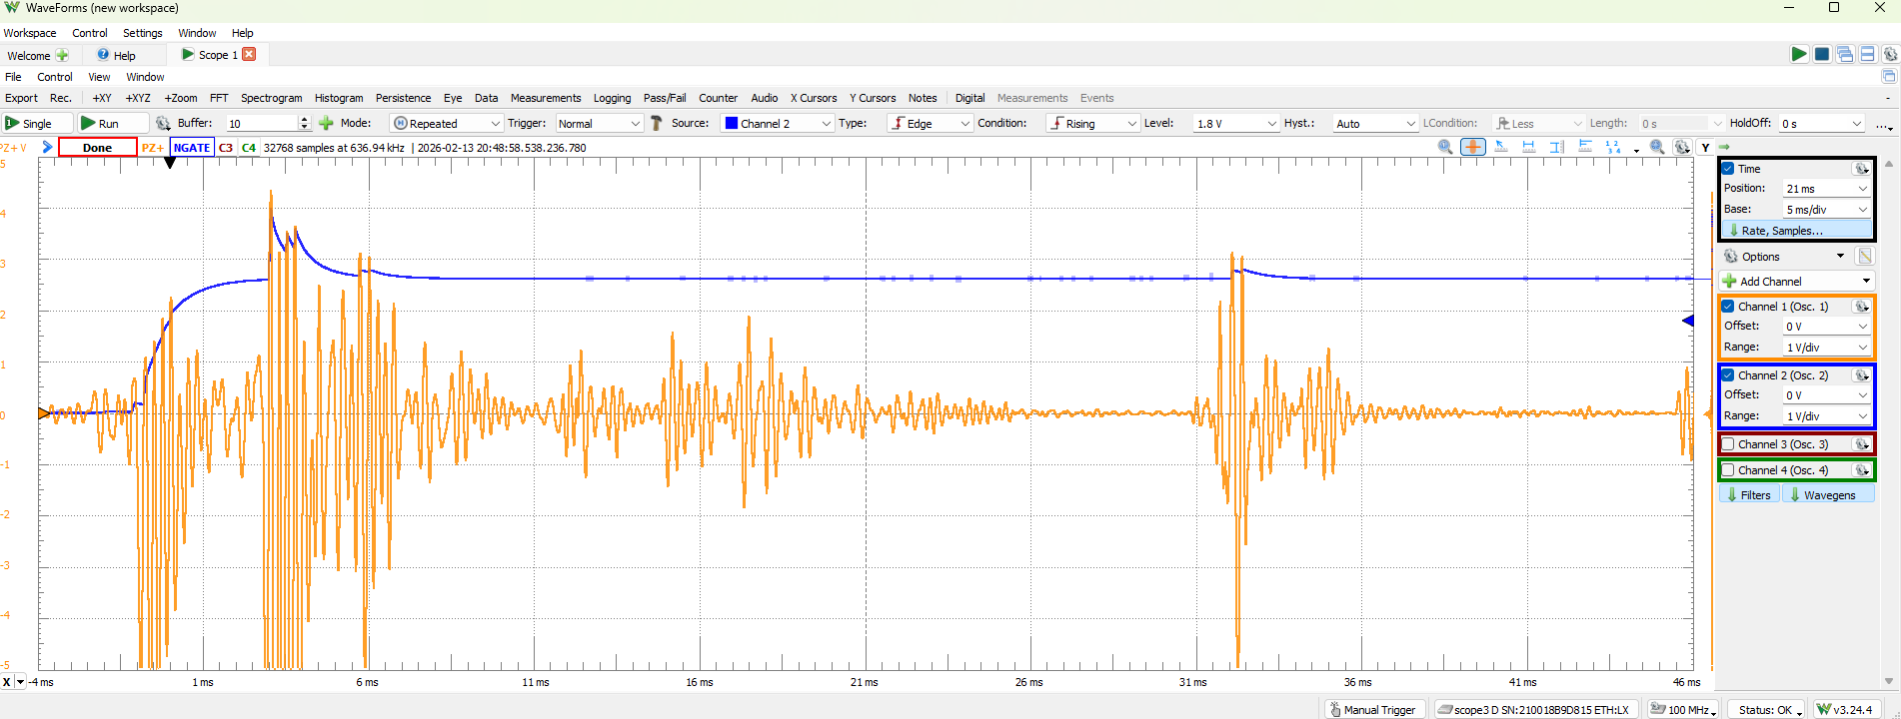
Fake Mouse Measurement
R7 = 10k

Slide 21
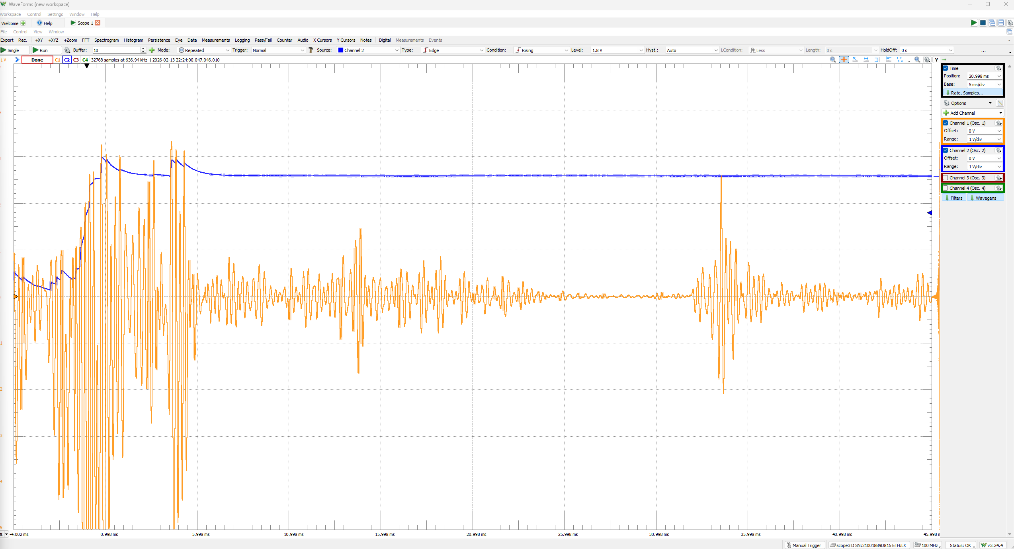
Real Mouse Measurement

Slide 22
Real Mouse Measurement PT2

Slide 23
I had a thought…
R7 was a huge lever arm but really, C1 is the ticket.
The piezo is like 10nF and the C1 is 100n. Let’s move R7 back to 1k and change C1 to 10n.
I’m such a goof. You can see it plain as day in the DNP R7 plots. Really high negative voltage (D1 not in conduction). Really low forward voltage (capacitive voltage divider with D1 in conduction).
Way more sensitive. And I don’t need an extra mosfet….See next slide for data.

Slide 24
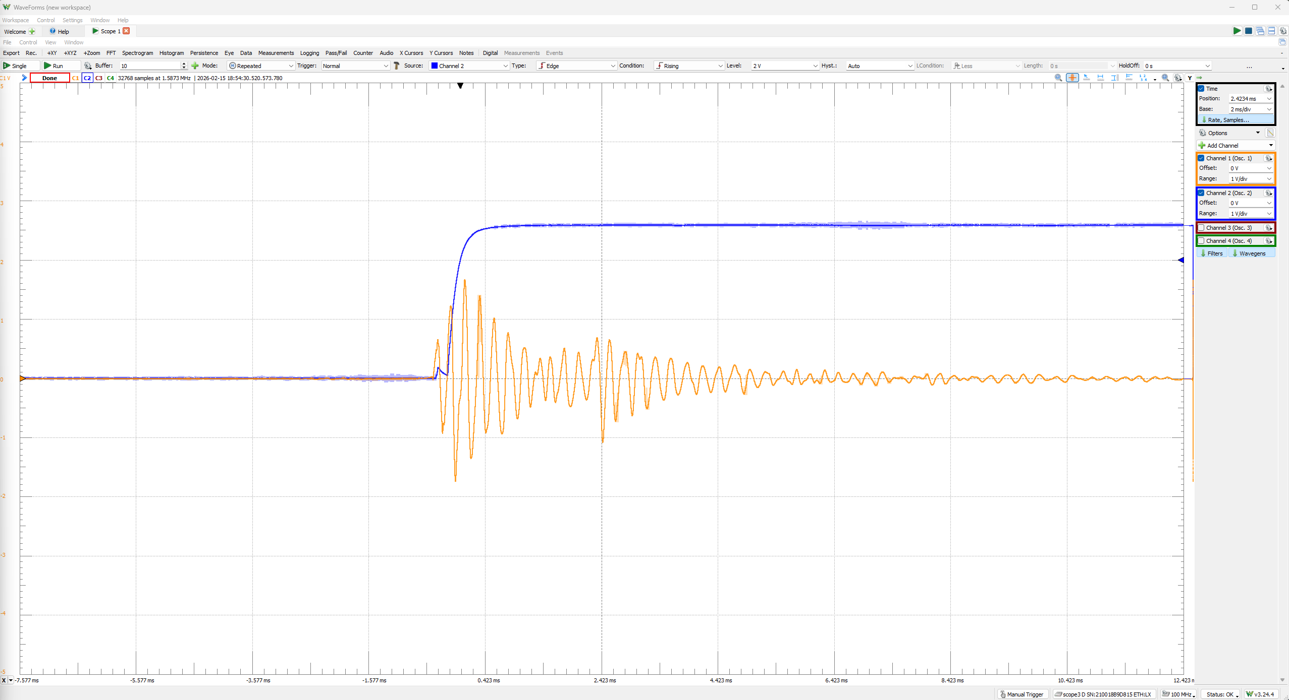
R7 = 1k, C1=10n, Gentle Tap Test

Slide 25
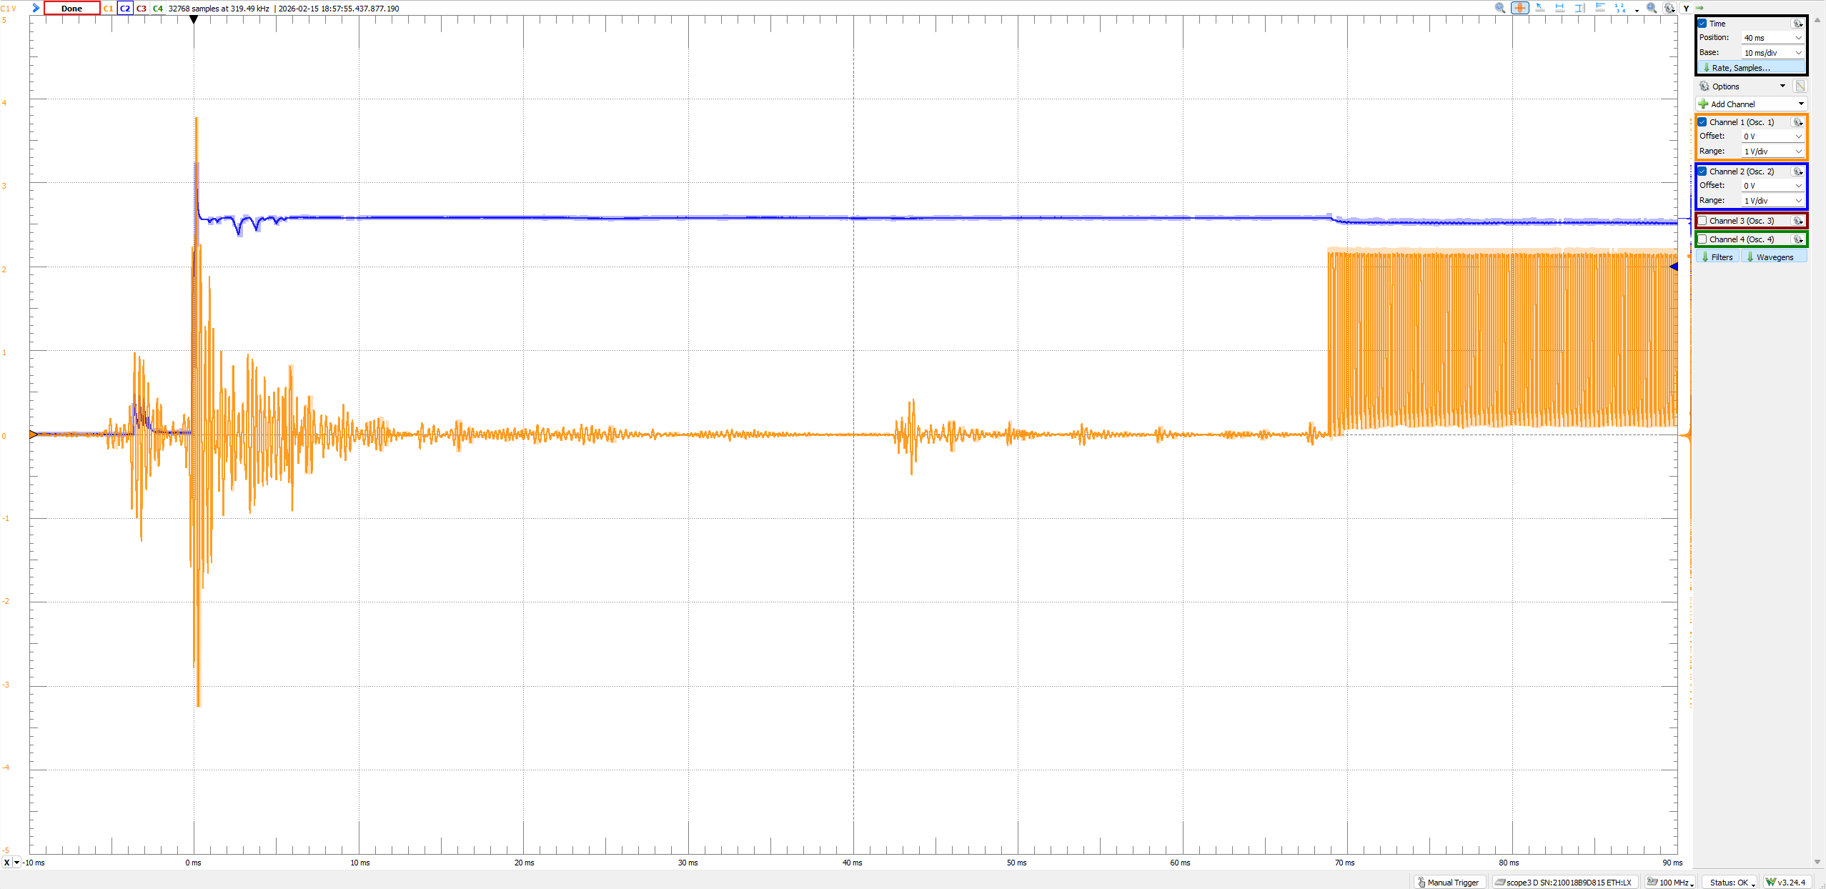
R7 = 1k, C1=10n, Trap Test

Slide 26
Conclusive enough for me…
Skip the extra mosfet pair.
Power the speaker through the diode with the ATTINY
Use 1k Pull-down on piezo
Use 10nF sensitive capacitor in with 100k R8

Slide 27
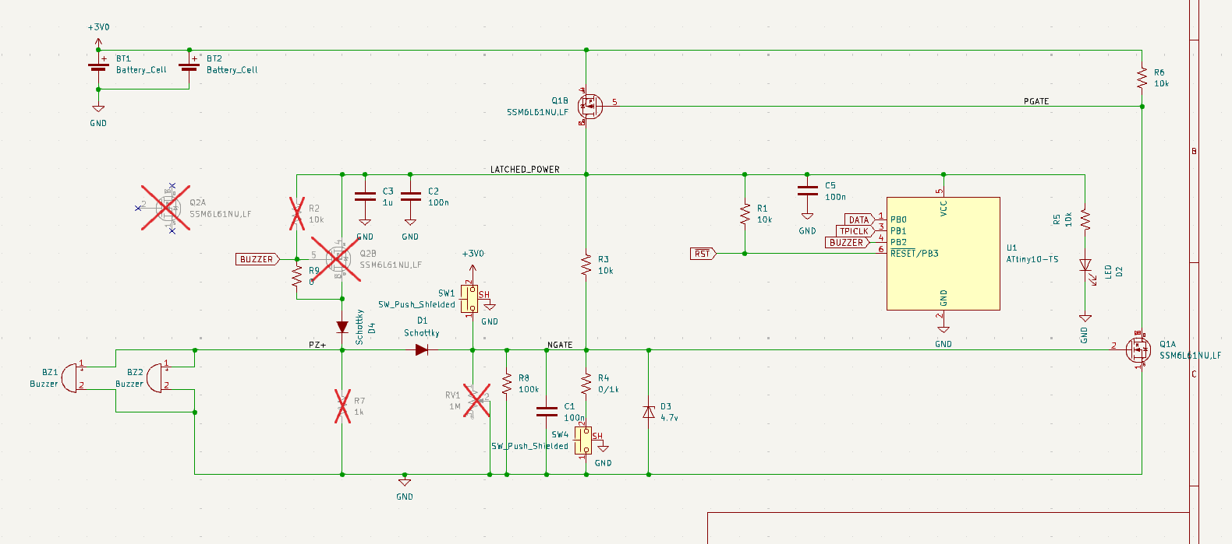
AS-BUILT (JLC QTY 5)

Slide 28
CHANGES TO MAKE

Slide 29
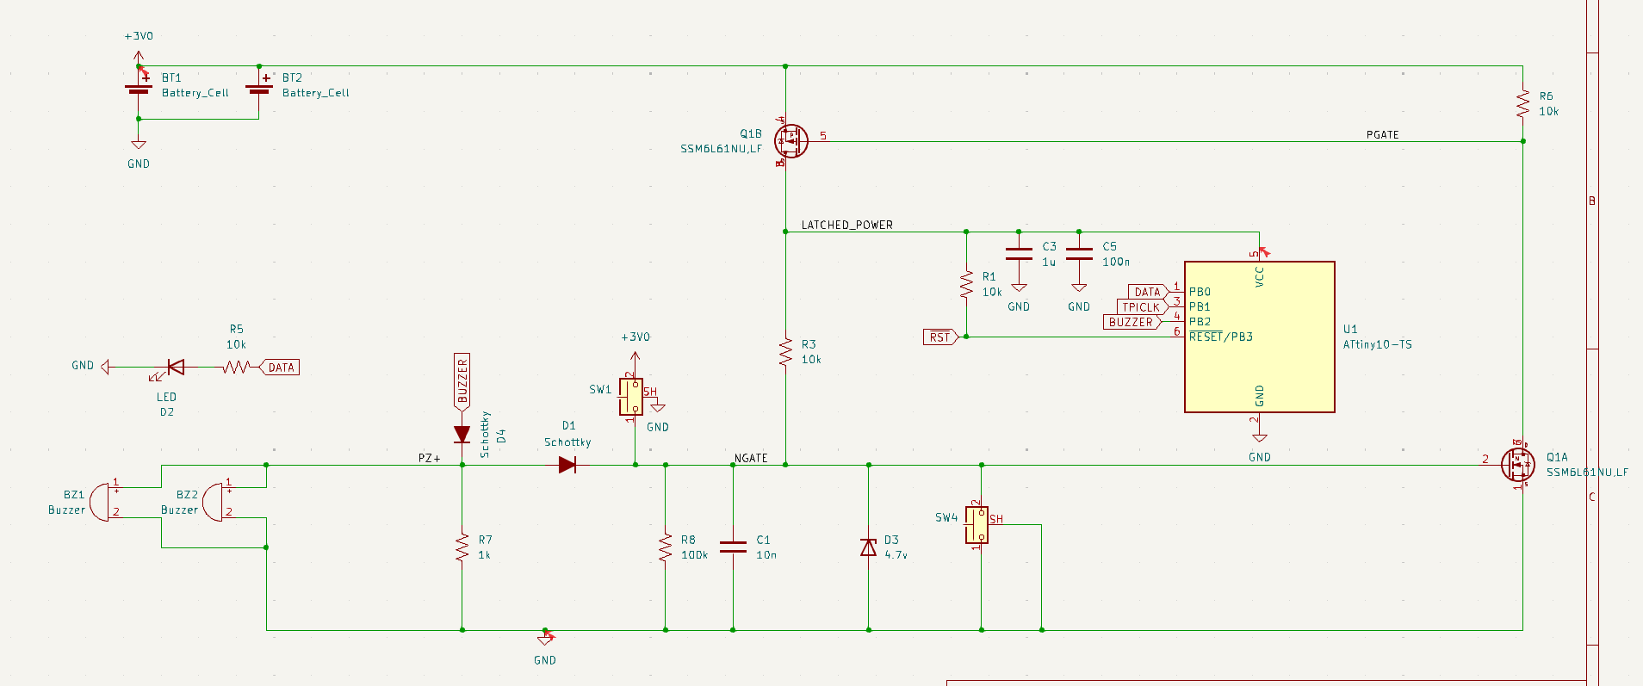
Changes Made

Slide 30
Low Power Testing
20nA draw when not triggered (1000 year battery life lmao)
~1.05mA average when triggered. Need to get this down
8.7 days of chirping.
LED resistor was modified for 6mA of draw but the device only seems to see 3mA of draw (resistor sized for min Vf)

Slide 31
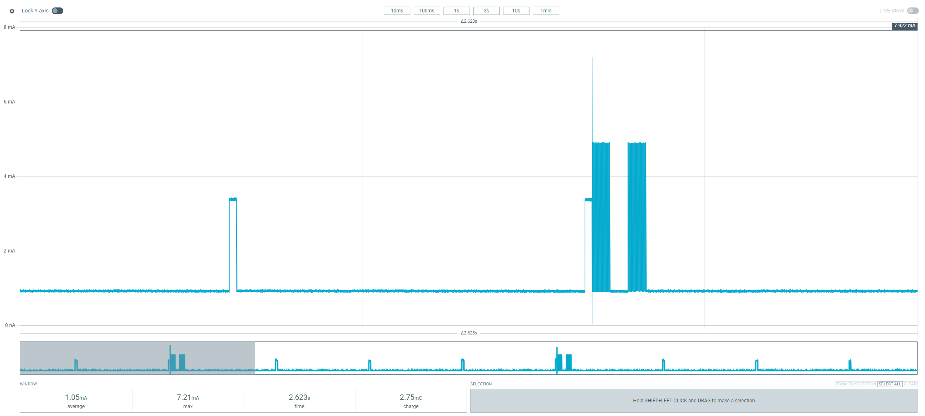
Blink and beeps
Blink

Slide 32
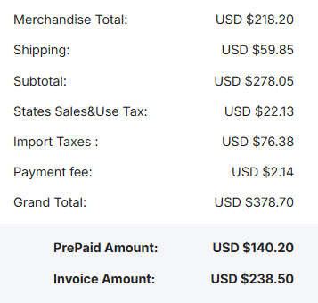
QTY 50 is off to the races!
Fuck a tariff
3/17/2026

Slide 33
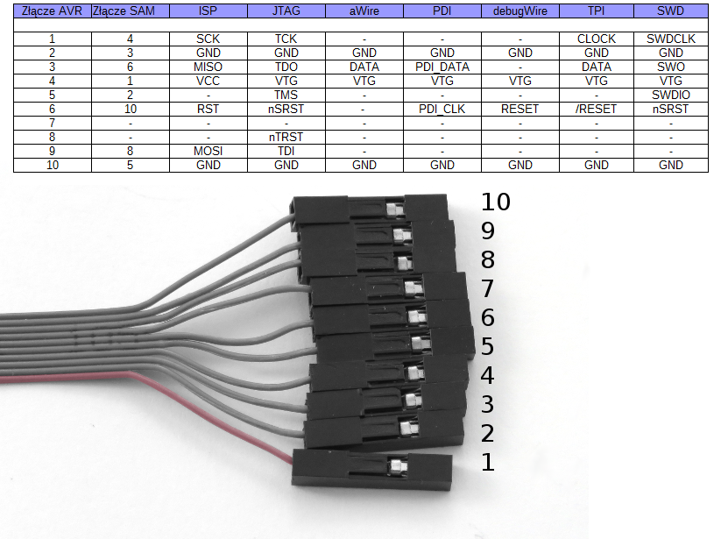
ICE Pinout

Slide 34
Sleep Studies
OG Code vs Sleeps

Slide 35
OG CODE:
OG CODE:
#define F_CPU 1000000UL
#include <avr/io.h>
#include <util/delay.h>
// Toggle PB2 by writing 1 to PINB bit
static inline void pb2_toggle(void) {
asm volatile("sbi %0, %1" :: "I"(_SFR_IO_ADDR(PINB)), "I"(PB2));
}
// 125 µs half period @ 1 MHz
static inline void half_period_125us(void) {
uint8_t n = 41; // 3*n - 1 = 122 cycles
asm volatile(
"1: dec %[n] \n\t"
"brne 1b \n\t"
"nop \n\t"
: [n] "+r"(n)
);
}
// 4 kHz tone on PB2
static inline void tone_pb2_4khz_ms(uint16_t duration_ms)
{
uint16_t periods = duration_ms * 4;
while (periods--) {
pb2_toggle();
half_period_125us();
pb2_toggle();
half_period_125us();
}
PORTB &= ~(1 << PB2); // force low
}
// 20 ms pulse on PB0
static inline void pulse_pb0_20ms(void)
{
PORTB |= (1 << PB0);
_delay_ms(20);
PORTB &= ~(1 << PB0);
}
int main(void)
{
// PB2 + PB0 outputs
DDRB |= (1 << PB2) | (1 << PB0);
PORTB &= ~((1 << PB2) | (1 << PB0));
tone_pb2_4khz_ms(50);
_delay_ms(50);
tone_pb2_4khz_ms(50);
_delay_ms(50);
tone_pb2_4khz_ms(50);
_delay_ms(50);
tone_pb2_4khz_ms(50);
uint8_t flash_count = 0;
while (1)
{
pulse_pb0_20ms(); // LED pulse every second
flash_count++;
if (flash_count >= 4) // every 4 seconds
{
flash_count = 0;
tone_pb2_4khz_ms(50);
_delay_ms(50);
tone_pb2_4khz_ms(50);
}
_delay_ms(980); // completes ~1 second total (20ms + 980ms)
}
}
1.05mA AVG!

Slide 36
ChatGPT “Sleeper Code”
600uA Sleep
734uA Average
Better!
The issue:
I am drawing 600uA sleeping…that’s bad sleep…except it’s really bad hardware

Slide 37
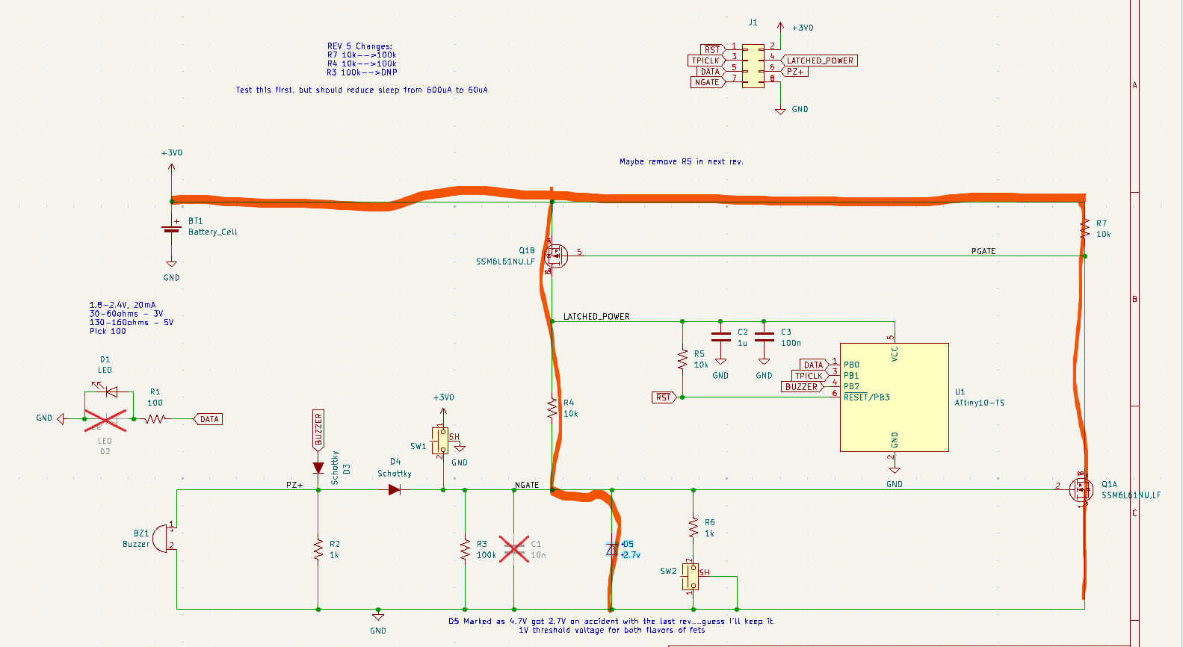
On-State Power Draws!
~300uA
300uA

Slide 38
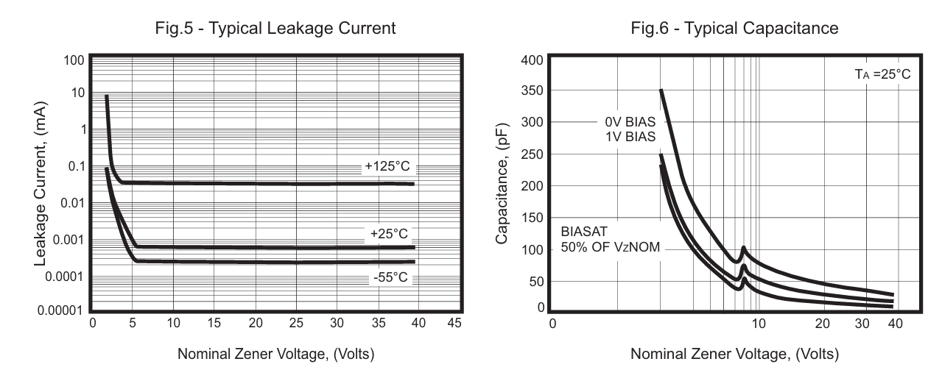
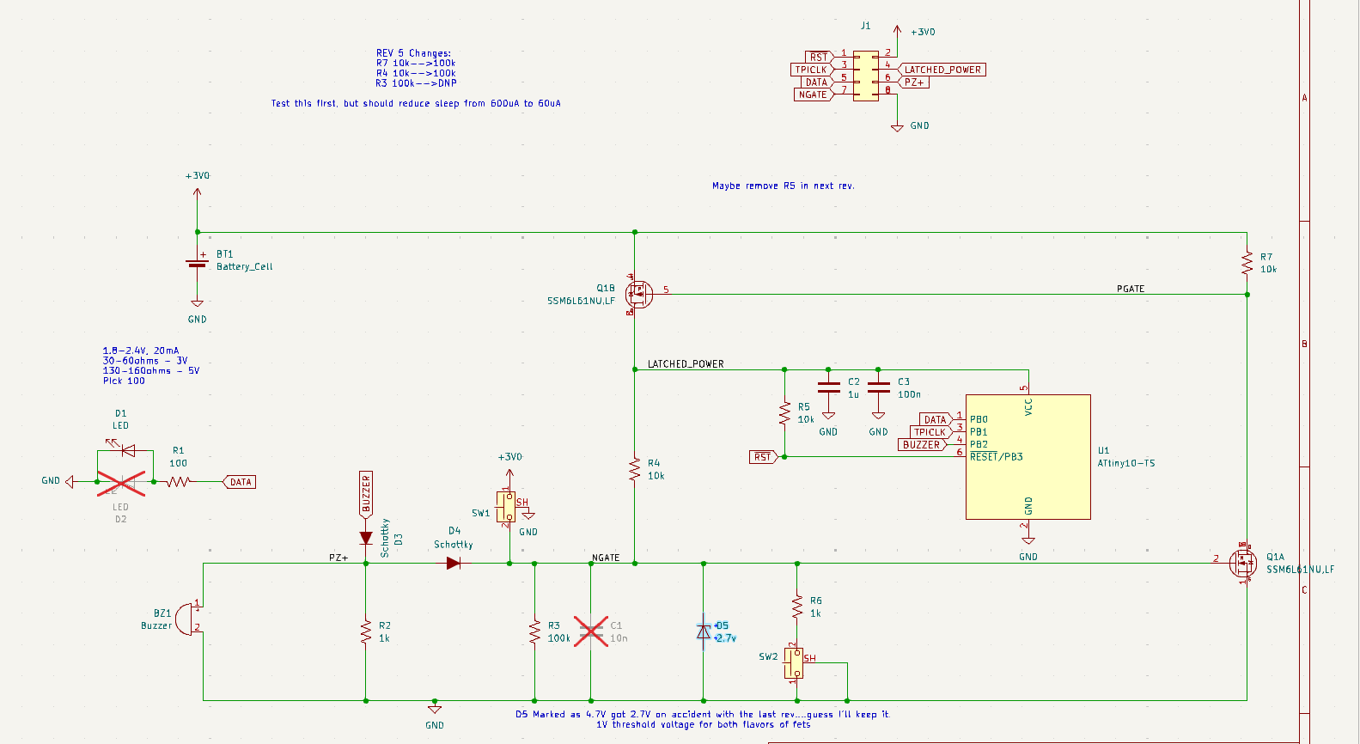
Fixes…
100k
100k
REMOVE*
*DNP This part, it is redundant when you factor in leakage and capacitance of D5

Slide 39
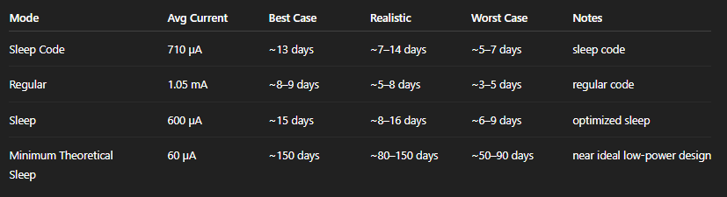
New Theoretical Sleep Draw
60uA
8 days→80days
Not a deal-killer for beta-test, but def. a miss on my part

Slide 40
Update: 3/20/2026
Replaced resistors R7/R4 with 100ks
Removed R3
New average draw: 180uA!
Sleep Current: 60uA
Sensitivity….questionable it should go up though.
"C:\Users\robot\OneDrive\Documents\Projects\MouseMinder\PowerProfilerData\ATTINY10Sleep_optimized_resistors.csv“
I won’t do this rework to 50x boards…but I’ll rework 1-2 for internal testing.

Slide 41
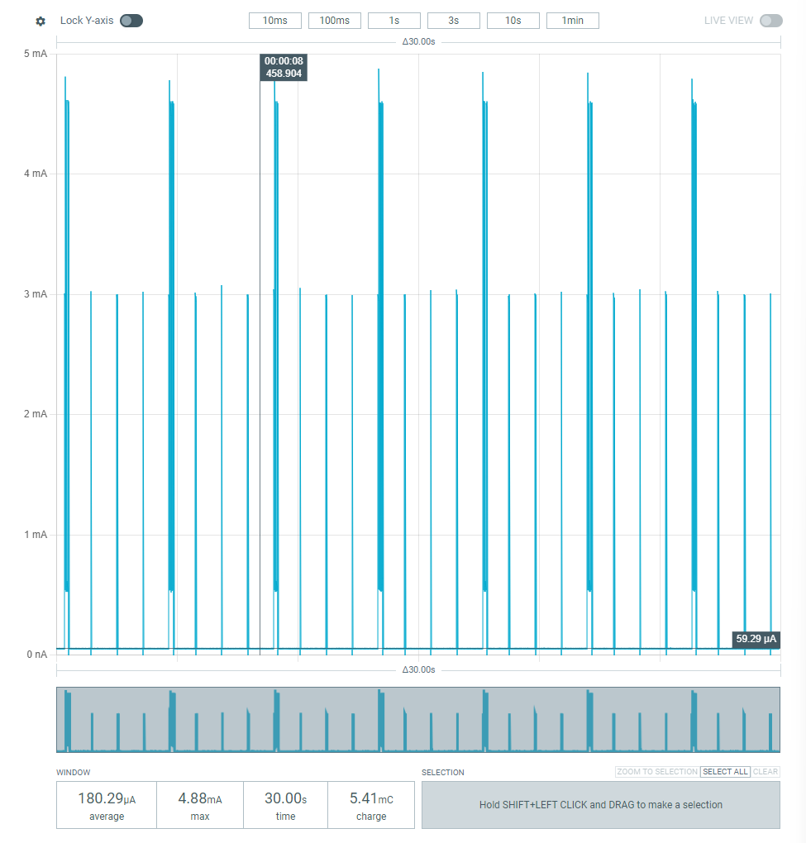
Plot

Slide 42
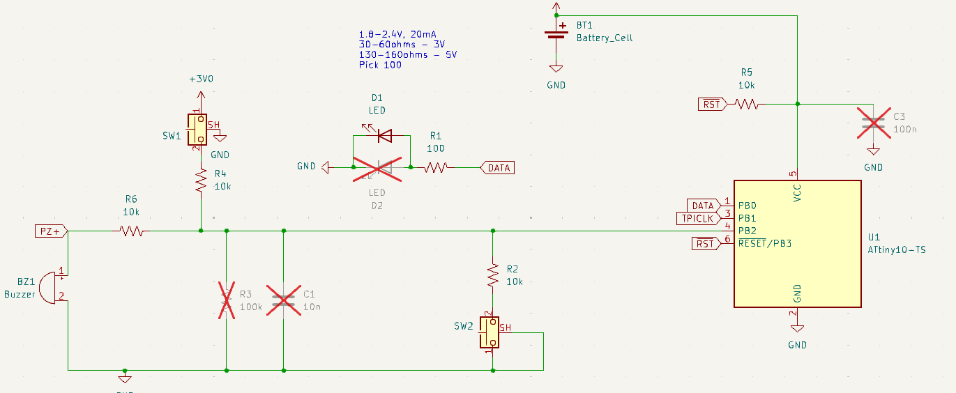
Dumb idea…3/21/2026
The attiny has stupid low sleep current like 500nA…
On-par with CR2032 self-discharge…
Why not just wire the piezo direct* into INT0 and use the internal clamping diodes handle the rest? Part count goes WAY down…
*Still want R6 here to limit diode current…

Slide 43
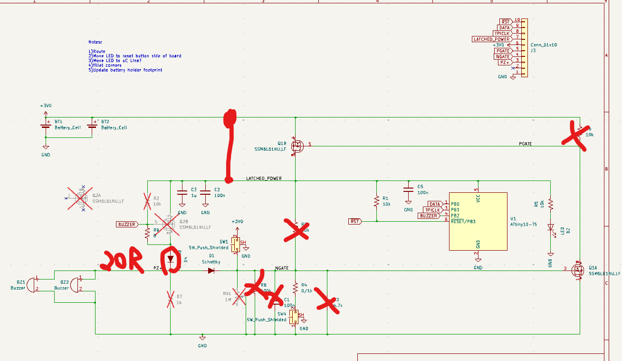
Circuit Mods…on PCBs I already have…

Slide 44
Programming Changes
PB2 needs pull-up turned on for sleep mode between pulses.
PB2 is also the interrupt from deep sleep.
PB2 is really the star of the show here.
PB2 is love, PB2 is life.
https://chatgpt.com/share/69bf128c-7c8c-8001-9b17-0a67c42d7913

Slide 45
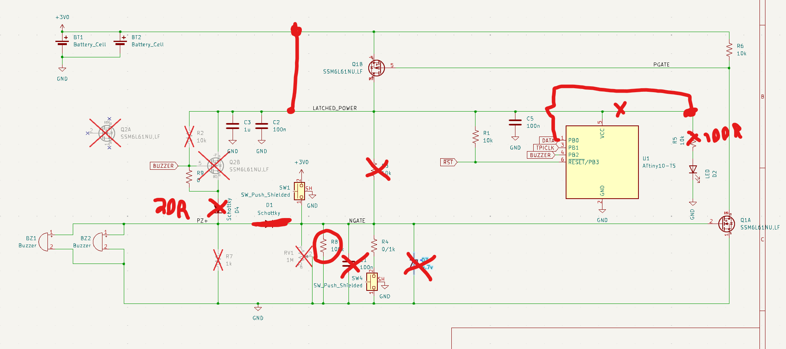
It works! Wow. Here’s my schematic

Slide 46
Improvements and to-dos
SW1 “Test” needs a 10k current limiting resistor, same with SW4 (from 1k).
Still need to probe interrupt line to check for major voltage violations. 20 ohms may not be enough.
Don’t want additional disturbances to disable sensor. Would probably want to move disable function to an unused pin like reset (no additional code!).
100k pulldown arbitrary.
Remove decoupling caps and see what happens.
Keep pads for R&C sensitivity adjustment.

Slide 47
Update to last slide:
Runs fine with no decoupling caps.
Reset switch to reset pin works a treat.
80uA → 4uA deep sleep once I cleaned off my filthy flux.
6.3 years of idle (ideally)
Self-discharge of a CR2032 gets us to like 2-5 years.
Chef’s Kiss.
Let’s measure voltage on PB2 when a trap goes off next.

Slide 48
Let’s work on a programming Jig for V4
Insert PCB
Press the Test button to begin programming/QC sequence
Program at 5V
Shutdown (don’t want to burn out LED)
Apply 3V to 3V Rail
Tap Piezo and measure analog voltage on PZ+
Hopefully this triggers the unit
If the unit doesn’t trigger, we can apply power to the Latched_Power Rail
Read Phototransistor on LED
Read Analog Voltage on NGate
Press Reset Button
Test Pass

Slide 49
Visual Sequence
Apply 5V on Battery Pin
Insert PCB into Jig
Press “Test” Button to Start
Program Success?
Disable 5V Power, Apply 3V
Solenoid Tap Power On?
LED = RED
ERROR MSG
LED = RED
ERROR MSG
LED Blinking?
Press “RST” Button
NGATE Goes Low?
TEST PASS
LED = RED
ERROR MSG
LED = RED
ERROR MSG

Slide 50
QTY 50 ARRIVED 4/2/2025
They work!
783uA average (3v)!

Slide 51
POGO Pinout
Top View
RST
Batt
CLK
CLK
3R
LC
PD
GN
GND
GND
Latched
Latched
DATA
PZ
NGATE

