Slide 1
Homework 4
The Center Selection Problem
Zhicong Sun
Computer Science and Engineering
12032471@mail.sustech.edu.cn
2020.10.15

Slide 2
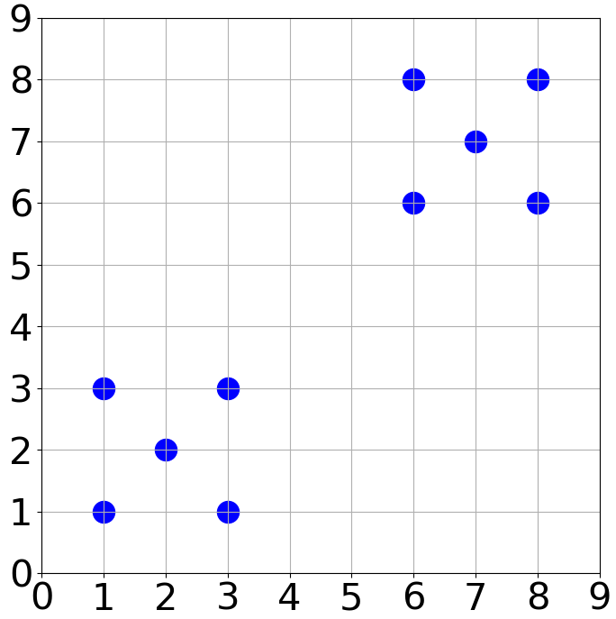
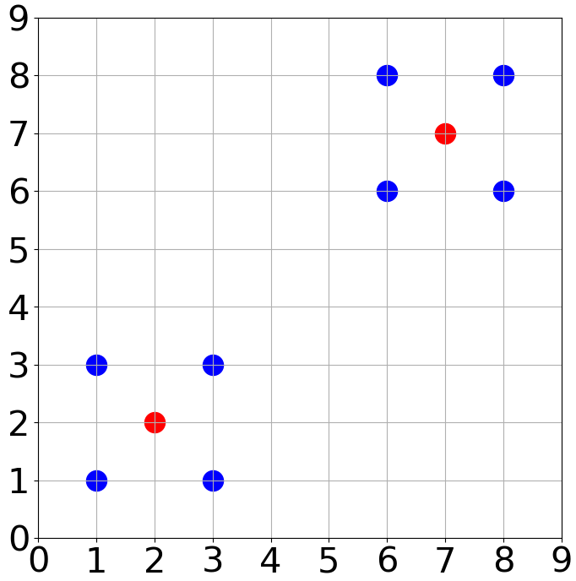
Exercise 3-1
r(C) = 2r(C*)
r(C*)
10 sites & 2 centers
Optimal solution

Slide 3
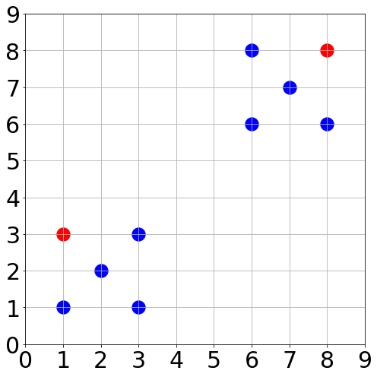
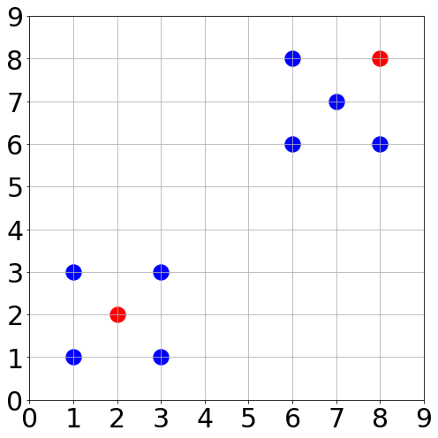
Exercise 3-1
r(C) = 2r(C*)
2r(C*)
2r(C*)
r(C*)
2r(C*)
e.g.1: r(c)= 2r(C*)
e.g.2: r(c)= 2r(C*)
r(C) is always equal to 2r(C*) no matter which staring site

Slide 4
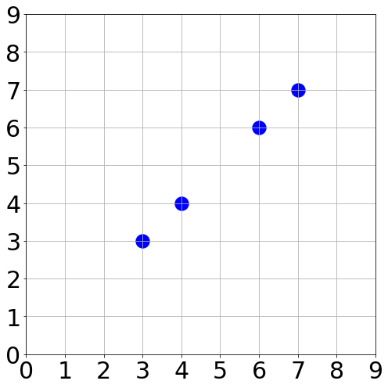
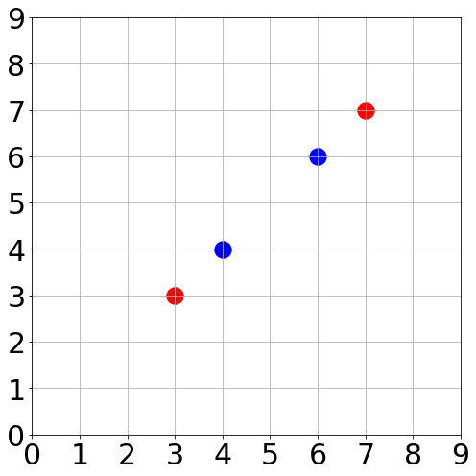
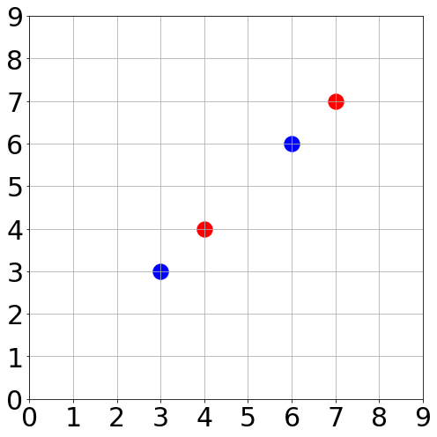
Exercise 3-1
r(C) = r(C*)
r(C*)
r(C*)
r(C*)
r(C*)
4 sites & 2 centers
e.g.1: r(c)= r(C*)
e.g.2: r(c)= r(C*)
r(C) is always equal to r(C*) no matter which first site

Slide 5
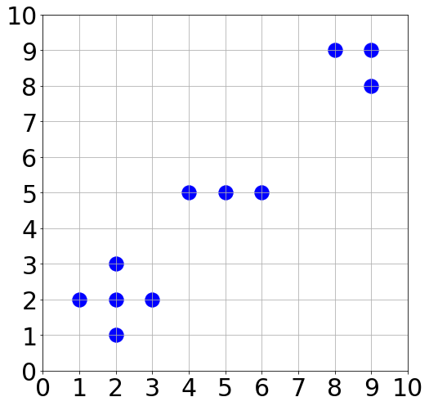
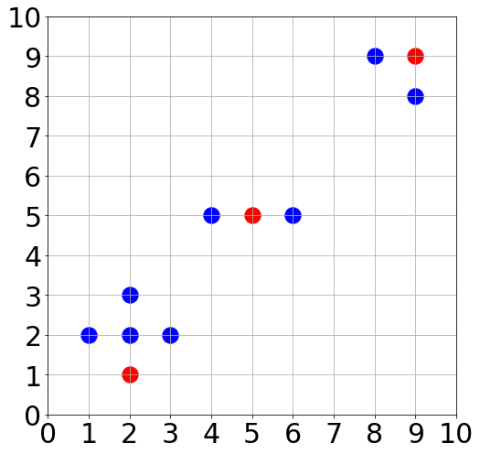
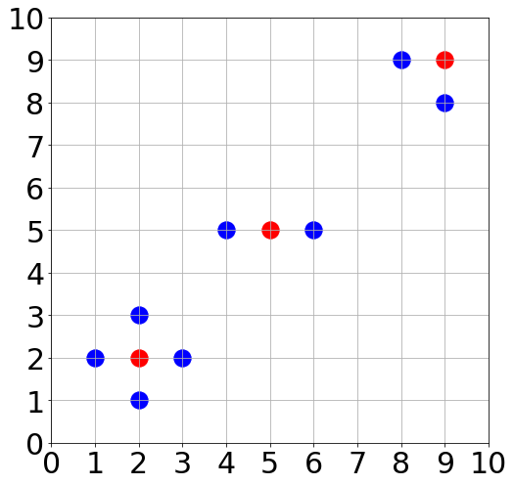
Exercise 3-2
A method to choose the first site
r(C*)
r(C*)
r(C*)
r(C*)
r(C*)
2r(C*)
r(C*)
11 sites & 3 centers
e.g.1: r(c)=2r(C*)
e.g.2: r(c)= r(C*)
Optimal one
It is better to choose the center of a part of sites

Slide 6
Thanks!
Please contact me with email
if you have any problem
ZhicongSun
Computer Science and Engineering
12032471@mail.sustech.edu.cn
2020.10.15

