Slide 1
Homework 5
Initialization problem of K-means
Zhicong Sun
Computer Science and Engineering
12032471@mail.sustech.edu.cn
2020.10.22
Notes:
Hello everyone! It is very luck to be here! My name is SZC, computer science and engineering, today I want to introduce something about IoT-Internet of Thing.

Slide 2



Use initial centers
Density-based center initialization method
Define:
Step1:
Select the site which has the highest density as the first center from A
Step2:
Select a site that meets the following equation from the remaining sites in A
Step3:
Repeat step 2 until k centers are found
Notes:
When we encounter a strange things, the first thing we want to ask must be: what is this? What can it do?
Does anyone know what IoT is
Maybe you are as shy as me
Let’s look at this video to find the answer

Slide 3
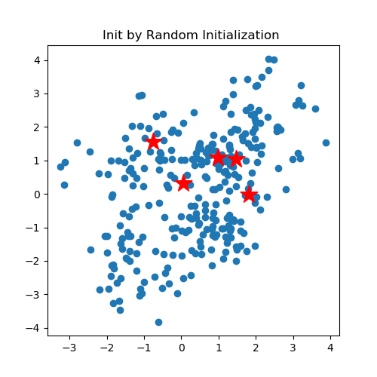
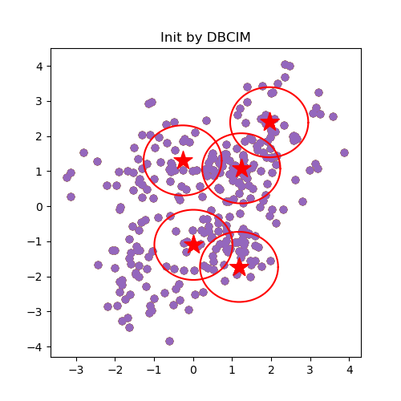
Use initial centers
Density-based center initialization method
Random Initialization
Density-based method
Notes:
When we encounter a strange things, the first thing we want to ask must be: what is this? What can it do?
Does anyone know what IoT is
Maybe you are as shy as me
Let’s look at this video to find the answer

Slide 4
Use initial centers
Density-based center initialization method
Random initialization
Density-based method
Notes:
When we encounter a strange things, the first thing we want to ask must be: what is this? What can it do?
Does anyone know what IoT is
Maybe you are as shy as me
Let’s look at this video to find the answer

Slide 5
Use initial partitions
Equally divided partition initialization method
Step1:
Compare the maximum site spacing of two dimensions, select the dimension with the larger maximum site spacing
Step2:
Divide sites into K partitions evenly, distance between each cluster
Step3:
Calculate the center of each partition by the following equation
Notes:
When we encounter a strange things, the first thing we want to ask must be: what is this? What can it do?
Does anyone know what IoT is
Maybe you are as shy as me
Let’s look at this video to find the answer

Slide 6
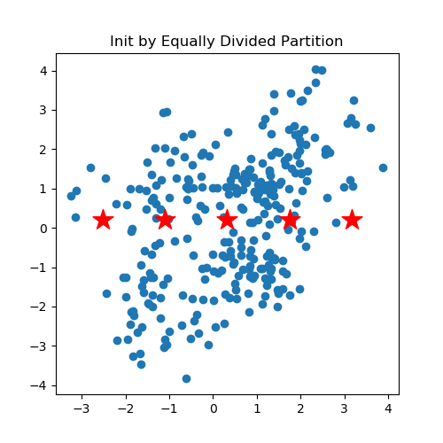
Use initial partitions
Equally divided partition initialization method
Partitions & Centers
Clustering process
Notes:
When we encounter a strange things, the first thing we want to ask must be: what is this? What can it do?
Does anyone know what IoT is
Maybe you are as shy as me
Let’s look at this video to find the answer

Slide 7
Thanks!
Please contact me with email
if you have any problem
ZhicongSun
Computer Science and Engineering
12032471@mail.sustech.edu.cn
Github: RadarSun
2020.10.22

