Slide 1
Homework 3
The Load balancing Problem
Zhicong Sun
Computer Science and Engineering
12032471@mail.sustech.edu.cn
2020.10.10

Slide 2
Exercise 2-1:
2 machines and 5 jobs(t_{j} of each job is 2,2,2,3,3)
Greedy algorithm
Sorted greedy
algorithm
The order of jobs:
2,3,2,3,2
M1
3 | 2 | 2
3 | 2
T1=7
M1
2 | 2 | 2
3 | 3
T1=6
M2
T2=5
M2
T2=6
T=7
T*=6
T/ T* = 7/6

Slide 3
Exercise 2-1:
3 machines and 7 jobs(t_{j} of each job is 3,3,3,4,4,5,5)
Greedy algorithm
Sorted greedy
algorithm
The order of jobs:
3,4,4,3,5,5,3
M1
5 | 3 | 3
5 | 3
4 | 4
M1
3 | 3 | 3
4 | 5
4 | 5
T1=9
T1=11
M2
T2=8
M2
T2=9
M2
T3=8
M2
T3=9
T=11
T*=9
T/ T* = 11/9

Slide 4
Exercise 2-1:
m machines and 2m+1 jobs
(t_{j} of each job is m,m,m,m+1,m+1,…,2m-1,2m-1)
Sorted greedy algorithm
Each machine deals with one job,
t_{j} of each job is 2m-1, 2m-1, 2m-2, 2m-2, … , 2m-1-[(m-1)/2]
Each machine deals with another job,
t_{j} of each job is m, m, m+1, m+2, … , 2m-1-[m/2],
now total time of each machine is 3m-1
Another job with t=m will be arranged to one machine
T = 4m-1

Slide 5
Exercise 2-1:
m machines and 2m+1 jobs
(t_{j} of each job is m,m,m,m+1,m+1,…,2m-1,2m-1)
Optimal solution:
One machine deals with the jobs with time of {m,m,m} others deal with {m+i, 2m-i}
Other machines deal with {m+i, 2m-i}so T*=3m
So T*=3m
T/ T* = (4m-1)/3m
4/3

Slide 6
Exercise 2-2:
Some machines are more efficient than others
Weight-influenced greedy algorithm
Suppose that each machine has it own processing weigt w_{m} ,m is the number of machine
the larger the weight is, the larger the processing time is
Replace t_{j} with tw_{jm}
for example, t_{j} = 1, w_{m} = 2, so tw_{jm} = 1*2 = 2

Slide 7
Exercise 2-2:
Some machines are more efficient than others
Weight-influenced sorted greedy algorithm
procedure Weight-Influenced-Greedy-Balance
Sort jobs in descending order of processing time(so t₁≥t₂≥… ≥t_{n})
for j=1,…,n do
compute tw_{jm}=t_{j} *w
Let M_{i} =machine that achieves min_{k} Tw_{k}
Assign job j to machine M_{i}
Set A(i) to A(i)U{j}
Set Tw_{i} to Tw_{i} + t_{j}
end for
end procedure

Slide 8
Exercise 2-2:
Some machines are more efficient than others
Weight-influenced sorted greedy algorithm
Easy Example 1: 2 machines and 5 jobs, M₁ has weight =1, M₂ has weight =2, t_{j} of each job is 1,2,2,3,4
M1
4*1 | 2*1 | 2*1
3*2 | 1*2
Tw1=8
M2
Tw2=8
Tw=8=Tw*

Slide 9
Exercise 2-2:
Some machines are more efficient than others
Weight-influenced sorted greedy algorithm
Easy Example 2: 2 machines and 5 jobs, M₁ has weight =1, M₂ has weight =2, t_{j} of each job is 3,3,4,4,5
Optimal solution
M1
5*1 | 4*1 | 3*1
4*2 | 3*2
Tw1=12
M1
5*1 | 4*1 | 4*1
3*2 | 3*2
Tw1=13
M2
Tw2=14
M2
Tw2=12
Tw=14
T*=13
T/ T* = 14/13

Slide 10
Exercise 2-2:
Some machines are more efficient than others
Weight-influenced sorted greedy algorithm
Complex Example 2: 4 machines and 12 jobs, M_{i} has weight =1,2,3,4 ,t_{j} of each job is 1,1,2,2,3,3,4,4,5,5,6,6
M1
6*1 | 4*1 | 4*1 | 3*1 | 2*1 | 1*1
6*2 | 3*2 | 1*2
5*3 | 2*3
5*4
Tw1=20
M2
Tw2=20
M3
Tw3=21
M4
Tw4=20
Tw=21

Slide 11
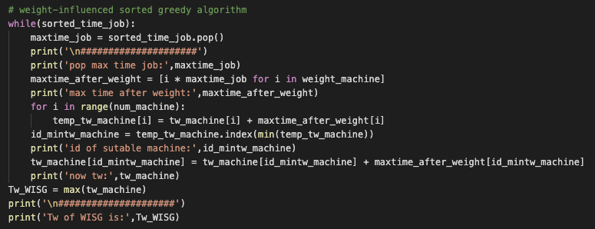

Exercise 2-2:
Some machines are more efficient than others
Weight-influenced sorted greedy algorithm
Through 1000 Random Tests: 2 machines and 5 jobs, M₁ has weight =1, M₂ has weight =2, t_{j} of each job is random
T/ T* = 1.0114

Slide 12
Thanks!
Please contact me with email
if you have any problem
ZhicongSun
Computer Science and Engineering
12032471@mail.sustech.edu.cn
2020.10.10

