Slide 1

Agenda
Concurrency in Go
Concurrency patterns
-Barrier
-Future
-Pipeline
-Workers Pool
-Publish/Subscribe

Slide 2
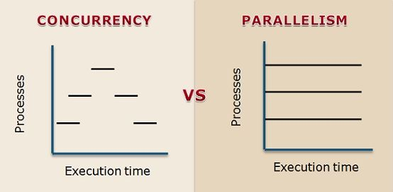
Concurrency
Goroutines
Goroutine Synchronization
-Standard sync package
-Channels(Buffered, Unbuffered)

Slide 3
Concurrency patterns
Barrier
Future
Pipeline
Workers Pool
Publish/Subscribe

Slide 4
Barrier Design Pattern
-What is it
-Code example
-Common uses

Slide 5
2. Future Design Pattern
-What is it
-Code example
-Common uses

Slide 6
3. Pipeline Design Pattern
-What is it
-Code example
-Common uses

Slide 7
4. Workers Pool Design Pattern
-What is it
-Code example
-Common uses

Slide 8
5. Publish/Subscribe Design Pattern
-What is it
-Code example
-Common uses

Slide 9




Thank you

