Slide 1
Credit Card Approval Prediction
R. Bimo Mandala Putra

Slide 2



Ways Bank Make Money
Interest income
Capital markets income
Fee-based income
Interest Income
Depositor
Creditor
Deposit
Lending
Interest
Payment
+ Interest
How Do Banks Make Money? - Overview, Forms, Examples (corporatefinanceinstitute.com)

Slide 3
Problem
Depositor
Creditor
Deposit
Lending
Interest
Payment
+ Interest
Defaulter
By assuming 1 person creditor lending Rp 1.000.000 with interest 5%.
Credit Loan : Rp 1000.000
Interest : 5%
Risk lose : ± Rp 1000.000
Profit : Rp 50.000
https://www.investopedia.com/terms/l/lossgivendefault.asp

Slide 4
Target & Goals
02
Goals
04
Result
Prevent Potential Bad User aproval credit card
Eliminate or reduce loss from Bad User
01
Problem
03
Objective
Loss because of Bad User
Identify Bad User and predict it using ML models

Slide 5
Data Pre-Processing & Analysis
application_record.csv
credit_record.csv
438.557 Rows
1.048.574 Rows
18 Columns
3 Columns
Duplicate data : 12 Rows
Missing Values :
134203 Rows on Occupation type
Duplicate data : 0 Rows
Missing Values : 0 Rows

Slide 6
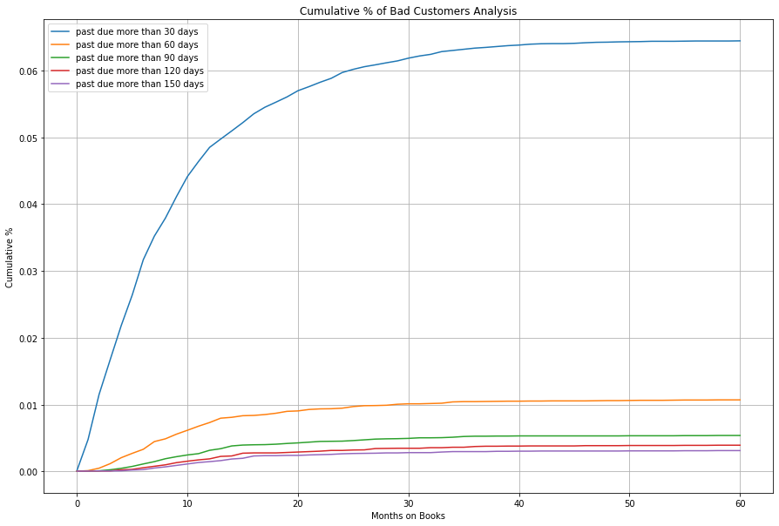
Data Pre-Processing & Analysis
Determine Target with Vintage analysis
User 30 Days past due looks higher than other user, it happens more often.
We can’t just say user who 30 past days are Bad User
User 60 Past due or more will be categorized as Bad User

Slide 7
Feature Engineering
New feature column
Age
Months_in_books
Status (Target)
Define Age of user, Transformed from `days_birth` column divided by 365 days
Define How many Months user join Credit service,
Pivoted from `Credit.csv`
Define whatever user are Bad User
or Good user,
Score =< 60 past due =Bad score
Score < 30past due = Good Score
Good Score>Bad Score = Good User
Good Score<Bad Score = Bad User

Slide 8
Feature Engineering
Encoding
Binary
Convert the negative value to 0 and the positive value to 1
More than 2
Convert the Column with One Hot Encoding Technique
Imbalance
Over Sampling with Smooth
Extremely Imbalance Data between Good & Bad User
Scaling
Non-Categorical / Numeric don’t have normal distribution
Standard Scaler

Slide 9
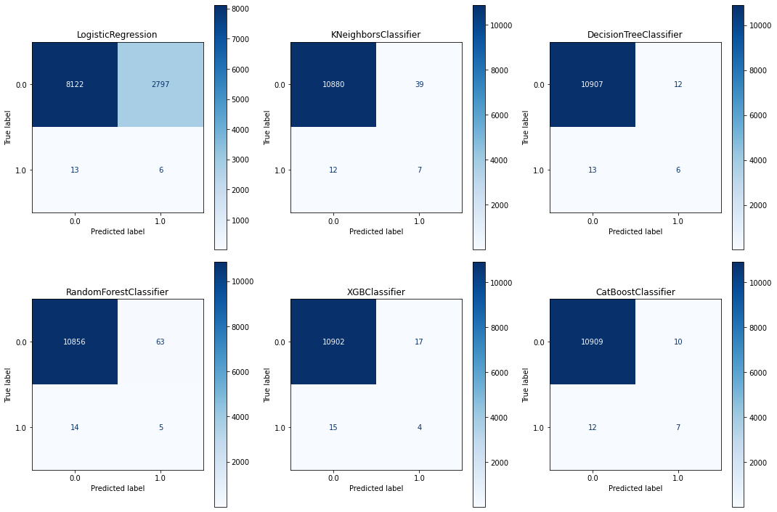
Model Comparison - Classifier
Choose model with highest recall with tolerable accuracy, we want false negative smallest as possible
Decision Tree & Cat Boost have good performance

Slide 10
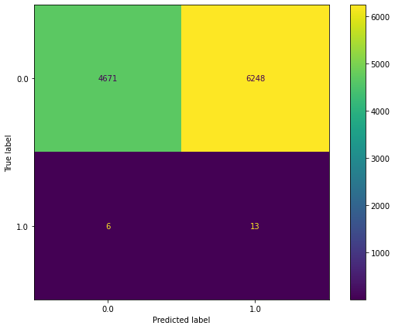
Hyperparameter tuning
Decision Tree
Hyperparameter failed, more trial with new parameter needed

Slide 11
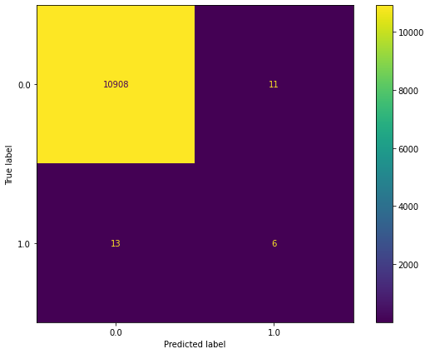
Hyperparameter tuning
Cat Boost Classifier
Hyperparameter failed, more trial with new parameter needed

Slide 12
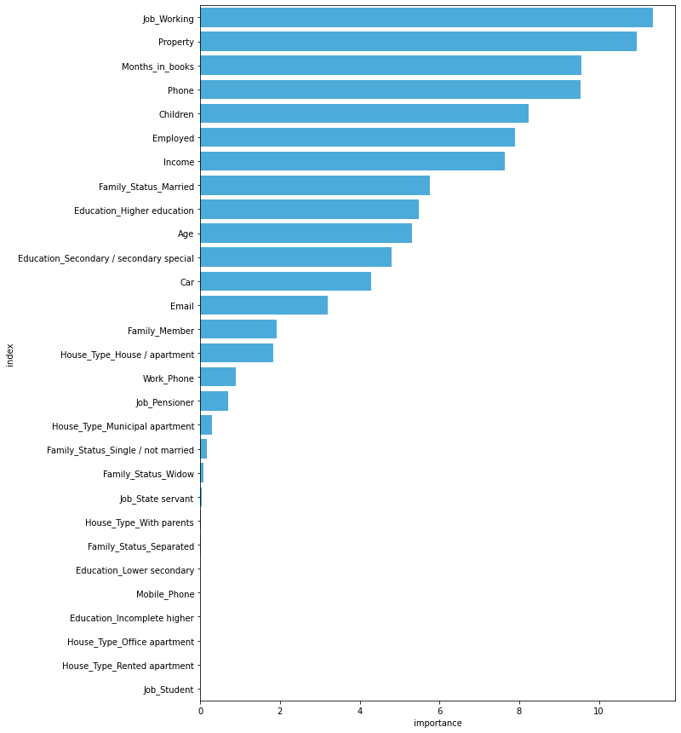
How Model Interpret the Data
Job_Working,Property,Months_in_books are features with the most contributions

Slide 13
Model’s accomplishments
Model successfully reduce loss from Defaulters
▼ 26%
Rp 1.250.000
Assumption : Before using model all defaulter approval credit are approved, returned 75% value, 5% interest and Rp 1.000.000 loan money each person
Before
Defaulters : 19
Prevented : 0
Loss : Rp 4.750.000
After (with Model)
Defaulters : 19
Prevented : 7
Wrong predict : 10
Loss : Rp 3.500.000

Slide 14
Conclusion
The Cat Boost model successfully reduce loss from defaulters, with 26,3% percentage there are more room for improvement
Job with working attributes are the most important feature. By analysis, it is found that good user able to pay their dept from working as worker with their stable income than other job.
The Extreme Imbalance of data set make it hard to create model, example if model predict all value as good user model still have 99% accuracy but cannot predict even a single Bad User
For Profit purpose User predicted as Bad User by the model still have a chance actually a Good User, we must still consider user economics value with their property or other valuable value for loss recovery in credit risk management.
Failure in Hyper Parameter tuning because there is a chance wrong with chosen parameter, more trial with new parameter value for finding best parameter.

Slide 15
Thanks!
Do you have any questions?

