Slide 1
📚SkillBook
Made by:
Buzási Regina
Bagoly Donát
Pettermann Shaun Pharrell
2026 | Team SkillBook https://github.com/RadeonGamer06/skillbookgithub.github.io/

Slide 2
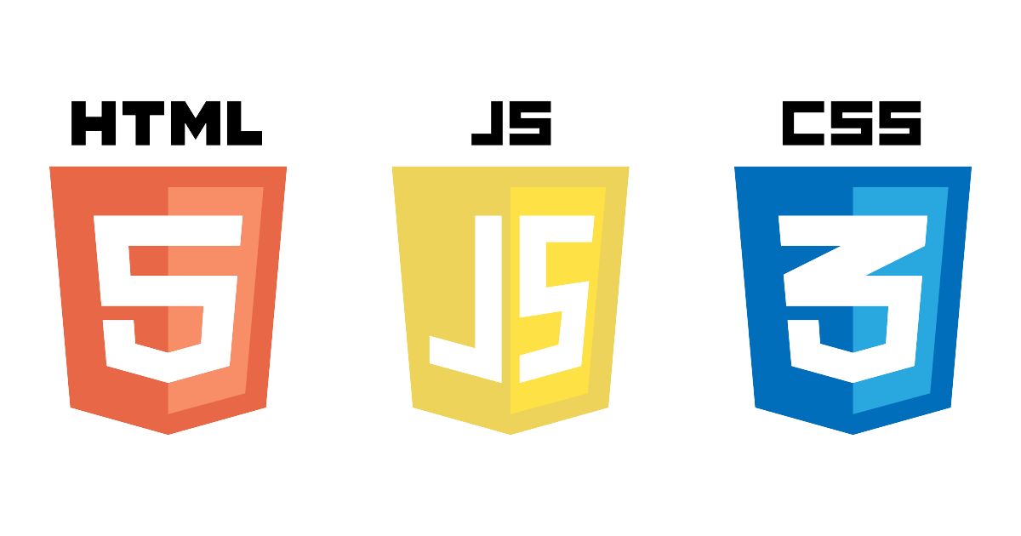
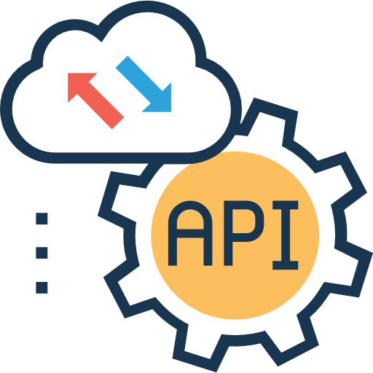



Teamwork
Frontend
Pettermann Shaun Pharrell
Backend, Project manager
Bagoly Donát
Database
Buzási Regina

Slide 3



Short definition
Pettermann Shaun Pharrell
Bagoly Donát
Did the design, the look and feel of the website, and its basic functions.
Made the application behind the website that handles all the functions.
Buzási Regina
Created the database and filled the tables with data and stored procedures.

Slide 4
Presentation sequence
Project Introduction
Database Design
What is SkillBook?
Tables, relationships, stored procedures
The Real Problem
Tech Stack
What gap does this platform fill?
Frontend, backend, and database technology
Key Features
Why We Built This
Students, instructors, and admin capabilities
Motivation and goals
Design Plan
Q&A
UI/UX overview and page structure
Questions and discussion

Slide 5
What is SkillBook?
🎓 Students
SkillBook
Browse, enroll and learn from courses. Leave reviews, chat with instructors.
👩‍🏫 Instructors
📖 Course Catalog
Create and manage courses, upload materials, answer student messages.
✍️ Easy Enrollment
🛡️ Admins
📁 Material Upload
Full platform oversight: manage users, courses, categories, and all content.
💬 Direct Messaging
⭐ Course Reviews
🔐 Secure Auth

Slide 6





Why we build SkillBook?
And what gap does SkillBook fill?
😤 Too many tools
👨‍🏫 Instructors lack control
📋 No unified booking system
🏫 Missing community layer
No easy way for learners to browse available courses, check uploaded materials, and profile management.
No built in communication between students and instructors leads to lower engagement and higher dropout rates.
✅ SkillBook solves all of this. One platform for learning, booking, and communication.

Slide 7
Key features
📚
✍️
📁
Course catalog
Easy enrollment
Material upload
Browse courses across 36 categories
One-click registration for any course
Teachers upload PDFs, images, documents
💬
⭐
🔐
Messaging
Reviews & ratings
Secure auth
Direct chat between students and instructors
Students rate and review completed courses
JWT-based authentication with role access control

Slide 8

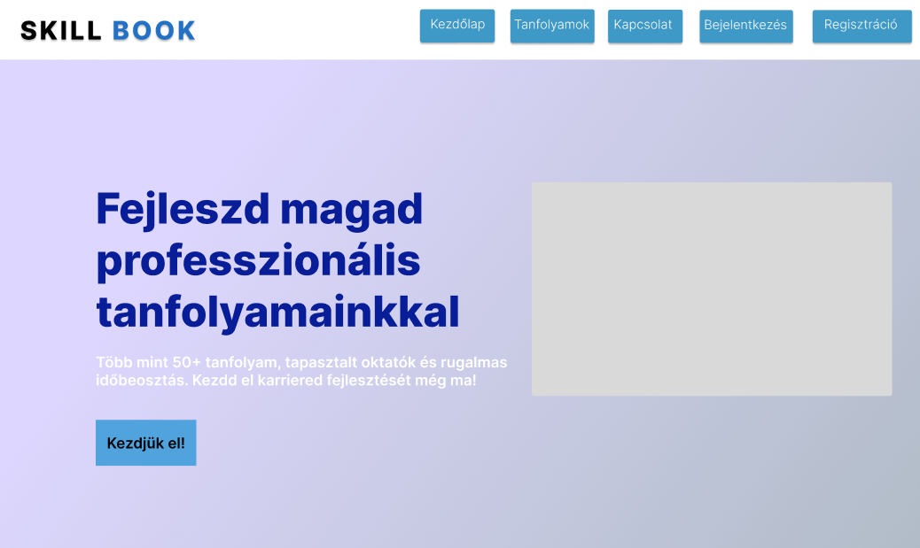
Design plan – home page
Page Structure
🏠 Home
📚 Course Listing
🔍 Course Detail
👤 User Profile
➕ Create Course
📋 My Courses
💬 Messaging
🛡️ Admin Panel
Brand Colors:
Primary
#7c3aed
Secondary
#059669
Background
#f5f3ff
Text
#1e1b4b

Slide 9
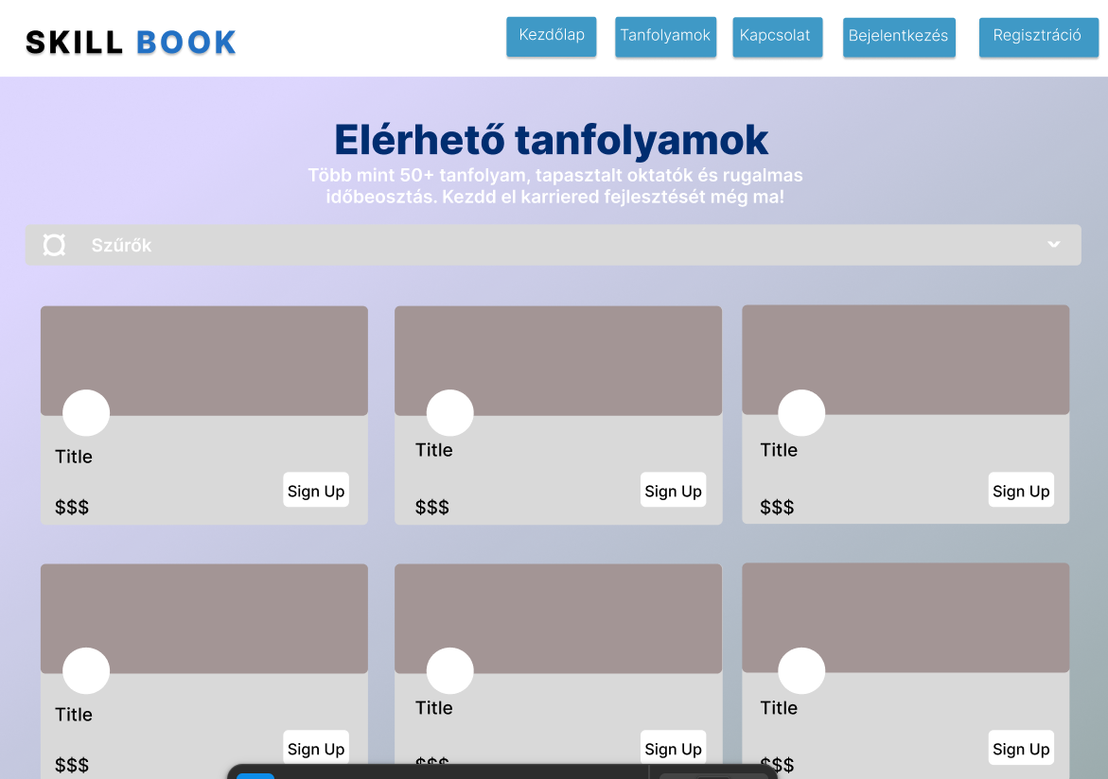
Design plan – courses page

Slide 10
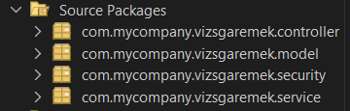

Backend layers
4 backend layers:
Controller
Model
Security
Service

Slide 11
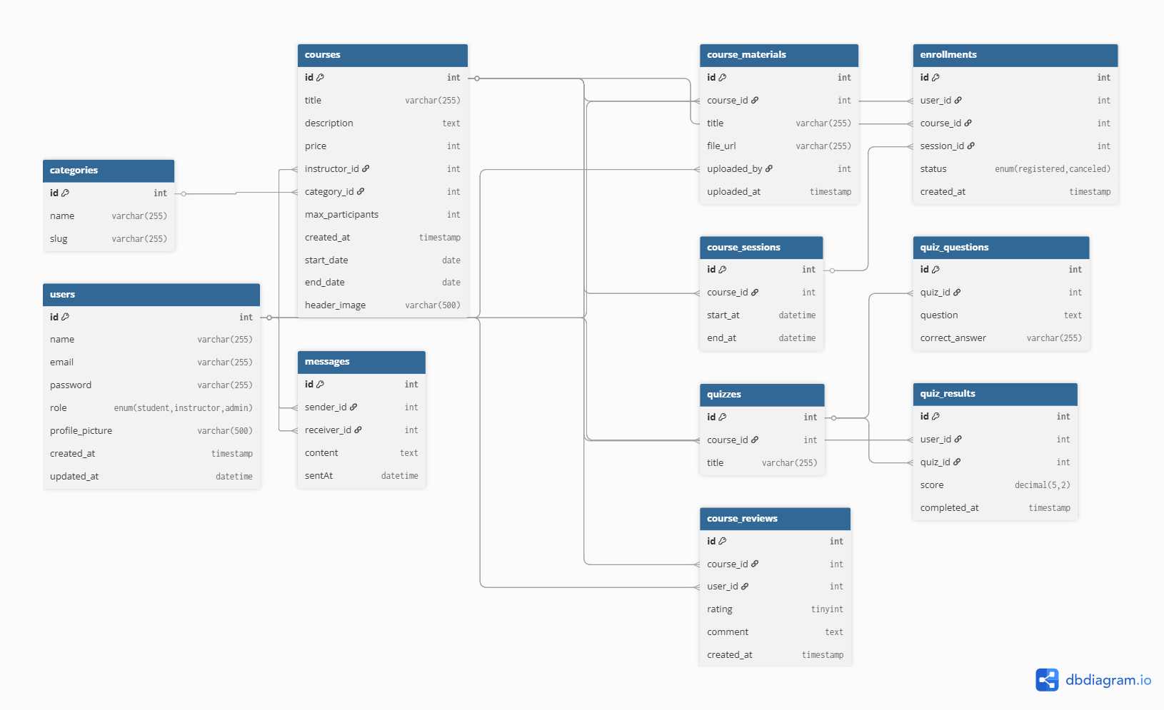
Database design – relations

Slide 12
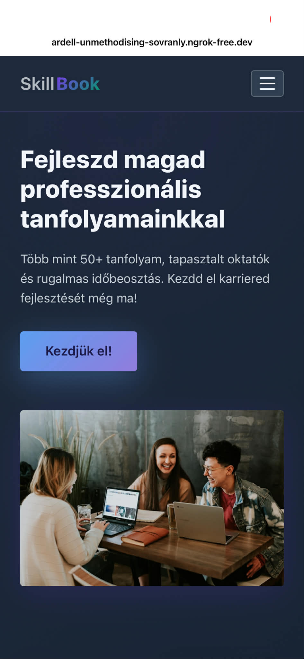
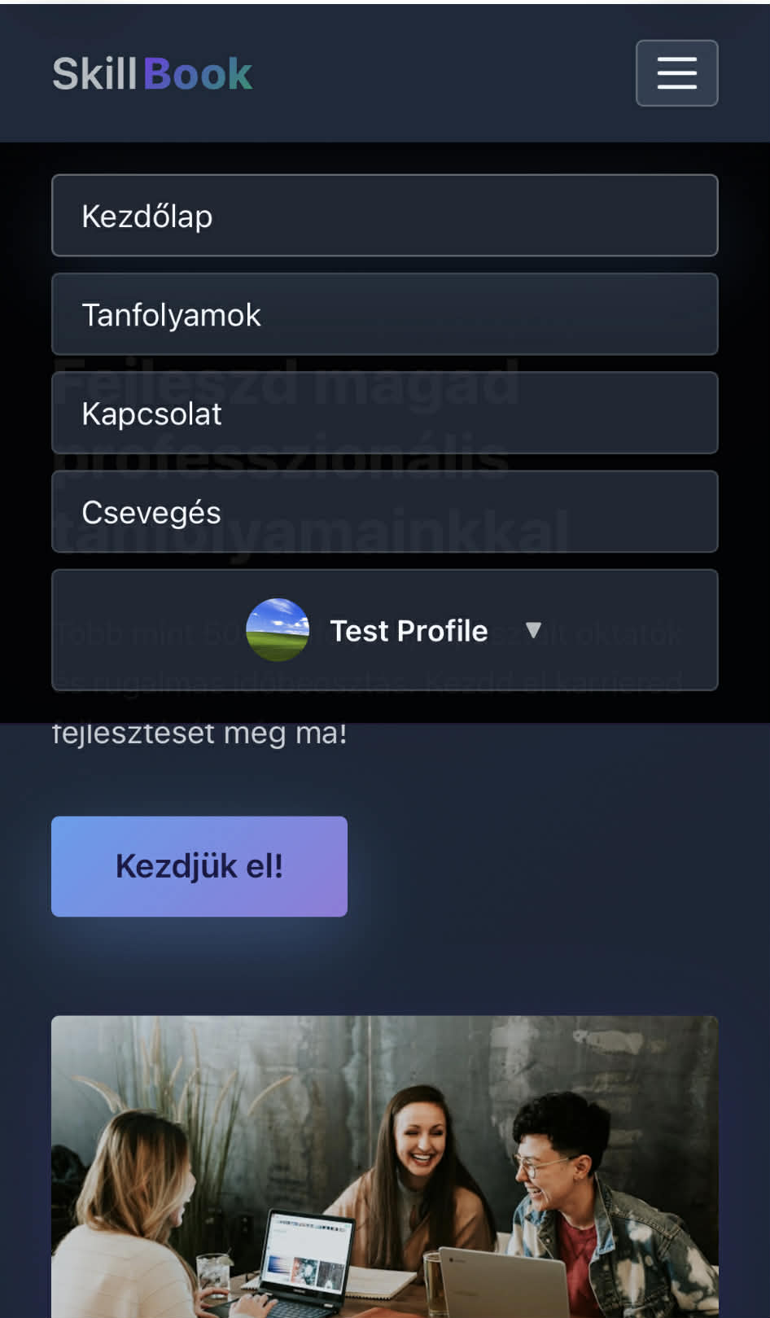
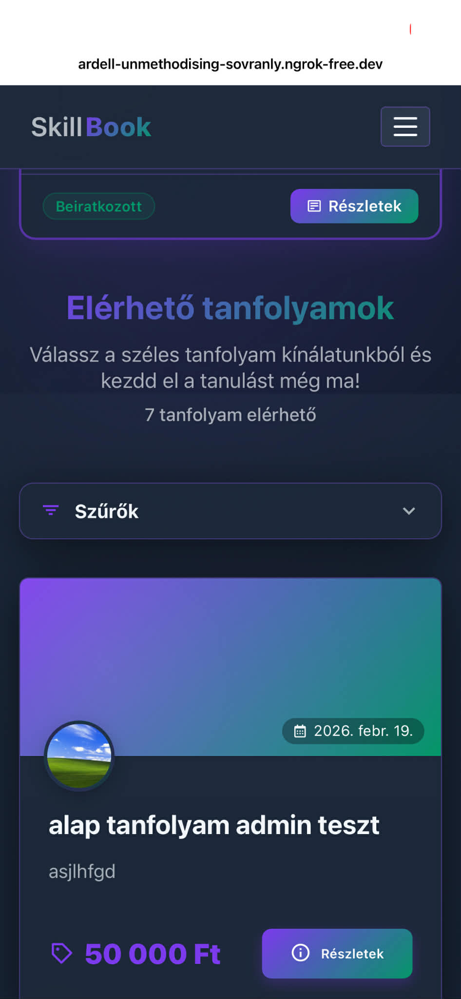
Responsive pages

Slide 13
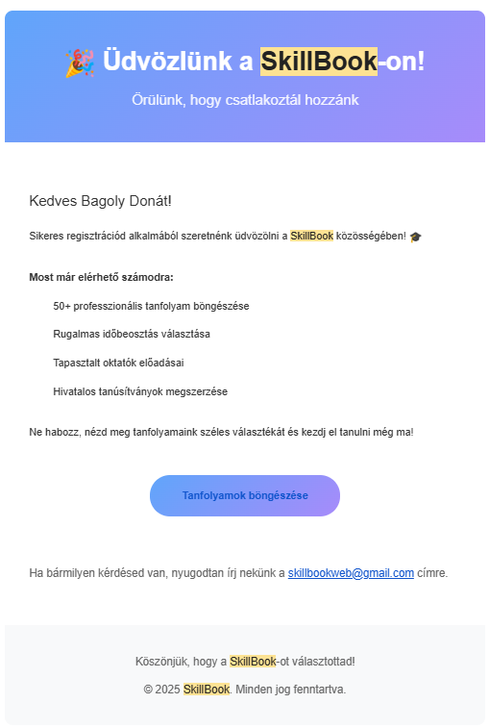
Email services
When you create an account, change: profile picture, password.. Etc... you get an email of it.

Slide 14
Technology stack
Frontend
Backend
Database
HTML / CSS
Java
MySQL
Semantic structure, custom properties, responsive grid
RESTful API, controllers for each entity
Relational database with foreign key constraints
JavaScript
JWT Authentication
Stored Procedures
Dynamic auth, API calls, DOM manipulation
Token-based auth with role-based access control
Stored procedures for CRUD
all business logic in DB
Bootstrap
File Upload API
phpMyAdmin
Responsibility, hamburger dropdown menus, mobile view.
Profile pictures, course headers, materials
Database management and administration interface

Slide 15
Why we built SkillBook
🎯
Real-World Need
🌍
Accessible Education
Many small schools and training centers still manage enrollments through phone calls, emails, or paper forms. SkillBook digitalizes this entirely.
Affordable access to quality learning should not be a privilege. Our platform makes finding and joining courses simple for everyone.
🏗️
Full-Stack Challenge
💡
Portfolio Quality
We wanted to build something that exercises every layer: database design, REST API, authentication, file handling, and a polished frontend UI.
A functional booking + LMS system demonstrates skills beyond a typical CRUD app. Including roles, sessions, and real-time features.

Slide 16
Future plans
❓ Quiz system
In the future, we would like to have quiz system integrated into the site fot the teachers.
🎓 Teacher qualifications
It would be nice if the teacher could only create a course if they had the necessary qualifications.

Slide 17
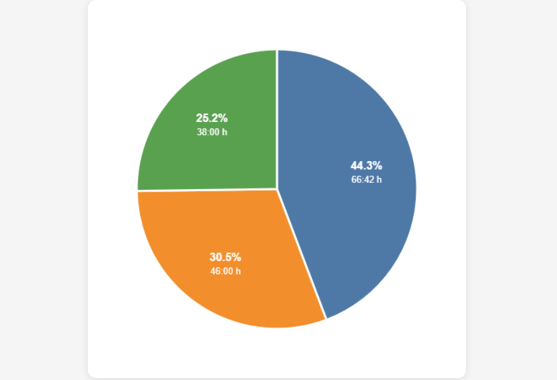

Jira work hours
We used jira for project management.

Slide 18
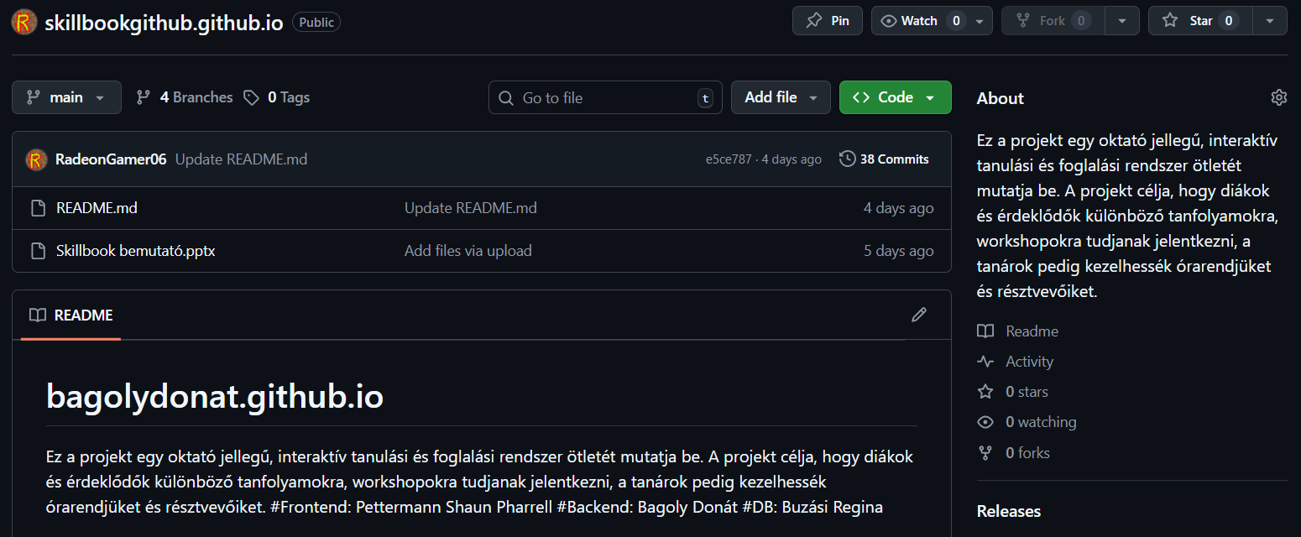
Github

Slide 19
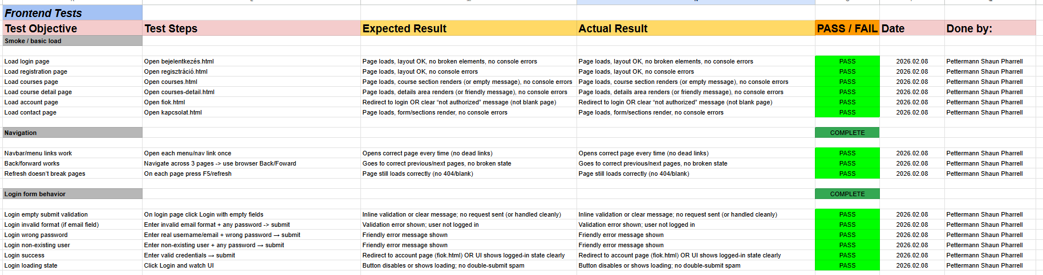
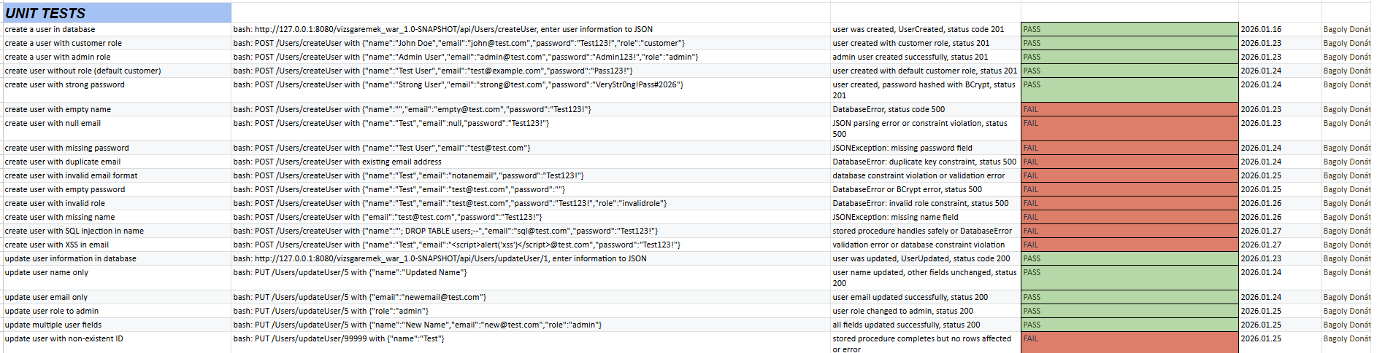
Some tests

Slide 20
📚 SkillBook
Try SkillBook
We built SkillBook to prove that modern, scalable,
and user friendly education platforms are achievable
with the right architecture and design.
✅ Problem solved: Unified learning, enrollment & communication
🏗️ Tech used: HTML · JS · JAVA · MySQL
📊 Database: 11 tables · 66 stored procedures
👥 Users supported: students · Teacher · Admins

