Slide 1

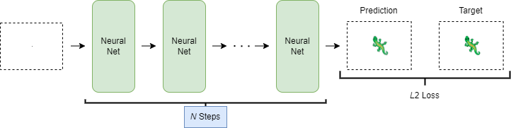
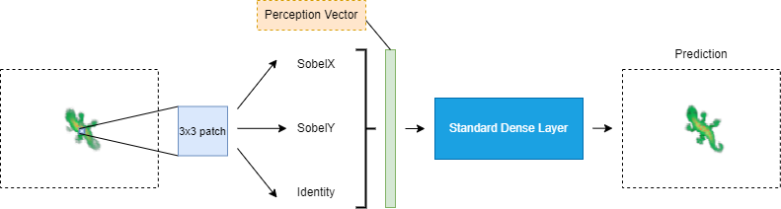
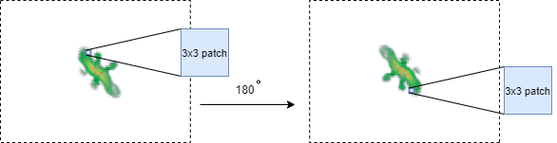
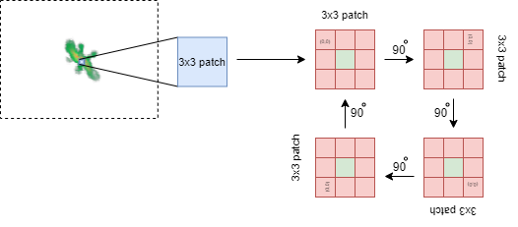
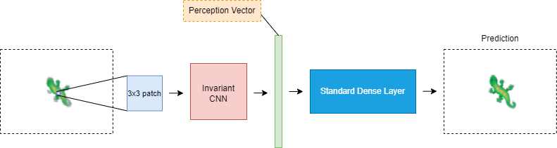
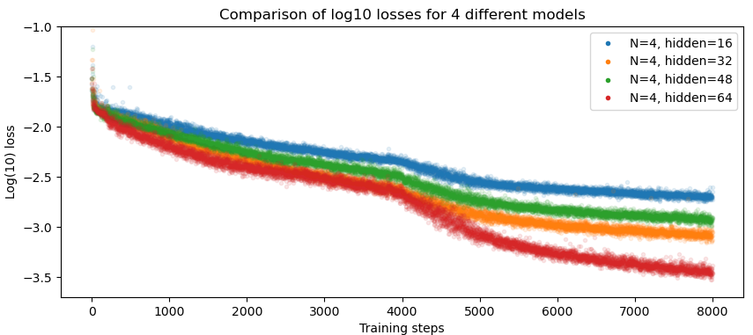
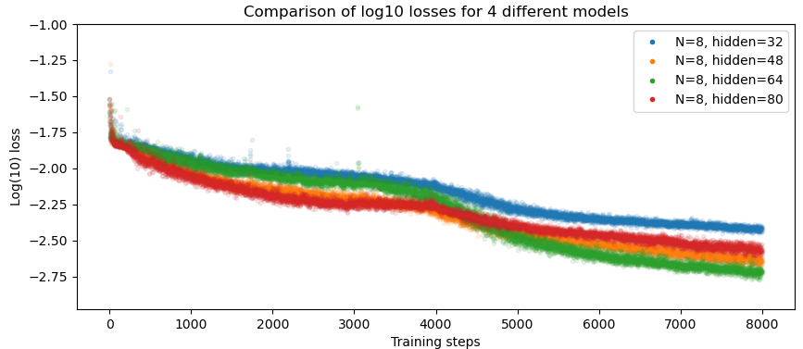
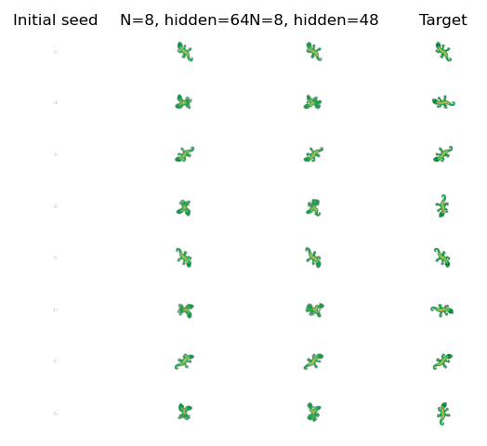
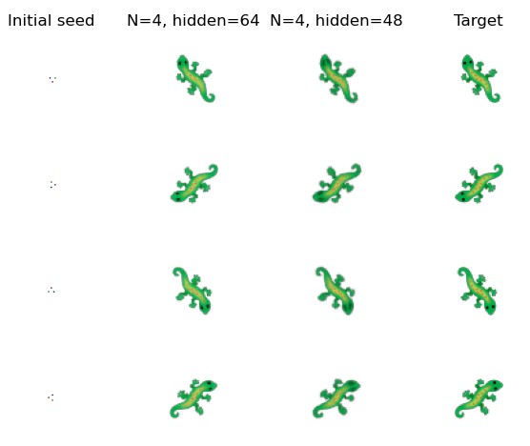
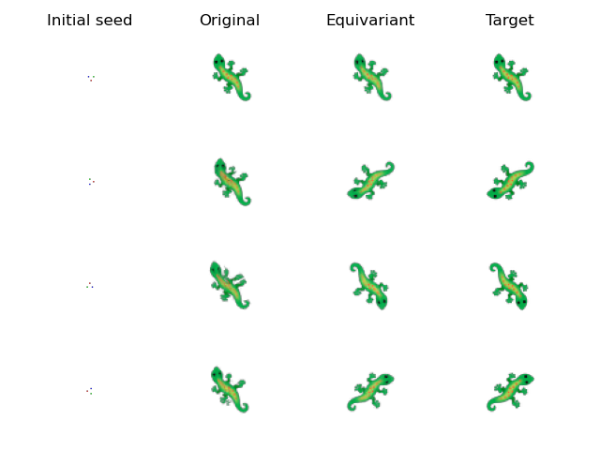





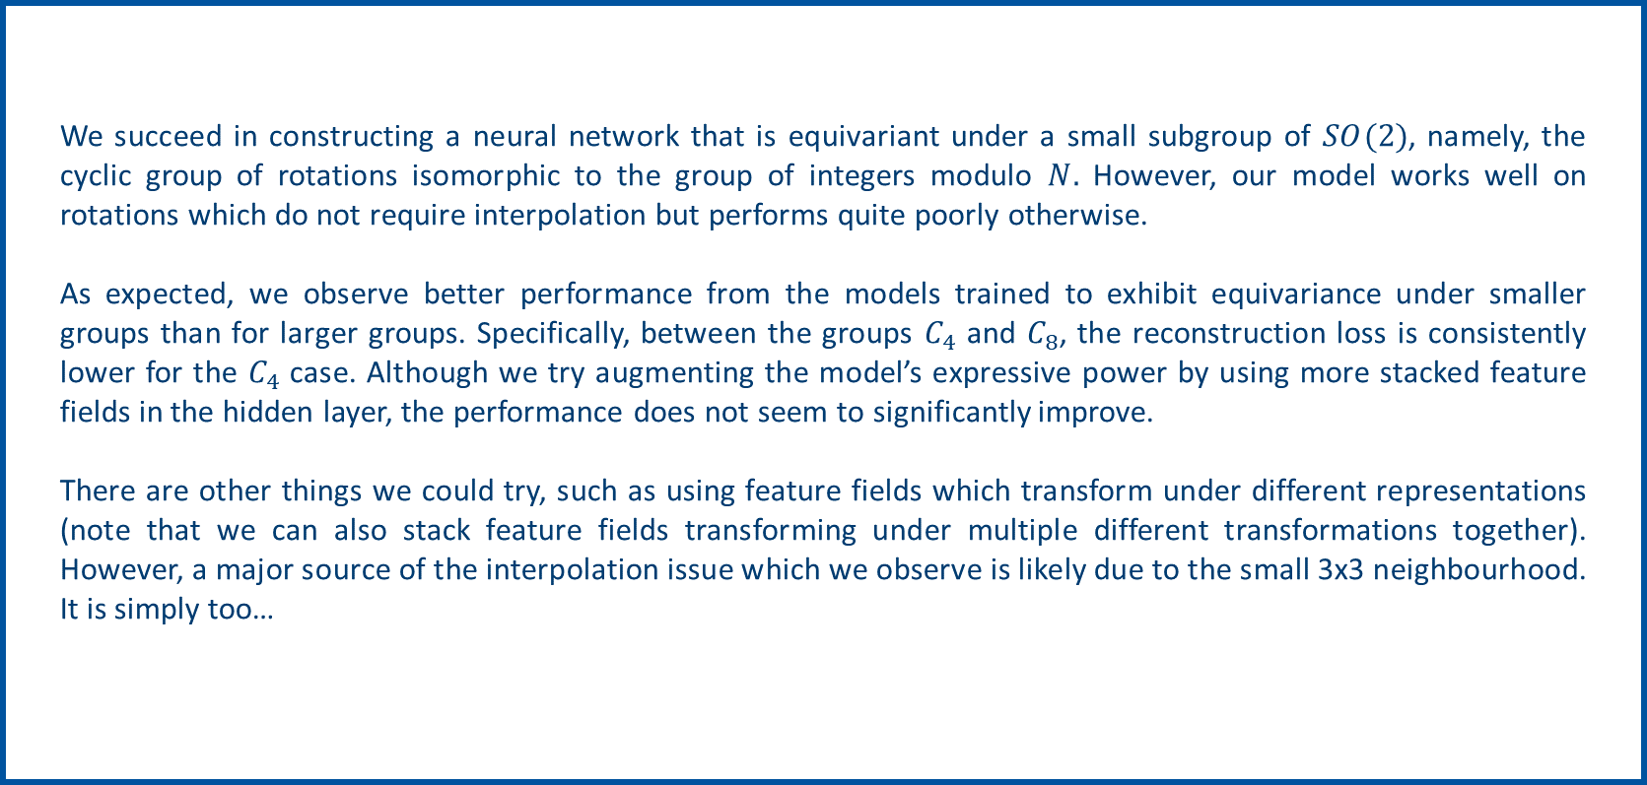

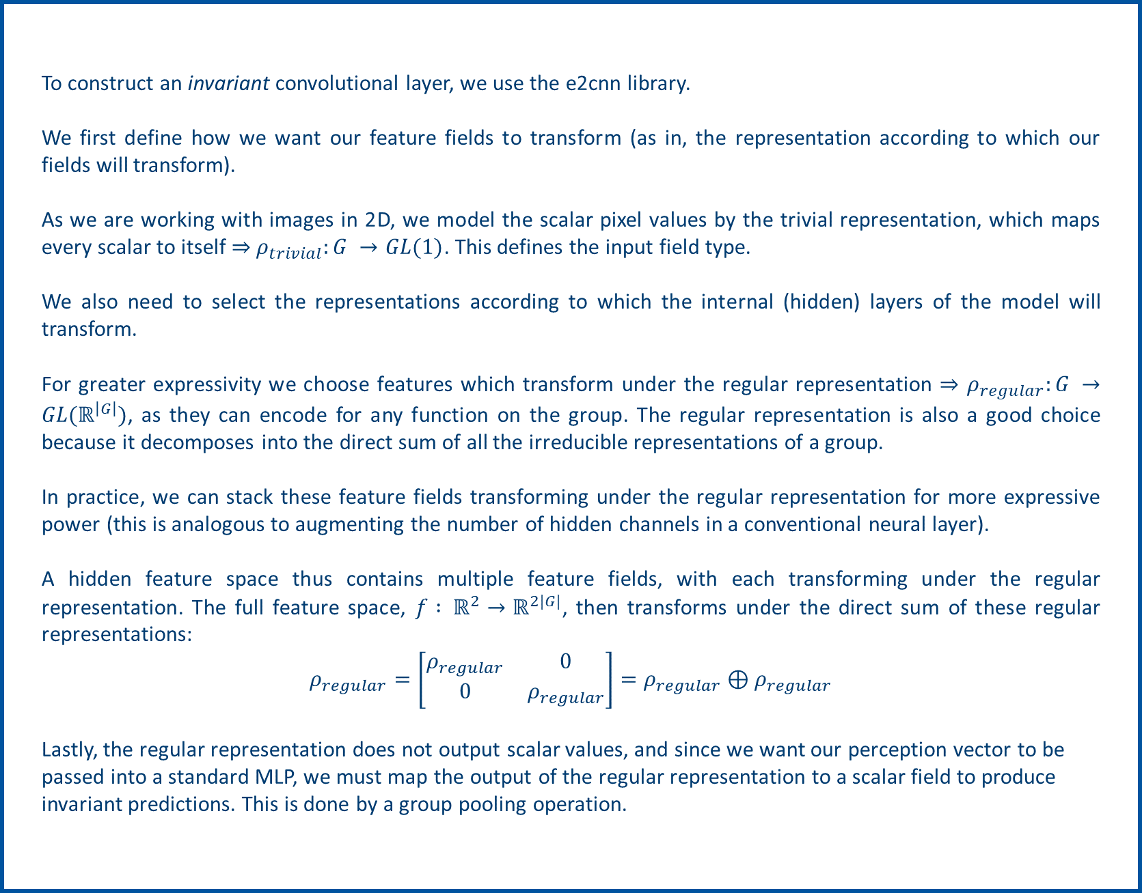
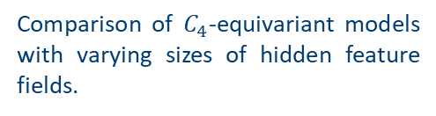
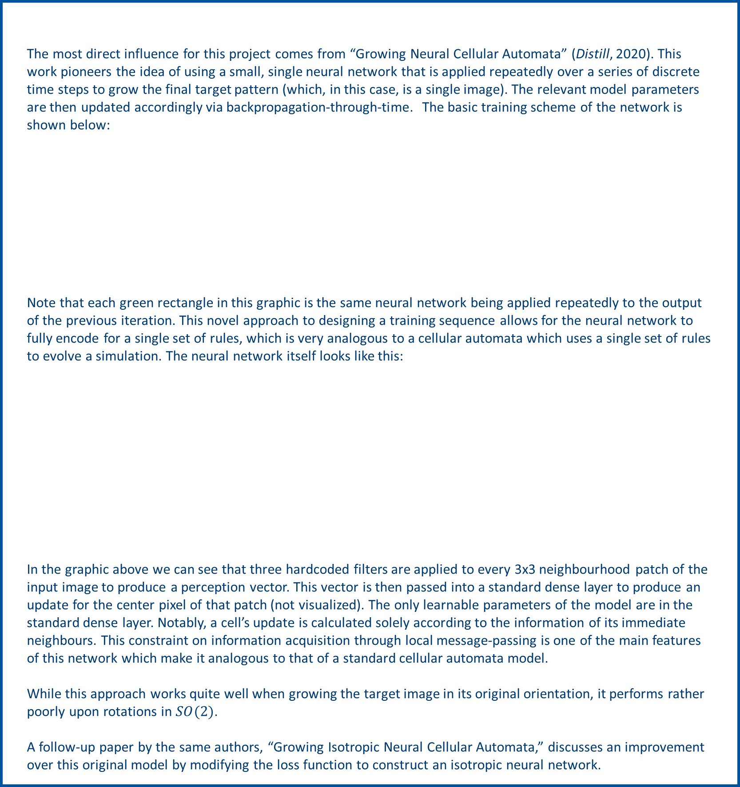

Equivariant Lizard
Simeon Radev
Introduction
Related Work
Cellular automata (CAs) are discrete models of computation which can use a relatively small set of pre-defined rules to simulate seemingly arbitrarily complex systems. Certain rules have even been shown to be Turing complete. Due to their inherent similarity to self-organizing, biological organisms, there is some significant potential for using these models of computation, or some adaptation of them, to model real-life, cellular growth.
As these systems modeled by CAs are often too complex to be predictable, it can be useful to have a way of learning the underlying rule which governs the system. As such, there is much interest in using neural networks to try and learn such rules.
Recent successes include a model which is capable of learning a set of “rules” to grow a target image starting from a single seed. In this work we explore some limitations of this initial model and present one possible extension of it to make it more analogous to real self-organizing organisms.
The most direct influence for this project comes from “Growing Neural Cellular Automata” (Distill, 2020). This work pioneers the idea of using a small, single neural network that is applied repeatedly over a series of discrete time steps to grow the final target pattern (which, in this case, is a single image). The relevant model parameters are then updated accordingly via backpropagation-through-time. The basic training scheme of the network is shown below:
Note that each green rectangle in this graphic is the same neural network being applied repeatedly to the output of the previous iteration. This novel approach to designing a training sequence allows for the neural network to fully encode for a single set of rules, which is very analogous to a cellular automata which uses a single set of rules to evolve a simulation. The neural network itself looks like this:
In the graphic above we can see that three hardcoded filters are applied to every 3x3 neighbourhood patch of the input image to produce a perception vector. This vector is then passed into a standard dense layer to produce an update for the center pixel of that patch (not visualized). The only learnable parameters of the model are in the standard dense layer. Notably, a cell’s update is calculated solely according to the information of its immediate neighbours. This constraint on information acquisition through local message-passing is one of the main features of this network which make it analogous to that of a standard cellular automata model.
While this approach works quite well when growing the target image in its original orientation, it performs rather poorly upon rotations in $SO(2)$.
A follow-up paper by the same authors, “Growing Isotropic Neural Cellular Automata,” discusses an improvement over this original model by modifying the loss function to construct an isotropic neural network.
Background
Our goal is to construct an equivariant neural network like the one described in the original 2020 publication, but which can grow the target image in other directions. Instead of using a loss function modification approach, we will use core concepts from group theory to construct a model that is equivariant to a subgroup of $SO$(2).
As a review, an equivariant model is one which produces an output that transforms according to the transformation of its input.
$$T_{out}\left[g\right] \left(F\left(x\right)\right)=F \left(T_{in}\left[g\right]\left(x\right)\right), ∀g∈G,$$
where $g$ is an element from the group $G,$ $T_{out}\left[g \right]$is the transformation of the model's output under the action of the group element $g∈G$, and $T_{in}\left[g\right]$ is, similarly, the transformation of the model's input under the action of that same group element. We select the cyclic group of rotations $C_{N}$, a subgroup of $SO\left(2\right)$, as the group under which to construct equivariant functions.
We construct equivariance by exploiting the local message passing of the model. Notice how, in the top right figure, any particular 3x3 neighbourhood patch rotates along with its target image.
Additionally, when a patch is rotated, the value of its center pixel remains unchanged. Any particular pixel is thus invariant to rotations of its 3x3 neighbourhood.
Therefore, we need only make the perception layer of the model invariant to rotations, by replacing the current, hardcoded filters with learnable layers invariant under the group $C_{N}.$
Methods
To construct an invariant convolutional layer, we use the e2cnn library.
We first define how we want our feature fields to transform (as in, the representation according to which our fields will transform).
As we are working with images in 2D, we model the scalar pixel values by the trivial representation, which maps every scalar to itself ⇒$ρ_{trivial}:G →GL(1)$. This defines the input field type.
We also need to select the representations according to which the internal (hidden) layers of the model will transform.
For greater expressivity we choose features which transform under the regular representation ⇒ $ρ_{regular}:G →GL(ℝ^{\left|G\right|})$, as they can encode for any function on the group. The regular representation is also a good choice because it decomposes into the direct sum of all the irreducible representations of a group.
In practice, we can stack these feature fields transforming under the regular representation for more expressive power (this is analogous to augmenting the number of hidden channels in a conventional neural layer).
A hidden feature space thus contains multiple feature fields, with each transforming under the regular representation. The full feature space, $f : ℝ^{2}→ℝ^{2|G|}$, then transforms under the direct sum of these regular representations:
$$ρ_{regular}=\left[\begin{matrix}ρ_{regular} & 0 \\ 0 & ρ_{regular}\end{matrix}\right]=ρ_{regular}⊕ρ_{regular}$$
Lastly, the regular representation does not output scalar values, and since we want our perception vector to be passed into a standard MLP, we must map the output of the regular representation to a scalar field to produce invariant predictions. This is done by a group pooling operation.
Experiments
Our experiments mainly involve training our model on larger feature fields, and on the cyclic group with varying cardinalities. Though our main interest is the cyclic group of 90-degree rotations, we also explore our model’s performance when trained to be equivariant under the cyclic group $C_{8}.$
We also visualize the outputs of some of these models to qualitatively compare their performance, and their ability to exhibit equivariant properties. In general, we see that the models trained under equivariance constraints succeed for rotations that do not invoke interpolation effects.
The plot on the left shows the training loss converging for our equivariant model under $C_{4}.$ We see that with more hidden feature fields the model performs better. This is expected as a larger hidden layer gives more expressive power to the model.
The plot on the right shows the plot of the training loss for our equivariant model under $C_{8}$. We can see that although the various models seem to converge, they all perform worse than the equivariant models under $C_{4}$, suggesting that the current architecture is not expressive enough to make the model equivariant under larger group elements.
Conclusion
We succeed in constructing a neural network that is equivariant under a small subgroup of $SO(2)$, namely, the cyclic group of rotations isomorphic to the group of integers modulo $N.$ However, our model works well on rotations which do not require interpolation but performs quite poorly otherwise.
As expected, we observe better performance from the models trained to exhibit equivariance under smaller groups than for larger groups. Specifically, between the groups $C_{4}$ and $C_{8}$, the reconstruction loss is consistently lower for the $C_{4}$ case. Although we try augmenting the model’s expressive power by using more stacked feature fields in the hidden layer, the performance does not seem to significantly improve.
There are other things we could try, such as using feature fields which transform under different representations (note that we can also stack feature fields transforming under multiple different transformations together). However, a major source of the interpolation issue which we observe is likely due to the small 3x3 neighbourhood. It is simply too…
Comparison of $C_{4}$-equivariant models with varying sizes of hidden feature fields.
$C_{4}$-equivariant model performance on ${90}^{°}$ rotations vs original model.
References
In the above figure we can see the performance of several models trained to be equivariant under $C_{8}.$ We can see that the model is able to successfully rotate the target at multiples of 90 degrees, however it struggles to do so successfully at angles that would require pixel interpolation.
On the two figures to the right, we see that the $C_{4}$ equivariant networks successfully rotate the target upon a rotation of their input, whereas the original model fails (as expected).
S Wolfram, “Theory and Applications of Cellular Automata.” World Scientific, 1986.
M Cook, “A Concrete View of Rule 110 Computation.” arXiv, 2009.
A Mordvintsev, et al. “Growing Isotropic Neural Cellular Automata.” arXiv, 2022.
J Springer, G Kenyon, “It's Hard For Neural Networks To Learn The Game Of Life.” International Joint Conference on Neural Networks, 2021.
N H Wolff, J A Hertz, “Learning Cellular Automaton Dynamics with Neural Networks.” NeurIPS, 1992. D Grattarola, et al. “Learning Graph Cellular Automata.” NeurIPS, 2021.
R Palm, et al. “Variational Neural Cellular Automata.” ICLR, 2022.
M Weiler, G Cesa. “General E(2)-Equivariant Steerable CNNs.” NeurIPS, 2019.

