Slide 1
Silent Voice
Review 3: explainability, GAN augmentation and live-use findings
Radha Krishna | CB.SC.U4CSE23134 | 23CSE461 NNDL | Group 1 (Team 1) | 15-Oct-2026

Slide 2
Where we are: BiLSTM vs 1D CNN
94.55%
91.74%
0.74 ms
737 K
1D CNN test accuracy
BiLSTM test accuracy
CNN latency (BiLSTM 4.12)
CNN params (BiLSTM 2.67 M)
261 ISL word classes, 4,276 clips from INCLUDE; 642 held-out test clips (seed 42, stratified by class)
Input: MediaPipe Holistic landmarks, 60 frames x 225 values, not pixels
Chosen model: 1D CNN, higher accuracy and about 5x faster
Teammate's Transformer is reported separately

Slide 3
Base paper: INCLUDE (ACM Multimedia 2020)
Sridhar et al., "INCLUDE: A Large Scale Dataset for Indian Sign Language Recognition", doi:10.1145/3394171.3413528
Provides the 263-class ISL word videos (IIT Bombay / AI4Bharat, CC BY-NC-SA); we use 261 classes
Their baseline works on video frames; ours works on landmark skeletons, which makes models small and fast
Our contribution: BiLSTM vs 1D CNN comparison, ablation, robustness / explainability audit, a working local web app
Source data stays with its owners; only derived landmark tensors are shared.

Slide 4
Explainability: what does the CNN look at?
Hiding body pose hurts most (94.5 to 16.4%): the model leans heavily on pose position
Right hand matters more than left (36.6% vs 79.3%)
Frame-by-frame occlusion shows no single dead zone; the whole sign carries information
This dependence on pose explains the camera-position failure found later

Slide 5
GAN augmentation: tried, did not help
94.08%
93.30%
-0.78 pp
CNN, real data only
CNN, real + GAN
change in test accuracy
2,871 synthetic clips generated (class-conditional GAN, seed 42); training set 2,993 to 5,864 clips
The classifier recognised the intended class in only 17% of synthetic clips: they are not realistic signs yet
Synthetic motion changes about 2.2x faster frame to frame than real signs
Conclusion: report honestly; we do not ship GAN data. The 94.08% here is a separate retrain, not the 94.55% headline model

Slide 6
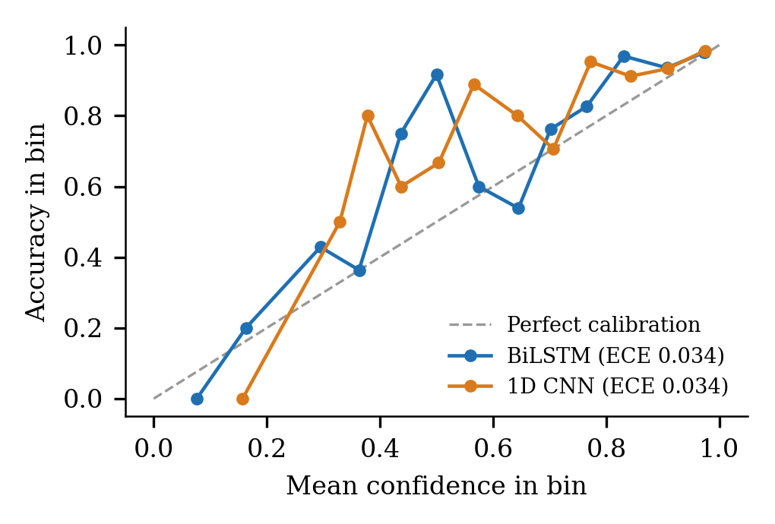
Calibration: can we trust the confidence?
CNN expected calibration error 0.034; temperature scaling (T = 0.82) gives 0.024
Wrong predictions average 0.70 confidence vs 0.92 when right
Keeping only predictions >= 0.9 confidence: 98.0% accuracy on 77% of clips
The live app uses a 0.5 confidence floor and shows nothing below it

Slide 7
Live-use findings: why webcam detection failed
Simulated on the 642 test clips; not yet measured with live webcam users
Cause | Before | Fixed + retrained | Fix
Camera 2.5x closer, lower | 1.4% | 96.0% | Move pose to the dataset's signer position
2.5 s sign in 5 s live buffer | 61.7% | 95.0% | Cut the stream into signs by hand visibility
Left-handed signer | 18.5% | 96.0% | Settings toggle mirrors the input
CNN retrained on position-normalised data: 95.95% on the same 642 test clips (research model 94.55%)
BiLSTM not retrained yet (61.7% through the live path). Users must lower their hands between words

Slide 8
Ablation study (1D CNN, 8 epochs, 1 seed)
Right hand and pose carry most of the signal
Left hand and z add little (may be noise: one seed only)
Short 8-epoch runs give 75%, below the 94.55% full-length model: read the ranking, not the level
Not run: augmentation, architecture, temporal and data-size groups

Slide 9
AI tools used, limits and next steps
Tools: MediaPipe Holistic (landmarks), PyTorch (training), FastAPI + React (app); Claude (Anthropic) assisted with code, tests and documents, with every reported number reproduced from the repository's scripts and logs
Limits: split is by class, not signer; 261 words only; no facial expression; live accuracy with real webcam users not yet measured
Next: run the webcam test plan (MT-17 to MT-20), retrain the BiLSTM on position-normalised data, publish the dataset on IEEE DataPort, signer-disjoint evaluation

