Slide 1
Smart Traffic Management System
A multi-agent AI system: Max-Pressure signals, A* routing, ambulance preemption, negotiated bus priority, hill-climbing tuning
M1
P.M. Radha Krishna (CB.SC.U4CSE23134) Environment & Simulation
M2
Member 2 Intersection Agent
M3
Member 3 Vehicle Agent & Search
M4
Member 4 Priority Vehicles
M5
Member 5 Coordinator & Testing
AI Case Study | Review 1 & Review 2 | Amrita Vishwa Vidyapeetham, Coimbatore
Notes:
Presenter: M1. Introduce the team and say that each member owns one agent or algorithm end to end: code, scenario, tests.

Slide 2
Why fixed-time signals fail
TEAM
Three problems, each solved by a different agent
Whole team
Static timing
Emergency delay
Information lag
The same green goes to an empty side street and to a rush-hour arterial.
Solved by: Intersection agents (Max-Pressure)
Ambulances lose time at every red light on their way.
Solved by: Ambulance preemption protocol
Drivers find out about an accident only when they reach the queue.
Solved by: Coordinator broadcasts + A* re-planning
-47.5%
-29.6%
96 s
average wait vs fixed-time (S1)
ambulance travel time, 0 s at red (S3)
vs 145 s travel past an accident (S4)
Notes:
Presenter: M1. State the three problems and the headline numbers. Every number comes from results/results.json and can be regenerated live.

Slide 3
Five agents, five owners
TEAM
Each member owns an agent, its algorithm, its scenario and its tests
Whole team
M1
Environment & simulator
BPR travel time, saturation flow, N x N grids
S8 scalability, visual demo
M2
Intersection agent
Max-Pressure + anti-starvation, green-wave
S1, S2
M3
Vehicle agent
A* (vs BFS, UCS, Greedy, W-A*), beliefs
S4, S7, A* trace
M4
Ambulance + Bus agents
Preemption; negotiated priority
S3, S5
M5
Coordinator (TMC)
Hill climbing, incident broadcast, protocol
S6, 43-test suite
Notes:
Presenter: M1. Walk the table. Each row maps to a module under src/ and to named tests in tests/.

Slide 4
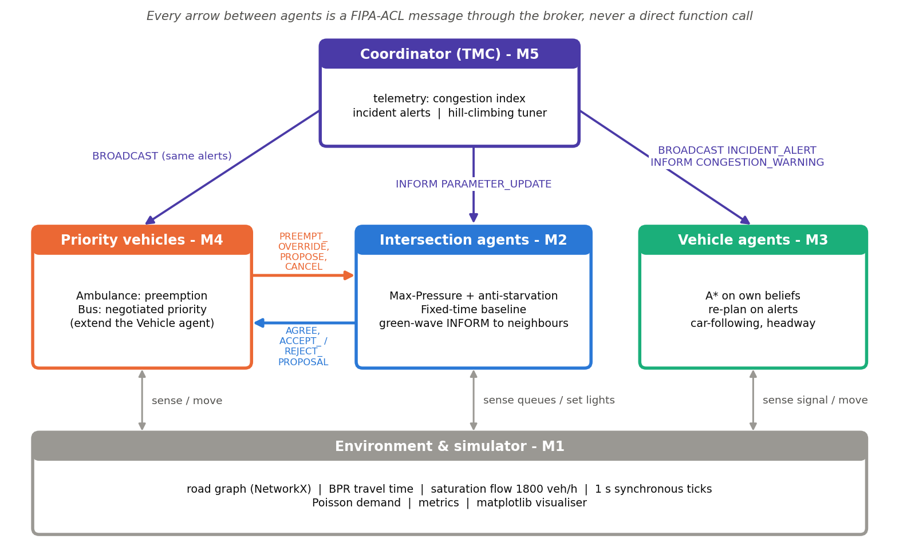
System architecture
TEAM
Agents interact only through FIPA-ACL messages via the broker
Whole team
Notes:
Presenter: M5. Point out that no agent calls another agent's code. Signals are set by intersections only; the coordinator informs and tunes but never switches a light.

Slide 5
PEAS formulation
TEAM
Review 1: what each agent optimises, senses and controls
Whole team
Agent | Performance | Environment | Actuators | Sensors
Intersection | Min delay, max throughput, no starvation, 3 s yellow | 4-leg junction, 8 roads, random arrivals | Phase NS / EW / yellow; AGREE, ACCEPT, REJECT | Queue counts on 8 roads; inbox
Vehicle | Min travel time, min stops | Road graph, signals, cars ahead | Accelerate / stop / cross; choose route | Speed, signal, gap; TMC alerts
Ambulance | Min response time, 0 s at red | Roads with background traffic | Drive 60 km/h; PREEMPT, CANCEL | Route look-ahead ETA; AGREE
Bus | Min passenger delay, limited harm | Mixed traffic; junctions may refuse | PROPOSE, CANCEL | Next-junction ETA; replies
Coordinator | Network delay; delay on unseen traffic | Whole network (aggregate) | BROADCAST alerts; PARAMETER_UPDATE | All road densities; incidents
Notes:
Each member presents their own agent's row: M2 intersection, M3 vehicle, M4 ambulance and bus, M5 coordinator.

Slide 6
Environment & agent analysis
TEAM
Review 1: task-environment properties and agent architectures
Whole team
Partially observable
each agent sees only local roads + messages
Multi-agent
cooperative junctions, competing vehicles
Agent | Architecture
Intersection | Utility-based, with internal state
Vehicle | Goal-based, model-based (search)
Ambulance | Goal-based + communication
Bus | Utility-based negotiator
Coordinator | Learning agent (critic = simulation)
Stochastic
Poisson arrivals, random incidents
Sequential
a green now changes every later queue
Dynamic
queues grow while agents think
Continuous
positions and speeds; time in 1 s ticks
Known physics
roads and BPR known; demand not
Notes:
Presenter: M1 for the environment properties, M5 for the architecture table. Key line: partial observability is modelled explicitly, since vehicles plan on their own beliefs.

Slide 7
Route search: A* over each vehicle's beliefs
M3
Review 1: algorithmic modelling & search strategy
Vehicle & Search
State-space formulation
Admissible: h(n) <= h*(n)
State: junction the vehicle is at
Actions: drive any road it believes is open
Goal test: s = destination
Step cost: BPR travel time t0 (1 + 0.15 (V/C)^4)
Heuristic: h(n) = straight-line distance / v_max
Evaluation: f(n) = g(n) + h(n)
No route is shorter than the straight line, and no road is faster than v_max, so h never over-estimates. Congestion only raises true cost. (UT-01)
Consistent: h(u) <= c(u,v) + h(v)
Triangle inequality plus c(u,v) >= length / v_max. So f never decreases, the first goal popped is optimal, and nothing is re-expanded. (UT-02)
Notes:
Presenter: M3. Emphasise that the heuristic stays admissible under congestion, and that vehicles search on beliefs, which is why broadcasts matter.

Slide 8
A* step by step
M3
3x3 congested grid, INT_10->INT_11 closed, trip W0 -> E2 (python run_simulation.py --astar-trace)
Vehicle & Search
Step | Expand | g(n) s | h(n) s | f = g + h
1 | W0 | 0.0 | 64.44 | 64.44
2 | INT_00 | 14.41 | 51.95 | 66.37
3 | INT_01 | 28.82 | 40.76 | 69.58
4 | INT_10 | 28.96 | 45.57 | 74.52
5 | INT_02 | 43.23 | 32.22 | 75.45
6 | INT_11 | 44.99 | 32.22 | 77.21
7 | INT_12 | 57.64 | 20.38 | 78.02
8 | INT_22 | 72.05 | 14.41 | 86.46
9 | E2 | 86.46 | 0.0 | 86.46
What to notice
f never decreases: 64.4 -> 86.5 (consistency)
High-h nodes (N0, W1) are never expanded
A*: 9 expansions | UCS: 20 expansions
Same optimal cost: 86.46 s
Route: W0 > INT_00 > INT_01 > INT_02 > INT_12 > INT_22 > E2
Notes:
Presenter: M3. Run the command live if time permits. Point at the f column and explain why it is monotone.

Slide 9
Why A*? Five strategies compared
M3
S7: 6x6 (60 nodes, 168 roads), 200 random trips, one closed road
Vehicle & Search
Notes:
Presenter: M3. A* is optimal in 100% of trips with 14.1 expansions against 36 for UCS. Greedy is cheap but optimal only 51.5% of the time. Manhattan is tighter but only valid because roads are axis-aligned.

Slide 10
Max-Pressure signal control
M2
Review 1: decentralised; each junction uses only its own 8 queues
Intersection
INT_00 movement | Q_in | Q_out | max(0, w)
N0 -> south | 8 | 2 | 6
S -> N0 (north) | 3 | 5 | 0
W0 -> east | 2 | 1 | 1
E -> W0 (west) | 4 | 0 | 4
Algorithm (every second)
Movement pressure: w = Q_in - Q_out
Phase pressure: P = sum of max(0, w)
Anti-starvation: S = P + 0.5 x red-time
After 5 s minimum green:
- red side empty -> keep green
- green >= 30 s -> switch
- S(red) > S(green) + 1 -> switch
Every switch goes through a 3 s YELLOW
NS green for 12 s:
S(NS) = 6 + 0.5 x 0 = 6
S(EW) = 5 + 0.5 x 12 = 11
11 > 6 + 1 -> YELLOW, then EW green
Notes:
Presenter: M2. Without the starvation term, pure pressure would keep NS green (6 > 5). The term is what serves the waiting side.

Slide 11
Results: signals
M2
S1 2x2 grid, 10 seeds | S2 rush hour, 87% of traffic N-S
Intersection
-47.5% wait vs fixed-time. 14 of 108 E-W cars never served without anti-starvation; 0 with it.
Notes:
Presenter: M2. Honest note: the green-wave hand-off slightly hurts on random grid demand (8.1 to 9.3 s), so it is optional; it is kept because it demonstrates peer-to-peer INFORM messages (IT-07).

Slide 12
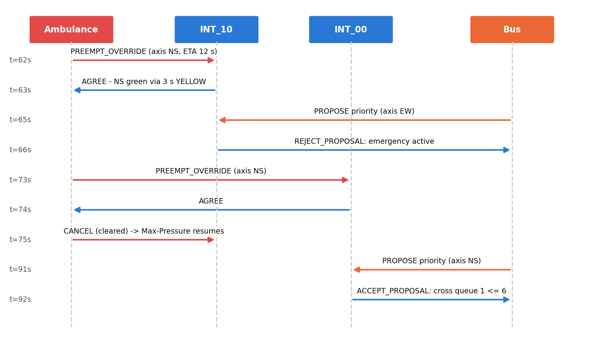
Multi-agent interaction, as it happened
M4
Review 2: messages recorded in the demo run (python run_simulation.py --protocol)
Priority vehicles
Two protocols
Ambulance: PREEMPT_OVERRIDE -> AGREE -> CANCEL. Absolute, but always via yellow.
Bus: PROPOSE -> ACCEPT or REJECT. The junction decides; refused here because the ambulance holds INT_10.
Notes:
Presenter: M4. This conflict was not scripted: the bus happened to propose while the ambulance held INT_10, and the intersection rejected it with a reason.

Slide 13
Results: priority vehicles
M4
S3 same controller, preemption off vs on | S5 bus priority, 4 buses x 40 passengers
Priority vehicles
Bus priority | Light cross | Heavy cross
Bus travel (s) | 63.8 -> 58.0 | 63.3 -> 59.5
Car wait (s) | 2.41 -> 4.76 | 2.87 -> 4.12
Accepted / rejected | 64 / 0 | 43 / 21
Net passenger-s saved | 807 | 453
Ambulance 29.6% faster, 0 s at red, other cars -0.12 s.
Bus priority: cars wait longer, but more people get through sooner. The junction refuses when the cross street is long.
Notes:
Presenter: M4. Stress that both runs in S3 use the same Max-Pressure controller. The old version compared against fixed-time, which mixed two effects.

Slide 14
Coordinator: broadcasts and hill climbing
M5
S4 accident on INT_00->INT_01 | S6 tuning signal parameters
Coordinator
Closure: static routing strands 12 / 12 cars; A* re-routing delivers 100%. Tuning: unseen traffic 8.65 s -> 6.96 s; best of 3 restarts 6.85 s; 62 simulations.
Notes:
Presenter: M5. Restart 1 stops at a worse local optimum (8.37 s), which is why restarts are needed. The random restart 2 started at the best point (6.85 s). Tuned values were validated on seeds never used in the search.

Slide 15
Tools, setup and code structure
M1
Review 2: tool/package selection & code structure
Environment
Tool | Why
Python 3.10+ | Readable; standard in AI courses
NetworkX | Graph storage; search written by hand
rich | Readable live console demo
HTML demo page | Route demo, offline
unittest | 43 tests, no extra install
Not SUMO / Mesa | Would hide the models we need to explain
pip install -r requirements.txt
python run_simulation.py --all
python tests/run_tests.py
python generate_results.py
src/agents: 6 agent classes
src/algorithms: A*, Max-Pressure, hill climbing
src/environment: roads, grids, simulator
src/protocols: FIPA-ACL broker
tests: 23 unit, 9 integration, 9 system
Notes:
Presenter: M1. We deliberately wrote the broker and search ourselves so every step can be shown and tested.

Slide 16
Scalability: 2x2 to 8x8
M1
S8: demand grows with grid size; every vehicle runs to its destination
Environment
461
agents on the 8x8 grid (64 junctions)
1.44 ms
per simulated second at 8x8: grows linearly
-42..47%
wait reduction at every size
Notes:
Presenter: M1. Each junction decides in O(1) from local data, so adding junctions adds no work to existing ones. A* runs inside each vehicle.

Slide 17
Testing
M5
Review 2: demo quality & testing scenarios
Coordinator
43/43
11 defects found & fixed
Reason() ran twice per tick: timers at 2x
Departure times ignored
Ambulance baseline used a different controller
Preemption skipped yellow (unsafe)
Green-wave messages ignored
Vehicles omniscient about incidents
... each has a regression test
automated tests pass
Level | Checks | #
Unit | A* admissible/consistent/optimal, Max-Pressure rules, BPR, broker | 23
Integration | Protocols; safety: never green to green, yellow >= 3 s | 9
System | Each scenario's acceptance criterion | 9
Notes:
Presenter: M5. Mention that IT-05 failed during this cycle and exposed a real bug: vehicles waiting to depart ignored alerts. The fix is pre-trip listening.

Slide 18
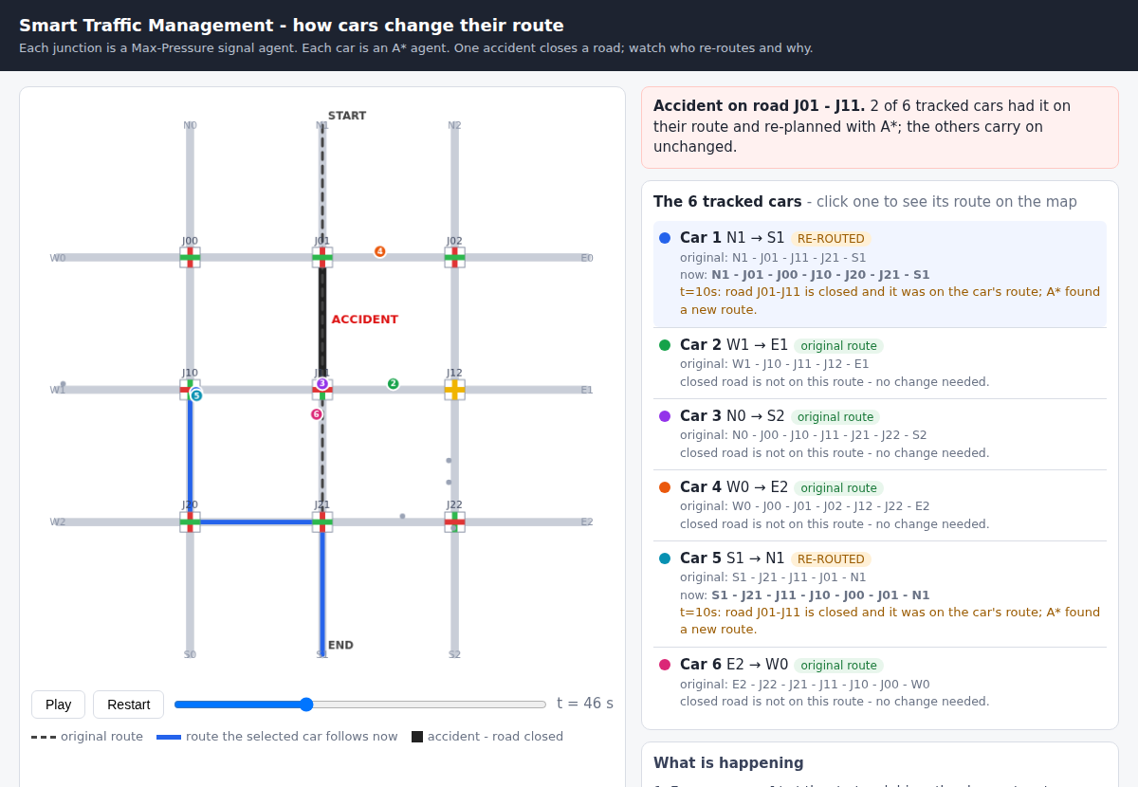
Live demo
M1
What we will run in front of you
Environment
1
run_demo.py
Opens the page: 6 cars, 1 accident, who re-routes
2
--protocol
Message log (ambulance, bus, incident)
3
--scenario 1..8
Result tables for every experiment
4
--astar-trace
A* expansion table
5
tests/run_tests.py
43 tests in about 25 s
Notes:
Presenter: M1 drives the laptop; each owner narrates their part. Backup: results/figures/demo_2_after.png if the laptop display fails.

Slide 19
Limitations and next steps
TEAM
What we did not model, and what we would add
Whole team
Limitations (honest)
Ideas to extend
Two-phase signals, through movements only
Single-lane roads
Synthetic grid demand, not calibrated
Messages never delayed or lost
Green-wave helps corridors only
Bus priority doubles cross-street car wait
Q-learning junctions vs Max-Pressure
Contract-Net bidding between ambulances
Pedestrian agents and safe min-green
OpenStreetMap import (Coimbatore)
Message loss / delay robustness
Simulated annealing vs hill climbing
Notes:
Whole team. Saying the limitations first makes the positive results more credible.

Slide 20
Decentralised agents, measurable gains
-47.5%
-29.6%
100%
43/43
average wait
ambulance time
optimal A* routes
tests pass
Every number is regenerated by python generate_results.py and checked by an automated test.
Questions?
Notes:
Whole team. For Q&A, each owner answers questions on their module; the viva bank is in the report's Appendix A.

