Slide 1
Smart Traffic Management System
A multi-agent AI system: Max-Pressure signals, A* routing, ambulance preemption, accident re-routing, hill-climbing tuning
M1
P.M. Radha Krishna (CB.SC.U4CSE23134) Task environment & simulation
M2
Member 2 Junction agent: Max-Pressure
M3
Member 3 Vehicle agent: A* search
M4
Member 4 Ambulance agent & FIPA-ACL protocol
M5
Member 5 Traffic centre: hill climbing; testing
AI Case Study | Review 1 & Review 2 | Amrita Vishwa Vidyapeetham, Coimbatore
Notes:
Presenter: M1. Introduce the team and say that each member owns one agent or algorithm end to end: code, scenario, tests.

Slide 2
Why fixed-time signals fail
TEAM
Three problems, each solved by a different agent
Whole team
Static timing
Emergency delay
Information lag
The same green goes to an empty side street and to a rush-hour arterial.
Solved by: Intersection agents (Max-Pressure)
Ambulances lose time at every red light on their way.
Solved by: Ambulance preemption protocol
Drivers find out about an accident only when they reach the queue.
Solved by: Coordinator broadcasts + A* re-planning
-47.5%
-29.6%
96 s
average wait vs fixed-time (S1)
ambulance travel time, 0 s at red (S3)
vs 145 s travel past an accident (S4)
Notes:
Presenter: M1. State the three problems and the headline numbers. Every number comes from results/results.json and can be regenerated live.

Slide 3
Five components, five owners
TEAM
Three algorithms: A*, Max-Pressure, hill climbing. Each member owns code, tests, experiment and slides
Whole team
M1
Task environment
PEAS, environment properties, BPR, Poisson demand
S8 scalability
M2
Junction agent
Max-Pressure + anti-starvation
S1, S2
M3
Vehicle agent
A* search, beliefs, re-planning
S4, S7, A* trace
M4
Ambulance agent
FIPA-ACL preemption protocol
S3, S5
M5
Traffic centre
Hill climbing with random restarts
S6, 47-test suite
Notes:
Presenter: M1. Walk the table. Each row maps to a module under stms/ and to named tests in tests/.

Slide 4
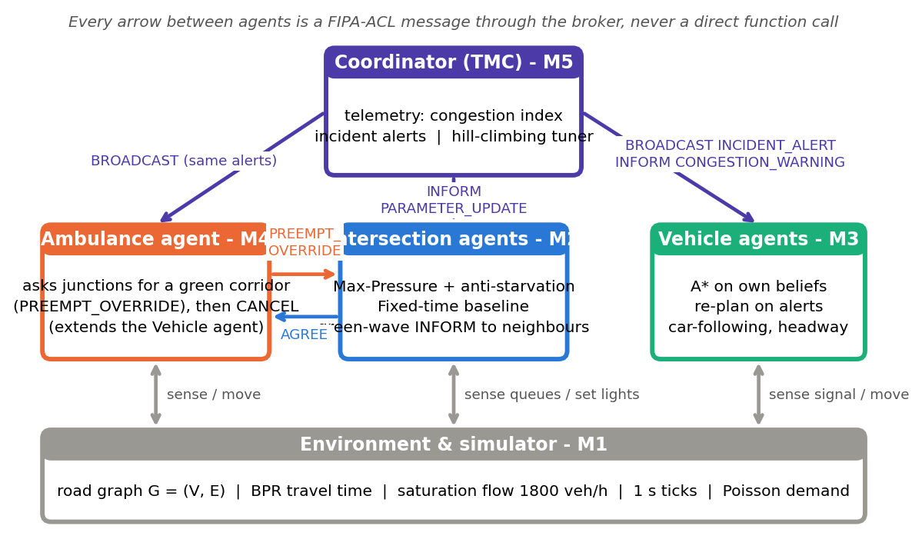
System architecture
TEAM
Agents interact only through FIPA-ACL messages via the broker
Whole team
Notes:
Presenter: M5. Point out that no agent calls another agent's code. Signals are set by intersections only; the coordinator informs and tunes but never switches a light.

Slide 5
PEAS formulation
TEAM
Review 1: what each agent optimises, senses and controls
Whole team
Agent | Performance | Environment | Actuators | Sensors
Intersection | Min delay, max throughput, no starvation, 3 s yellow | 4-leg junction, 8 roads, random arrivals | Phase NS / EW / yellow; AGREE | Queue counts on 8 roads; inbox
Vehicle | Min travel time, min stops | Road graph, signals, cars ahead | Accelerate / stop / cross; choose route | Speed, signal, gap; TMC alerts
Ambulance | Min response time, 0 s at red | Roads with background traffic | Drive 60 km/h; PREEMPT, CANCEL | Route look-ahead ETA; AGREE
Coordinator | Network delay; delay on unseen traffic | Whole network (aggregate) | BROADCAST alerts; PARAMETER_UPDATE | All road densities; incidents
Notes:
Each member presents their own agent's row: M2 intersection, M3 vehicle, M4 ambulance, M5 coordinator.

Slide 6
Environment & agent analysis
TEAM
Review 1: task-environment properties and agent architectures
Whole team
Partially observable
each agent sees only local roads + messages
Multi-agent
cooperative junctions, competing vehicles
Agent | Architecture
Intersection | Utility-based, with internal state
Vehicle | Goal-based, model-based (search)
Ambulance | Goal-based + communication
Coordinator | Learning agent (critic = simulation)
Stochastic
Poisson arrivals, random incidents
Sequential
a green now changes every later queue
Dynamic
queues grow while agents think
Continuous
positions and speeds; time in 1 s ticks
Known physics
roads and BPR known; demand not
Notes:
Presenter: M1 for the environment properties, M5 for the architecture table. Key line: partial observability is modelled explicitly, since vehicles plan on their own beliefs.

Slide 7
Route search: A* over each vehicle's beliefs
M3
Review 1: algorithmic modelling & search strategy
Vehicle (A*)
State-space formulation
Admissible: h(n) <= h*(n)
State: junction the vehicle is at
Actions: drive any road it believes is open
Goal test: s = destination
Step cost: BPR travel time t0 (1 + 0.15 (V/C)^4)
Heuristic: h(n) = straight-line distance / v_max
Evaluation: f(n) = g(n) + h(n)
No route is shorter than the straight line, and no road is faster than v_max, so h never over-estimates. Congestion only raises true cost. (UT-01)
Consistent: h(u) <= c(u,v) + h(v)
Triangle inequality plus c(u,v) >= length / v_max. So f never decreases, the first goal popped is optimal, and nothing is re-expanded. (UT-02)
Notes:
Presenter: M3. Emphasise that the heuristic stays admissible under congestion, and that vehicles search on beliefs, which is why broadcasts matter.

Slide 8
A* step by step
M3
3x3 congested grid, INT_10->INT_11 closed, trip W0 -> E2 (python scripts/run_simulation.py --astar-trace)
Vehicle (A*)
Step | Expand | g(n) s | h(n) s | f = g + h
1 | W0 | 0.0 | 64.44 | 64.44
2 | INT_00 | 14.41 | 51.95 | 66.37
3 | INT_01 | 28.82 | 40.76 | 69.58
4 | INT_10 | 28.96 | 45.57 | 74.52
5 | INT_02 | 43.23 | 32.22 | 75.45
6 | INT_11 | 44.99 | 32.22 | 77.21
7 | INT_12 | 57.64 | 20.38 | 78.02
8 | INT_22 | 72.05 | 14.41 | 86.46
9 | E2 | 86.46 | 0.0 | 86.46
What to notice
f never decreases: 64.4 -> 86.5 (consistency)
High-h nodes (N0, W1) are never expanded
A*: 9 expansions | UCS: 20 expansions
Same optimal cost: 86.46 s
Route: W0 > INT_00 > INT_01 > INT_02 > INT_12 > INT_22 > E2
Notes:
Presenter: M3. Run the command live if time permits. Point at the f column and explain why it is monotone.

Slide 9
Why A*: compared with baseline searches
M3
S7: 6x6 (60 nodes, 168 roads), 200 random trips, one closed road
Vehicle (A*)
Notes:
Presenter: M3. A* is optimal in 100% of trips with 14.1 expansions against 36 for UCS. Greedy is cheap but optimal only 51.5% of the time. Manhattan is tighter but only valid because roads are axis-aligned.

Slide 10
Max-Pressure signal control
M2
Review 1: decentralised; each junction uses only its own 8 queues
Junction
INT_00 movement | Q_in | Q_out | max(0, w)
N0 -> south | 8 | 2 | 6
S -> N0 (north) | 3 | 5 | 0
W0 -> east | 2 | 1 | 1
E -> W0 (west) | 4 | 0 | 4
Algorithm (every second)
Movement pressure: w = Q_in - Q_out
Phase pressure: P = sum of max(0, w)
Anti-starvation: S = P + 0.5 x red-time
After 5 s minimum green:
- red side empty -> keep green
- green >= 30 s -> switch
- S(red) > S(green) + 1 -> switch
Every switch goes through a 3 s YELLOW
NS green for 12 s:
S(NS) = 6 + 0.5 x 0 = 6
S(EW) = 5 + 0.5 x 12 = 11
11 > 6 + 1 -> YELLOW, then EW green
Notes:
Presenter: M2. Without the starvation term, pure pressure would keep NS green (6 > 5). The term is what serves the waiting side.

Slide 11
Results: signals
M2
S1 2x2 grid, 10 seeds | S2 rush hour, 87% of traffic N-S
Junction
-47.5% wait vs fixed-time. 14 of 108 E-W cars never served without anti-starvation; 0 with it.
Notes:
Presenter: M2. Honest note: the green-wave hand-off slightly hurts on random grid demand (8.1 to 9.3 s), so it is optional; it is kept because it demonstrates peer-to-peer INFORM messages (IT-07).

Slide 12
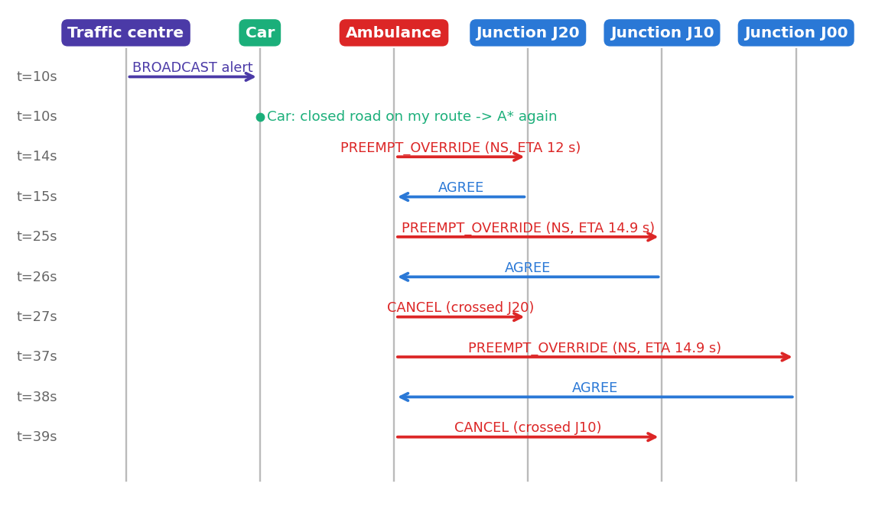
Multi-agent interaction, as it happened
M4
Review 2: messages recorded in the demo run (python scripts/run_simulation.py --protocol)
Ambulance & protocol
Two protocols
Accident: one BROADCAST from the traffic centre; each car checks its route and re-runs A*.
Ambulance: PREEMPT_OVERRIDE -> AGREE -> CANCEL. Absolute, but always via yellow.
Notes:
Presenter: M4. These are the real messages of the demo run: python scripts/run_simulation.py --protocol prints the same log.

Slide 13
Results: ambulance and conventional vs ours
M4
S3 same controller, preemption off vs on | S5 whole city: conventional vs our system
Ambulance & protocol
S5 (accident + ambulance) | Conventional | Ours
Ambulance trip (s) | 119.0 | 64.0
Ambulance wait at red (s) | 48.0 | 0.0
Avg wait per car (s) | 24.31 | 16.74
Cars arrived (%) | 91.84 | 97.92
Ambulance 46.2% faster and 0 s at red; average car wait 31.1% lower than conventional.
Honest note: single cars can be slower in our system; the gain is in the average.
Notes:
Presenter: M4. S3 uses the same Max-Pressure controller in both runs. S5 compares a conventional city (fixed-time lights, no alerts, no preemption) with ours on identical traffic and the identical accident.

Slide 14
Coordinator: broadcasts and hill climbing
M5
S4 accident on INT_00->INT_01 | S6 tuning signal parameters
Traffic centre
Closure: static routing strands 12 / 12 cars; A* re-routing delivers 100%. Tuning: unseen traffic 8.65 s -> 6.96 s; best of 3 restarts 6.85 s; 62 simulations.
Notes:
Presenter: M5. Restart 1 stops at a worse local optimum (8.37 s), which is why restarts are needed. The random restart 2 started at the best point (6.85 s). Tuned values were validated on seeds never used in the search.

Slide 15
Tools, setup and code structure
M1
Review 2: tool/package selection & code structure
Environment
Tool | Why
Python 3.9+, stdlib only | Agents need no extra package
Pyodide | Same Python runs in the browser
HTML canvas + http.server | Website, offline with run_demo.py
matplotlib, rich | Report charts, console tables
unittest | 47 tests, no extra install
Not SUMO / Mesa | Would hide the models we need to explain
python run_demo.py
python tests/run_tests.py
python scripts/run_simulation.py --all
python scripts/generate_results.py
stms/agents: junction, vehicle, ambulance, traffic centre
stms/algorithms: A*, Max-Pressure, hill climbing
stms/environment: roads, grids, simulator
stms/protocols: FIPA-ACL broker
web/, scripts/, tests/, docs/
tests: 23 unit, 7 integration, 8 system, 9 demo
Notes:
Presenter: M1. We deliberately wrote the broker and search ourselves so every step can be shown and tested.

Slide 16
Scalability: 2x2 to 8x8
M1
S8: demand grows with grid size; every vehicle runs to its destination
Environment
461
agents on the 8x8 grid (64 junctions)
1.49 ms
per simulated second at 8x8: grows linearly
-42..47%
wait reduction at every size
Notes:
Presenter: M1. Each junction decides in O(1) from local data, so adding junctions adds no work to existing ones. A* runs inside each vehicle.

Slide 17
Testing
M5
Review 2: demo quality & testing scenarios
Traffic centre
47/47
11 defects found & fixed
Reason() ran twice per tick: timers at 2x
Departure times ignored
Ambulance baseline used a different controller
Preemption skipped yellow (unsafe)
Green-wave messages ignored
Vehicles omniscient about incidents
... each has a regression test
automated tests pass
Level | Checks | #
Unit | A* admissible/consistent/optimal, Max-Pressure rules, BPR, broker | 23
Integration | Protocols; safety: never green to green, yellow >= 3 s | 7
System | Each scenario's acceptance criterion | 8
Demo | Website run: routes, ambulance, signals, queues | 9
Notes:
Presenter: M5. Mention that IT-05 failed during this cycle and exposed a real bug: vehicles waiting to depart ignored alerts. The fix is pre-trip listening.

Slide 18
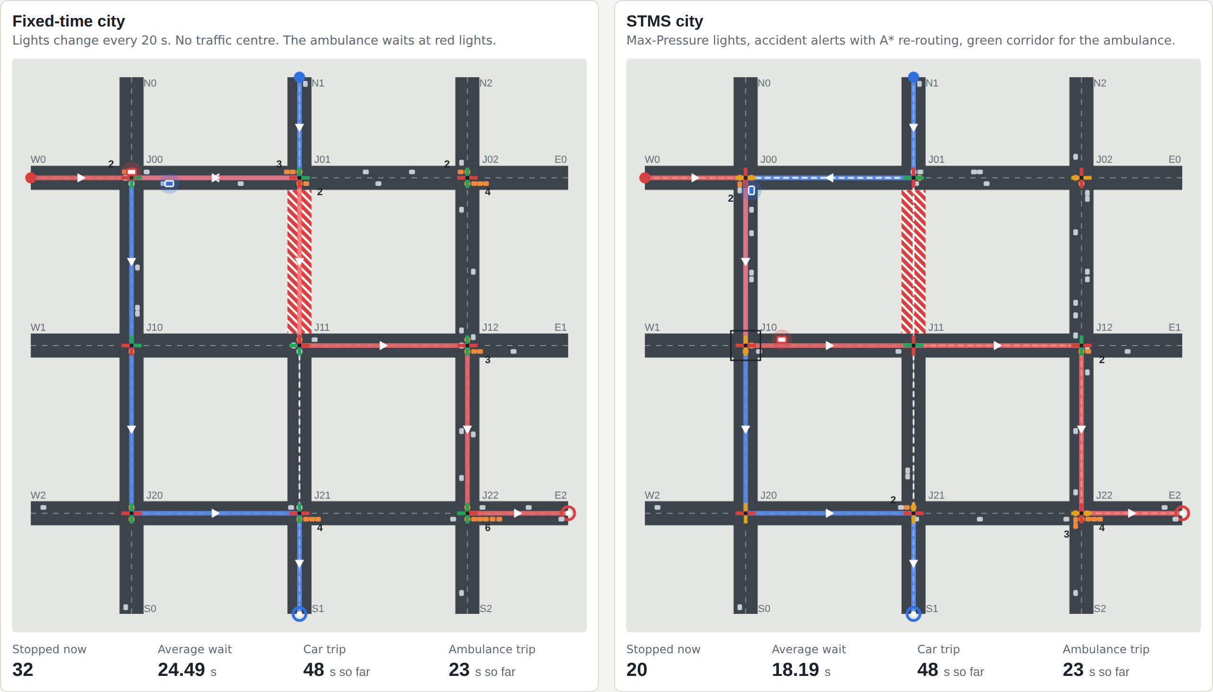
Live demo
M1
What we will run in front of you
Environment
1
run_demo.py
Send car, send ambulance, close roads
2
Junction panel
Max-Pressure scores and decision
3
Message log
PREEMPT_OVERRIDE, AGREE, CANCEL, alerts
4
scripts/run_simulation.py
Result tables for S1-S8
5
tests/run_tests.py
47 tests in about 30 s
Notes:
Presenter: M1 drives the laptop; each owner narrates their part. Backup: results/figures/demo_1_before.png if the laptop display fails.

Slide 19
Limitations and next steps
TEAM
What we did not model, and what we would add
Whole team
Limitations (honest)
Ideas to extend
Two-phase signals, through movements only
Single-lane roads
Synthetic grid demand, not calibrated
Messages never delayed or lost
Green-wave hand-off is optional (no gain on random demand)
Ambulance assumed to reach every junction by message
Q-learning junctions vs Max-Pressure
Contract-Net bidding between ambulances
Pedestrian agents and safe min-green
OpenStreetMap import (Coimbatore)
Message loss / delay robustness
Simulated annealing vs hill climbing
Notes:
Whole team. Saying the limitations first makes the positive results more credible.

Slide 20
Decentralised agents, measurable gains
-47.5%
-29.6%
100%
47/47
average wait
ambulance time
optimal A* routes
tests pass
Every number is regenerated by python scripts/generate_results.py and checked by an automated test.
Questions?
Notes:
Whole team. For Q&A, each owner answers questions on their module; the viva bank is in the report's Appendix A.

