Slide 1

Window Functions in MySQL
Radha Raman Jha

Slide 2
Window functions Operate in a "window" of rows defined by a specific set of criteria and allows perform calculations across a set of rows related to the current row within the result set of a query..
Key Aspects of Window Functions include
Partitioning: The result set can be divided into partitions or groups based on one or more columns. The window function is then applied independently within each partition.
2. Ordering: Rows within each partition are typically ordered based on one or more columns. This order determines the sequence number in the result set.
3. Frame Specification: We can define a frame, which is a subset of rows within the current partition. The frame specifies which rows to include in the window calculation, and it can be based on row counts or ranges relative to the current row.

Slide 3
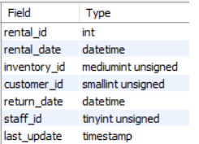
Commonly used Window Functions in MySQL https://dev.mysql.com/doc/sakila/en/
ROW_NUMBER() - assigns a unique number to each row within individual partitions.
RANK() - assigns a rank to each row based on specified column values. Ties share the same rank.
DENSE_RANK() - assigns ranks to rows, skipping ranks for tied values, resulting in no gaps between ranks.
Query for all the above Window Functions :-
select customer_id, count(*) num_rental,
row_number() over(order by count(*) desc ) row_num_rnk,
rank() over(order by count(*) desc) rank_rnk,
dense_rank() over(order by count(*) desc) dense_rank_rnk
from rental
group by customer_id order by count(*) desc limit 10;
desc rental;

Slide 4
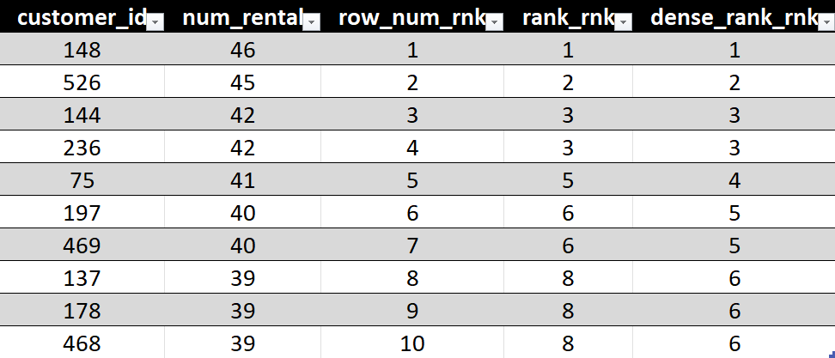
Results and Observations on it
row_number()
Assigns Different row number to each customer ordered by decreasing number of rentals ignores ties.
rank()
Assigns Same number to customers having same number of rentals and skips number for next one
dense_rank()
Assigns Same number to customers having same number of rentals and continues number count for next one

Slide 5
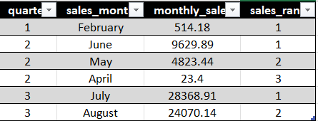
Partition aspect of calculation
select quarter(payment_date) quarter,
monthname(payment_date) sales_month,
sum(amount) monthly_sales,
rank() over(partition by(quarter(payment_date)) order by sum(amount) desc) sales_rank
from payment
group by quarter(payment_date), monthname(payment_date)
order by 1;
Note :-
For Every Quarter, the different months have been ranked based on decreasing number of monthly sales.

Slide 6
Conclusion
Ranking functions can be used to evaluate pertinent business problems.
It can be used to keep a track of customer requirement.
It can also be used to have an idea of seasonal variation of the inventory stocks required in advance.

Slide 7


