Slide 1
Centralized Admin Management With Role Based Access
Project guide :-
Smt. N. SUSHMA
Assoc . Prof,CSE
Batch Number:08
D. V Sai Ganesh(213C1A0509)
M. Radha Krishna(213C1A0521)
K. Jeevana Rekha(213C1A0519)

Slide 2
ABSTRACT
Centralized admin management with role-based access control (RBAC) helps organizations manage user access efficiently. It assigns permissions based on roles, improving security and reducing manual work. This system ensures only authorized users can access specific resources, making administration easier and more secure.

Slide 3
PROJECT TITLE JUSTIFICATION
Provide a single platform for managing admin roles.
Secure restricted access for different users.
Prevents the unauthorized access to critical data.
Suitable for businesses of all sizes.

Slide 4
INTRODUCTION
A digital platform for managing backend operations of an e-commerce website.
Centralized Management – Handle products, orders, and users from one platform.
Role-Based Access – Secure admin panel with different user permissions.
Real-Time Data Updates – Ensures accurate inventory and order tracking.

Slide 5
OBJECTIVE AND SCOPE OF THE PROJECT
OBJECTIVE:-
Allow all customers to view available products easily.
Approve and manage sellers/warehouses before they can operate.
Enable product and user management (add, edit, delete).
SCOPE:-
Coupons & Discounts – Unlike Flipkart, our platform does not offer discount coupons.
Customer Reviews & Ratings – No feature to leave reviews for products.
Live Order Tracking – Users cannot track real-time delivery status.

Slide 6
BASIC CONCEPTS RELATED TO THE PROJECT
Role-Based Access Control (RBAC) – Ensures only authorized admins can make changes.
Seller & Warehouse Verification – Ensures only verified sellers operate.
Sales Monitoring & Reporting – Helps admins track total revenue and performance.
User Deletion – Admin can remove unauthorized or inactive users.

Slide 7
ANALYSIS AND EXPLANATION OF THE IDENTIFIED PROBLEM
Problems in Traditional Systems:
Anyone can sell without admin approval , causing security issues.
Security risks – Unauthorized changes to products/orders.
Admin cannot see total sales and revenue and real time.
Proposed Solution:
Centralized admin panel – One dashboard for all approvals and operations.
Secure approval process – Only verified sellers and warehouses get access.

Slide 8
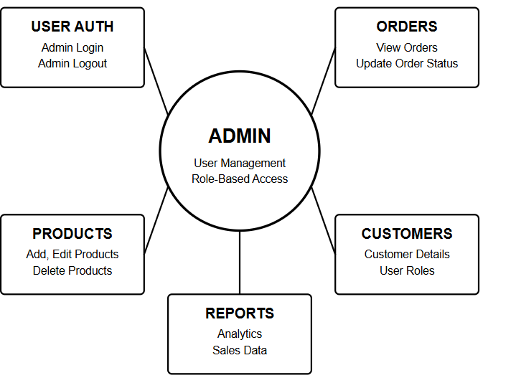
SOFTWARE REQUIREMENT ANALYSIS
FUNCTIONAL REQUIREMENTS :
User authentication (Admin login/logout)
Product management (Add, edit, delete products)
Order management (View, update order status)
User management (Customer details, roles)
Reports & analytics

Slide 9
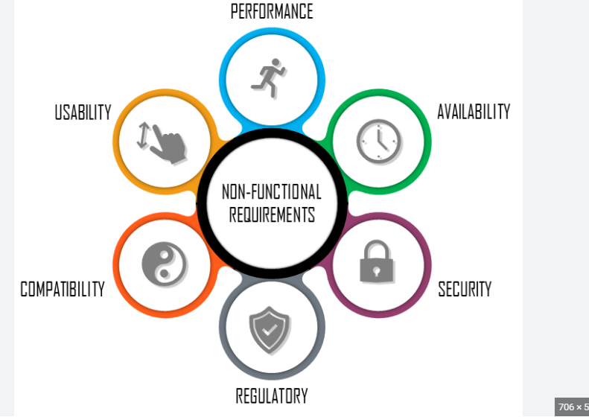
Non-Functional Requirements:
Performance – Pages should load quickly.
Security – Only admins can access the panel.
Scalability – The system should support many users.
Usability – The interface should be simple and user-friendly.
Reliability – The system should work without issues.

Slide 10
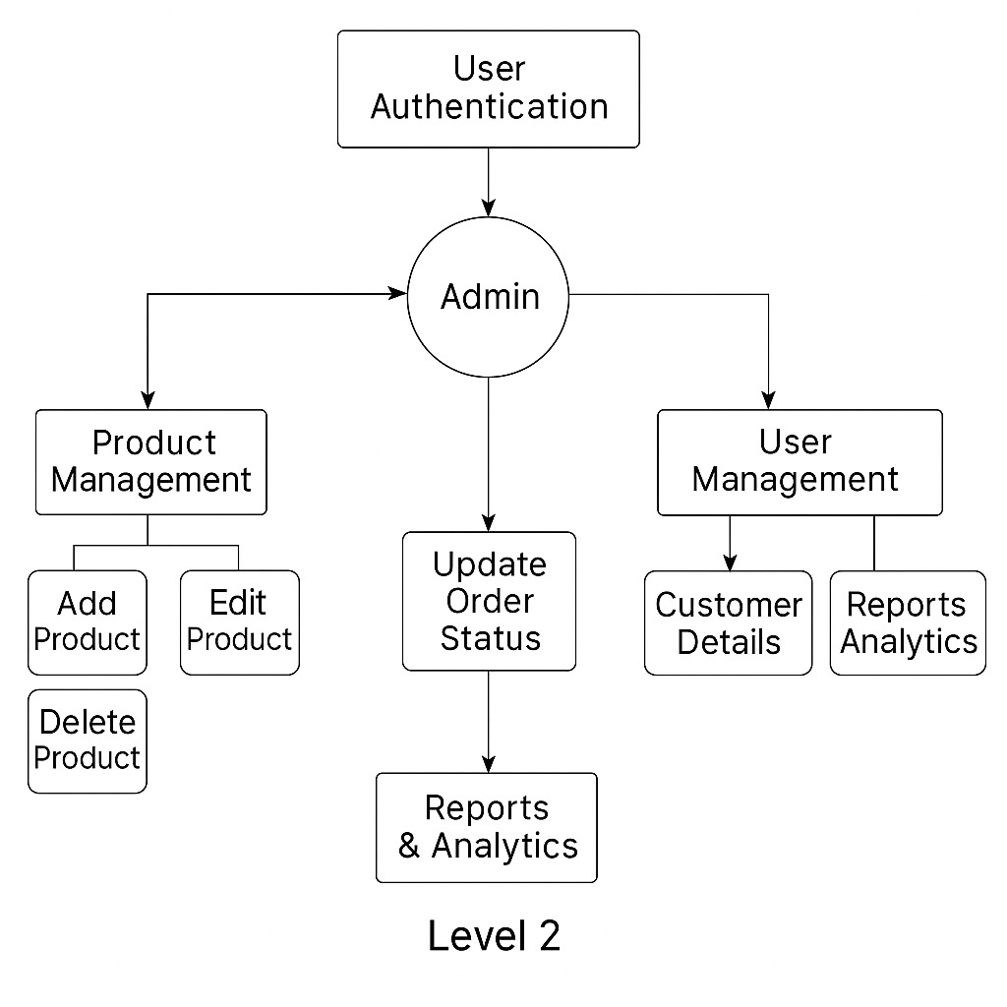
SOFTWARE DESIGN DATAFLOW DIAGRAM

Slide 11
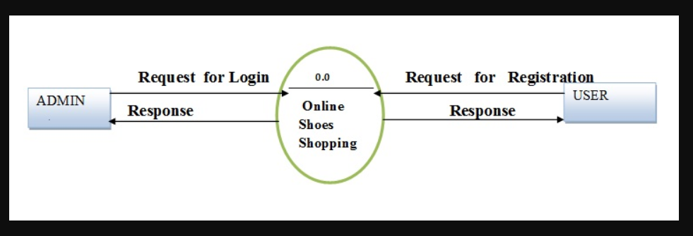
LEVEL:0

Slide 12
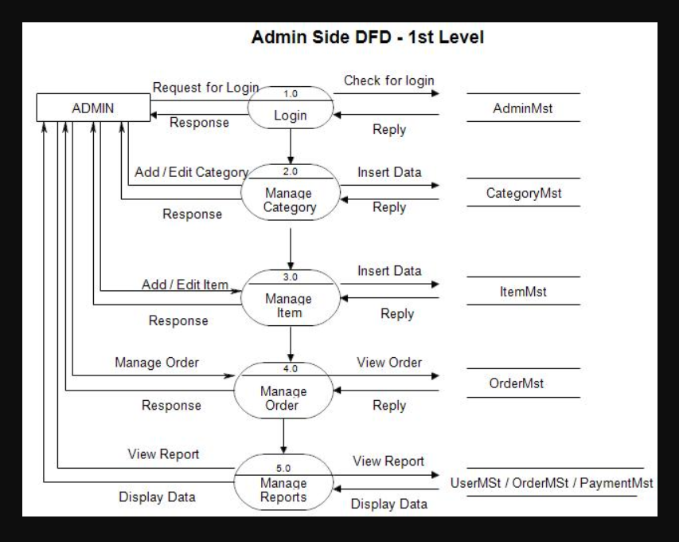
LEVEL:1

Slide 13
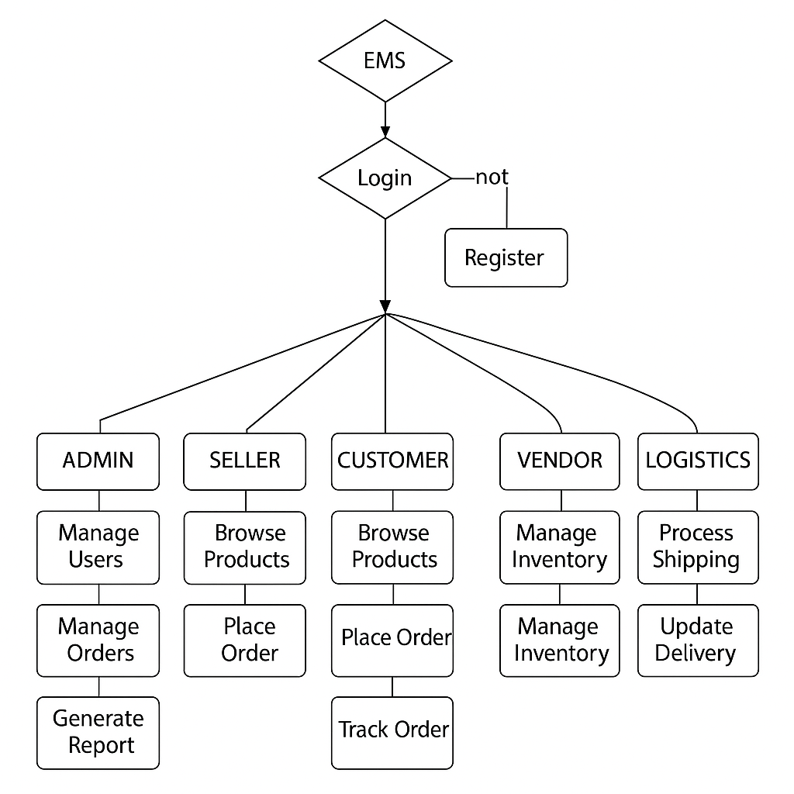
CONTROL FLOW DIAGRAM

Slide 14
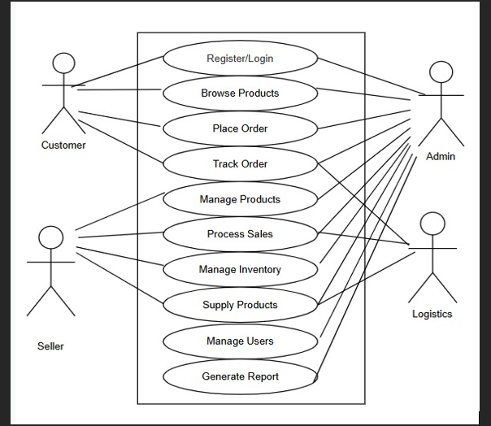
UML DIAGRAMS USE CASE DIAGRAM

Slide 15
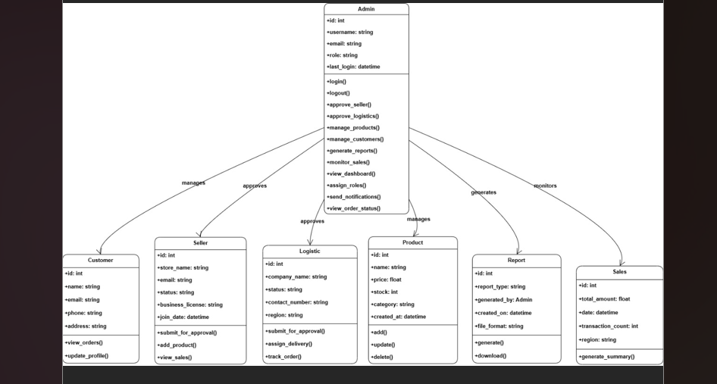
CLASS DIAGRAM

Slide 16
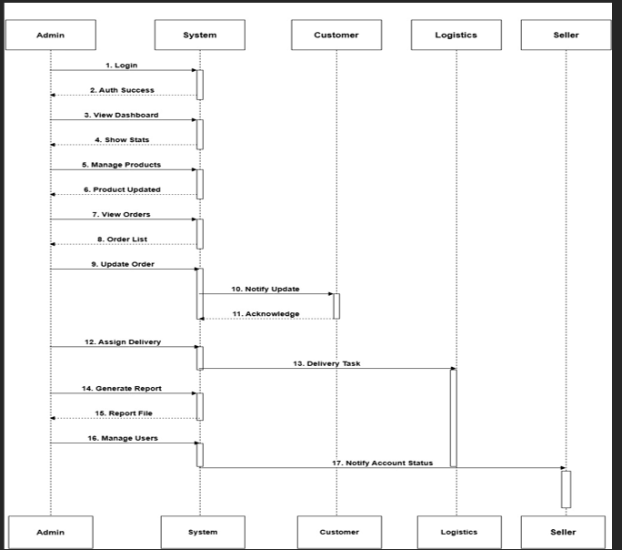
SEQUENCE DAIGRAM

Slide 17
THANK YOU

