Slide 1
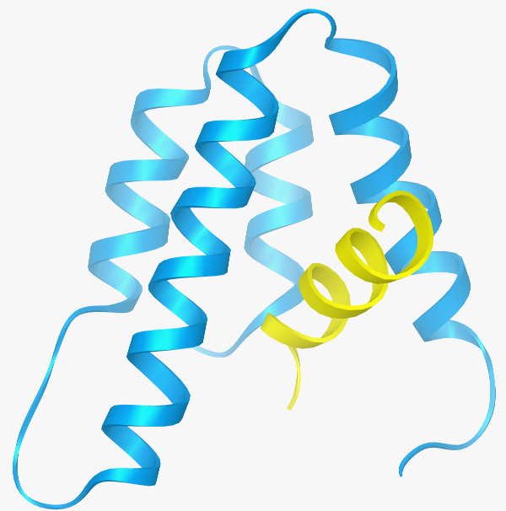
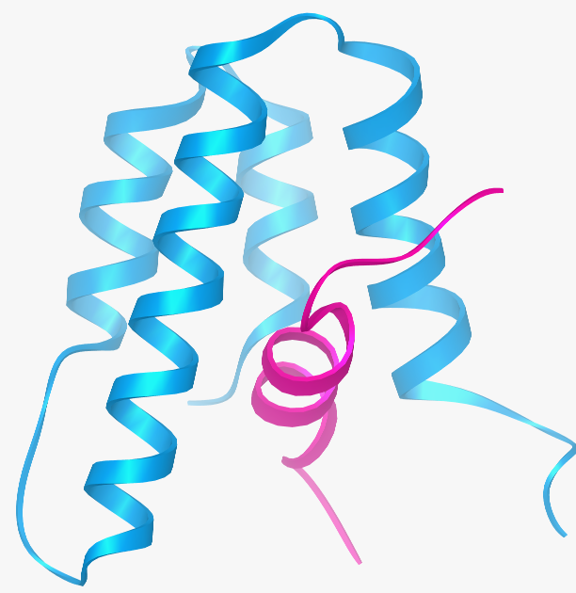
NIQMLLEAADYLER
AMSSLVYVASSDMP
Φ ΦΦ AA
N
C
8
21
374
361
C
C
N
N
N
C
Notes:
So how do the two Sin3 PAH2 complexes compare?
Remarkably, the PAH2 domain, particularly helices 2, 3 and 4 adopt virtually the same structure in the two complexes. Helix 1 on the other hand packs differently in the two complexes.
As anticipated from our sequence analysis, the biggest difference is in the orientation of the SID helices. It’s not a simple 180 degree flip – that would have been too bizarre but it’s a flip nonetheless.
So has this been observed before. It turns out it has – but not in the context of transcription factor-coregulator interactions.

