Slide 1

Healthcare Analytics for
Doctor Visits
Radheshyam Suthar
DIY Project

Slide 2

PROBLEM STATEMENT
Doctor-visit data contains demographic, health, illness, activity-reduction, income, healthcare-access and chronic-condition indicators. The project analyzes these variables to identify measurable patterns in recorded doctor visits and summarize statistically supported relationships in the dataset.
Key focus
• Visit distribution
• Demographic patterns
• Health & illness
• Access indicators
• Statistical evidence

Slide 3
Project Description
This project performs exploratory and statistical analysis on 5,190 healthcare records. The workflow includes data-quality checks, univariate and bivariate analysis, health/illness and access comparisons, Spearman correlation, non-parametric tests, and an exploratory Poisson count-regression model.
Analytical questions
• How do visits vary by gender and age?
• How are illness, health and reduced activity related to visits?
• Do access/chronic indicators differ in recorded visits?
• Which relationships are statistically detectable?

Slide 4

WHO ARE THE END USERS?
Healthcare analysts
Explore utilization patterns and subgroup differences.
Public health planners
Review descriptive patterns for planning and monitoring.
Healthcare researchers
Use the dataset for exploratory statistical analysis.
Healthcare managers
Understand recorded visit patterns across patient indicators.

Slide 5

Technology Used
Python
Core analysis language
Pandas & NumPy
Data loading, cleaning and transformation
Matplotlib & Seaborn
Charts and exploratory visualization
SciPy
Spearman, Mann–Whitney U and Kruskal–Wallis tests
Statsmodels
Poisson GLM / count regression
Jupyter / Google Colab
Notebook-based execution and documentation

Slide 6
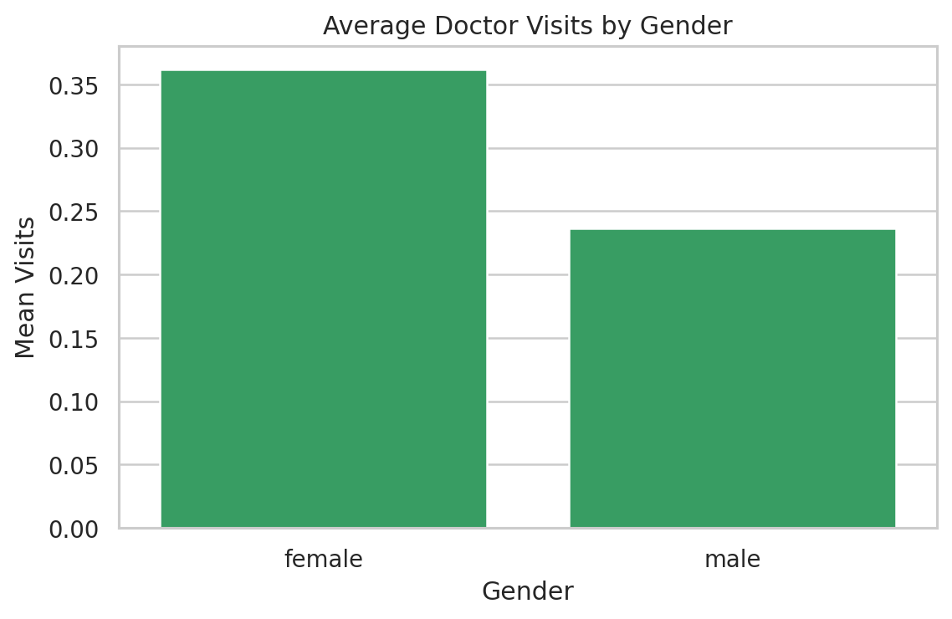
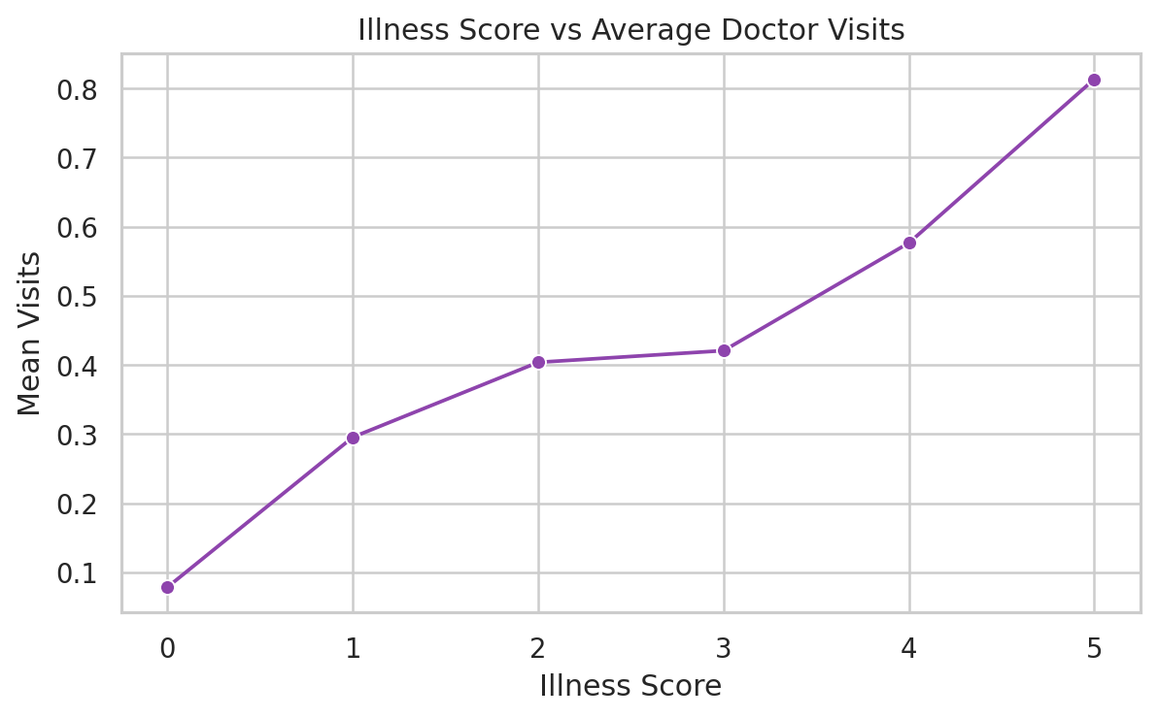
RESULTS
5,190
records
13
supplied columns
79.79%
zero-visit records
0
missing values
• Female records: mean visits 0.362 vs 0.236 for male records.
• Activity reduction has the strongest positive Spearman association with visits (ρ=0.336).
• Illness is also positively associated with visits (ρ=0.263).
• Long-term chronic condition: mean visits 0.603 (yes) vs 0.262 (no).
• Private-insurance comparison was not statistically significant (Mann–Whitney p=0.762).
Demo Link : https://github.com/Radhe-jangir/healthcare-analytics-doctor-visits

Slide 7
Thank you

