Slide 1

Seasonal Agriculture
Performance Analysis
Major Project — VOIS AICTE Batch 1 (2026–2027)
Radheshyam Suthar
Indira Gandhi National Tribal University
AICTE STU ID: STU69c4bfbbd70d51774501819
Domain: Agriculture Data Analytics

Slide 2

PROBLEM STATEMENT
Agricultural performance is influenced by seasonal environmental conditions, farming practices, resource availability and market conditions. Raw agricultural data does not clearly explain how performance changes across seasons or what patterns occur under different seasonal conditions.
Records
Variables
Seasons
4,000
28
3
observations
dataset attributes
Kharif • Rabi • Zaid
Goal: identify meaningful patterns, relationships, variations and data-driven insights.
2

Slide 3
PROJECT DESCRIPTION
Seasonal Agriculture Performance Analysis
The project applies a complete data-analytics workflow to a 4,000-row agricultural dataset. The analysis covers dataset inspection, data-quality treatment, exploratory analysis, seasonal and crop-wise comparisons, correlation analysis, statistical significance testing, and multiple linear regression.
• Dataset inspection & descriptive statistics
• Missing-value treatment and duplicate verification
• Seasonal and crop-wise exploratory analysis
• Correlation and significance testing
• One-Way ANOVA + Kruskal-Wallis validation
• Multiple linear regression and model evaluation
3

Slide 4

WHO ARE THE END USERS?
Seasonal Agriculture Performance Analysis
Farmers & farm managers
Agricultural analysts
DATA-DRIVEN
DATA-DRIVEN
Use yield, water-use and crop comparisons for planning.
Interpret seasonal and crop-wise patterns from the dataset.
Researchers & students
Planners & policymakers
DATA-DRIVEN
DATA-DRIVEN
Use statistical and regression analysis as an analytical case study.
Support evidence-based resource and agricultural planning.
4

Slide 5

TECHNOLOGY USED
Seasonal Agriculture Performance Analysis
Python
Pandas
Core programming language
Data manipulation & analysis
NumPy
Matplotlib
Numerical computation
Data visualization
Seaborn
SciPy
Statistical visualizations
ANOVA & Kruskal-Wallis tests
Scikit-learn
Google Colab
Regression & model evaluation
Notebook execution environment
5

Slide 6
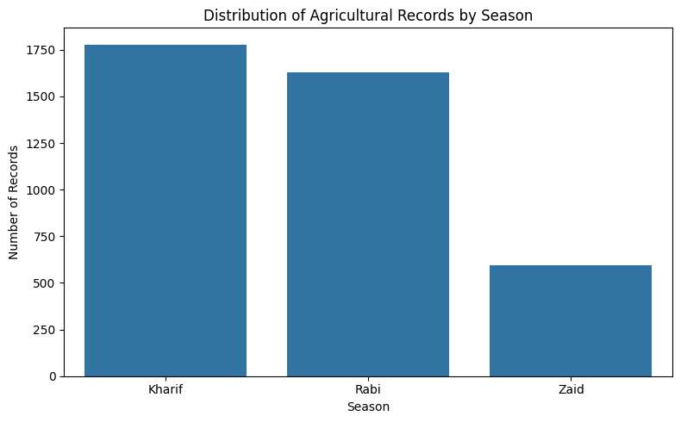
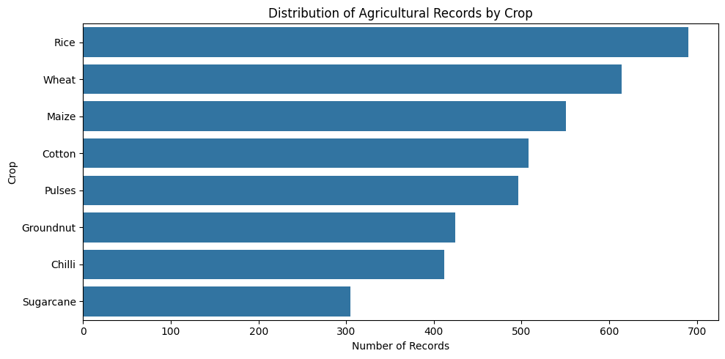
RESULTS — DATASET & DATA QUALITY
Seasonal Agriculture Performance Analysis
Initial missing values
Duplicates
After cleaning
Final dataset
120
0
0
4,000 × 28
across 3 numeric variables
rows
missing values
retained
Season records: Kharif 1,779 • Rabi 1,627 • Zaid 594 | Most records: Rice (690).
6

Slide 7
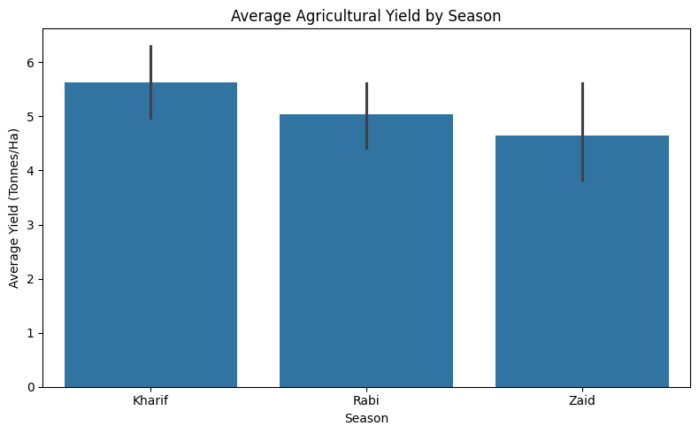
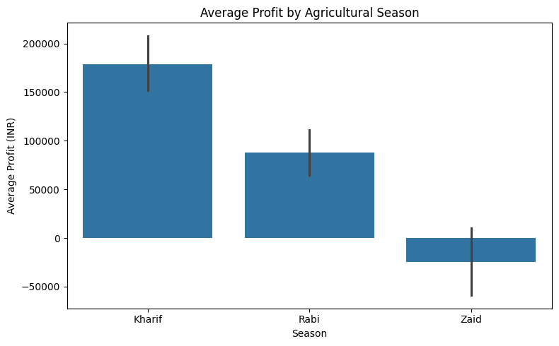
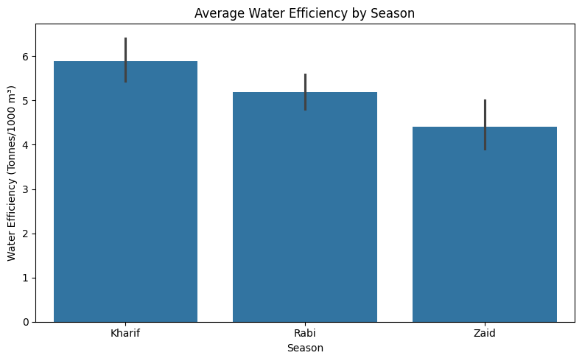
RESULTS — SEASONAL PERFORMANCE
Seasonal Agriculture Performance Analysis
Mean yield
Mean profit
Water efficiency
5.63 / 5.04 / 4.64
₹178.9k / ₹87.7k / -₹24.8k
5.892 / 5.186 / 4.413
Kharif / Rabi / Zaid tonnes/ha
Kharif / Rabi / Zaid
Kharif / Rabi / Zaid
Kharif shows the highest mean yield, mean profit and water efficiency in the observed dataset.
7

Slide 8
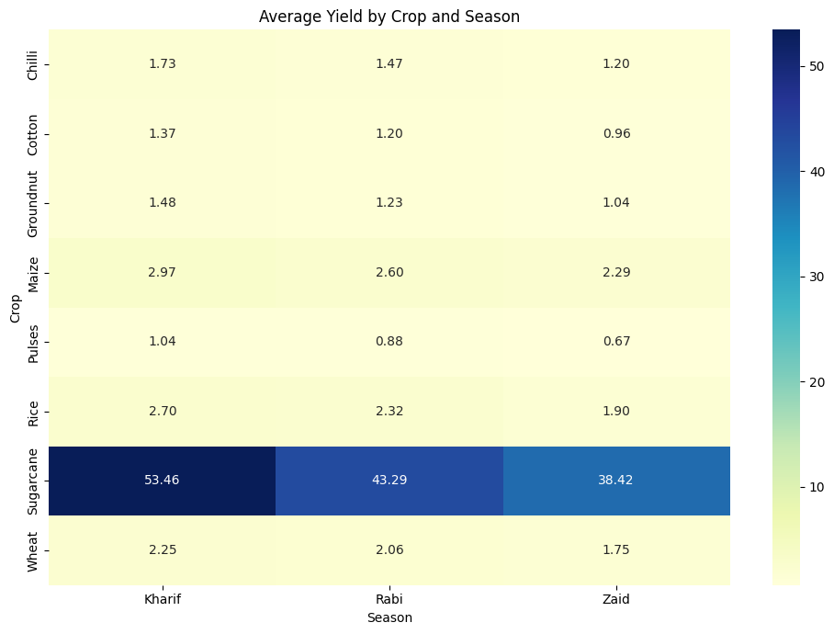
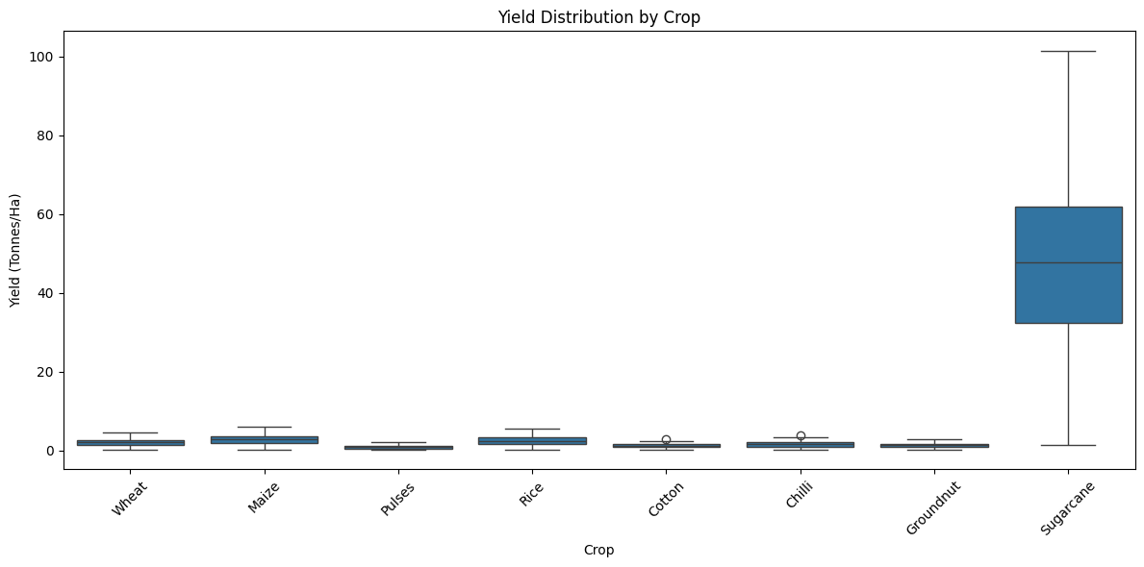
RESULTS — CROP × SEASON PERFORMANCE
Seasonal Agriculture Performance Analysis
Mean yield by crop
Sugarcane 46.642 • Maize 2.710 • Rice 2.431 • Wheat 2.108 • Chilli 1.543 • Groundnut 1.323 • Cotton 1.230 • Pulses 0.922 tonnes/ha
Crop-wise ANOVA and Kruskal-Wallis tests both found statistically significant yield differences (p < 0.05).
8

Slide 9
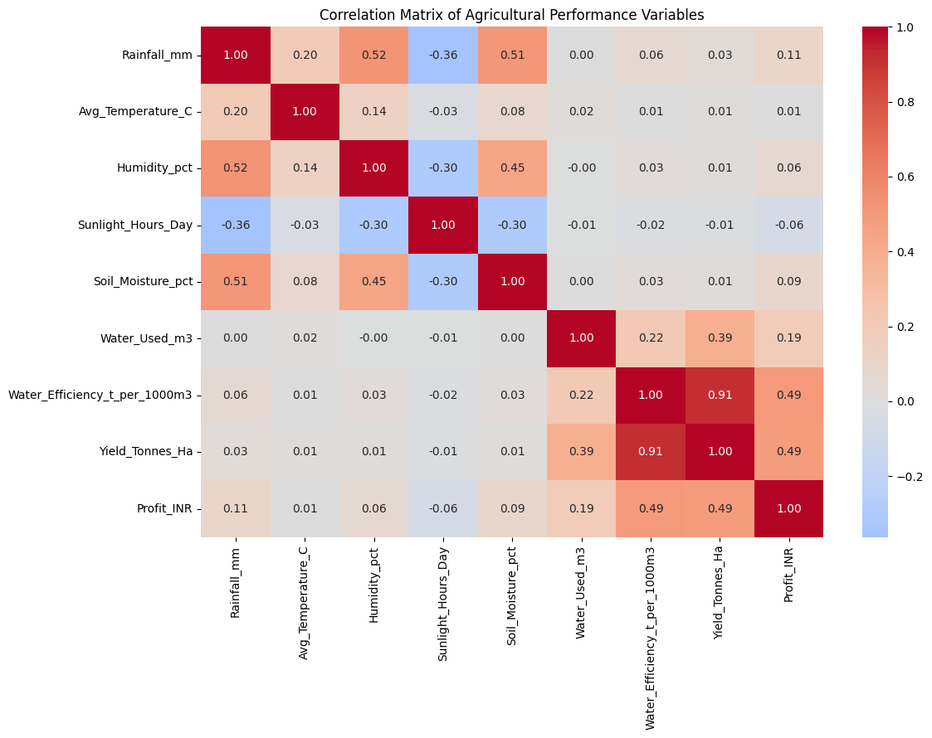
RESULTS — CORRELATION & STATISTICAL TESTING
Seasonal Agriculture Performance Analysis
Water efficiency ↔ Yield
Yield ↔ Profit
r = 0.913
r = 0.488
strong positive
positive
Water used ↔ Yield
Water efficiency ↔ Profit
r = 0.386
r = 0.489
moderate positive
positive
Seasonal tests
ANOVA: F = 1.5439, p = 0.2137 → not significant for seasonal means.
Kruskal-Wallis: H = 68.7131, p ≈ 1.20×10⁻¹⁵ → significant seasonal distributions.
Interpretation: seasonal differences are detectable under the non-parametric rank-based test.
9

Slide 10
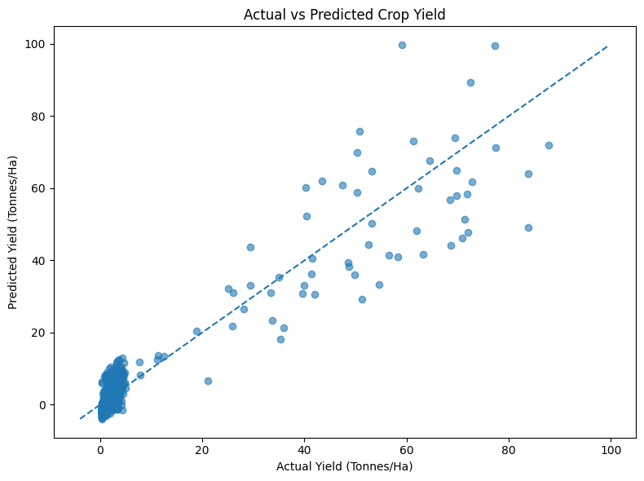
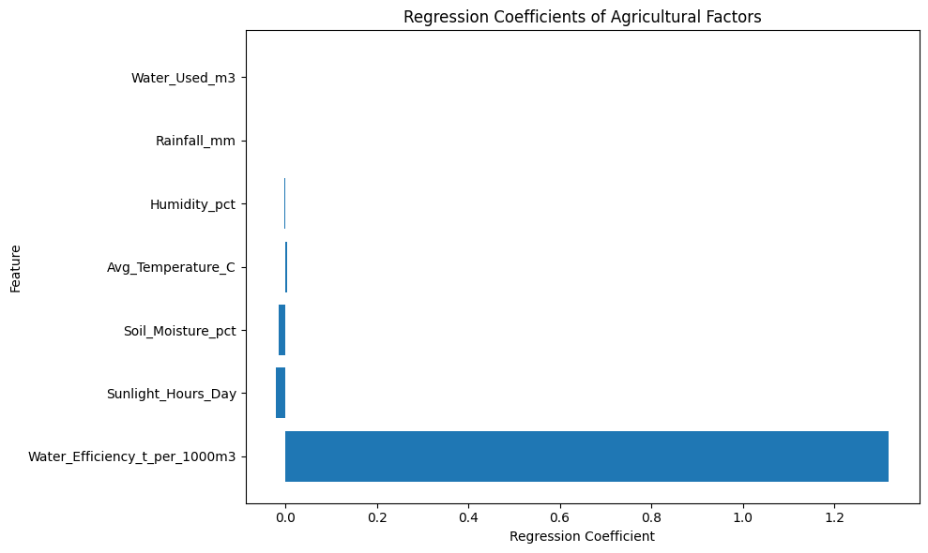
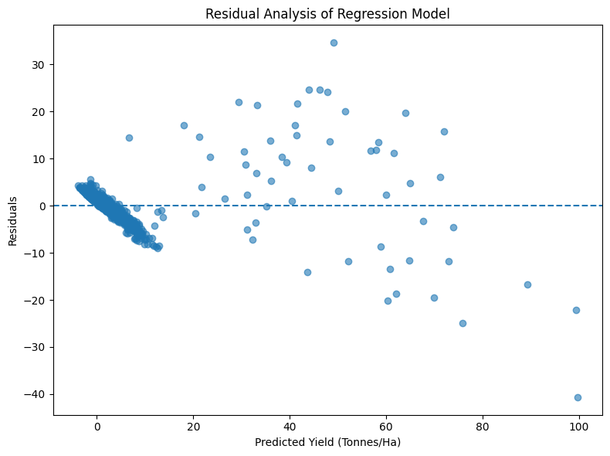
RESULTS — REGRESSION MODEL
Seasonal Agriculture Performance Analysis
R²
Adjusted R²
MAE
RMSE
Train/Test
0.8796
0.8785
2.8046
4.8179
3200 / 800
strong explanatory power
7 predictors
tonnes/ha
tonnes/ha
80:20 split
Largest fitted coefficient magnitude: Water_Efficiency_t_per_1000m3 = 1.3198. Intercept = -3.8552.
10

Slide 11
FUTURE SCOPE
Seasonal Agriculture Performance Analysis
• Extend the dataset with fertilizer use, crop variety, pest management, farm practices and market variables.
• Build interactive dashboards for seasonal, crop-wise and resource-use monitoring.
• Compare additional machine-learning models for yield prediction.
• Add time-series analysis when multi-year observations are available.
• Use richer farm-level data to support more targeted agricultural decision-making.
These extensions address the limitations identified in the notebook and can improve practical decision support.
11

Slide 12
GITHUB LINK
Seasonal Agriculture Performance Analysis
Project repository
GitHub repository : https://github.com/Radhe-jangir/seasonal-agriculture-performance
Project files:
• Seasonal_Agriculture_Performance_Analysis.ipynb
• Dataset CSV
• PPT
12

Slide 13

VOIS COURSE COMPLETION CERTIFICATE
Seasonal Agriculture Performance Analysis
Course name: Data Visualization
13

Slide 14
Thank You
Seasonal Agriculture Performance Analysis
Radheshyam Suthar
Indira Gandhi National Tribal University
Major Project — VOIS AICTE Batch 1 (2026–2027)
14

