Slide 1
MUTUAL FUND ANALYTICS6
BLUESTOCK CAPSTONE PROJECT
INVESTOR INTELLIGENCE
Shivam Kumar Mehta|B.Tech, LPU
Submission Date: 12 June 2026

Slide 2

The Challenge: Data Complexity
Data Fragmentation: Raw financial data exists in disparate silos making performance analysis difficult.
Opaque Behavior: Identifying retail investor patterns and churn causes requires deep multi-dimensional analytics.
SIP Continuity: High rates of SIP attrition often go unnoticed without a structured intelligence system.

Slide 3





Core Strategic Objectives
Performance
Comprehensive analysis of fund performance and benchmark comparison.
Behavior
Mapping investor demographic patterns and transaction behaviors.
Risk Control
Developing advanced risk analytics (VaR, Sharpe) for better oversight.
Recommendation
Building an intelligent engine to match funds with risk appetite.
Dashboards
Creating interactive Power BI visualizers for real-time insights.

Slide 4




Data Engineering & ETL Workflow
i
Row Data
Python ETL
SQLite
Analytics
Power BI
Insights
CSV Datasets (10)
Cleanup A Transform
Integrated DB
Jupyter Modeling
Visualizations
Business Logic
Datasets: Fund Master, NAVHistory, AUM, 5lP Inliows, Category Inliows, Investor Transactions, Portfolio Holdings, etc.

Slide 5
Industry Trends: EDA Insights
Fiscal 2025 AUM
765.74
Fiscal 2024 AUM
753.40
SIP Contributions
92.89 Lakh
23.1%YoYGrowth: Asset base reached record highs driven by retail participation.
SIP Dominance: SIP flows grew 45% YoY, representing structural investment shifts. Equity Lead: Equity schemes constitute 70% of the total investor folio share.

Slide 6


Advanced Performance Analytics
Historical VaR: Quantifying potential loss at a 95% confidence interval over time.
Conditional VaR (CVaR): Analyzing the "tail risk" or the average loss beyond theVaR threshold.
Rolling Sharpe Ratio: Tracking risk-adjusted returns over a rolling 90-day window to evaluate consistency.

Slide 7



Deep Investor Intelligence
i
Cohort & Continuity
Cohort Analysis: Grouping investors by entry year to track behavior evolution and retention.
SIP Continuity: Mapping the lifespan of systematic plans to identify churn-prone demographics.
No surface-Level Categories | Adaptability to Investors | Builds Emotional Connection
Uncovers motivations, | Considers life moments, trends. | Builds trust by integrating
emotions. and behaviors | ond shifting priorities instead of | emotions and cognitive biases
other than demographics. | relying on static modelG. | into strategies.
Personalization at Soole | Anticipmes Key diggers | IquIti-oeneratlonal Needs
Tailors strategies to individual | Engages proactively during | Balances differing priorities
goals rother than offering | pivotal life moments and | ocros6 generations to foster
generic solutions.
decision-making events.
loyalty.
g, At-Risk Identification: Segmenting the investor base to find accounts with highest redemption probability.
Future-l•roofing Wends Incorporates ESG, digital assets, end emerging technologies to remoin relevant.
Educates Investors Guides investors post biases
for informed, confident decision-moking.
Long-Term Relationships Strengthens loyalty through deeper uncterstondirjp end meaningful engagement.

Slide 8
Fund Recommendation Logic
Algorithm: Filters schemes based on RiskAppetite $\rightarrow$ Ranks by 9O-Day RollingSharpe Ratio $\rightarrow$ Selects Top 3Funds.
Conservative
Low Risk
Debt/Liquid Orientated
Liquid Index Fund
Balanced
Moderate
Hybrid/Bluechip Equity
Flexi Cap Growth
Aggressive
High Risk
Mid/Small Cap Sectoral
Small Cap Alpha Fund

Slide 9
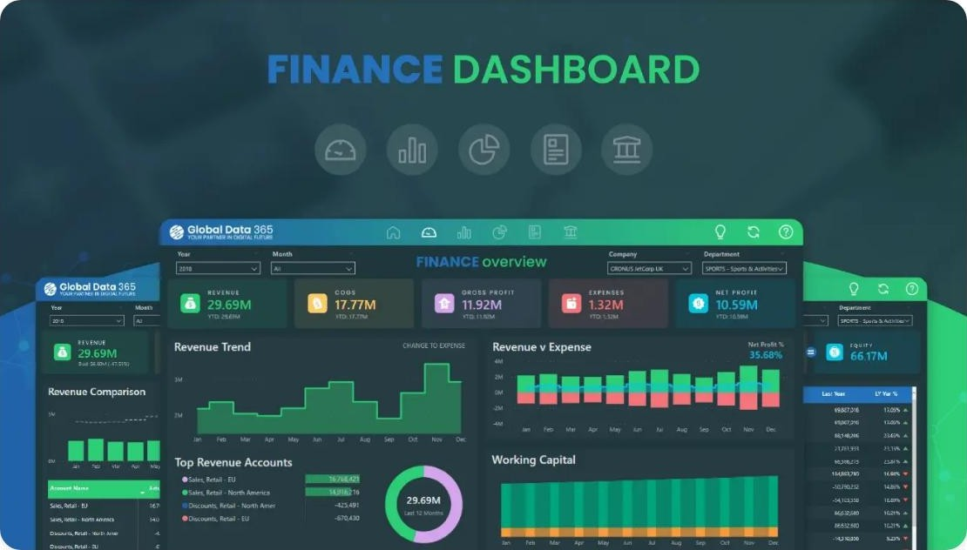
Dashboard: Industry Performance
Key Visual Components
{@ KPI Cards: Total AUM, Portfolio Counts, and active SIP Inflows. m AUM Trends: Multi-year comparison of industry growth vs
benchmark.
Fund Scorecard: Interactivefilter-based performance vs Risk metrics.

Slide 10
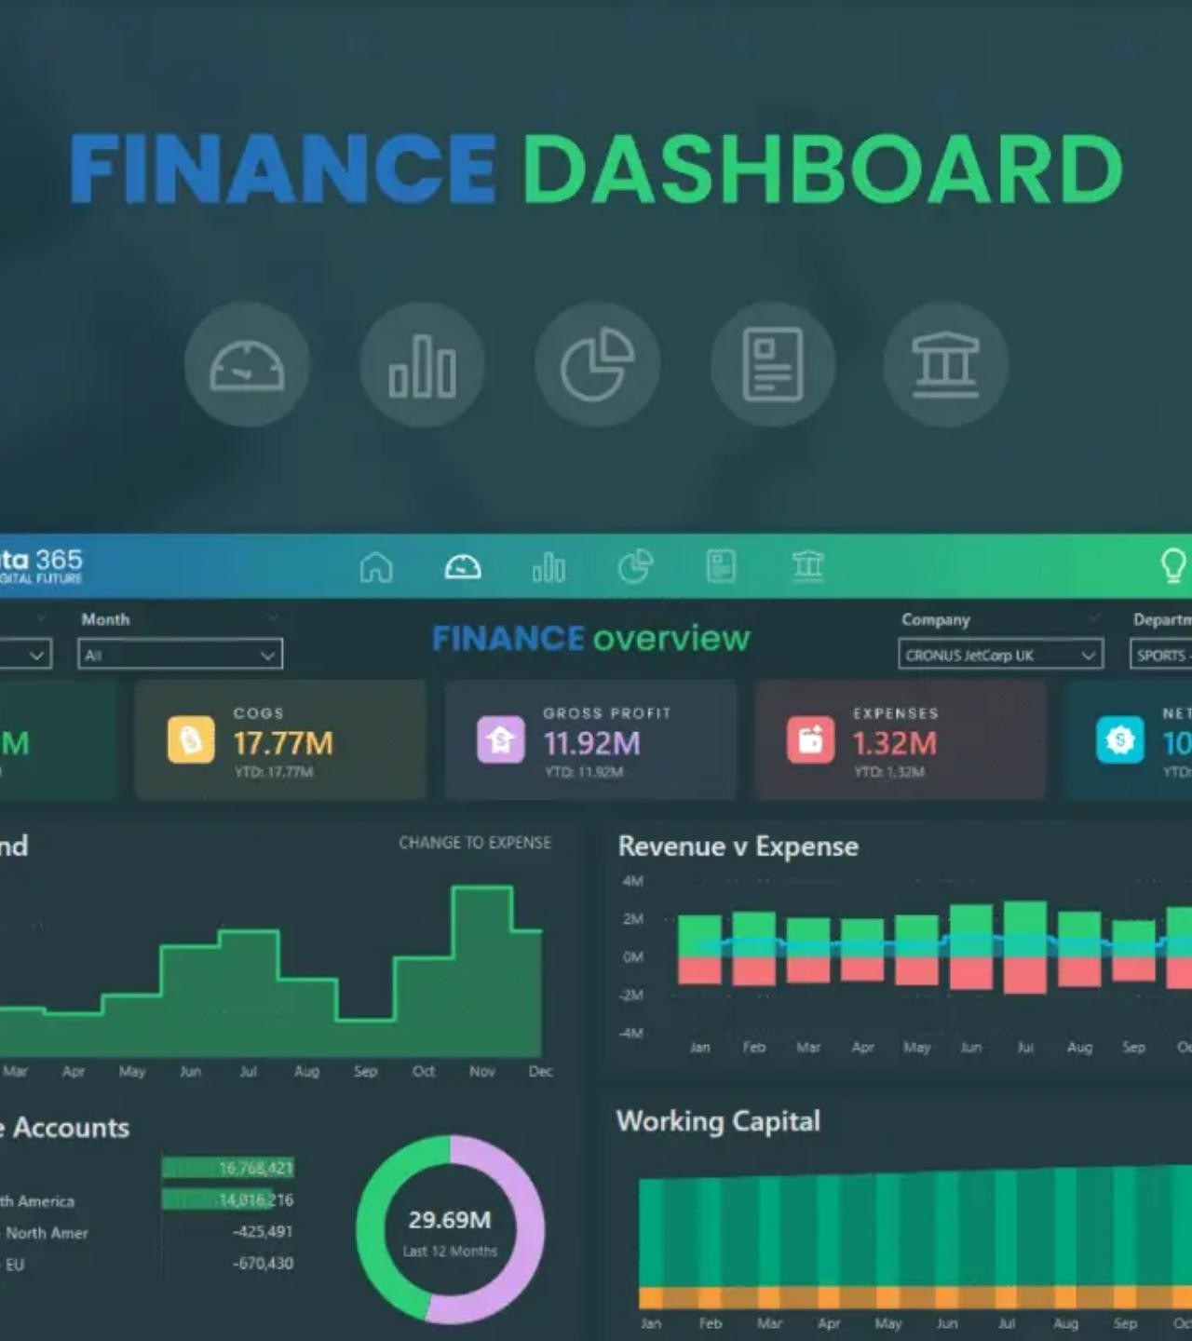
Dashboard: Investor Insights
Geographic Analysis: Transaction volume mapped by state and city tier.
Age Demographics: Segmentation of inflows by investor age brackets.
SIP Trends: Tracking monthly SIP inflow vs Nifty market shifts.

Slide 11
_{I} Key Findings &Future Scope
Liquid Funds
Attracted the highest consistent monthly inflows during volatility.
Sharpe Performance
Moderate-risk funds demonstrated superior risk-adjusted ratios.
High Risk Base
Identified that -30% of new investors are at high risk of early churn.
Recommendations for Phase II:
@ Integrate Live Market APIs for real-time risk tracking.
t§ Implement ML-based predictive analytics for SIP behavior.
B
Web deployment for investor-facing advisory models.

Slide 12
CONCLUSION
Empowering stakeholders with data-driven intelligence.
This project demonstrates an end-to-end analytics capability—from ETL and SQL integration to advanced risk modeling and business intelligence—generatinghigh-value insights for the Indian Mutual Fund ecosystem.
Thank You!
Questions & Discussion

Slide 13

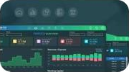
Imoge Sources
https://static.vecteezy.com/system/resources/previews/0ó8/ó3ó/574/non 2x/dynamic-financiaI-data-visuaIization-background-vector.jpg
Source: www.vecteezy.com
t— “- -“'t—“
'“ '. ,'
https://cdn.prod.website-files.com/óóe5b5Oec3880ff24ac7aOaó/ó73b5a833fdeoc9d1491be2b ó73b59fcda48cfdbf5893afb Ebook Investor Segmentation Benefits.png
Source: www.fundmarketers.com
https://gIobaIdata3ó5.com/wp-content/upIoads/2023/03/Front-Page-2.webp
Source: globaldata365.com

