Slide 1
An Awesome Problem

Slide 2
Best Fit Line
The problem is to find the best fit line
Often appears in statistical data / scientific data.

Slide 3
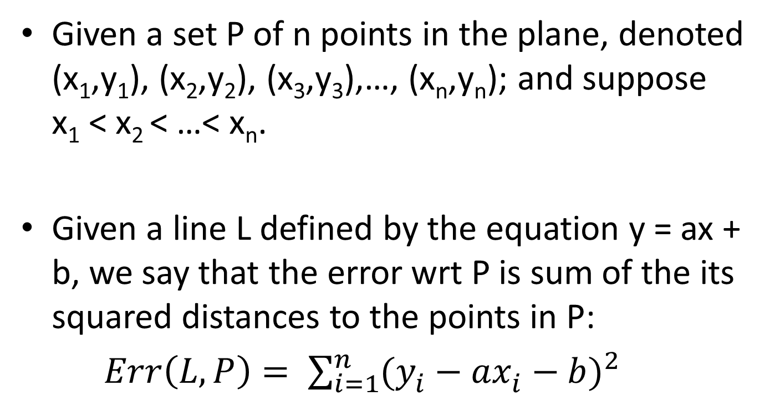
A formal statement
Given a set P of n points in the plane, denoted (x₁,y₁), (x₂,y₂), (x₃,y₃),…, (x_{n},y_{n}); and suppose x₁ < x₂ < …< x_{n}.
Given a line L defined by the equation y = ax + b, we say that the error wrt P is sum of the its squared distances to the points in P:
$Err\left(L,P\right)= \sum_{i=1}^{n}{{(y_{i}^{}−ax_{i}^{}−b)}^{2}}$

Slide 4

Natural Goal for best fit line
Find the line with minimum error
Has a closed form solution

Slide 5
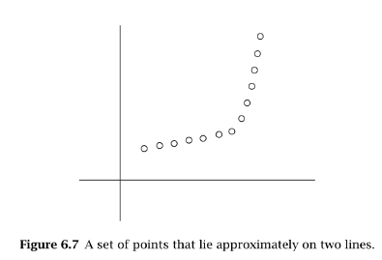
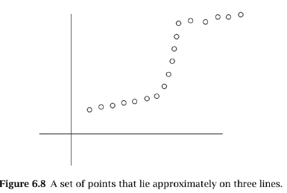
Can it handle these?

Slide 6
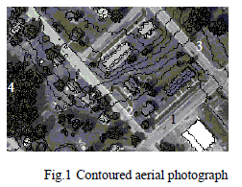
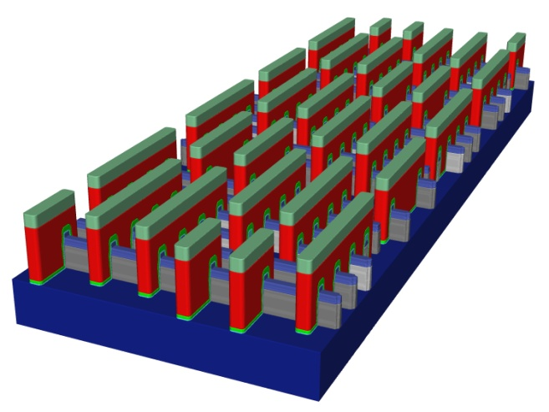
An interesting application
A Novel Method for Extracting Building from LIDAR Data----------Fc-S method by Zizhen et al. The International Archives of the Photogrammetry, Remote Sensing and Spatial Information Sciences. Vol. XXXVII. Part B1. Beijing 2008
http://www.electronics-eetimes.com/en/3d-tool-aims-at-28nm-for-mems-and-new-structures.html?cmp_id=7&news_id=222912048#

Slide 7
Can it handle these?
We want to fit multiple lines through P.
But how many?
Also, Lines must minimize the error.

Slide 8
The Problem statement
SEGMENTED LEAST SQUARES
Given a set P of n points in the plane, denoted (x₁,y₁), (x₂,y₂), (x₃,y₃),…, (x_{n},y_{n}); and suppose x₁ < x₂ < …< x_{n}.
Partition P into some segments.
Segments is a subset of P that represents a contiguous set of x-coordinates.
Compute the line minimizing the error with respect to the points in S.

Slide 9
A Penalty Function
We want to penalize too many partitions as well as the error.
So Penalty is sum of
The number of segments into which we partition P, times a fixed, given multiplier C > 0.
For each segment, the error value of the optimal line through that segment.
Objective: Find a partition with minimum penalty.

Slide 10
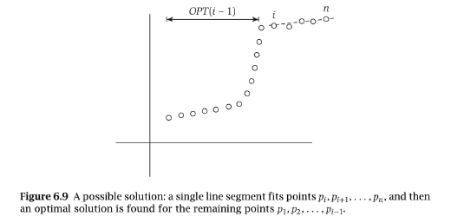
Exploiting the subproblems
We want a polynomial number of sub problems.
Great Observation.
The last point p_{n} belongs to a single segment in the optimal partition, and that segment begins at some earlier point p_{i}.

Slide 11
Recurrence relation
Let OPT(i) be the optimal value for the points p_{1,} p_{2,} …, p_{i} .
Let e_{i,j} denote the minimum error of any line through p_{i,} p_{i+1,} …, p_{j} .
We want to compute OPT(n).
So the Observation is
If the last segment of the optimal partition is p_{i,} p_{i+1,} …, p_{n}, then the value of the optimal solution is OPT(n) = e_{i,n} + C + OPT(i-1).

Slide 12
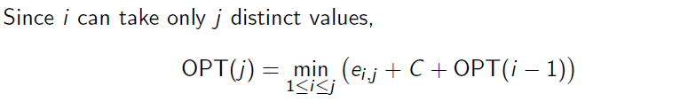
Completing the recurrence relation
The segment p_{i,} p_{i+1,} …, p_{j} is used in an optimum solution for the subproblem if and only if the minimum is obtained using index i.

Slide 13
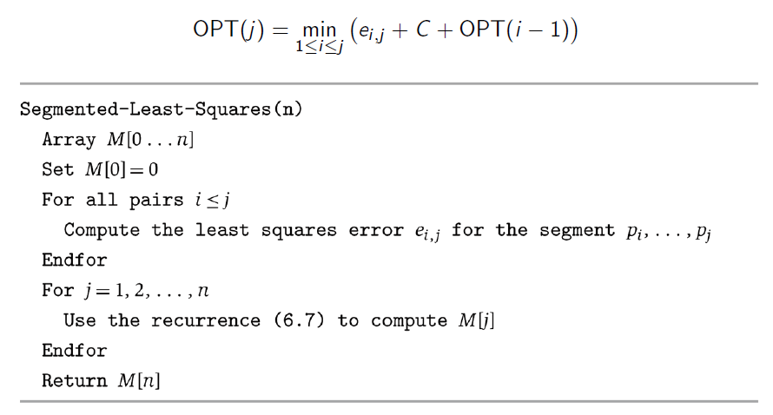
So the algorithm
O(n)
O(n³)
O(n) for each j

Slide 14
Final solution
Find-Segment(j)
If j== 0 then
Output nothing
Else
Find an i that minimizes e_{i,j} + C + M[i-1]
Output the segment {p_{i}, …,p_{j}} and the
result of Find-Segment(i-1)
Endif

Slide 15
Reference
Algorithm Design by Kleinberg and Tardos
courses.cs.vt.edu/~cs5114/.../lecture12-dynamic-programming.pdf‎

