Slide 1
Fundamentals of Machine Learning Data Pre-processing
Compiled by: Radheshyam Baliga Bantwal

Slide 2
What is Data Pre-processing?
Data Preprocessing in machine learning is the crucial first step where raw data is cleaned, transformed, and prepared to be fed into a model. It directly impacts the accuracy, efficiency, and reliability of your predictions.
Why?
- In practice, data is incomplete, inconsistent or noisy
- ML Models need structured, high quality data (garbage in, garbage out)

Slide 3
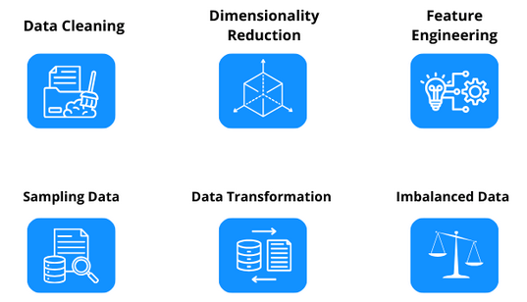
Key steps in data pre-processing

Slide 4
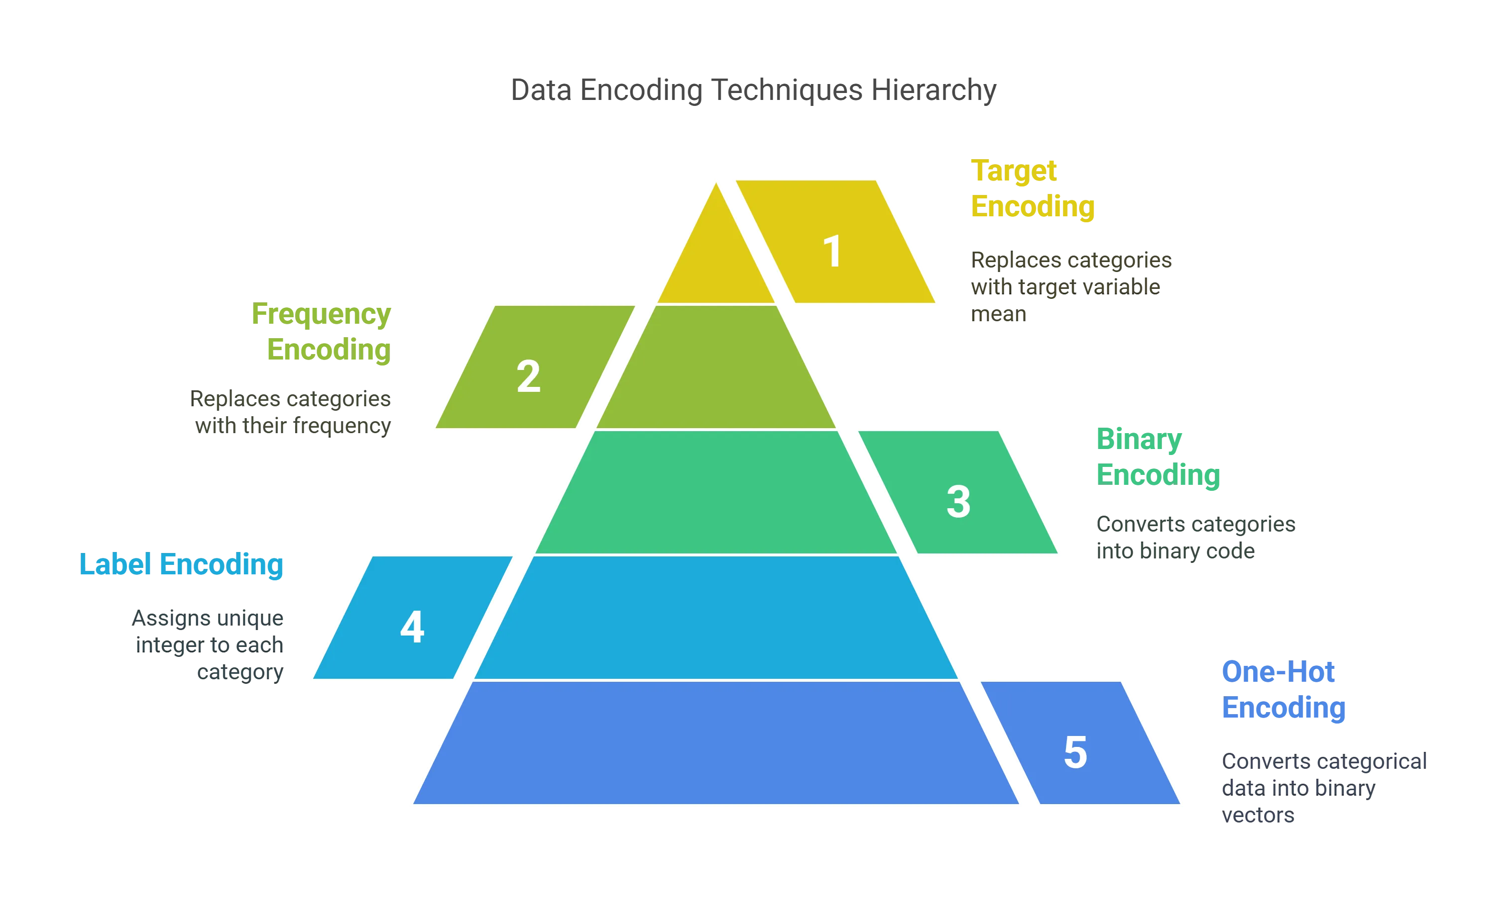
Categorical Encoding

Slide 5
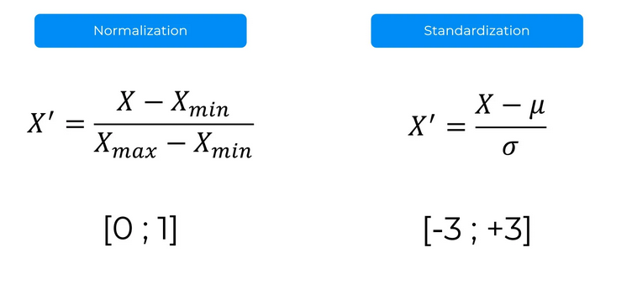
Feature Scaling

Slide 6
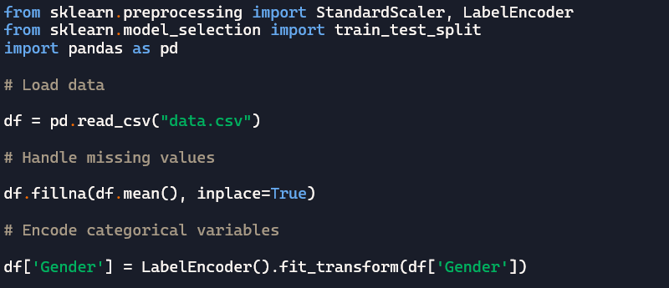
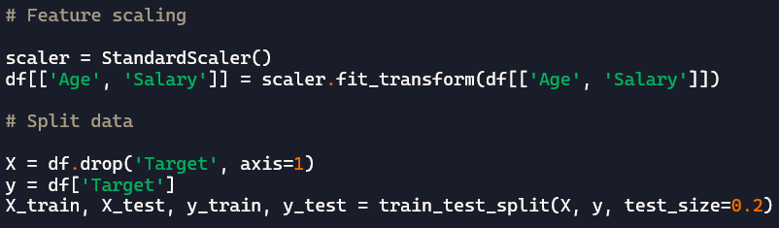
Example

Slide 7
Data Pre-processing in Action…
Lab for data pre-processing

Slide 8
What next….
Regression
Classification
Clustering
Natural language Processing
Deep Learning

Slide 9
Q & A

