Slide 1

Project Title –
SEASONAL AGRICULTURE PERFORMANCE ANALYSIS
Name: Radhika Ashok Bhadoriya
College: Prestige Institute of Management and Research
AICTE STU ID : STU692ee45c16a131764680796

Slide 2

PROBLEM STATEMENT
Agricultural activities are influenced by seasonal variations in environmental conditions, farming practices, resource availability and market conditions.
The project analyses the given agricultural dataset to investigate seasonal differences in agricultural performance by identifying meaningful:
Patterns
Trends
Relationships
Variations
Seasonal performance differences
The analysis helps understand how agricultural performance changes across Kharif, Rabi and Zaid seasons using statistical analysis and data visualization.

Slide 3
Project Description
Seasonal Agriculture Performance Analysis is a data analytics project focused on understanding agricultural performance across different seasons.
The dataset contains 4,000 farm records and 28 original variables covering:
Geographical information
Crops and seasons
Environmental conditions
Farming practices
Production and yield
Water usage
Economic performance
Disease/Pest risk
The project involved data understanding, data quality analysis, contextual missing-value treatment, statistical analysis, univariate analysis, outlier analysis, bivariate analysis, multivariate analysis and seasonal comparison.
The final analysis was used to identify important patterns and provide evidence-based recommendations for seasonal agricultural planning.

Slide 4
Objectives
Objectives of the Project
Explore and understand the agricultural dataset.
Identify and treat missing values and data-quality issues.
Examine agricultural performance across seasons.
Analyse relationships between environmental and agricultural variables.
Compare crop and seasonal performance.
Analyse production, profit and resource usage.
Identify unusual observations and outliers.
Study water usage and water efficiency.
Use statistical and visualization techniques to interpret the data.
Provide evidence-based insights and recommendations.

Slide 5

WHO ARE THE END USERS?
Farmers and agricultural practitioners
Agricultural planners
Agricultural researchers
Government and agriculture departments
Irrigation and resource-management planners
Agribusiness organizations
Data analysts
Students and academic researchers

Slide 6

Technology Used
Programming Language | Analytical Techniques
Python Libraries & Tools: Pandas NumPy Matplotlib Seaborn Google Colab | Descriptive Statistics Group-wise Analysis Univariate Analysis Outlier Analysis Bivariate Analysis Multivariate Analysis Seasonal Comparison Data Visualization

Slide 7
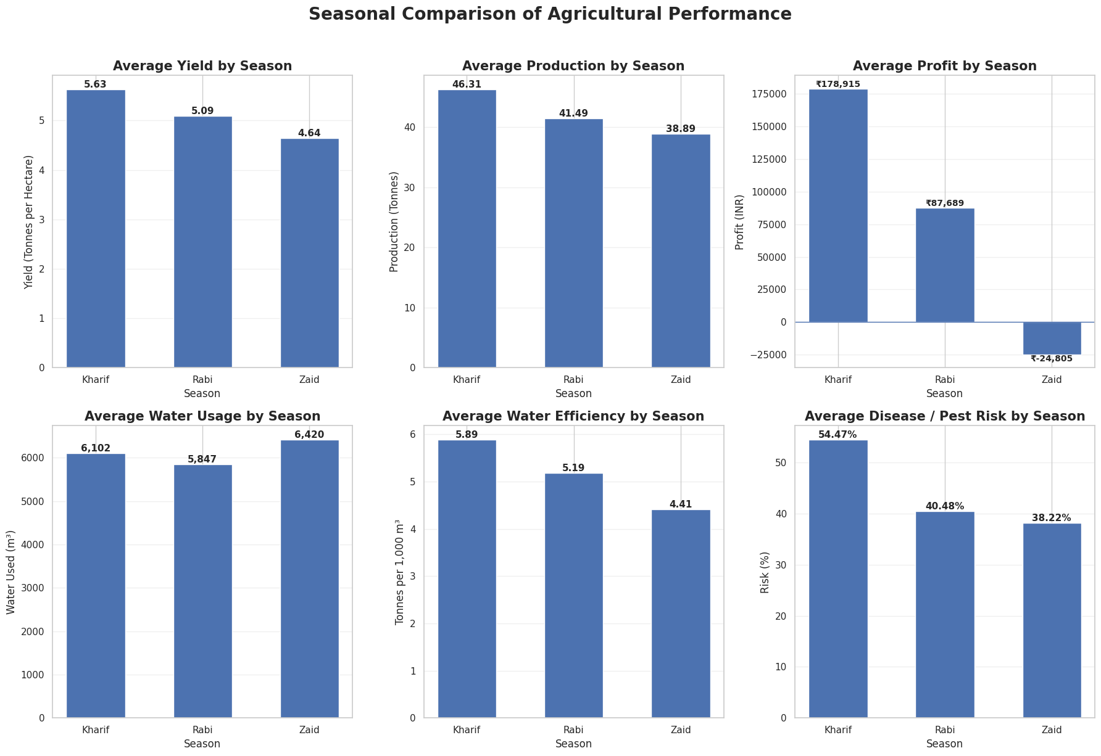
RESULTS: Seasonal Performance Comparison
Notes:
Key Observation: Kharif showed the strongest average performance, while Zaid recorded the lowest average yield, production and profit.

Slide 8
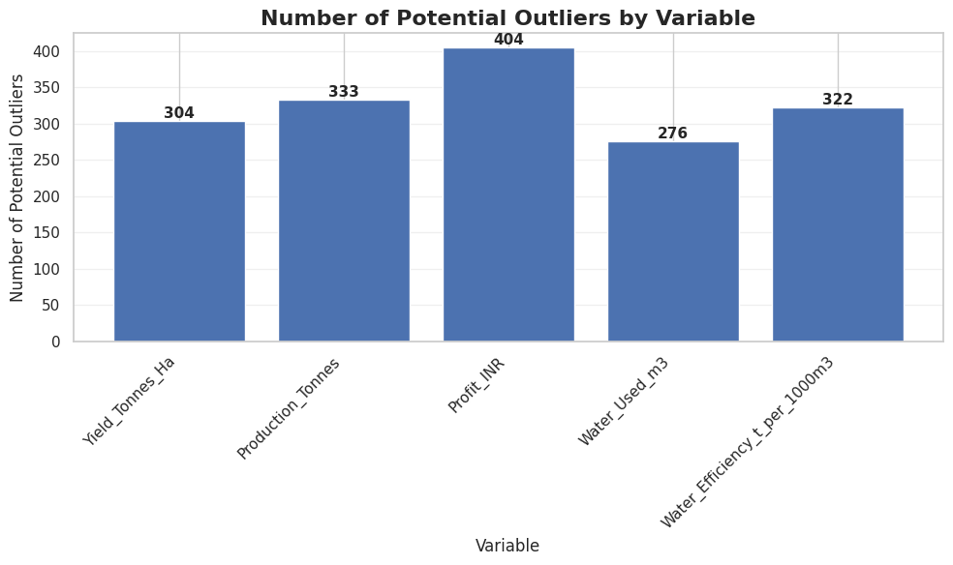
RESULTS: Outlier Analysis
[Add screen shots of your code ]
Notes:
IQR Method was used to identify unusually high or low observations.
Key Observation: Profit had the highest number of detected outliers (404; 10.10%).
Outliers were retained because they may represent genuine differences in farm-scale, production, price, cost or efficiency.

Slide 9
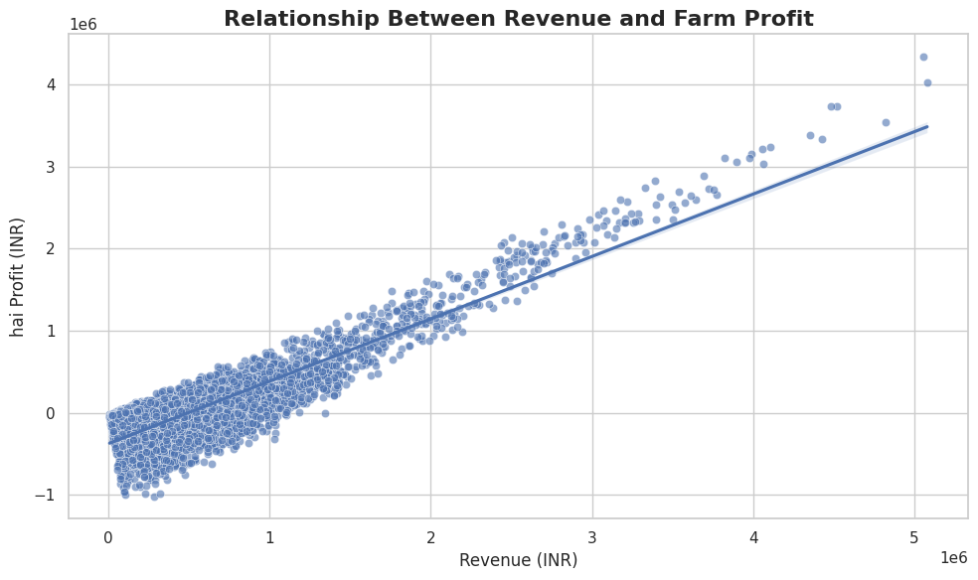
RESULTS: Relationship Between Revenue and Farm Profit
[Add screen shots of your code ]
Notes:
The analysis examined the relationship between revenue and farm profit using a scatter plot with regression analysis.
Key Observation: Revenue and profit were analyzed together to understand their association in the dataset.

Slide 10
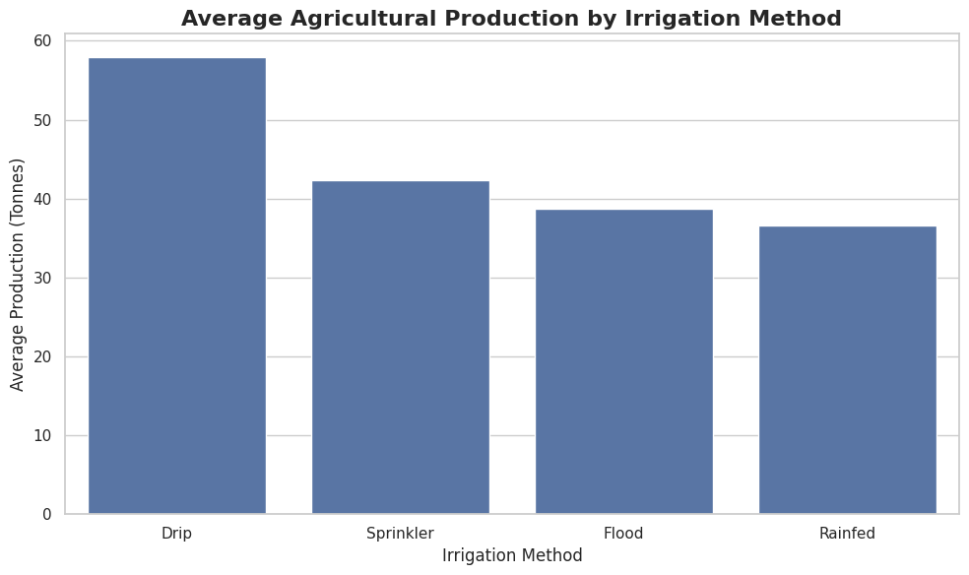
RESULTS: Production Performance by Irrigation Method
Notes:
Average production was compared across different irrigation methods to examine differences in agricultural performance.
Key Observation: Irrigation methods showed differences in average production.

Slide 11
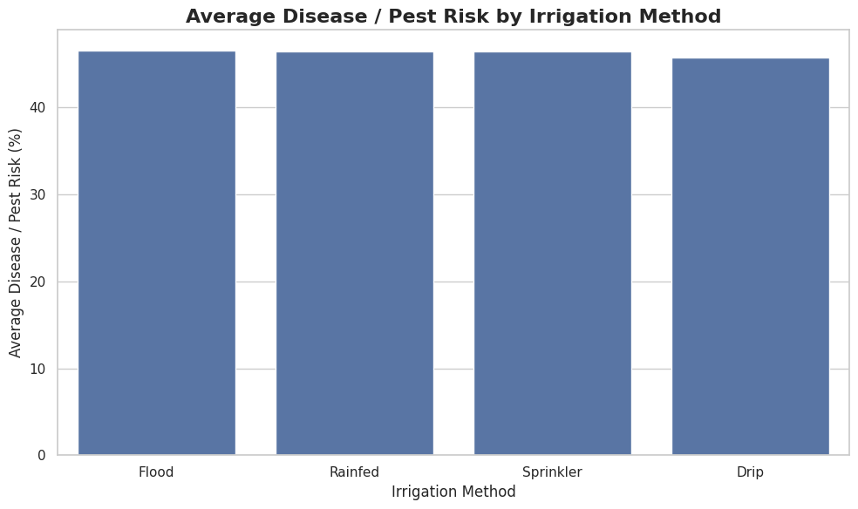
RESULTS: Disease/Pest Risk by Irrigation Method
Notes:
Average disease/pest risk was compared across irrigation methods to identify differences in observed agricultural risk levels.
Key Observation: Disease/pest risk varied across irrigation methods in the dataset.

Slide 12
Future scope
Include larger and more recent agricultural datasets.
Add more geographical and environmental information.
Analyse longer-term seasonal trends.
Integrate real-time weather and rainfall data.
Include additional soil and crop-health parameters.
Develop predictive models in future work.
Develop interactive dashboards for decision support.
Extend analysis to more states, crops and farming regions.
Validate findings using real-world field data.

Slide 13
GitHub Link
GitHub Repository
Seasonal Agriculture Performance Analysis
Repository:
https://github.com/
Project Contents
Google Colab analysis
Data cleaning
Statistical analysis
Visualizations
Seasonal comparison
Key insights
Recommendations
Project documentation

Slide 14
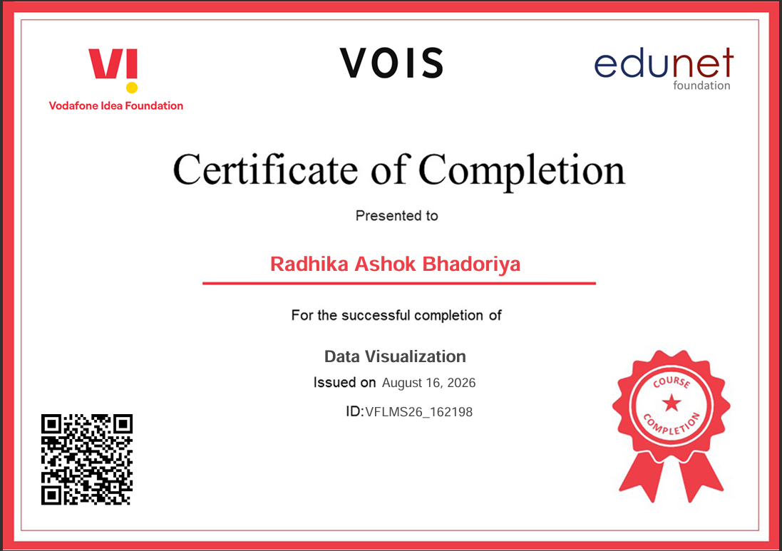
VOIS Course completion certificate -
Course name- Data Visualization

Slide 15
Thank you
.
.

