Slide 1
Module 4
Memory System Organization and
Architecture

Slide 2
Introduction
Programs and the data that processor operate are held in the main memory of the computer during execution, and the data with high storage requirement is stored in the secondary memories.

Slide 3
Memory Basic Concepts
Maximum size of the Main Memory
byte-addressable
CPU-Main Memory Connection
Processor
k
-bit
Memory
address bus
MAR
n
-bit
data bus
Up to 2
k
addressable
MDR
locations
Word length =
n
bits
Control lines
R
/
W
( , MFC, etc.)

Slide 4
Memory Basic Concepts
Measures for the speed of a memory:
  Memory access time.
  Memory cycle time.
An important design issue is to provide a computer system with as large and fast a memory as possible, within a given cost target.
Several techniques to increase the effective size and speed of the memory:
  Cache memory (to increase the effective speed).
  Virtual memory (to increase the effective size).

Slide 5
Memory Hierarchy / Multilevel Memory
Memory unit is essential component of digital computer since it is needed for storing programs and data.
Memory unit that communicates directly with CPU is called Main memory.
Devices that provide backup storage is called auxiliary memory.
Only programs and data currently needed by processor reside in the main memory.
All other information is stored in auxiliary memory and transferred to main memory when needed.

Slide 6
Main Memory
It is the memory used to store programs and data during the computer operation.
The principal technology is based on semiconductor integrated circuits.
It consists of RAM and ROM chips.
RAM chips are available in two form static and dynamic.

Slide 7
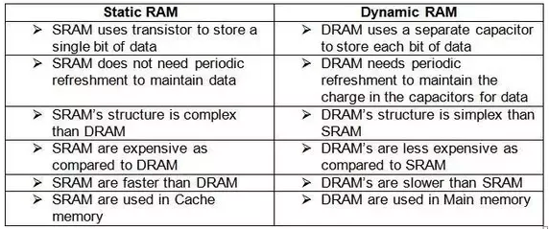

Slide 8
Main Memory
ROM uses Read Only Mode.
It is used for storing programs that are permanent and the tables of constants that do not change.
ROM store program called bootstrap loader whose function is to start the computer software when the power is turned on.
When the power is turned on, the hardware of the computer sets the program counter to the first address of the bootstrap loader

Slide 9
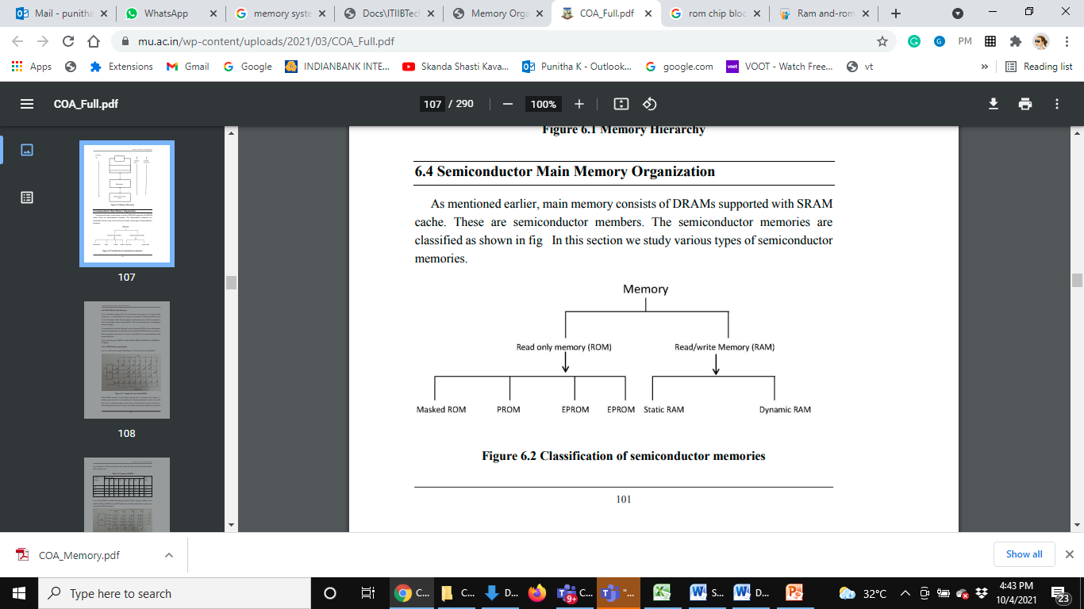

Slide 10
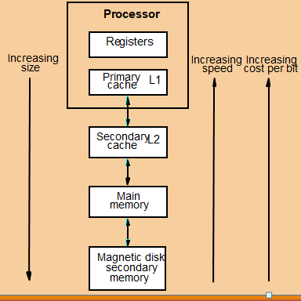
Memory Hierarchy

Slide 11
Memory Hierarchy(Levels of memory)
Level 1 or Register : Data is stored and accepted that are immediately stored in CPU. Most commonly used registers are accumulator, Program counter, address register etc.
Level 2 or Cache memory: Fastest memory which has faster access time where data is temporarily stored.
Level 3 or Main Memory: Memory on which computer works currently. It is small in size and once power is off data no longer stays in this memory.
Level 4 or Secondary Memory: External memory which is not as fast as main memory but larger and data stays permanently in this memory.

Slide 12
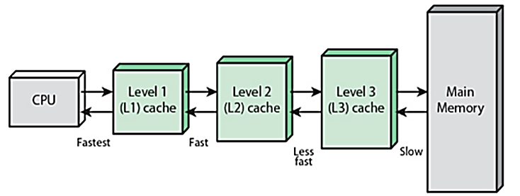
Cache Memory (Levels of memory)

Slide 13
Cache Memory
A special very high-speed memory.
Used to speed up and synchronizing with high-speed CPU.
Costlier than main memory or disk memory but economical than CPU registers.
Extremely fast memory type that acts as a buffer between RAM and the CPU. It holds frequently requested data and instructions so that they are immediately available to the CPU when needed.
Used to reduce the average time to access data from the Main memory.
Smaller and faster memory which stores copies of the data from frequently used main memory locations.
Various different independent caches in a CPU, which store instructions and data.

Slide 14
Cache Memory Management
Processor
Cache
Main
memory
Processor issues a Read request, a block of words is transferred from the main memory to the cache, one word at a time.
Subsequent references to the data in this block of words are found in the cache.
At any given time, only some blocks in the main memory are held in the cache. Which blocks in the main memory are in the cache is determined by a “mapping function”.
When the cache is full, and a block of words needs to be transferred
from the main memory, some block of words in the cache must be
replaced. This is determined by a “replacement algorithm”.

Slide 15
Locality of Reference
Analysis of programs indicates that many instructions in localized areas of a program are executed repeatedly during some period of time, while the others are accessed relatively less frequently.
Temporal locality of reference:
  Recently executed instruction is likely to be executed again very soon.
Spatial locality of reference:
  Instructions with addresses close to a recently instruction are likely
  to be executed soon.

Slide 16
Terminology
Cache: memory closest to the processor in a memory hierarchy
Caching: any storage management technique exploiting locality
Upper/lower level: memory closer/further from the processor
Block: unit of memory transfer (block of words) between two levels in a memory hierarchy. Also called a cache line /index

Slide 17
Cache Performance
Cache hit: If the processor finds the memory location it is searching
Cache miss: If the processor does not find the intended memory location
The performance of cache memory is frequently measured in terms of a quantity called Hit ratio.
Hit ratio = hit / (hit + miss)= Number of hits/total accesses
Miss penalty : time to move a block from a lower level in the hierarchy and satisfy the processor’s request

Slide 18
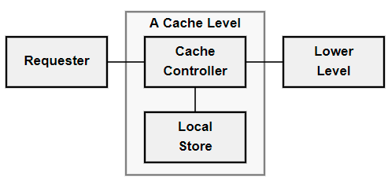
Cache Access Time
Effective access time is a standard effective average.
effective-access-time = hit-rate * cache-access-time + miss-rate * lower-level-access-time
Miss penalty is defined as the difference between lower level access time and cache access time.
effective-access-time = hit rate * cache-access-time + miss-rate * miss-penalty

Slide 20
Cache Mapping
Direct mapping, Associative mapping, and Set-Associative mapping

Slide 21
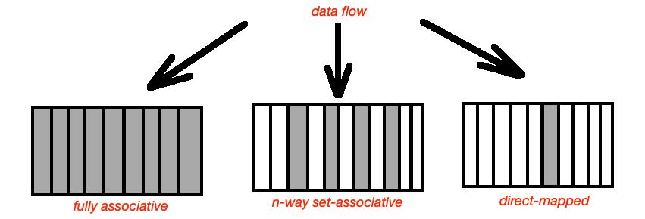
Three types of cache memory mapping

Slide 22
Three types of cache memory mapping
In a fully associative cache every memory location can be cached in any cache line. This memory type significantly decreases amount of cache-line misses, considered as complex type of cache memory implementation.
In direct-mapped cache memory location maps to a single cache line. It can be used once per address per amount of time. Performance of this cache memory type is lower than others.
In N-way-set-associative cache, the most common cache implementation, memory address can be stored in any N lines of cache.

Slide 23
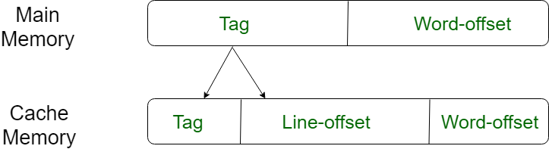
Cache Mapping: Direct mapping
Maps each block of main memory into only one possible cache line.
Index =Line number = block number

Slide 24
Blocks in a Direct-Mapped cache
One block = the whole cache
A simple processor example:
  Cache consisting of 128 blocks of 16 words each.
  Total size of cache is 2048 (2K) words.
  Main memory is addressable by a 16-bit address.
  Main memory has 64K words.
  Main memory has 4K blocks of 16 words each.
Main
Block 0
memory
Cache
Block 1
tag
Block 0
tag
Block 1
Block 127
Block 128
tag
Block 127
Block 129
T
ag
Block
W
ord
Block 255
5
7
4
Block 256
Main memory address
Block 257
Block 4095

Slide 25
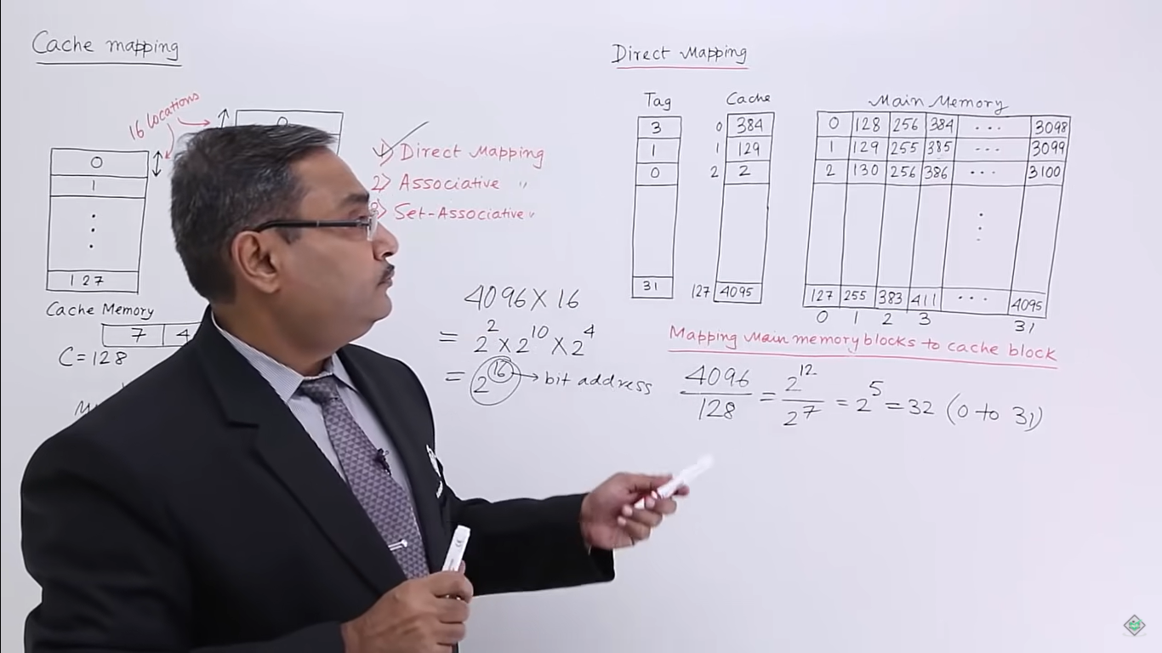
Partitioning of the memory into block in Direct-Mapped cache
Block size that are equal to the size of the Direct-mapped cache

Slide 26
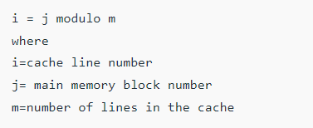
Direct-Mapped cache
A particular block of main memory can be mapped to one particular cache line only.
Block ‘j’ of main memory will map to line number (j mod number of cache lines) of the cache.
There is no need of any replacement algorithm.

Slide 27
Consider a direct mapped cache of size 16 KB with block size 256 bytes. The size of main memory is 128 KB. Find the number of bits in tag and Tag directory size.
Solution:
Given:-
  Cache memory size = 16 KB
  Block size = Frame size = Line size = 256 bytes
  Main memory size = 128 KB
Consider that the memory is byte addressable
Number of Bits in Physical Address-
Size of main memory= 128 KB = 2¹⁷ bytes
Thus, Number of bits in physical address = 17 bits

Slide 28
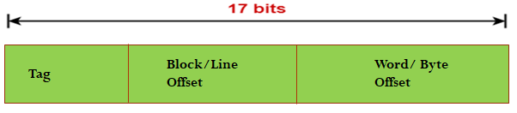
Consider a direct mapped cache of size 16 KB with block size 256 bytes. The size of main memory is 128 KB. Find the number of bits in tag and Tag directory size.
Solution:
Number of bits in physical address = 17 bits

Slide 29
Consider a direct mapped cache of size 16 KB with block size 256 bytes. The size of main memory is 128 KB. Find the number of bits in tag and Tag directory size.
Number of Bits in Block Offset-
Block size = 256 bytes = 2⁸ bytes
Thus, Number of bits in block offset = 8 bits

Slide 30
Consider a direct mapped cache of size 16 KB with block size 256 bytes. The size of main memory is 128 KB. Find the number of bits in tag and Tag directory size.
Number of Bits in Line Number-
Total number of lines in cache = Cache size /Line size
= 16 KB / 256 bytes
= 2¹⁴ bytes / 2⁸ bytes = = 2⁶ lines
Thus, Number of bits in line number = 6 bits

Slide 31

Number of Bits in Tag-
= Number of bits in physical address – (Number of bits in line number + Number of bits in block offset)
= 17 bits – (6 bits + 8 bits) = 17 bits – 14 bits
= 3 bits
Thus, Number of bits in tag = 3 bits
Block/Line Offset
Word/ Byte Offset
Tag

Slide 32
Tag Directory Size
= Number of tags x Tag size
= Number of lines in cache x Number of bits in tag
= 2⁶ x 3 bits
= 192 bits
= 24 bytes
Thus, size of tag directory = 24 bytes

Slide 33
Problem-02: Consider a direct mapped cache of size 512 KB with block size 1 KB. There are 7 bits in the tag. Find Size of main memory, Tag directory size and find to which cache line block 127 will be mapped to?
Solution
Given:
Cache memory size = 512 KB
Block size = Frame size = Line size = 1 KB
Number of bits in tag = 7 bits
Consider that the memory is byte addressable.

Slide 34
Number of Bits needed to find Block Offset-
Block size = 1 KB = 2¹⁰ bytes
Thus, Number of bits in word offset = 10 bits
Number of Bits in Line Number
Cache size / Line size = 512 KB / 1 KB = 2⁹ lines
Number of bits in line number = 9 bits

Slide 35
Number of bits in physical address
= Number of bits in tag + Number of bits in line number + Number of bits in block offset
= 7 bits + 9 bits + 10 bits = 26 bits
Number of bits in physical address = 26 bits
Size of Main Memory-
Number of bits in physical address = 26 bits
Thus, Size of main memory = 2²⁶ bytes = 64 MB
Tag Directory Size-
Tag directory size = Number of tags x Tag size
= Number of lines in cache x Number of bits in tag = = 2⁹ x 7 bits
= 3584 bits = 448 bytes
Thus, size of tag directory = 448 bytes
Mapping
Cache lines = 2⁹ = 512 lines
⁼ 127 modulo 512 = 127th cache line

Slide 36
3. Consider a direct mapped cache with block size 4 KB. The size of main memory is 16 GB and there are 10 bits in the tag. Find the Size of cache memory and Tag directory size.
Block size = Frame size = Line size = 4 KB
Size of main memory = 16 GB
Number of bits in tag = 10 bits
Number of Bits in Physical Address ?
Number of Bits in Block Offset ?
Number of Bits in Line Number ?
Number of Lines in Cache ?
Size of Cache Memory?
Tag Directory Size?

Slide 37
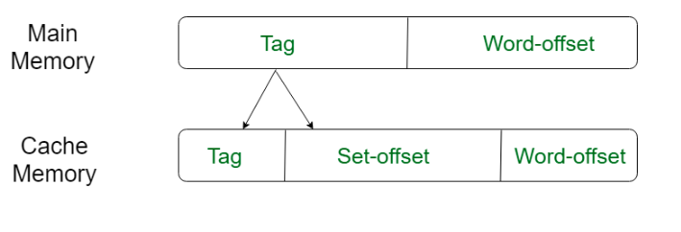
Set Associative Mapping
A particular block of main memory can be mapped to one particular cache set only.
Block ‘j’ of main memory will map to set number (j mod number of sets in cache) of the cache.
A replacement algorithm is needed if the cache is full.
Set number = number of blocks in the set= index

Slide 38
Set-Associative mapping
Cache
Main
memory
Block 0
Blocks of cache are grouped into sets.
Mapping function allows a block of the main
memory to reside in any block of a specific set.
Divide the cache into 64 sets, with two blocks per set.
Memory block 0, 64, 128 etc. map to block 0, and they
can occupy either of the two positions.
Memory address is divided into three fields:
- 6 bit field determines the set number.
- High order 6 bit fields are compared to the tag
fields of the two blocks in a set.
Set-associative mapping combination of direct and
associative mapping.
I = j modulo 64 ( as the set size is 64)
Number of blocks per set is a design parameter.
- One extreme is to have all the blocks in one set,
requiring no set bits (fully associative mapping).
- Other extreme is to have one block per set, is
the same as direct mapping.
tag
Block 0
Block 1
tag
Block 1
tag
Block 2
tag
Block 3
Block 63
Block 64
tag
Block 126
Block 65
tag
Block 127
T
ag
Set
W
ord
Block 127
6
6
4
Block 128
Main memory address
Block 129
Block 4095

Slide 39
Consider a 2-way set associative mapped cache of size 16 KB with block size 256 bytes. The size of main memory is 128 KB. Find Number of bits in tag and Tag directory size
Given: Set size = 2, Cache memory size = 16 K, Block size = Frame size = Line size = 256 bytes, Main memory size = 128 KB, consider that the memory is byte addressable.
Number of Bits in Physical Address-
Size of main memory= 128 KB = 2¹⁷ bytes
Thus, Number of bits in physical address = 17 bits

Slide 40
Consider a 2-way set associative mapped cache of size 16 KB with block size 256 bytes. The size of main memory is 128 KB. Find Number of bits in tag and Tag directory size
Number of Bits in Block Offset-
Block size = 256 bytes = 2⁸ bytes
Thus, Number of bits in block offset = 8 bits
Number of Lines in Cache-
Total number of lines in cache = Cache size /Line size
= 16 KB / 256 bytes = 2¹⁴ bytes / 2⁸ bytes = 64 lines

Slide 41
Consider a 2-way set associative mapped cache of size 16 KB with block size 256 bytes. The size of main memory is 128 KB. Find Number of bits in tag and Tag directory size
Number of Sets in Cache-
Total number of sets in cache
= Total number of lines in cache / Set size
= 64 / 2 = 32 sets = 2⁵ sets
Thus, Number of bits in set number = 5 bits

Slide 42
Consider a 2-way set associative mapped cache of size 16 KB with block size 256 bytes. The size of main memory is 128 KB. Find Number of bits in tag and Tag directory size
Number of Bits in Tag-
= Number of bits in physical address – (Number of bits in set number + Number of bits in block offset)
= 17 bits – (5 bits + 8 bits) = 17 bits – 13 bits = 4 bits
Thus, Number of bits in tag = 4 bits
Tag
Set Offset
Byte Offset/ Word Offset

Slide 43
Consider a 2-way set associative mapped cache of size 16 KB with block size 256 bytes. The size of main memory is 128 KB. Find Number of bits in tag and Tag directory size
Tag Directory Size-
= Number of tags x Tag size
= Number of lines in cache x Number of bits in tag
= 64 x 4 bits = 256 bits = 32 bytes
Thus, size of tag directory = 32 bytes

Slide 44
Fully Associative Mapping
A block of main memory can be mapped to any freely available cache line.
This makes fully associative mapping more flexible than direct mapping.
A replacement algorithm is needed to replace a block if the cache is full.

Slide 45
Associative mapping
Main
Block 0
memory
Main memory block can be placed into any cache
position.
Memory address is divided into two fields:
- Low order 4 bits identify the word within a block.
- High order 12 bits or tag bits identify a memory
block when it is resident in the cache.
Flexible, and uses cache space efficiently.
Replacement algorithms can be used to replace an
existing block in the cache when the cache is full.
Cost is higher than direct-mapped cache because of
the need to search all 128 patterns to determine
whether a given block is in the cache.
Cache
Block 1
tag
Block 0
tag
Block 1
Block 127
Block 128
tag
Block 127
Block 129
Tag
Word
Block 255
12
4
Block 256
Main memory address
Block 257
Block 4095

Slide 46
1.Consider a fully associative mapped cache of size 16 KB with block size 256 bytes. The size of main memory is 128 KB. Find the number of bits in tag, Tag directory size.
Cache memory size = 16 KB
Block size = Frame size = Line size = 256 bytes
Main memory size = 128 KB
Size of main memory= 128 KB = 2¹⁷ bytes
Number of bits in physical address = 17 bits

Slide 47
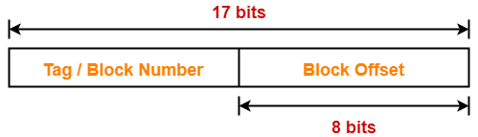
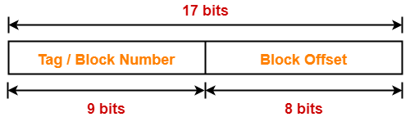
Number of Bits in Block Offset
Block size = 256 bytes = 2⁸ bytes
Number of bits in block offset = 8 bits
Number of Bits in Tag

Slide 48
Number of Lines in Cache
Total number of lines in cache = Cache size/Line size
= 16 KB / 256 bytes = 2¹⁴ bytes / 2⁸ bytes = 2⁶ lines
Tag Directory Size = Number of tags x Tag size
= Number of lines in cache x Number of bits in tag
= 2⁶ x 9 bits = 576 bits = 72 bytes
Size of tag directory = 72 bytes

Slide 49
2.Consider a fully associative mapped cache of size 512 KB with block size 1 KB. There are 17 bits in the tag. Find the size of main memory, Tag directory size
Cache memory size = 512 KB
Block size = Frame size = Line size = 1 KB
Number of bits in tag = 17 bits

Slide 50

Consider a fully associative mapped cache of size 512 KB with block size 1 KB. There are 17 bits in the tag. Find the size of main memory, Tag directory size
Cache memory size = 512 KB
Block size = Frame size = Line size = 1 KB
Number of bits in tag = 17 bits
Number of Bits in Block Offset
Block size = 1 KB = 2¹⁰ bytes
Thus, Number of bits in block offset = 10 bits

Slide 51
Number of Bits in Physical Address
Number of bits in physical address = Number of bits in tag + Number of bits in block offset
= 17 bits + 10 bits = 27 bits
Size of Main Memory= Number of bits in physical address = 27 bits
Size of main memory = 2²⁷ bytes = 128 MB

Slide 52
Number of Lines in Cache-
Total number of lines in cache = Cache size / Line size
= 512 KB / 1 KB = 512 lines = 2⁹ lines
Tag Directory Size-
= Number of tags x Tag size
= Number of lines in cache x Number of bits in tag
= 2⁹ x 17 bits = 8704 bits = 1088 bytes
Thus, size of tag directory = 1088 bytes

Slide 53
Replacement Algorithms
For direct mapping where there is only one possible line for a block of memory, no replacement algorithm is needed.
For associative and set associative mapping, however, an algorithm is needed.
For maximum speed, this algorithm is implemented in the hardware. Four of the most common algorithms are:
Least Recently Used:- This replaces the candidate line in cache memory that has been there the longest with no reference to it.
first In first Out:- This replaces the candidate line in the cache that has been there the longest.
Least frequently Used:- This replaces the candidate line in the cache that has had the fewest references.
Random Replacement:- This algorithm randomly chooses a line to be replaced from among the candidate lines. This yields only slightly inferior performance than other algorithms.

Slide 54
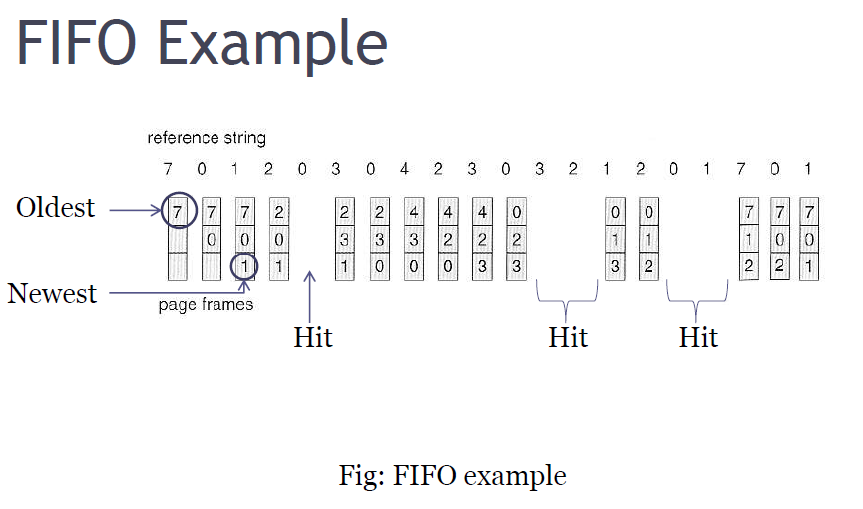
FIFO (First In First Out)
Pages in main memory are kept in a list
First in first out is very easy to implement
The FIFO algorithm select the page for replacement that has been in memory the longest time

Slide 55
FIFO (First In First Out)
Advantages:
  FIFO is easy to understand.
  It is very easy to implement.
Disadvantages:
  The oldest block in memory may be often used.

Slide 56
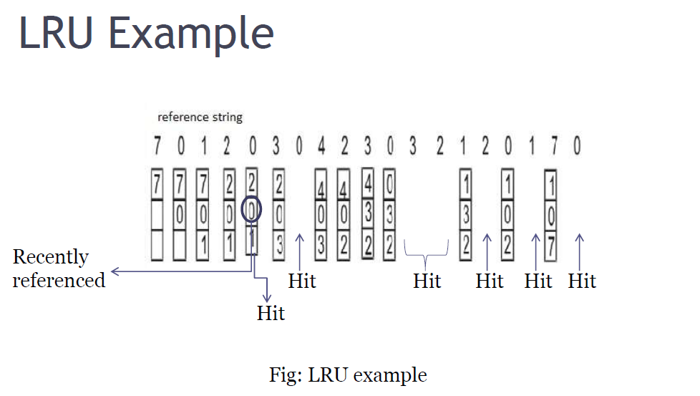
LRU (Least Recently Used)
The least recently used page replacement algorithm keeps track page uses over a
short period of time.

Slide 57
LRU (Least Recently Used)
Advantages:
  LRU page replacement algorithm is quiet efficient.
Disadvantages:
  Implementation difficult. This algorithm requires keeping track of what was used when, which is expensive if one wants to make sure
  the algorithm always discards the least recently used item.

Slide 58
LFU (Least Frequently Used)
The Least-Frequently-Used (LFU) Replacement technique replaces the least-frequently block in use when an eviction must take place.
Software counter associated with each block, initially zero is required in this algorithm.
The operating system checks all the blocks in the cache at each clock interrupt.
The R bit, which is '0' or '1', is added to the counter for each block. Consequently, the counters are an effort to keep track of the frequency of referencing each block.
When a block must be replaced, the block that has the lowest counter is selected for the replacement.

Slide 59
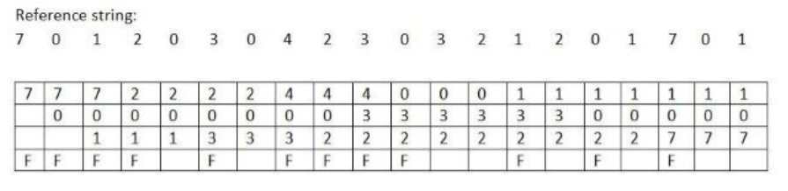
LFU (Least Frequently Used)
Number of page faults = 12.
Number of page hits= 8.

Slide 60
LFU (Least Frequently Used)
Advantages:
  Frequently used block will stay longer than (fifo)
Disadvantages:
  Older blocks are less likely to be removed , even if they are on longer frequently used because this algorithm never forgets anything.
  Newer blocks are more likely to be replaced even if they are frequently used.
  Captures only frequency factor.

Slide 61
Random Replacement
When we need to evict a page, choose one randomly
Advantage:
  Extremely simple
Disadvantages:
  Can easily make "bad" choices by swapping out pages right before they are needed.

Slide 62
Miss rate and Hit rate problems
Problem 1:
Consider a direct mapped cache with 8 cache blocks (0-7). If the memory block requests are in the order-
3, 5, 2, 8, 0, 6, 3, 9, 16, 20, 17, 25, 18, 30, 24, 2, 63, 5, 82, 17, 24
Which of the following memory blocks will be in the cache at the end of the sequence?
Also, calculate the hit ratio and miss ratio.

Slide 63
We have,
There are 8 blocks in cache memory numbered from 0 to 7.
In direct mapping, a particular block of main memory is mapped to a particular line of cache memory.
The line number is given by-
Cache line number = Block address modulo Number of lines in cache

Slide 64
Solution-
For the given sequence-
Requests for memory blocks are generated one by one.
The line number of the block is calculated using the above relation.
Then, the block is placed in that particular line.
If already there exists another block in that line, then it is replaced.

Slide 65
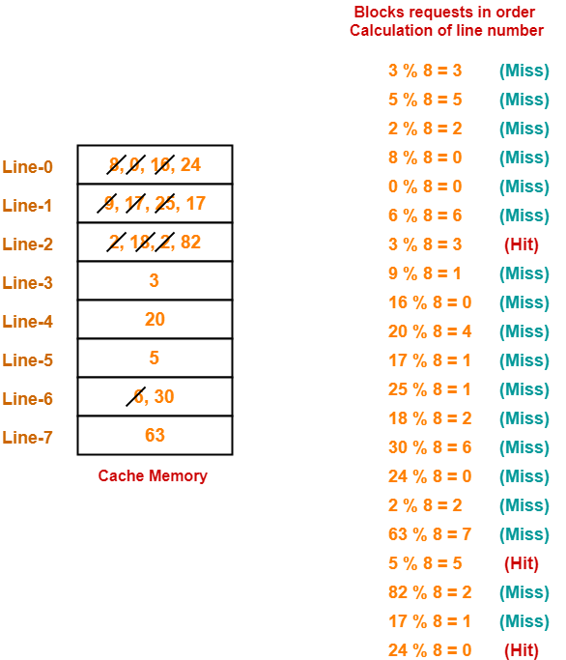

Slide 66
Hit ratio = 3 / 20
Miss ratio = 18 / 20

Slide 67
Problem2
Consider a fully associative cache with 8 cache blocks (0-7). The memory block requests are in the order-
4, 3, 25, 8, 19, 6, 25, 8, 16, 35, 45, 22, 8, 3, 16, 25, 7
If LRU replacement policy is used, which cache block will have memory block 7?
Also, calculate the hit ratio and miss ratio.

Slide 68
Solution:
We have,
There are 8 blocks in cache memory numbered from 0 to 7.
In fully associative mapping, any block of main memory can be mapped to any line of the cache that is freely available.
If all the cache lines are already occupied, then a block is replaced in accordance with the replacement policy.

Slide 69
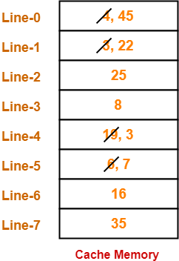

Slide 70
Thus,
Line-5 contains the block-7.
Hit ratio = 5 / 17
Miss ratio = 12 / 17

Slide 71
Average Memory access time Problem
A cache is having 60% hit ratio for read operation. Cache access time is 30 ns and main memory access time is 100 ns, 50% operations are read operation.
What will be the average access time for read operation?
Avg access time (for read operation) = Hit ratio * cache access time + miss ratio * ( Cache access time + MM access time )
Given, Cache access time is 30 ns and main memory access time is 100 ns.
Hit ratio = 60% so Miss ratio = 40%
so Avg access time = (0.6 * 30 ) + 0.4 * ( 30 + 100 )
= 18 + 52
= 70
so average access time for read operation is 70 ns.

