Slide 1
Module 5- Buses
Synchronous bus
Asynchronous bus

Slide 2
Introduction
Processor, main memory, and I/O devices connected by a common bus to provide a communication path for the transfer of data
Bus protocol – set of rules that govern the behaviour of devices connected to the
bus, like when to place information, assert control signals, etc.
Three types of bus lines – address, data, control
  Control signals – Read/Write, size of data, timing information
Bus master – initiates data transfers (also called initiator) – processor or DMAC
Slave or target – device addressed by the bus master
Schemes for timing of data transfers over the bus
  Synchronous
  Asynchronous
2

Slide 3
Synchronous Bus – Introduction
All devices derive timing information from a common clock line.
  This clock is not necessarily the processor clock.
  Equally spaced pulses on this line define equal time intervals.
  Each interval constitutes a bus cycle during which one data transfer may take place.
Note:
  In the timing diagram, address and data lines are shown as high and low at the same time since some lines may be high and some may be low. Crossing points indicate when the values change.
  Indeterminate or high-impedance state – intermediate level between high and low signal levels

Slide 4
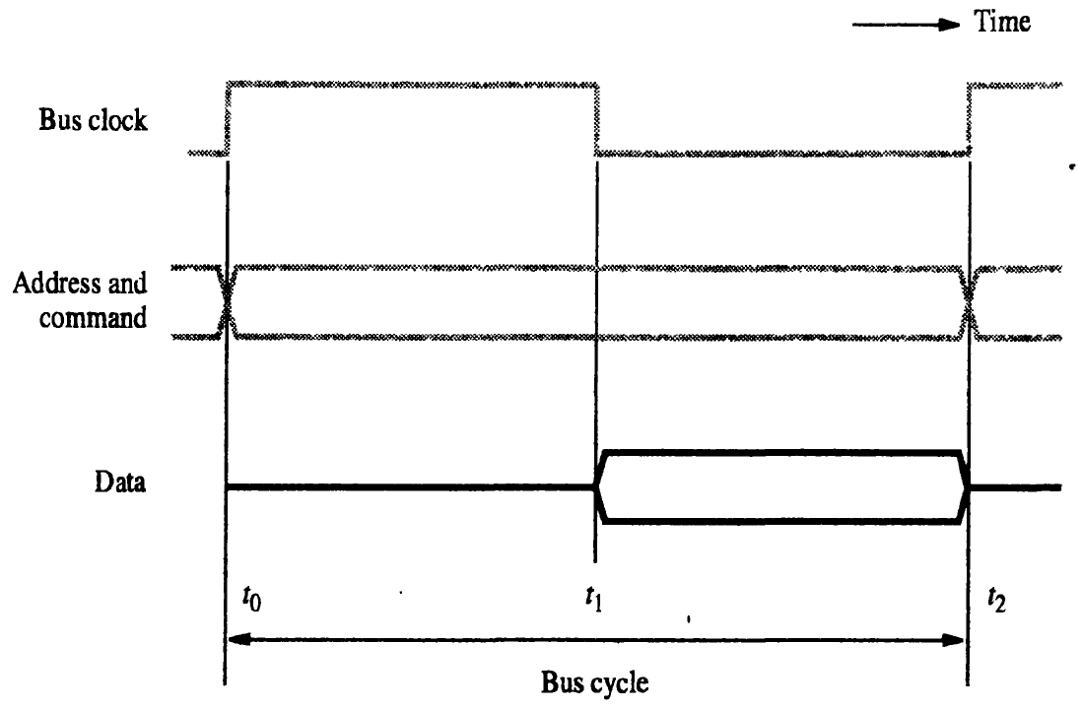
Single Cycle Transfer – Read
𝑡₀: Master places address and
commands
𝑡₁: Slave transfers data
𝑡₁ − 𝑡₀ > the maximum propagation delay between 2 devices
Data transfer should not happen between 𝑡₀ and 𝑡₁ since information on bus is unreliable
At the end of 𝑡₂, the master strobes the data into its input buffer.
𝑡₂ − 𝑡₁ > max propagation time
+ set up time of input buffer

Slide 5
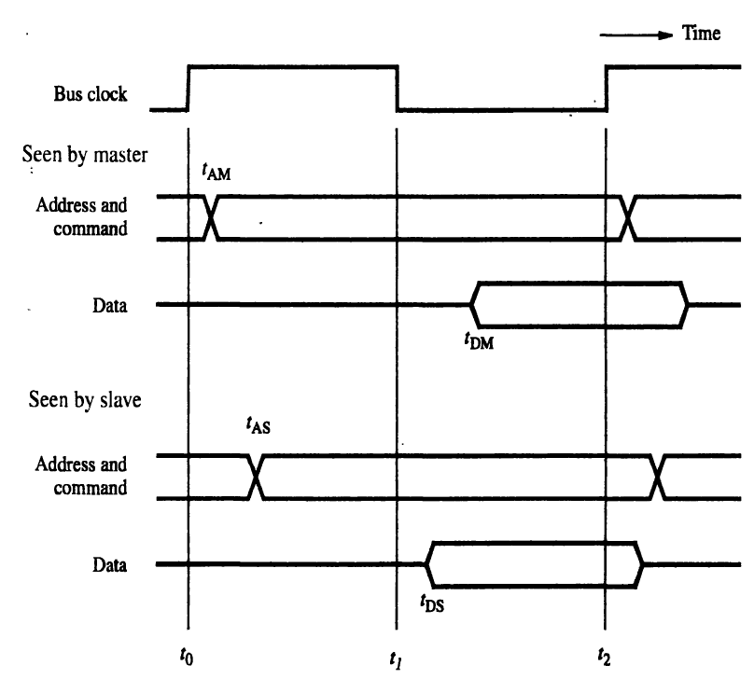
Read Operation - Detailed

Slide 6
Multiple-Cycle Transfer
In the previous case, data has to be transferred within one clock cycle.
Limitations:
  The clock cycle period must be chosen to accommodate the longest delays on the bus and the slowest device interface.
  This forces all devices to operate at the speed of the slowest device.
  The processor has no way to determine if the addressed device has
responded. If the device does not respond, malfunction will not be detected.
To overcome these limitations, incorporate control signals to represent response from the device and use a high frequency clock.
  Duration of data transfer can be adjusted to suit the device.
  No. of clock cycles involved will vary from device to device.

Slide 7
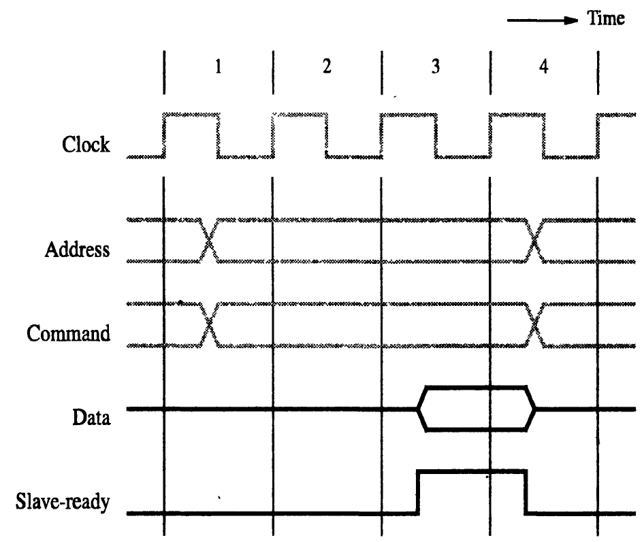
Multiple-Cycle Transfer
Clock cycle 1: Master sends address and command information.
Slave receives the info and decodes.
Clock cycle 2:
Slave decides to
respond and starts to access the requested data.
Clock cycle 3: Data is ready and slave places it on the bus and asserts Slave- ready signal.
Master strobes the data into its buffer at the end of clock cycle 3.
Master can start another transfer in cycle 4.
If addressed device does not respond, master aborts the operation after some cycles.

Slide 8
Asynchronous Bus – Introduction
Data transfers controlled by handshake between master and slave
Common clock is replaced by two timing control lines
  Master-Ready
  Slave-Ready
Data transfer by handshake protocol
  Master places address and command info on the bus and asserts the Master-
Ready signal after a delay to allow for any skew that may occur.
  All devices on the bus decode the address.
  Selected slave performs the required operation and asserts the Slave-Ready signal.
  Master removes its signal after Slave-Ready and strobes data if it is a read operation.
8

Slide 9
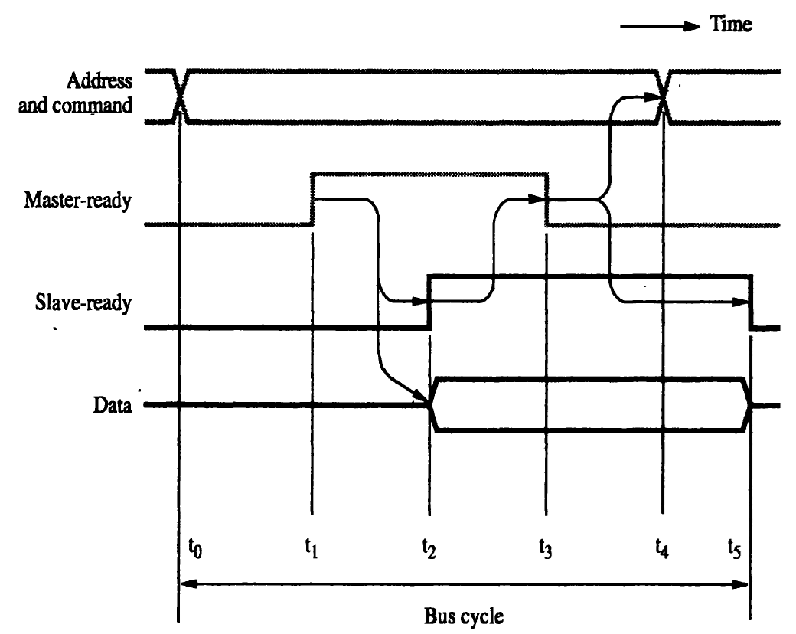
Read / Input Operation
9

Slide 10
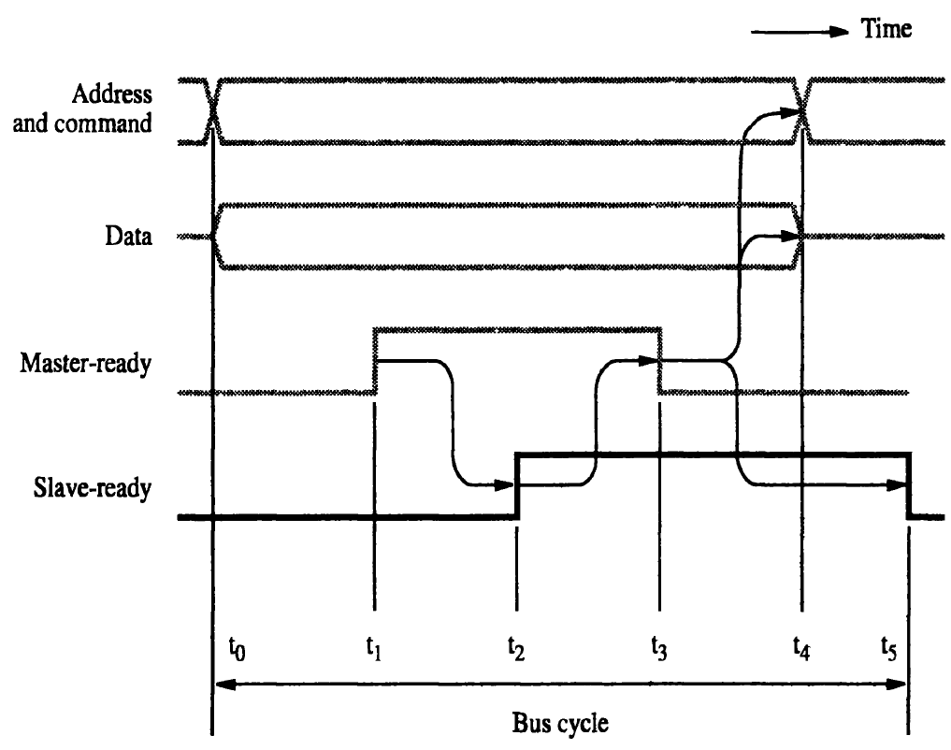
Write / Output Operation
10

