Slide 1
MLSA INTERNSHIP
GENERATIVE AI
“A BASIC TEXT GENERATOR”
NAME:-RADHIKA SAXENA
ROLL NO:- 2300290100195
YEAR:- 2
SEMESTER:- III
SECTION:- C
BRANCH:- CSE

Slide 2
A BASIC TEXT GENERATOR
It is a an AI model which generates text based on the user input.
The skills required are:-
1. Basic Python
2. API Key
3. Text generation

Slide 3
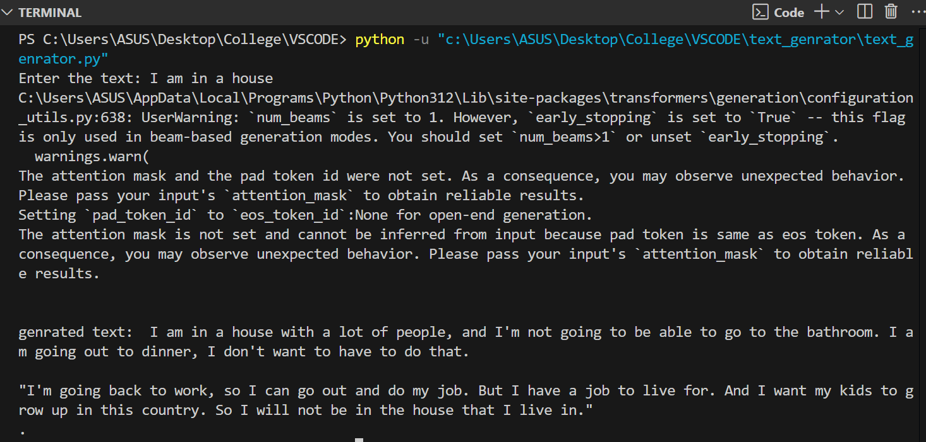
INPUT – OUTPUT IN BASIC TEXT GENERATOR

Slide 4
WORKING OF THE MODEL
It uses a pre-trained language model like “GPT-2”.
It understands the human text and generates human related text.
Th input is converted into tokens that the model can process.
The tokenized input is converted into input ID’s which the model can understand.
The model processes the input through various neural network to produce the next token in the sequence.
The model generates text by sampling from predicted token probabilities. The model can produce only 1 token at a time and appends it in the sequence.

Slide 5
The tokenized output is then converted into human-readable text using decoding function.
The final output is a sequence of text that starts from the same line of input text.
Example:-I love coding.
Generated Output:- I love coding . I am currently doing DSA.
(Max length:- It controls the numbers of tokens generated.)
(Temperature:- It controls the randomness in predictions.)

Slide 6
REQUIREMENTS
Software Required:-
1. Python
2. PyTorch
3. Transformer library by HuggingFace
Model Requirements:-
1. Pre-trained GPT-2 model
2. GPT—2 tokenizer

Slide 7


