Slide 1
MLSA INTERNSHIP
GENERATIVE AI
“SENTIMENT ANALYSIS TOOL”
NAME:-RADHIKA SAXENA
ROLL NO:- 2300290100195
YEAR:- 2
SEMESTER:- 3
SECTION:- C
BRANCH:-CSE

Slide 2
SENTIMENT ANALYSIS TOOL
It is an AI model which analyses the sentiment of the user input text and predicts whether the emotion is positive, negative or neutral.
Its Application are:-
a. Analysing product reviews and ratings.
b. In Political Sentiment Tracking
The skills required are:-
1. Sentiment Analysis
2. AI Builder
3. Text Processing

Slide 3
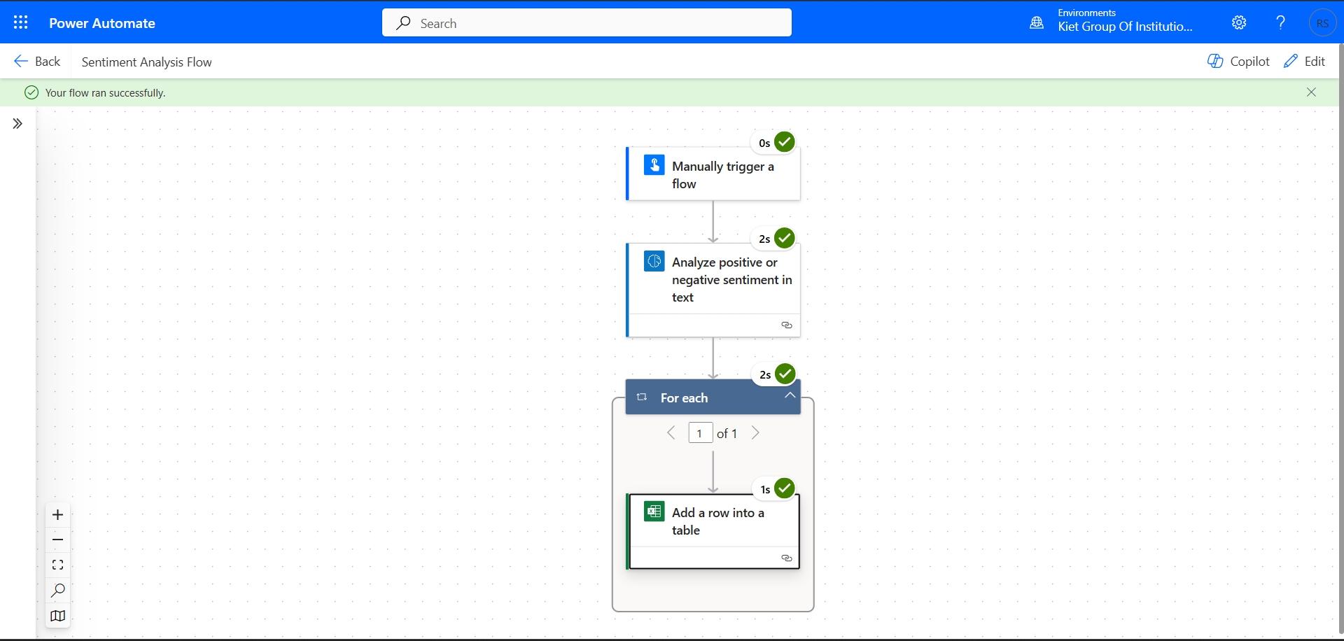
LAYOUT OF AN AI BUILDER SENTIMENT ANALYSIS TOOL

Slide 4
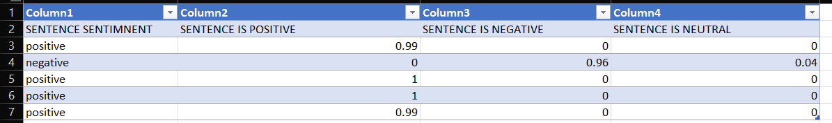
WORKING OF THE MODEL
Select the Sentiment Analysis Tool and structure the input parameters.
User can input text to analyse the sentiment of the text.
It cleans the text and standardize it for analysis.
It calculates Sentiment scores(i.e. positive , negative or neutral text).
It then creates the report and stores it in the excel sheet.
OUTPUT:-

Slide 5
BENEFITS OF A SENTIMENT ANALYSIS TOOL
It automates Sentiment Tracking.
It enables quick decision-making.
It reduces manual effort
It uses Power BI for reporting and trend analysis.

Slide 6
REQUIREMENTS
Microsoft Power Platform Access
Requires Text data for analysis.
Power Automate Flow
Database to store result(E.g.- Excel Sheet)

Slide 7


