Slide 1
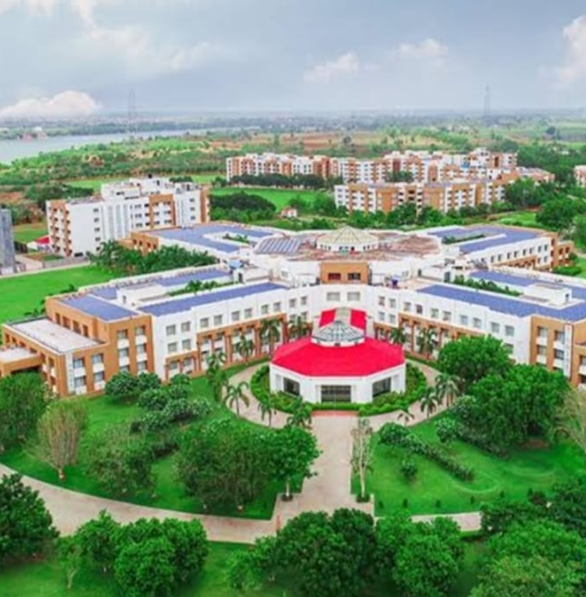

COLLEGE MANAGEMENT SYSTEM
MPSTMP SHIRPUR
SEMESTER 4 PROJECT
2023-24
DIVISION –A
RADHIKA VYAS: -70022200422

Slide 2

INTRODUCTION
2
A college management system is an ERP solution that enables the institutes to conduct online admissions, generate reports, create ID cards, enable online communication, manage curriculum, time tables and conduct online evaluations, track student progress, conduct data analysis, teach remotely, and handle enquiries and ..

Slide 3
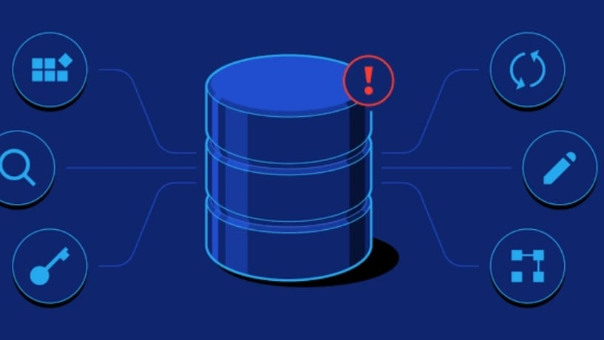
Database Design
Entities: Students, Faculty, Courses, Departments, Classes, Grades, Attendance, Events, etc. -
Relationships: - Students enroll in Courses. - Faculty teach Courses. - Courses belong to Departments. - Students attend Classes. - Grades are assigned to Students in Courses. - Students participate in Events, etc.
Attributes: Each entity has specific attributes. For example, a Student entity might have attributes like StudentID, Name, Email, Phone, etc.

Slide 4
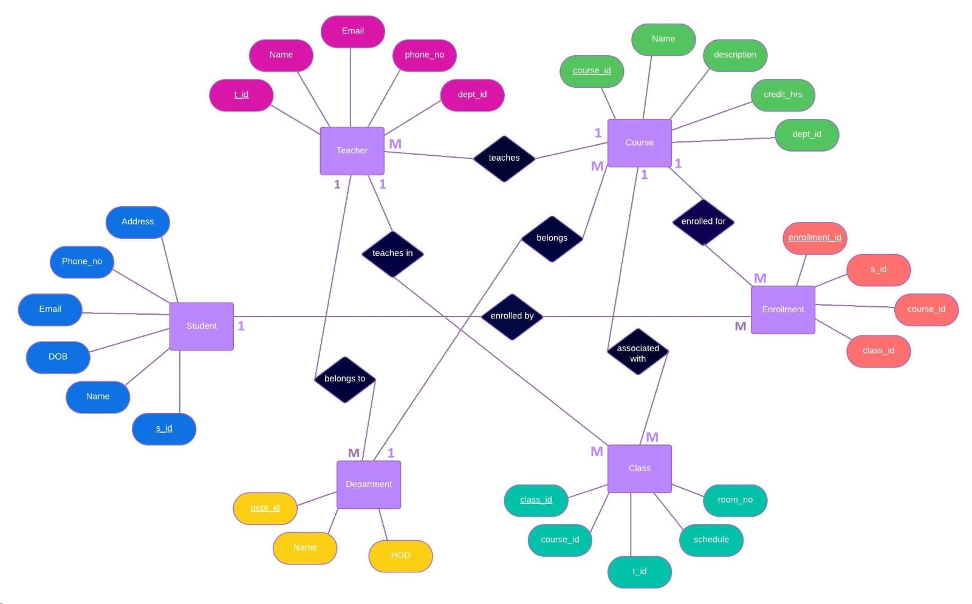
ER: - Diagram
Radhika Vyas(B258)

Slide 5

Functionality overview
Student Management: Registration, Enrollment, Profile Management, Attendance Tracking, Grade Viewing, etc.
Faculty Management: Profile Management, Course Assignment, Grading, etc. - Course Management: Creation, Modification, Assignment to Faculty, Enrollment Management, etc.
Administrative Tasks: User Management, Reporting, System Configuration, etc.

Slide 6
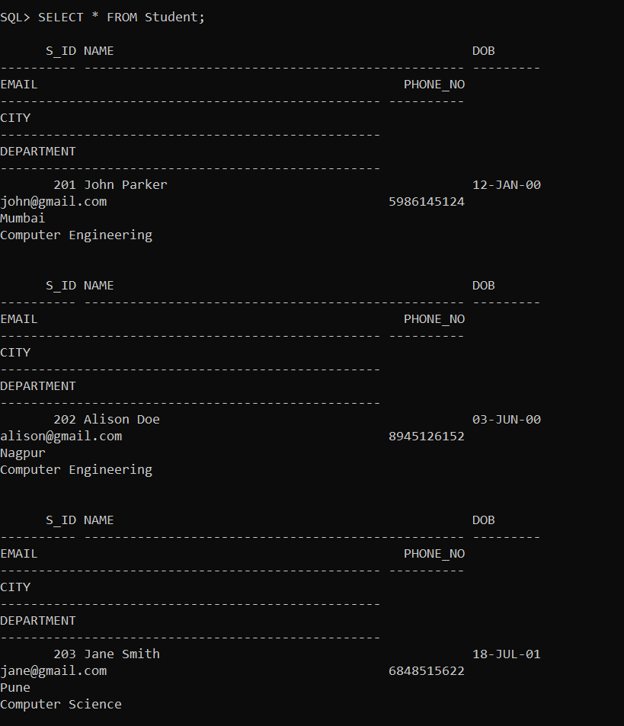
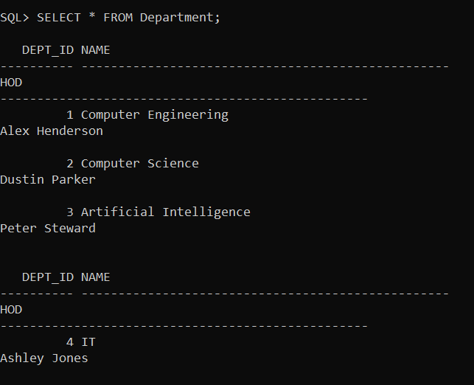
OVERVIEW OF SQL TABLE

Slide 7
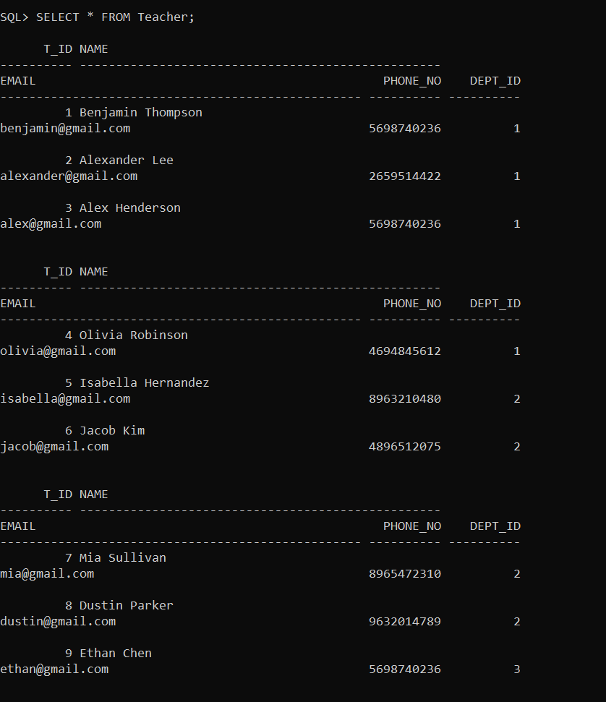
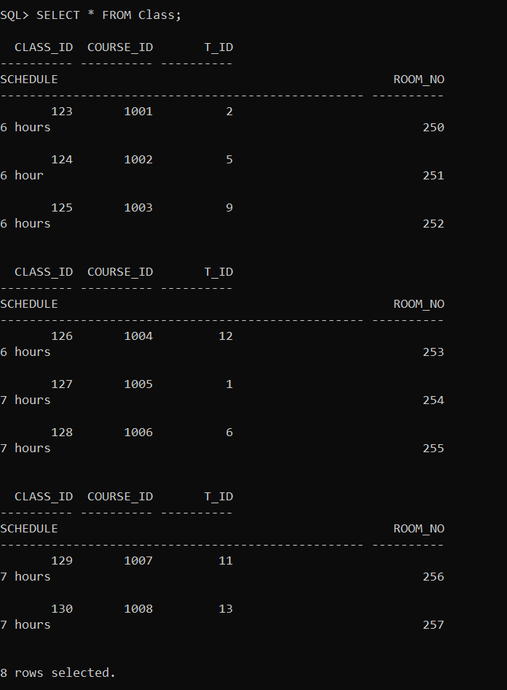
OVERVIEW OF SQL TABLE​

Slide 8
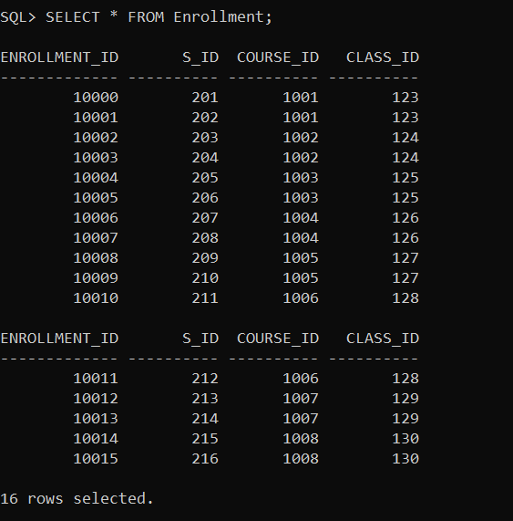
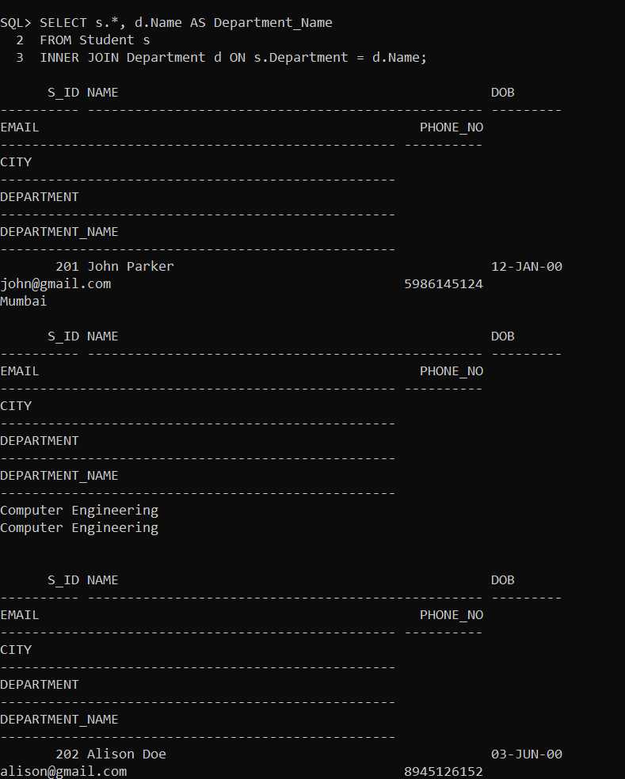
OVERVIEW OF SQL TABLE​​

Slide 9
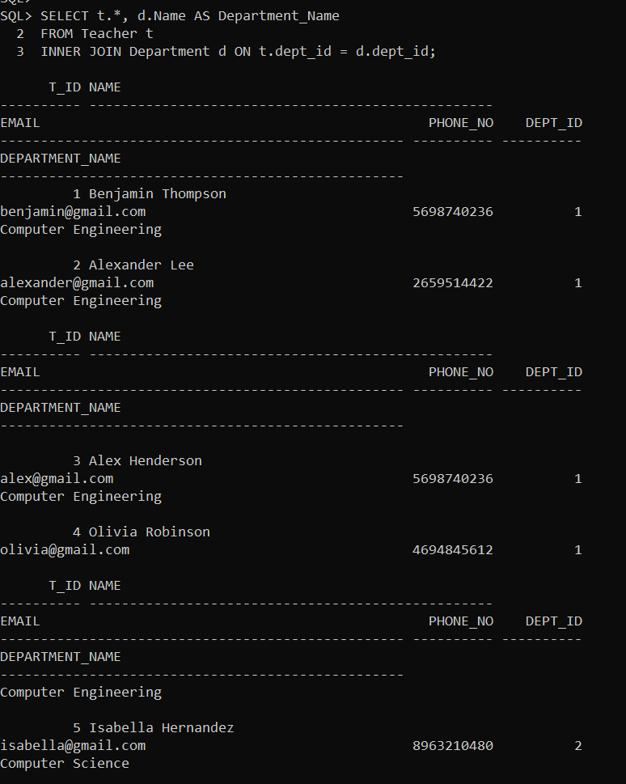
Queries
Select students with their corresponding department names
Select teachers with their corresponding department names

Slide 10
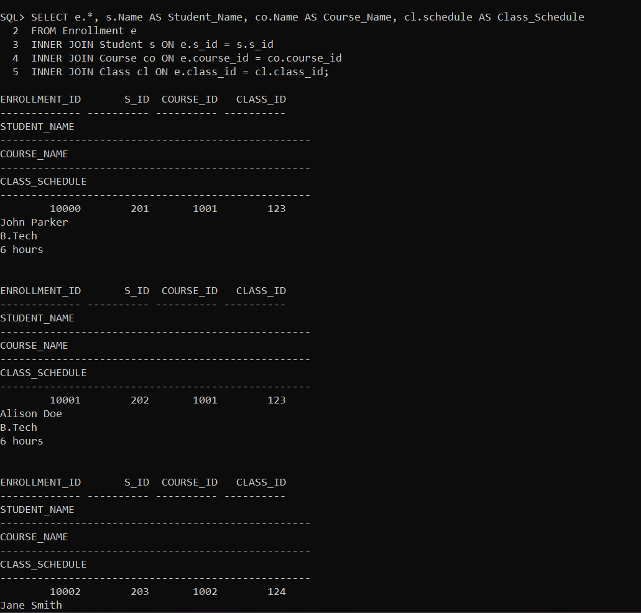
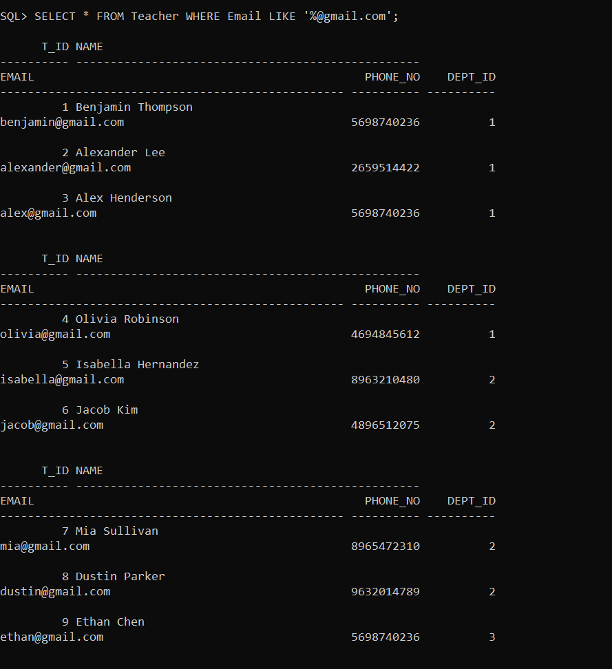
Queries​
Select enrollments with student names, course names, and class schedules:
Select the teachers who have an email ending with '@gmail.com':

Slide 11
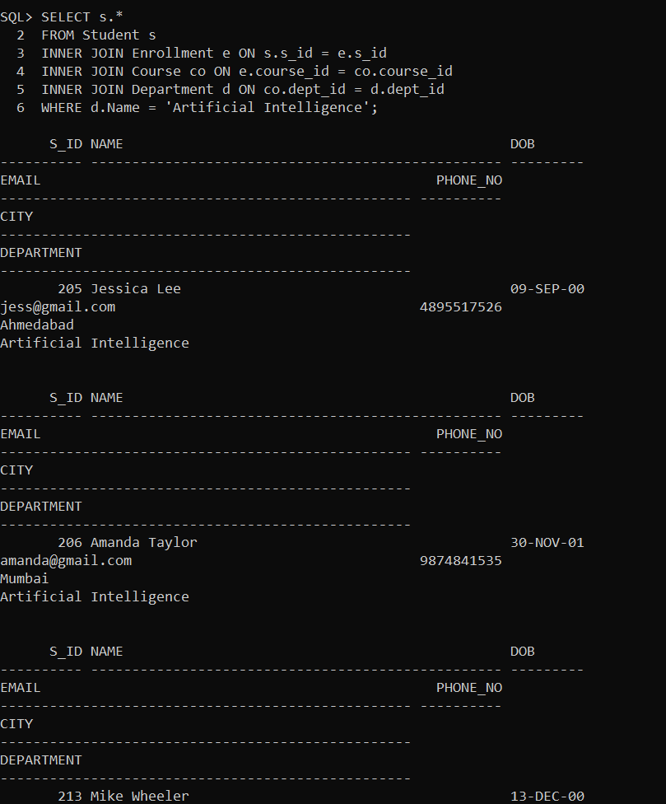
Select the students who are enrolled in courses offered by the Artificial Intelligence department:

Slide 12
-User Interface: Interfaces for Students, Faculty and Administrators to interact with the system.
-Database Layer Handles data storage, retrieval, and manipulation using SQL queries.
- Business Logic Layer: Implements the logic for various functionalities such as enrollment, grading, etc.
- ecurity Layer: Manages user authentication, authorization, and data encryption.
Modules and Components

Slide 13
- Data Access: Access to data is controlled through SQL queries and stored procedures.
- Security Measures: User authentication using usernames and passwords, role-based access control (RBAC), encryption of sensitive data (e.g., passwords), and secure transmission of data over networks.
Implementation Technologies:
- Database Management System: MySQL, PostgreSQL, Oracle, etc.
- Programming Languages: Java, Python, PHP, etc., for backend development.
- Frontend Technologies: HTML, CSS, JavaScript, etc., for building user interfaces.
Data Access and Security

Slide 14
Challenges and Future Enhancements
Challenges: Ensuring data consistency and integrity, scalability to handle large amounts of data, maintaining system security, etc.
Future Enhancements: Integration with other systems (e.g., learning management systems), implementation of advanced analytics for student performance tracking, mobile app development for increased accessibility, etc.

Slide 15
Conclusion
A college management system is an indispensable tool for modern educational institutions seeking to optimize their operations, enhance student experiences, and achieve academic excellence. Its implementation leads to increased efficiency, transparency, and communication while supporting data-driven decision-making and fostering a conducive learning environment.

Slide 16


