Slide 1
Used CAR PRICE PREDICTION
By
Radhika Narayana

Slide 2
Problem Statement
With the covid 19 impact in the market, we have seen lot of changes in the car market. Now some cars are in demand hence making them costly and some are not in demand hence cheaper. One of our clients works with small traders, who sell used cars. With the change in market due to covid 19 impact, our client is facing problems with their previous car price valuation machine learning models. So, they are looking for new machine learning models from new data. We have to make car price valuation model.

Slide 3
Business Goal
You have to scrape used cars data from sites like olx, cars24, cardekho, etc.
You are required to model the price of cars with the available independent variables. This model will then be used by the management to understand how exactly the prices vary with the variables. They can accordingly manipulate the strategy of the firm and concentrate on areas that will yield high returns. Further, the model will be a good way for the management to understand the pricing dynamics of a new market.

Slide 4
About Dataset
Data was collected from olx.in.
Data contains 18000 entries each having 9 variables.
Data contains Null values.
Data contains numerical as well as categorical variable.

Slide 5
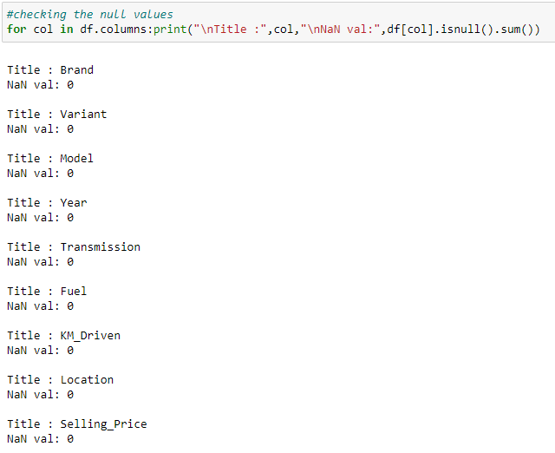
Null Values
There are many missing values present in the dataset. For the treatment of missing values, all the rows with missing values were dropped.
After dropping missing values the shape of the dataset changed to (18000, 9).

Slide 6
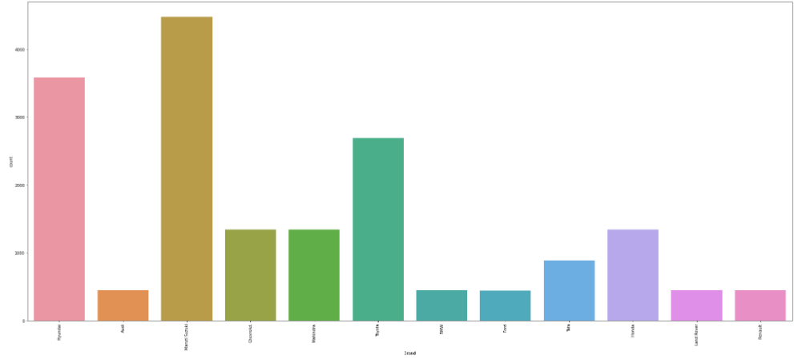
EDA
This is the countplot for one of the variable, Brand.
As we can see, Maruti Suzuki has the highest count, followed by Hyundai.

Slide 7
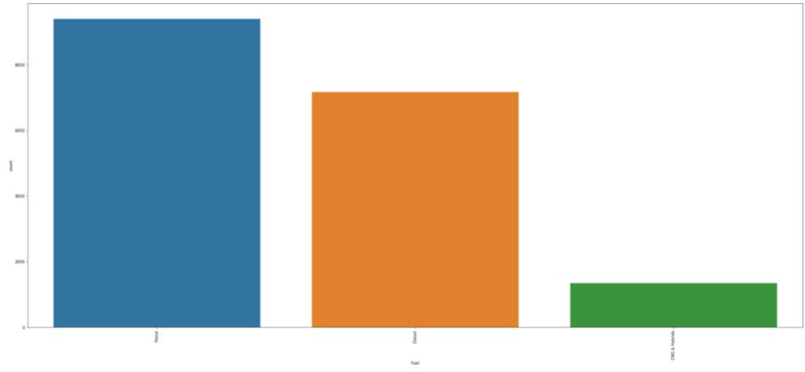
EDA
This is the countplot for one of the variable, Fuel Types.
As we can see, Petrol has the highest count, followed by Diesel.
While CNG & Hybrid has the least value.

Slide 8
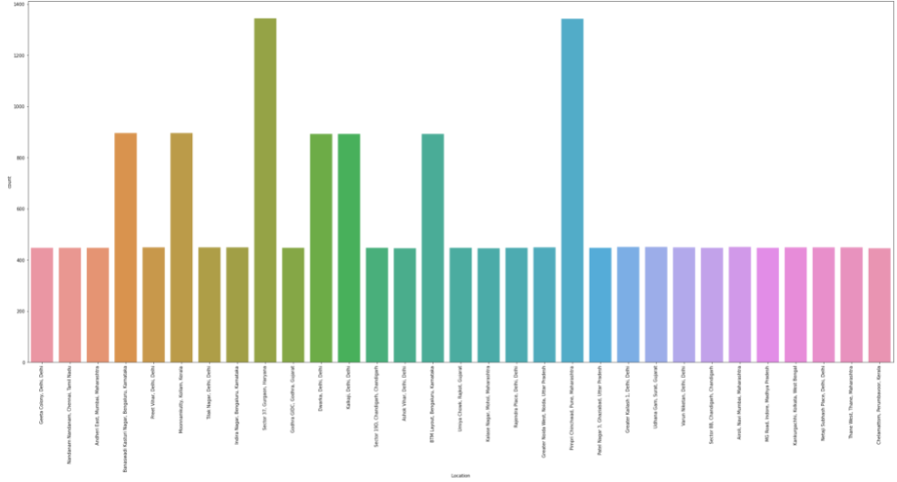
EDA
This is the countplot for one of the variable, States.
As we can see, the data in this graph is well spread. Haryana seems to have highest count while Maharashtra has the lowest count among them.

Slide 9
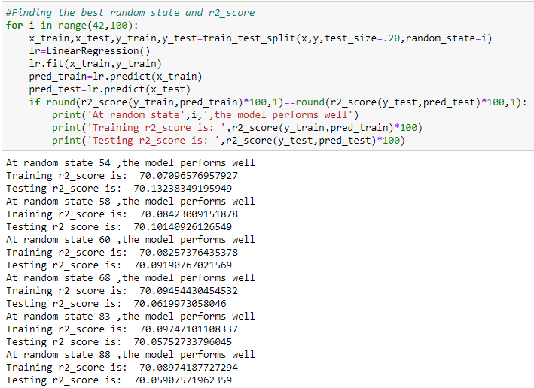
Model Building
The first thing we will do is get the best random state, for train test split. We will do this with the help of a simple linear regression model.

Slide 10
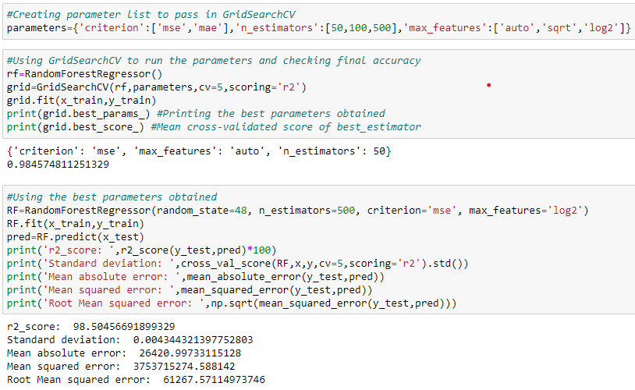
Random Forest Regressor

Slide 11
Conclusion
In this project we learned about car resale market and how data science and machine learning can be so helpful in this field.
Using predictive modeling and EDA we can determine which factors impact the market and which factors can be helpful in determining the prices.
After treating outliers, getting rid of redundant columns and other preprocessing, we manage to build a model which will give us fairly accurate results.

