Slide 1

Malignant Comments Classifier Project
Submitted by:
Radhika Narayana

Slide 2
ACKNOWLEDGMENT
Thanks for giving me the opportunity to work in FlipRobo Technologies as Intern and would like to express my gratitude to Data Trained Institute as well for trained me in Data Science Domain. This helps me to do my projects well and understand the concepts.
Dataset – FlipRobo Tech
Resources used – Google, GitHub, Blogs for conceptual referring.
Links – Medium.com, towardsdatascience.com

Slide 3
Business Problem
The proliferation of social media enables people to express their opinions widely online. However, at the same time, this has resulted in the emergence of conflict and hate, making online environments uninviting for users. Although researchers have found that hate is a problem across multiple platforms, there is a lack of models for online hate detection.
Online hate, described as abusive language, aggression, cyberbullying, hatefulness and many others has been identified as a major threat on online social media platforms. Social media platforms are the most prominent grounds for such toxic behaviour.
There has been a remarkable increase in the cases of cyberbullying and trolls on various social media platforms. Many celebrities and influences are facing backlashes from people and must come across hateful and offensive comments. This can take a toll on anyone and affect them mentally leading to depression, mental illness, self-hatred and suicidal thoughts.
Internet comments are bastions of hatred and vitriol. While online anonymity has provided a new outlet for aggression and hate speech, machine learning can be used to fight it. The problem we sought to solve was the tagging of internet comments that are aggressive towards other users. This means that insults to third parties such as celebrities will be tagged as unoffensive, but “u are an idiot” is clearly offensive.
Our goal is to build a prototype of online hate and abuse comment classifier which can used to classify hate and offensive comments so that it can be controlled and restricted from spreading hatred and cyberbullying.

Slide 4
Conceptual Background of the Domain Problem
In social media the people spreading or involved in such kind of activities uses filthy languages, aggression, images etc. to offend and gravely hurt the person on the other side.
This is one of the major concerns now. The result of such activities can be dangerous. It gives mental trauma to the victims making their lives miserable.
Online hate, described as abusive language, aggression, cyberbullying, hatefulness, insults, personal attacks, provocation, racism, sexism, threats, or toxicity has been identified as a major threat on online social media platforms.
These kinds of activities must be checked for a better future.

Slide 5
Motivation for the Problem Undertaken
The project was the first provided to me by Flip-Robo as a part of the internship programme. The exposure to real world data and the opportunity to deploy my skillset in solving a real time problem has been the primary objective.
The main aim is to build a prototype of online hate and abuse comment classifier which can used to classify hate and offensive comments so that it can be controlled and restricted from spreading hatred and cyberbullying.

Slide 6
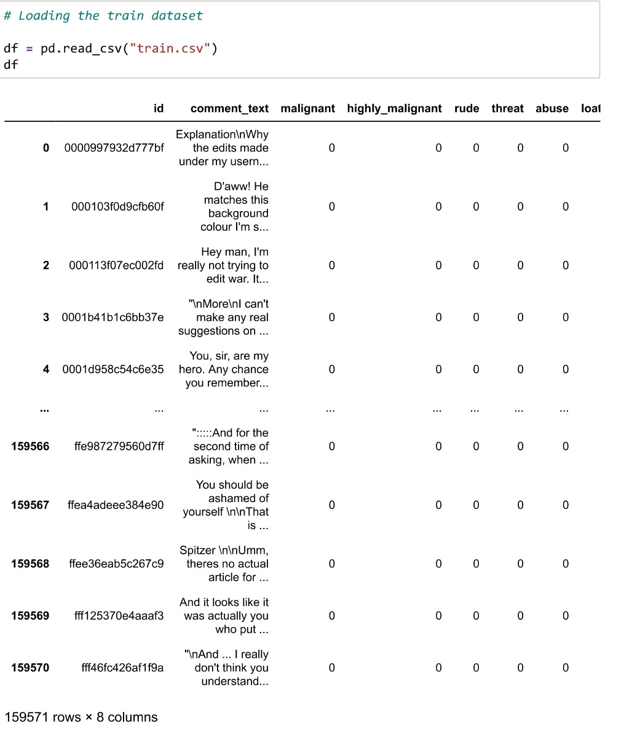
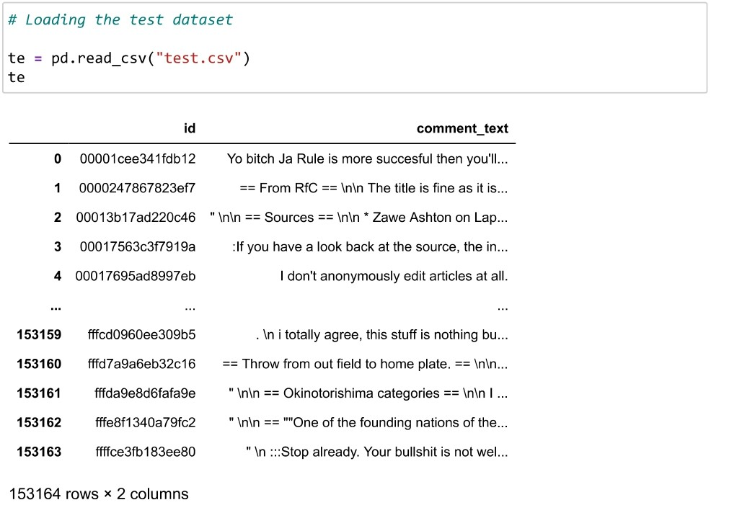
Data Sources and their formats
Dataset is provided by Flip-Robo technologies.
It has Train and Test Data Set and need to train our data in Train dataset and need to load the Test dataset to make the predictions.

Slide 7
Mathematical/ Analytical Modeling of the Problem
Here we need to find whether the given comments are malignant words or not. It is text classification problem where we need to predict the target variable from the text and, we have multiple target variables like malignant, high malignant, rude, abuse, loathe.
Therefore, we will be handling this modelling problem as classification.

Slide 8
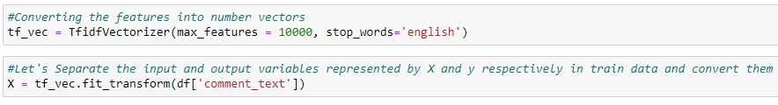
Data Pre-processing Done
For Data pre-processing we did some data cleaning, where we used WordNet lemmatizers to clean the words and removed special characters using Regexp Tokenizer.
Then, filtered the words by removing stop words and then used lemmatizers and joined and return the filtered words.
Used TFIDF vectorizer to convert those text into vectors and trained the train and loaded the test dataset

Slide 9
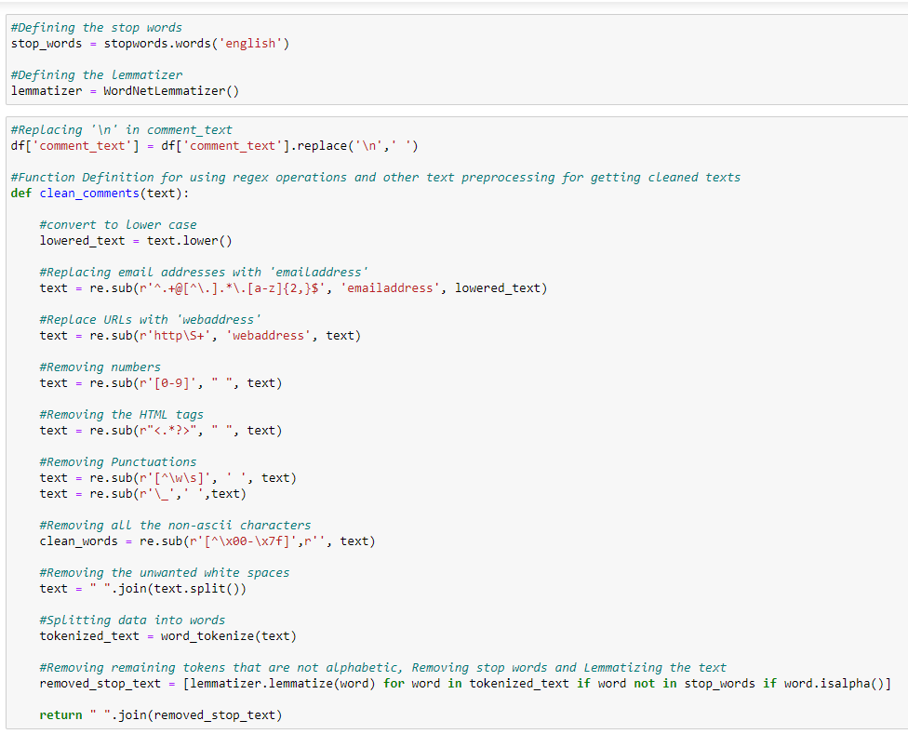
Data Pre-processing

Slide 10
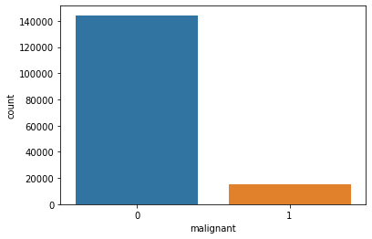
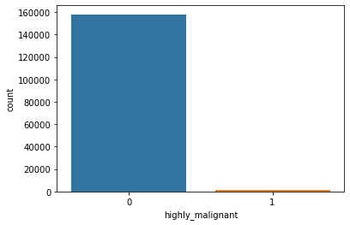
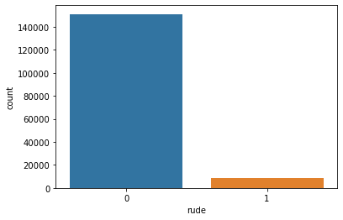
Data Visualization -
Used Count plot and distribution plot and for the different target variables.
Heat map for test the correlation between features and variables.

Slide 11
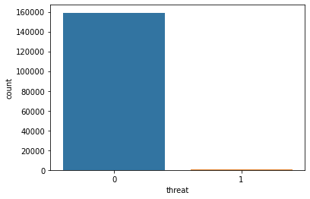

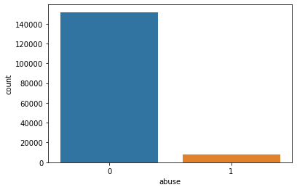
Data Visualization -

Slide 12
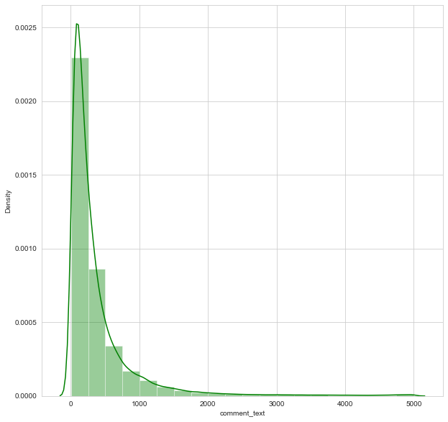
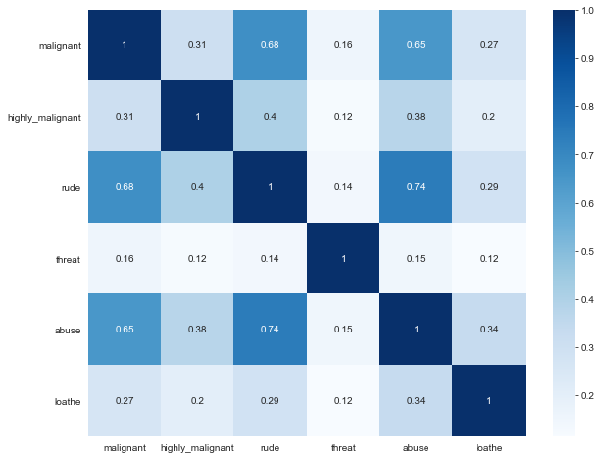
Data Visualization -

Slide 13
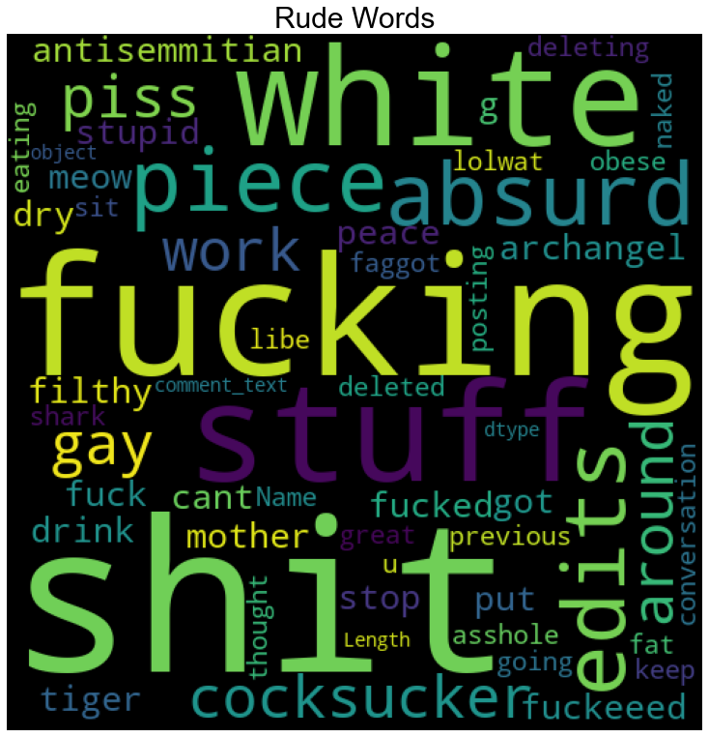
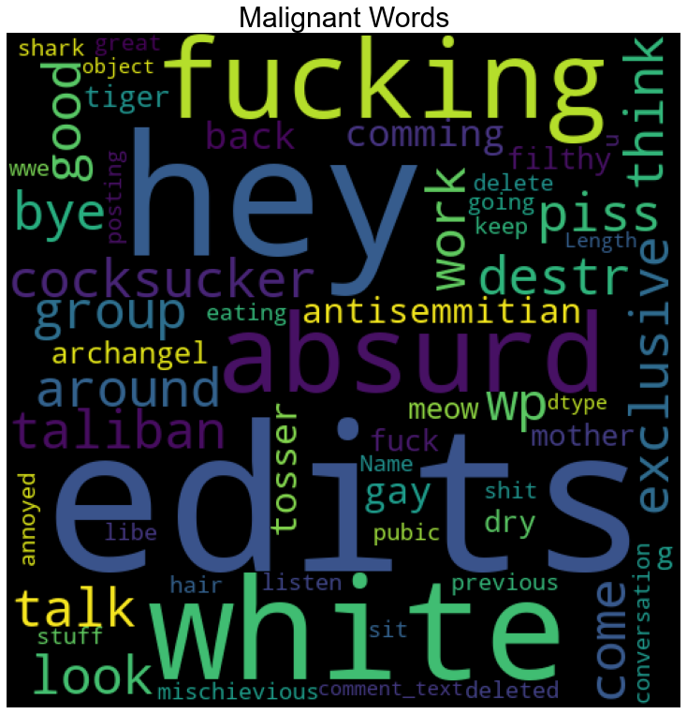
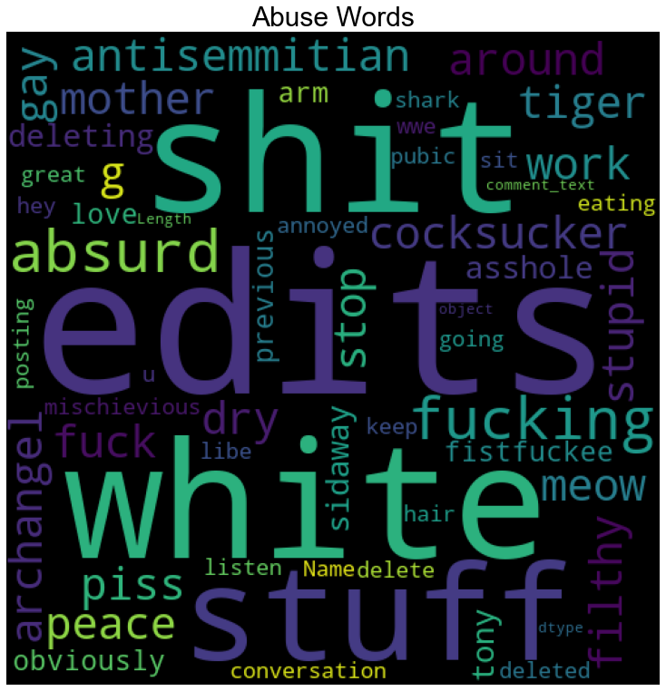
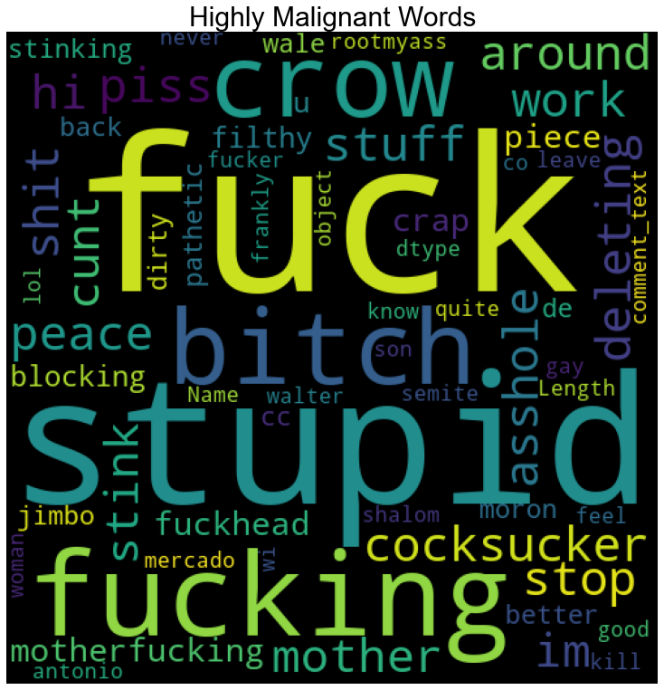
Data Visualization -

Slide 14
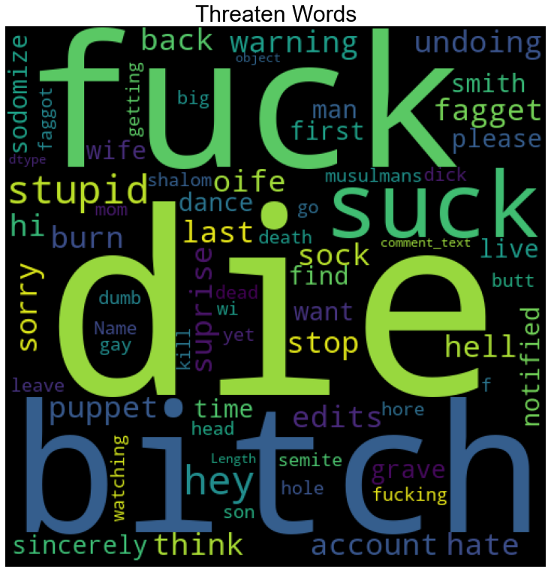
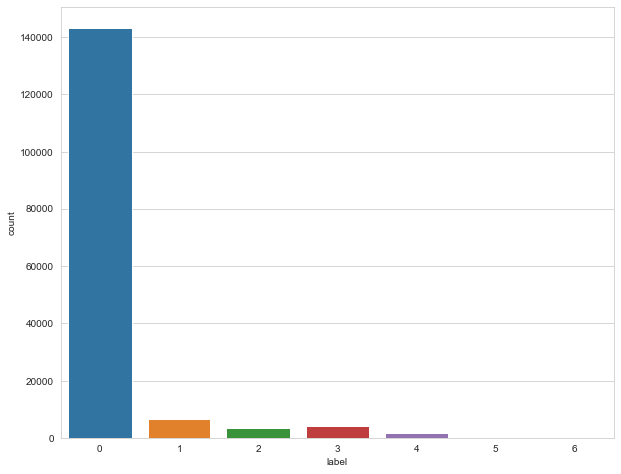
Data Visualization -

Slide 15
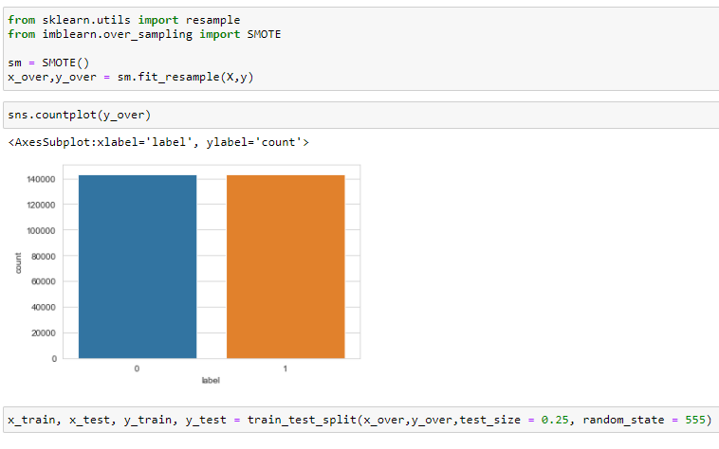
Split the train and test data for model building,
Logistic Regression
Decision Tree
Gradient Boost
Multinomial NB
Passive Aggressive

Slide 16
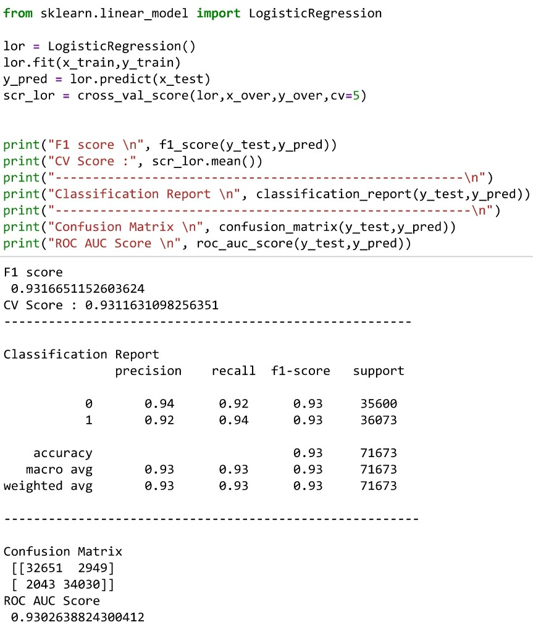
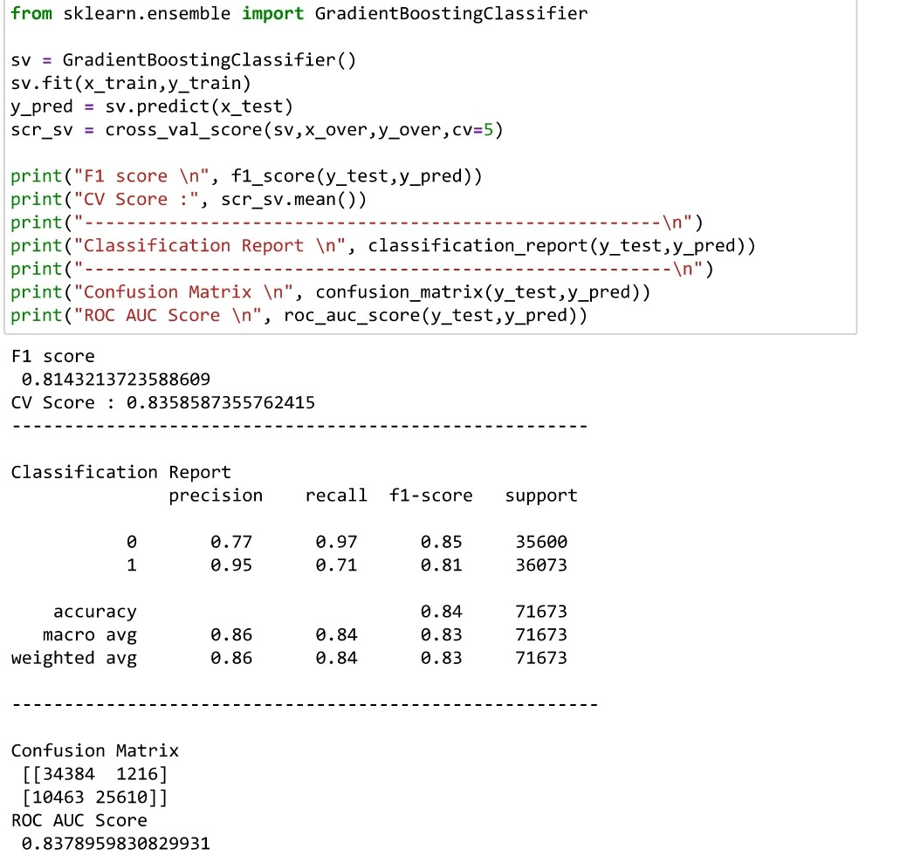
Model Building:
Logistic has CV Score – 93.02%
Gradient Boost has CV Score – 83.78%

Slide 17
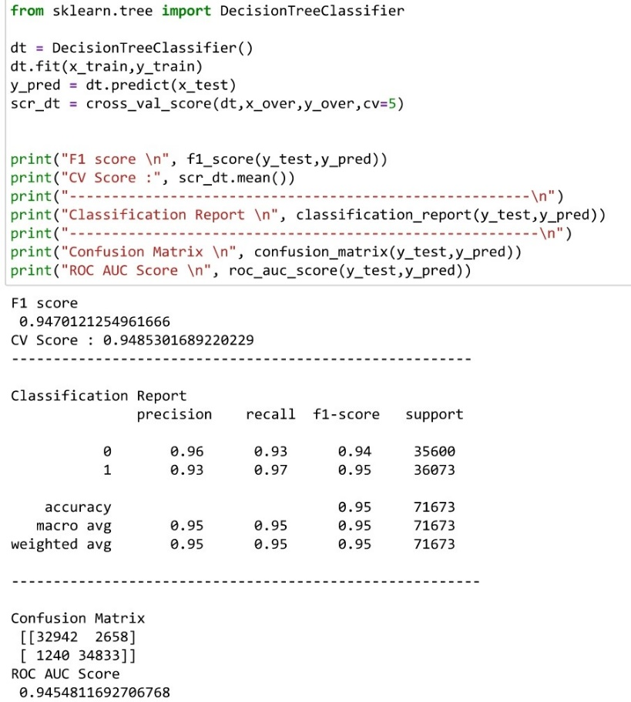
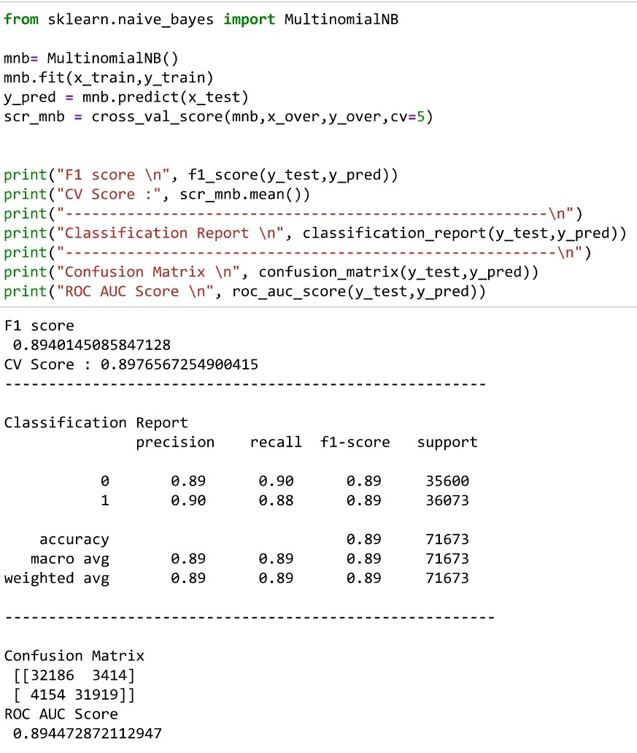
Decision Tree has CV Score – 94.54%
Multi-Nomial NB has CV Score – 89.44%

Slide 18
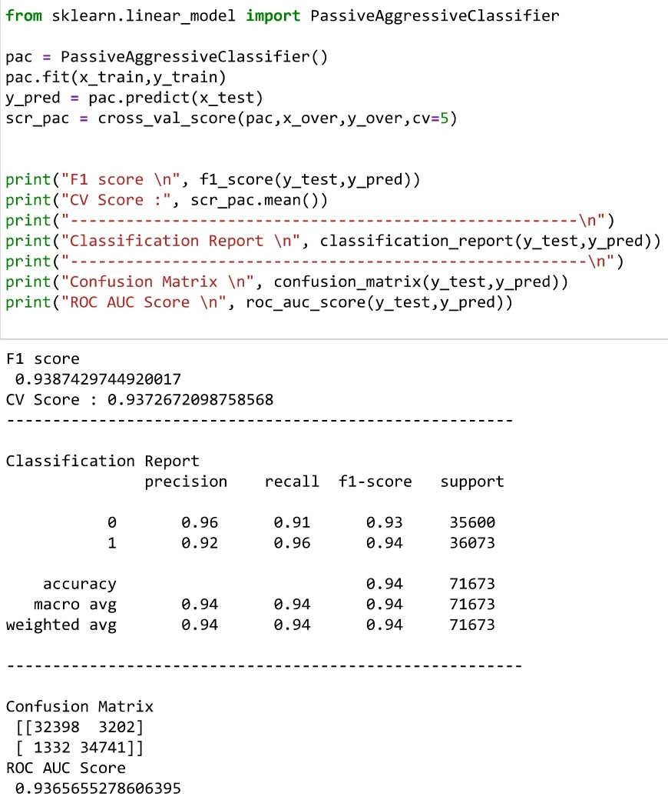
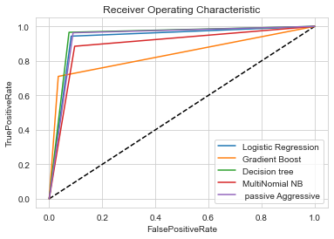
Passive Aggressive has CV Score – 93.65%

Slide 19
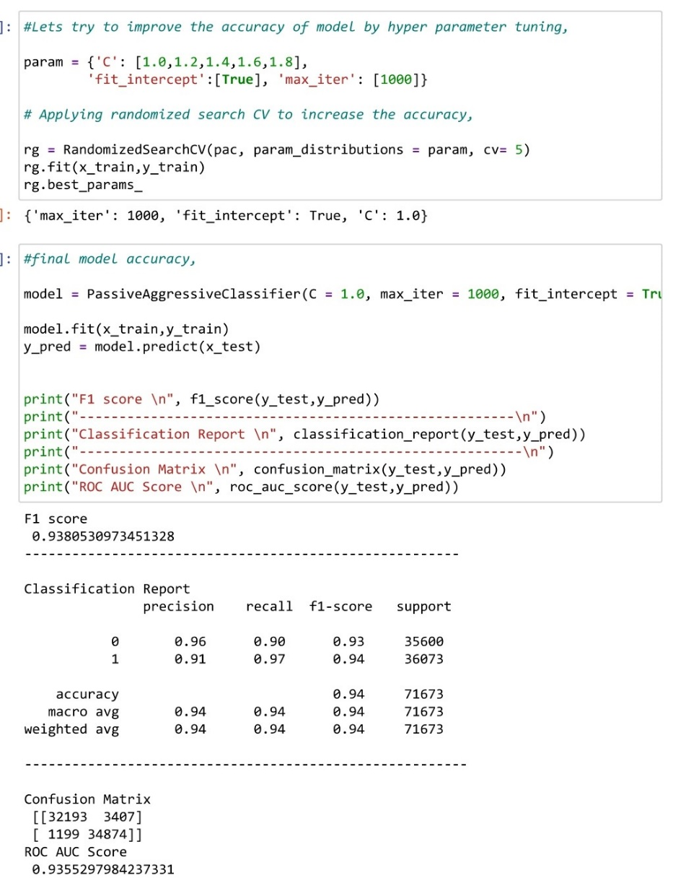
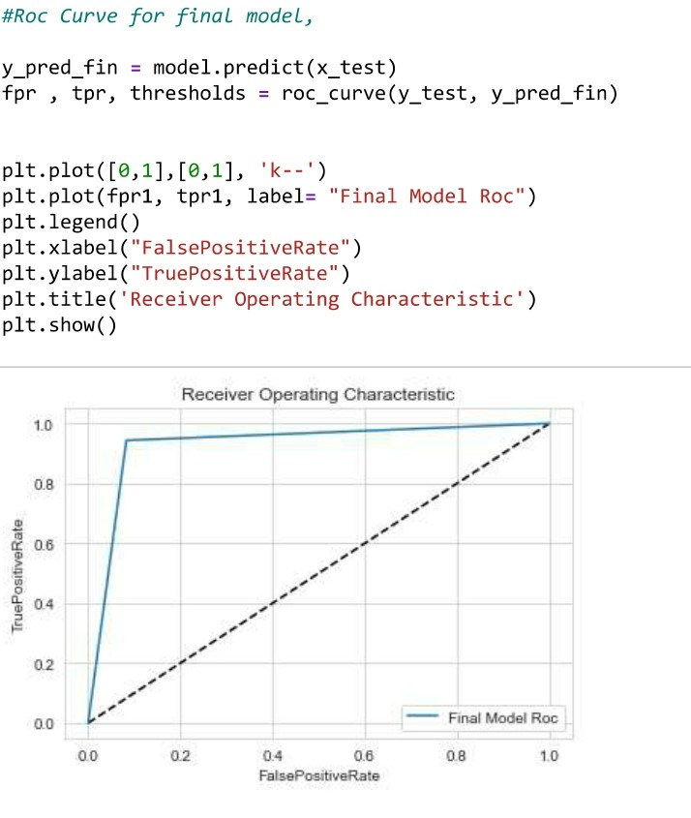
Hyper Parameter Tuning for the final model -> Passive Aggressive

Slide 20
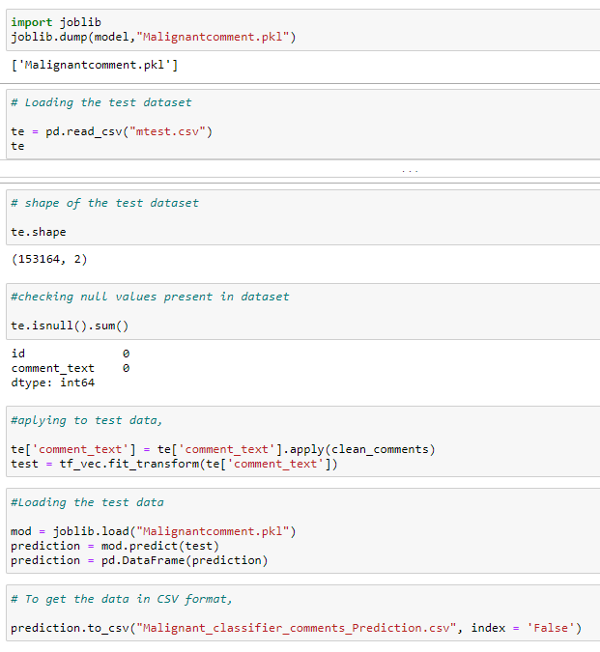
Finally Saving the model .pkl file and Loading the test data File,

Slide 21
Thank You !! ☺

