Slide 1


Web and Social Media Analytics – Capstone Project
Presented by,
Radhika Bansal

Slide 2
Agenda
Objectives of the project
Background of the topic
Key Findings
Recommendations
Appendix

Slide 3
Objectives
Provide Key Insights
Deliver valuable insights to help the cell phone industry develop products that meet market demands and integrate the latest technological advancements.
Optimize Product Development
Support the creation of innovative cell phone models that align with consumer preferences and emerging trends, ensuring a strong competitive advantage.
Enhance Marketing Strategies
Refine marketing approaches to elevate product perception and appeal, making products more attractive to potential customers.
Bridge the Supply-Demand Gap
Implement strategies to effectively balance consumer demand and product availability, ensuring timely delivery of the right products to the market.

Slide 4
Background of the topic
A firm has recently entered the mobile market, completing its initial three years in this competitive industry. Gaining a deep understanding of the market is essential for driving future growth.
Objective: Analyze Competitors
To strengthen its market position, the firm seeks to evaluate competitors' strategies, strengths, and weaknesses. This analysis is critical for developing well-informed and effective strategies.
Aim: Understand User Preferences
Recognizing the value of customer insights, the firm aims to identify user preferences. This will allow it to tailor its offerings to align with market demands, ensuring competitiveness and relevance.
Importance of Strategic Planning
Insights derived from competitor analysis and user preferences will serve as the foundation for the firm’s strategic planning. This will help solidify its market presence and improve customer satisfaction.

Slide 5
Key Findings

Slide 6
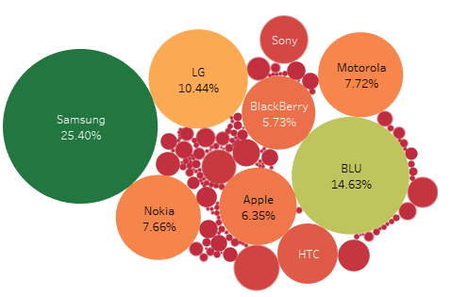
Most Popular Brands based on the number of reviews
Samsung Dominates Market with 25.4% market share, making it the most reviewed and popular brand among users.
Blu stands at 14.63%, focusing on budget-friendly devices that cater to a diverse audience.
LG's Contribution is 10.44%, showcasing its appeal through innovative features and user-friendly designs.
Apple's Premium Segment – 6.35%, appealing to users seeking premium devices with a strong ecosystem and brand loyalty.

Slide 7
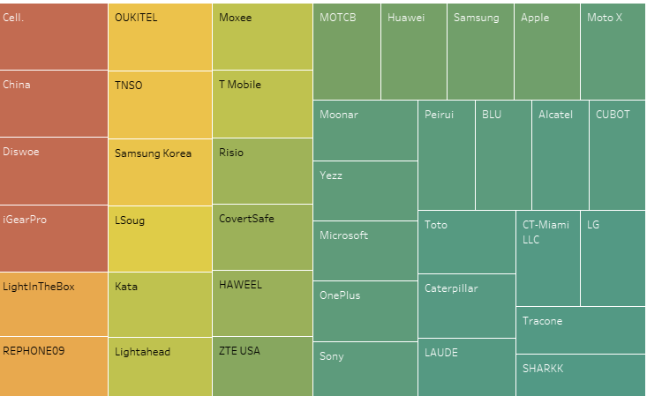
Rating of Brands by customers
Surprisingly, the lesser-known brands like Cell, China, Diswoe, Oukitel has 5/5 rating.
Samsung maintains a strong presence in the market, dominating in terms of popularity among consumers, which influences overall brand perception, among the known brands.
Despite Samsung's popularity, brands like Apple, Microsoft, OnePlus and Huawei have received positive customer feedback, indicating a competitive landscape.
Consumers place significant importance on the features offered by each brand, highlighting that customer satisfaction is closely tied to product specifications and innovations.

Slide 8
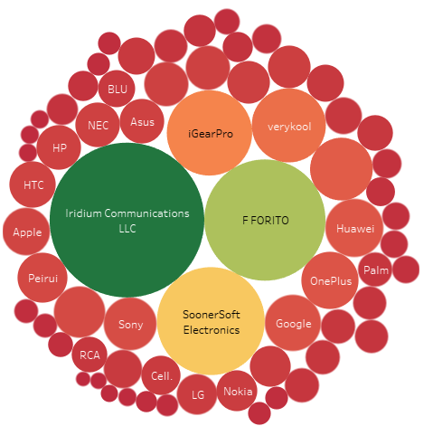
Brands vs. Price
Iridium has the costliest phones followed by Ffortico, iGearPro, Huawei, OnePlus, Google, Apple and so on.
Customer preference is phones within the price range of $70 to $150.

Slide 9
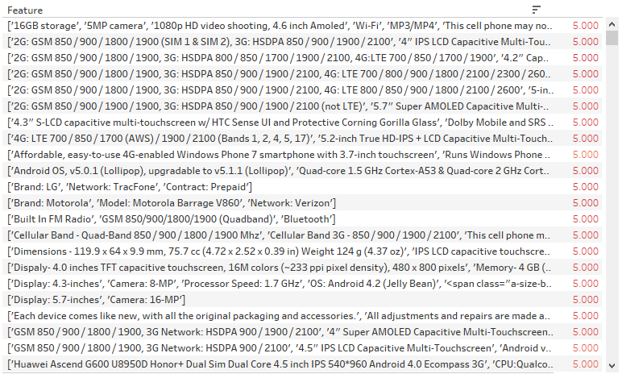
Most Favoured Features wrt. Customer Reviews
Some of the features in the phones with rating 5 are given in the picture.
These can be benchmarks for the desired features that people look for in a phone.

Slide 10
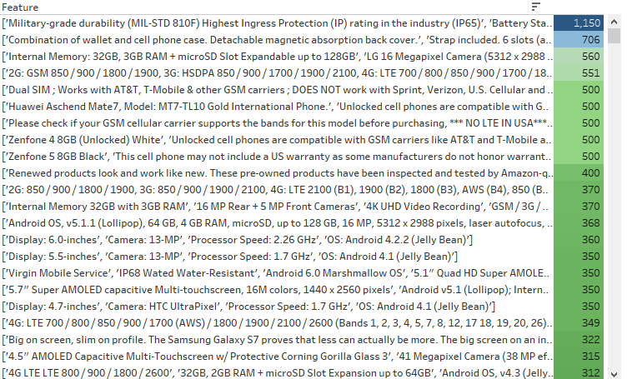
Most Favoured Features wrt. Average Price
The features of the phones and its average prices gives an idea of what people seek for the price range that they can afford.

Slide 11
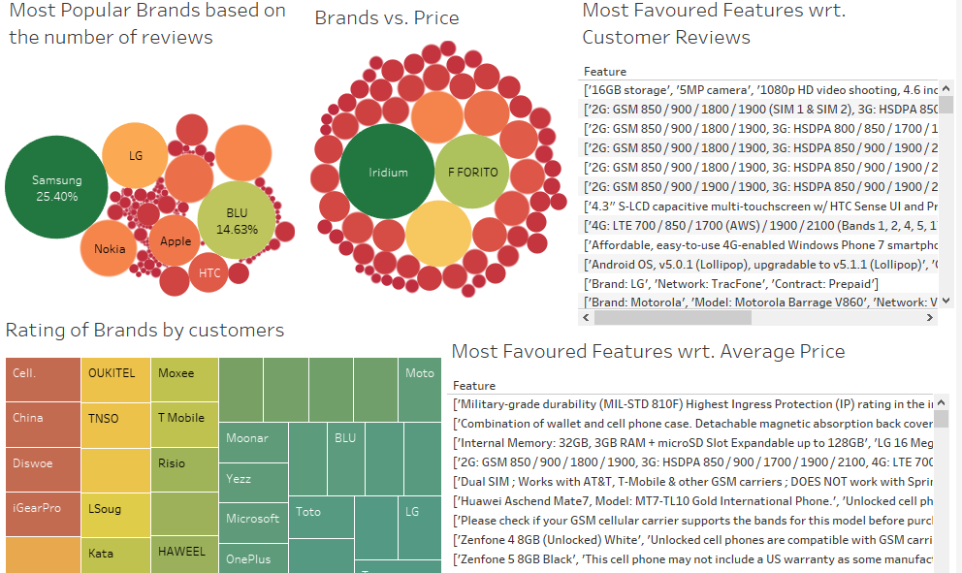
Final Dashboard

Slide 12

Recommendations
Monitor Competitors
Since our competitors include notable brands like Samsung, Motorola, HTC, Huawei, and Apple, we must closely monitor the services and features they offer to stay competitive.
Focus on Mid-range Market
Our target is the mid-range price segment, specifically products priced between $150 and $700. This focus allows us to strategically introduce our product range
Essential Features
To meet market expectations, our products must include key features such as Android OS, a screen size between 5.1 to 5.7 inches, a 2.7 GHz processor, and a 16MP camera.

Slide 13
Appendix
Here is the Python file for the project: https://colab.research.google.com/drive/1Q_KHVYfCt9fjVYNZqz88wrvGHq_lfI2n
The video link for the presentation is:
https://drive.google.com/file/d/1WcUrq6aDn2Xt1neB4-uiCjvf_381F8Jd/view?usp=drive_link

Slide 14
Thank You!

