Slide 1
DATA 606 Team B Football Match Prediction
Prof. Unal ‘Zak’ Sakoglu
Presented by-
Radhika Cheemala
Anurag Kunchi
Suhana Shaik

Slide 2
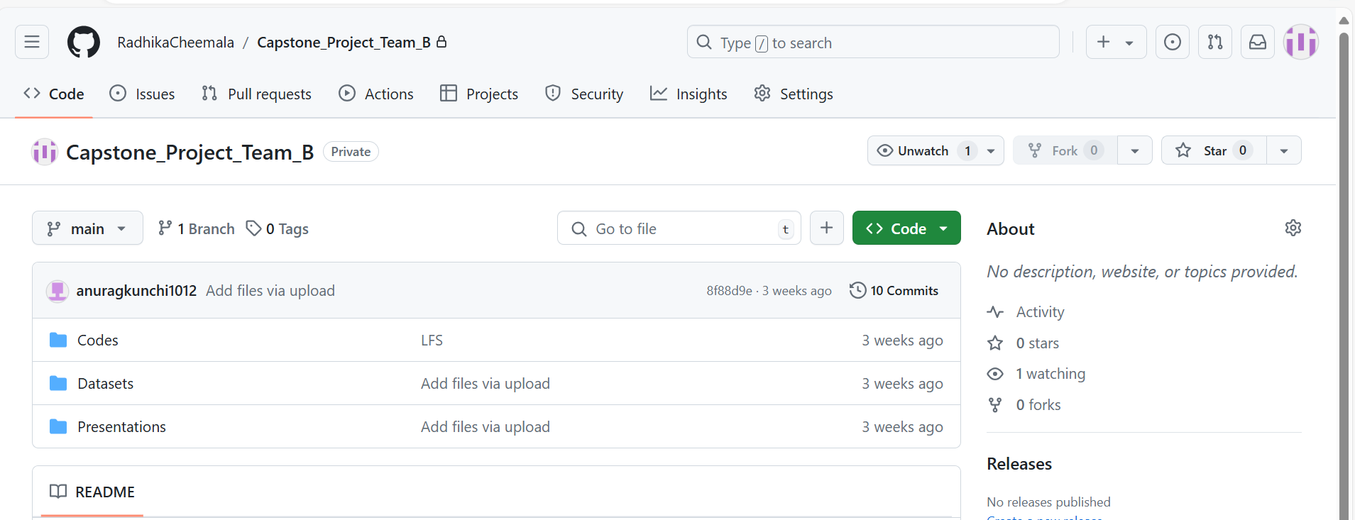
GitHub Repository
GitHub Link: https://github.com/RadhikaCheemala/Capstone_Project_Team_B.git

Slide 3
Project Overview
The primary objective of this project is to develop a predictive model to forecast the outcomes of football matches, specifically classifying the results into three categories: Home win, Away win, or Draw.
This project involves a classification task, where the machine learning model will be trained to predict the outcome of a match based on various features and data inputs.

Slide 4
Dataset Overview
Dataset Link: Football Stats, Tables & Results | Soccer Stats – FootyStats
Leagues Data: 2008 to present, leagues (England Premier league, Italy-Serie A, Spain- La liga and UEFA Champions League).
Dataset size:
Merging all 4 League matches : (21792,67)
Merging all 4 League matches : (58803,278)
League Name | Combined Matches size | Combined Players Size
England Premier | (6460, 67) | (10618, 278)
Italy league | (6081,67) | (11147,278)
Spain league | (6080,67) | (10147,278)
UEFA Champions | (3171,67) | (26891,278)

Slide 5
Methodology
Data Collection: Aggregate data from FootyStats i.e from 2008-2024.
Data Preprocessing: Clean data, handle missing values, normalize attributes.
3. Feature Engineering: Extract features like recent team performance, head-to-head stats.
4. Model Building: Use algorithms like LightGBM, Random Forest, XGBoost, and Catboost.
5. Evaluation: Use accuracy, precision, recall, and F1 score metrics for classification.
6. Deployment: Develop a dashboard and implement the top 10 important features as inputs to the dashboard.

Slide 6
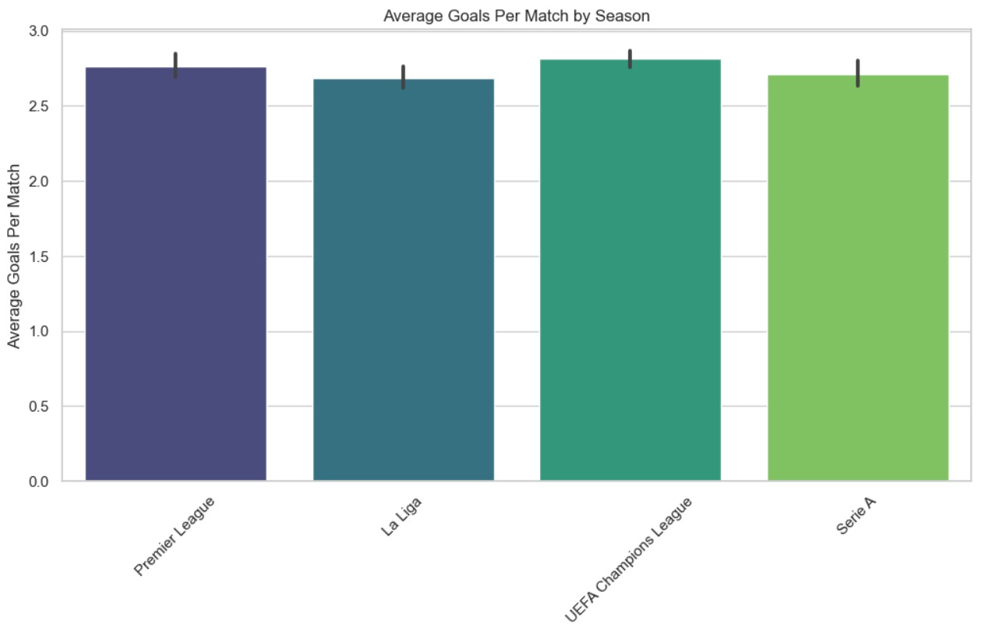
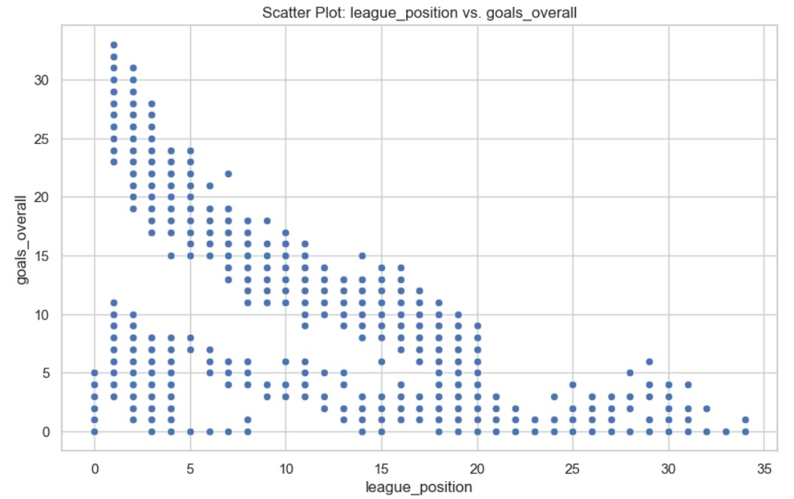
EDA

Slide 7
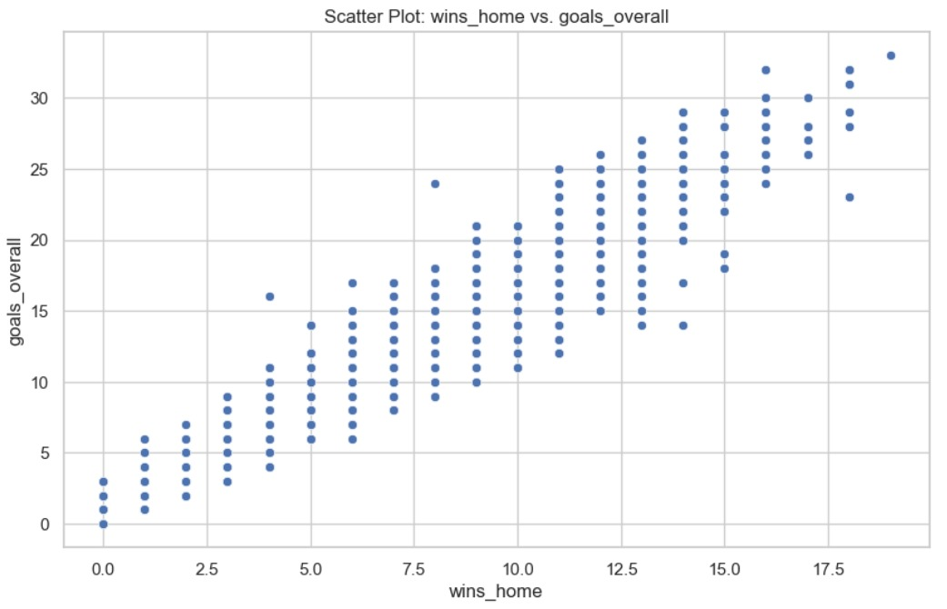
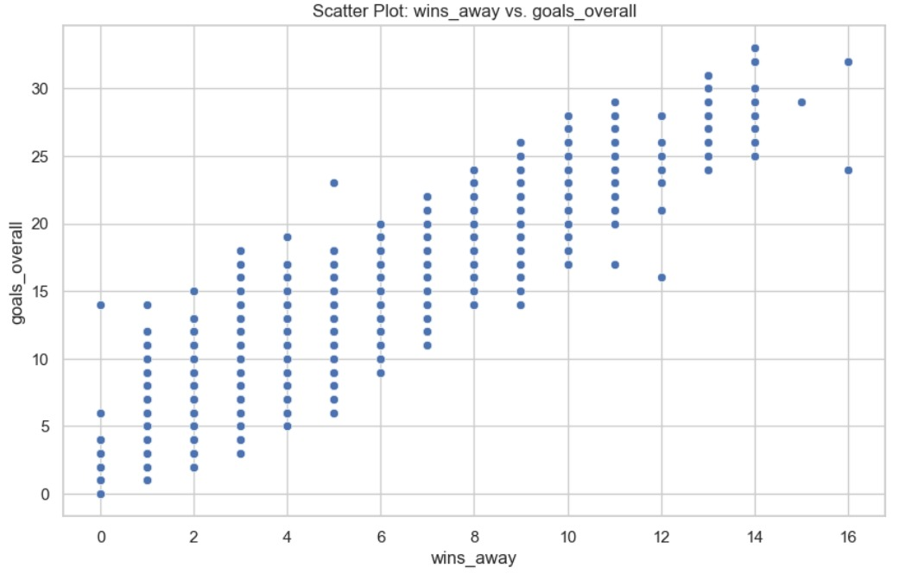
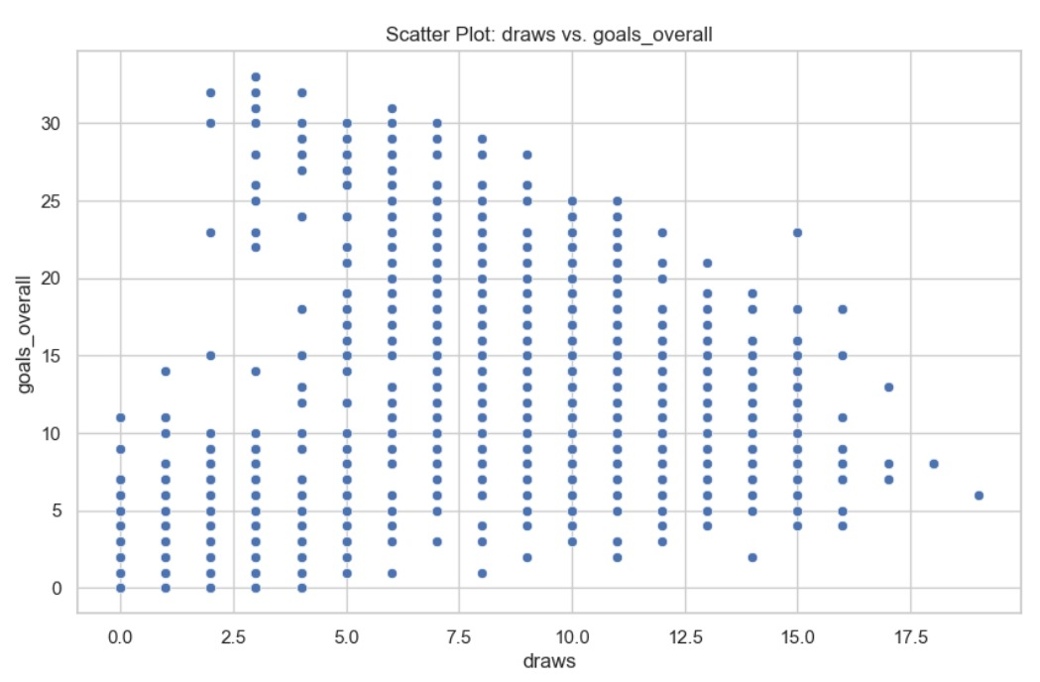
EDA

Slide 8
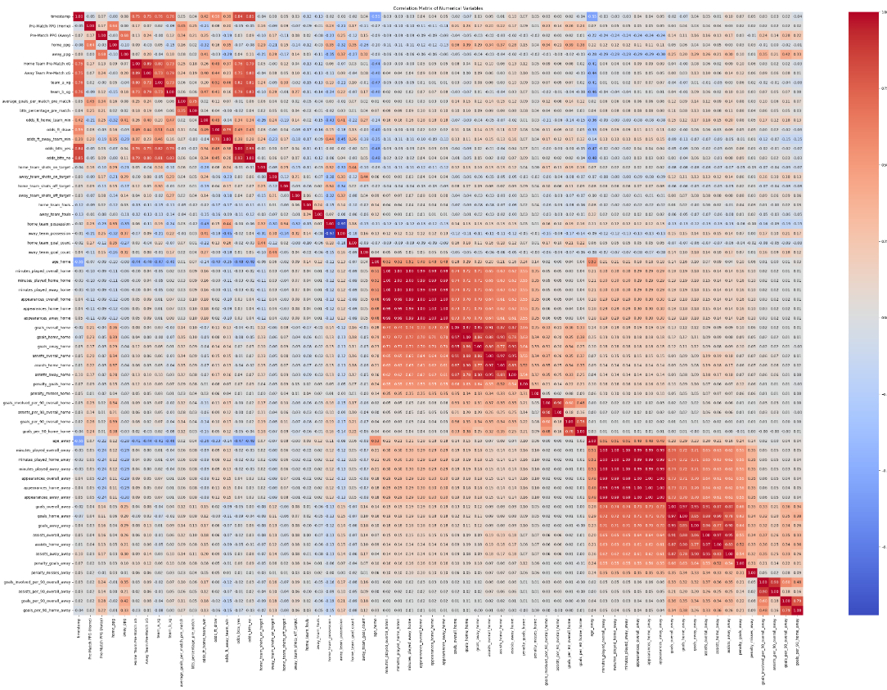
Correlation Matrix
• Strong correlation between home and away team statistics
- e.g. 'home_team_goal_count' and 'away_team_goal_count'
• High correlation among possession-related features
- 'home_team_possession', 'away_team_possession'
• Moderate correlation between shots and goals
- 'home_team_shot_on_target_count', 'home_team_goal_count'
• 'home_team_corner_count' and 'away_team_corner_count' show notable correlations
• Betting odds have significant correlations with outcomes
• 'home_team_formation' and 'away_team_formation' show minimal correlation with other features

Slide 9
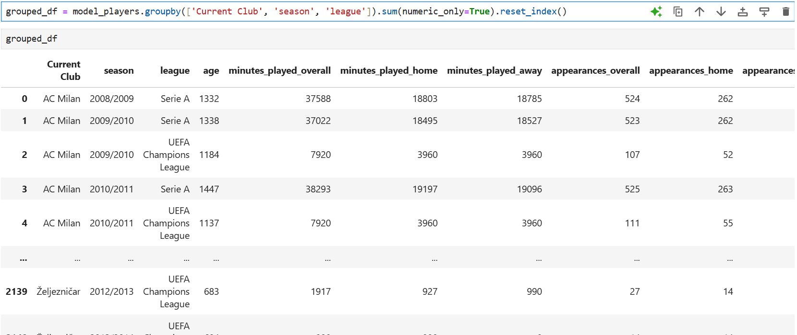
Data Splitting
Data Preparation:
Grouped Player data based on ‘current club’ and ‘season’ to get team experience.
Merge grouped players’ data with combined matches data.
Create the final dataset for implementation. i.e (29995,76)
Split data:
Train Data: 2008-2022 (25059,71)
Validation Data: 2022 (1865,71)
Test Data: 2023- Present (3071,71)

Slide 10
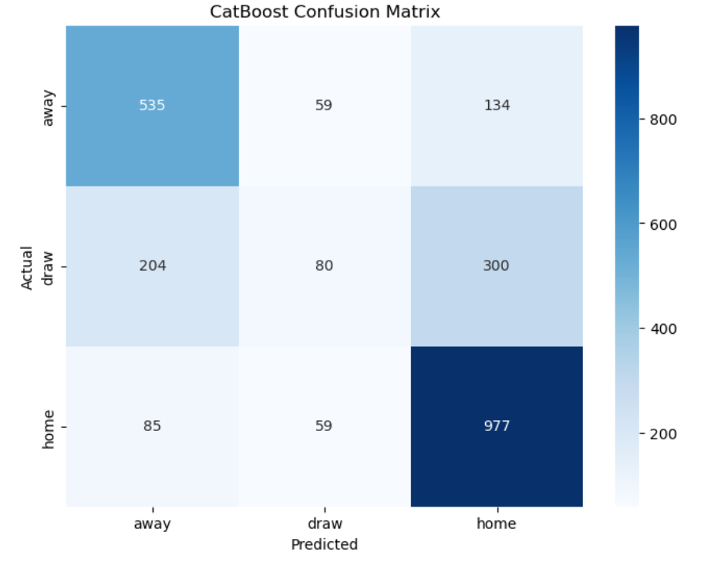
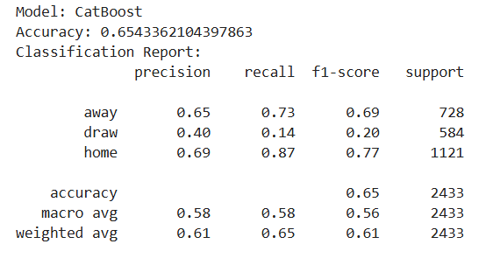
CatBoost Alogirthm
CatBoost Algorithm:
Handles categorical features well, like team names or player positions.
Can automatically deal with factors like home/away status.
Good for predicting outcomes with many influencing factors.

Slide 11
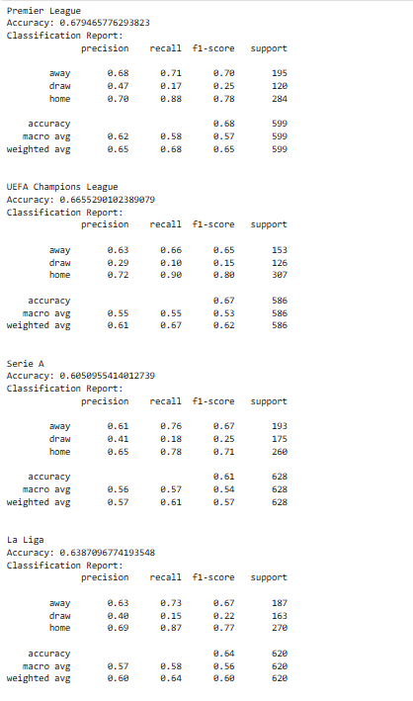
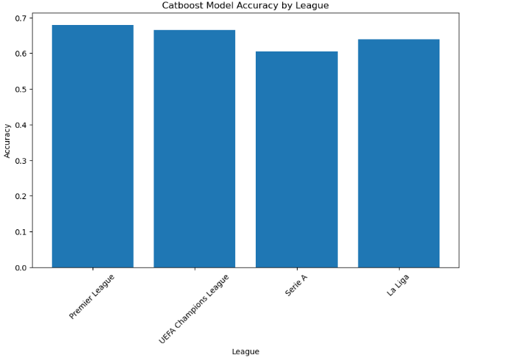
CatBoost for Individual Leagues

Slide 12
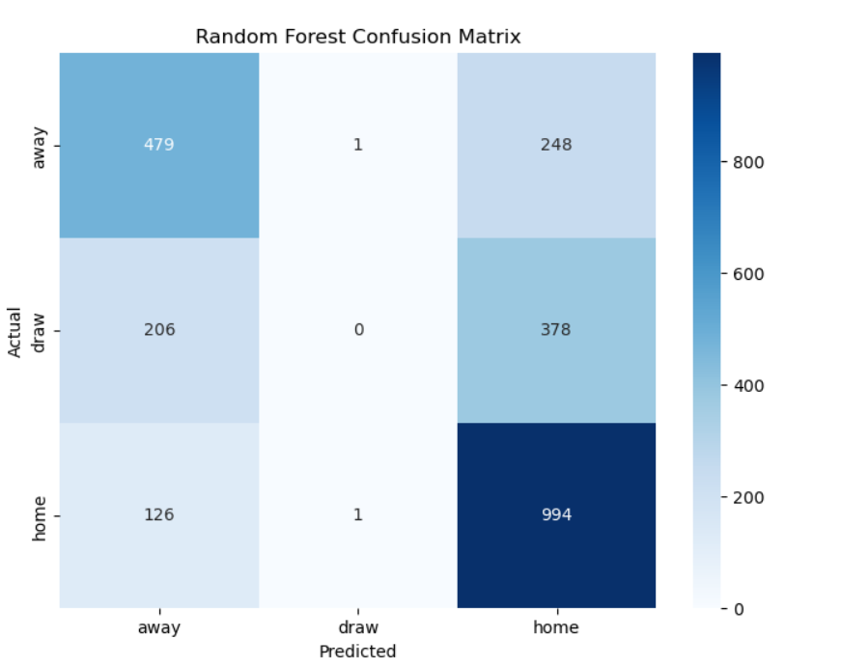
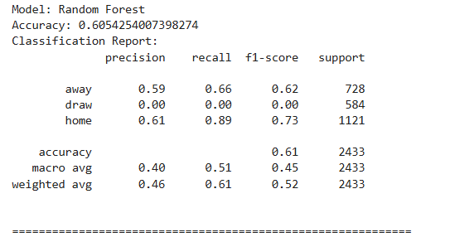
Random Forest
Random Forest Algorithm:
Less prone to overfitting, helpful when dealing with unpredictable factors in football prediction.
Good at ranking feature importance, helping identify key factors in match outcomes.

Slide 13
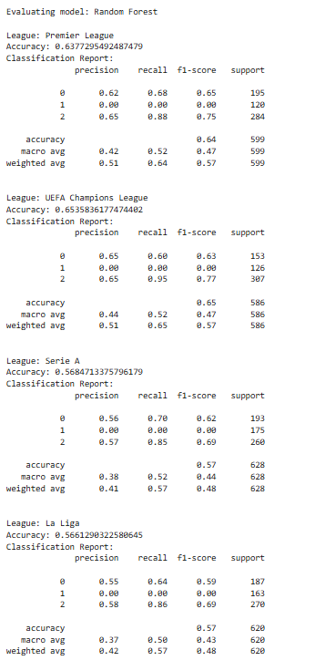
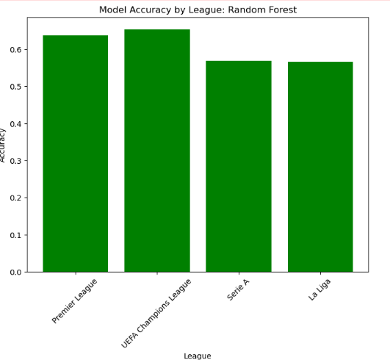
Random Forest for Individual League

Slide 14
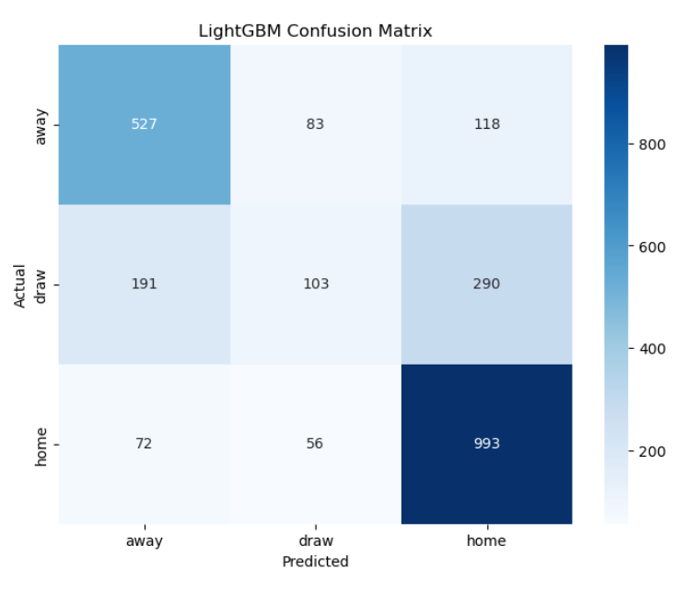
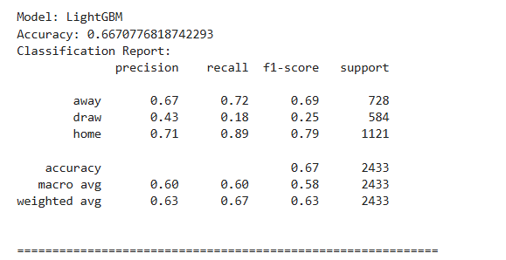
LightGBM
LightGBM Algorithm:
Efficient with large datasets, useful for historical match data.
Can quickly process multiple seasons of league data.
Good at identifying complex patterns in team performance over time.

Slide 15
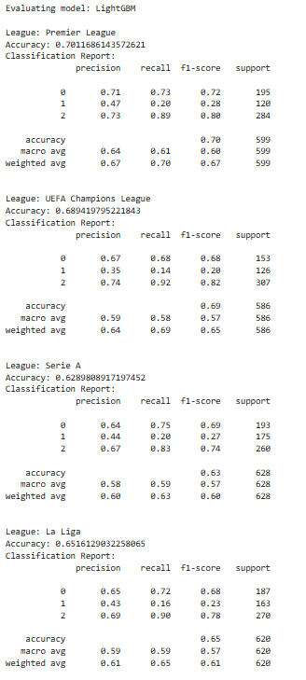
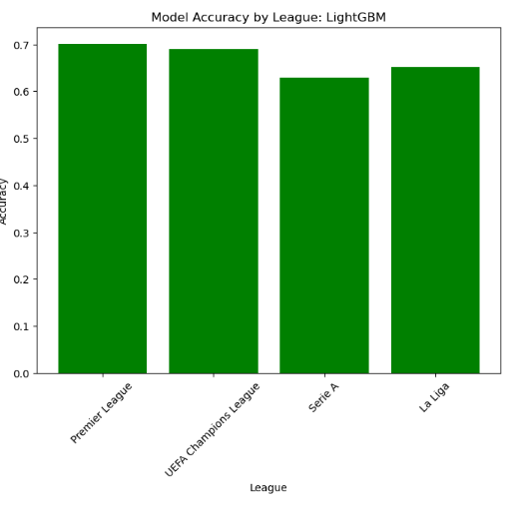
LightGBM for Individual League

Slide 16
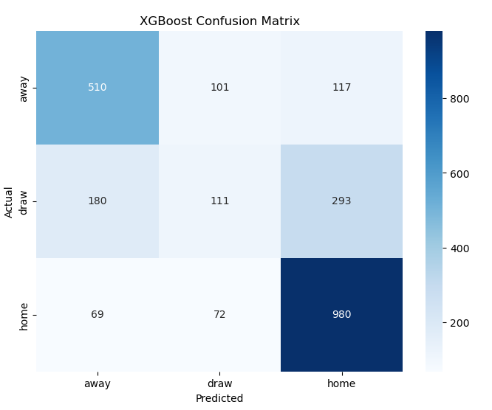
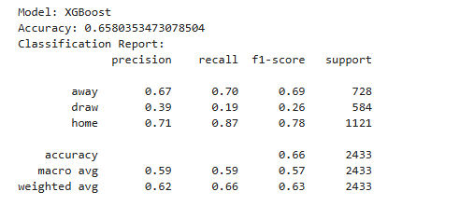
XGBoost
XGBoost Algorithm:
Handles missing data well, useful for incomplete player statistics.
Can effectively weigh various factors like form, injuries, and head-to-head records.
Good at predicting probabilities of win, draw, or loss.

Slide 17
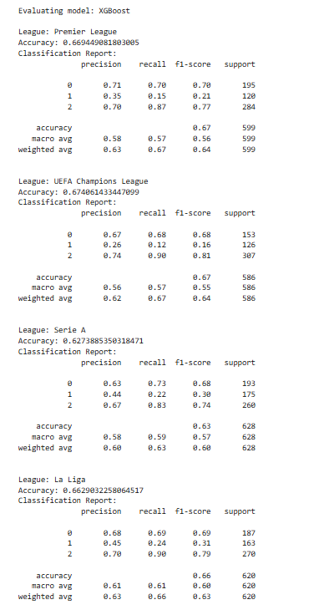
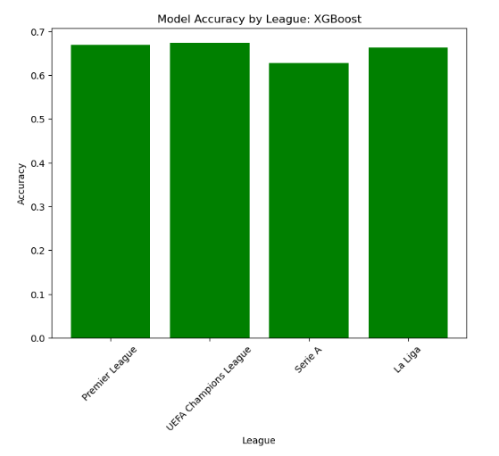
XGBoost for Individual League

Slide 18
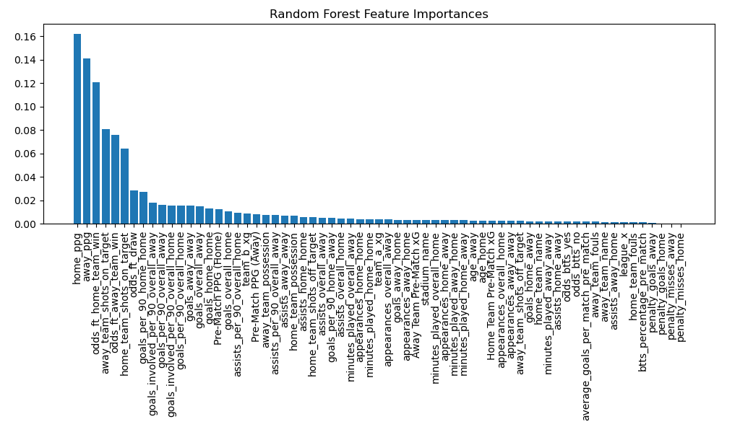
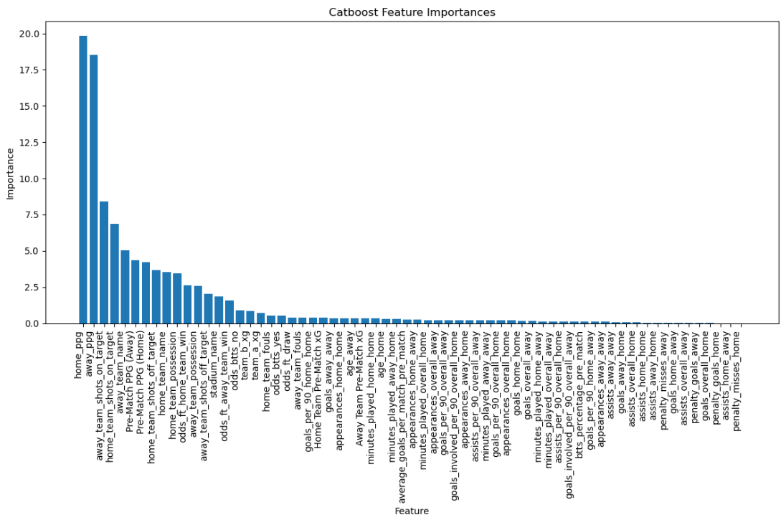
Feature Importance Analysis

Slide 19
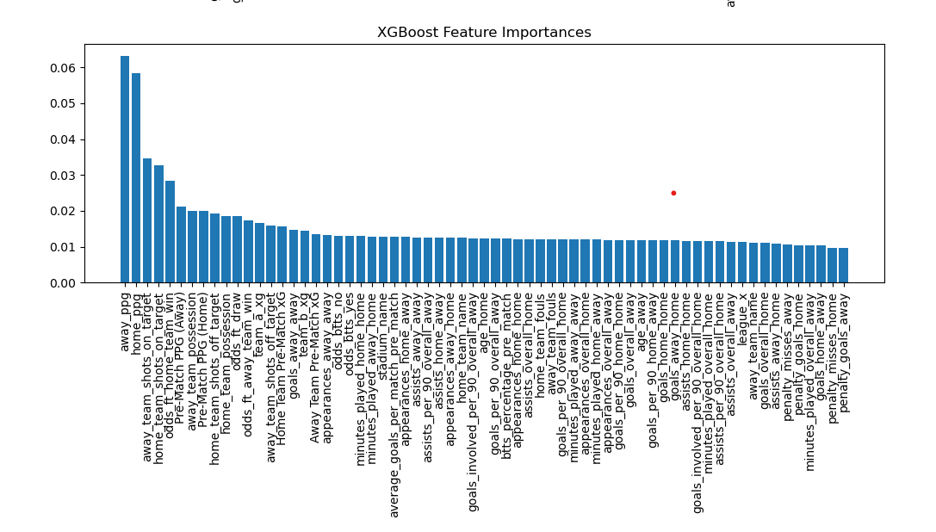
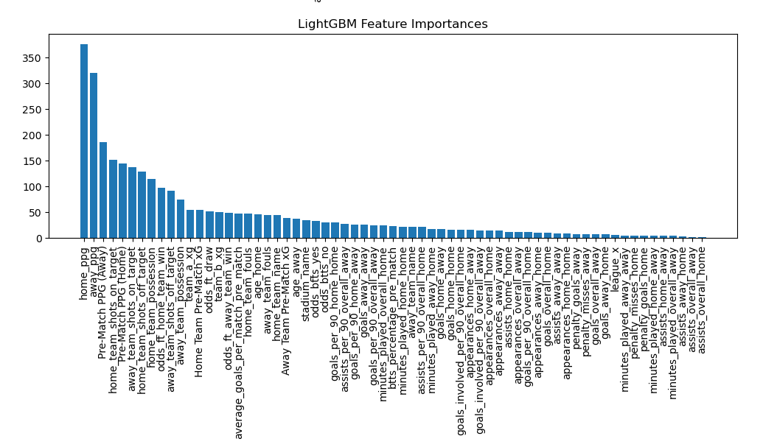

Slide 20
Challenges and Limitations
• Data Quality and Availability:
- Inconsistent or missing player statistics.
- Limited historical data for newer teams or players.
• Feature Selection:
- Identifying the most relevant factors for prediction.
- Balancing between too many and too few features.
• Evaluation Metrics:
- Choosing appropriate metrics for football prediction.
- Dealing with class imbalance (e.g., fewer draws than wins/losses).

Slide 21
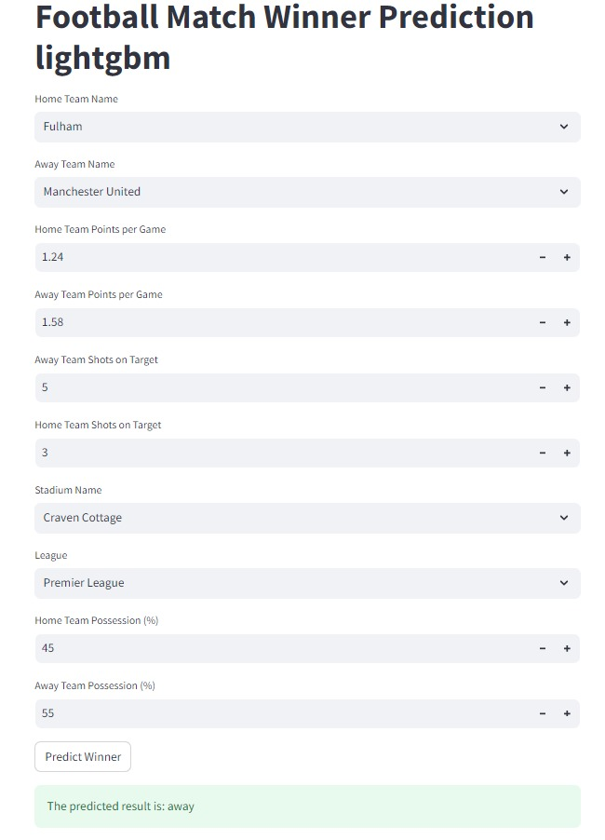
Dashboard
• Key Input Columns:
- Home team name
- Away team name
- Home points per game
- Away points per game
- Home team shots on target
- Away team shots on target
- Home team possession
- Away team possession
- Stadium name
- League
• User Interaction:
- Provide inputs for the above columns
• Output:
- Displays predicted match result

Slide 22
Conclusion
• Successfully developed a football match prediction model using machine learning.
• LightGBM algorithm provided the best accuracy among tested methods.
• Integrated both historical and real-time data for improved predictions.
• Key features include team performance metrics, match context, and betting odds.
• Dashboard created for user-friendly predictions based on input features.
• Project offers potential for further refinement and application in football analytics.
Algorithms | League | Indiviudal Accuracy | Combined Accuracy
CatBoost | Premier League | 68% | 65%
 | UEFA Champions League | 67%
 | Serie A | 61%
 | La Liga | 64%
LightGBM | Premier League | 70% | 67%
 | UEFA Champions League | 69%
 | Serie A | 63%
 | La Liga | 65%
XGBoost | Premier League | 67% | 66%
 | UEFA Champions League | 67%
 | Serie A | 63%
 | La Liga | 66%
Random Forest | Premier League | 64% | 61%
 | UEFA Champions League | 65%
 | Serie A | 57%
 | La Liga | 57%

Slide 23
Literature Review and Related Work
1. Past Research:
• Many studies have attempted to predict football match results.
• These typically rely on historical data.
• Machine learning techniques have been used, but often without real-time information.
2. Our Unique Approach:
• We incorporate live team data and current betting odds.
• These factors change constantly and can greatly affect match outcomes.
• Our goal is to enhance prediction accuracy beyond models using only past data.

Slide 24
References
FootyStats: https://footystats.org/leagues
Player Attributes: FIFA 23 Ratings Hub - EA SPORTS Official Site
Live Data: Premier League Football News, Fixtures, Scores & Results

Slide 25
THANK YOU

