Slide 1
DATA 606 Team B Football Match Prediction
Prof. Unal ‘Zak’ Sakoglu
Presented by-
Radhika Cheemala
Anurag Kunchi
Suhana Shaik

Slide 2
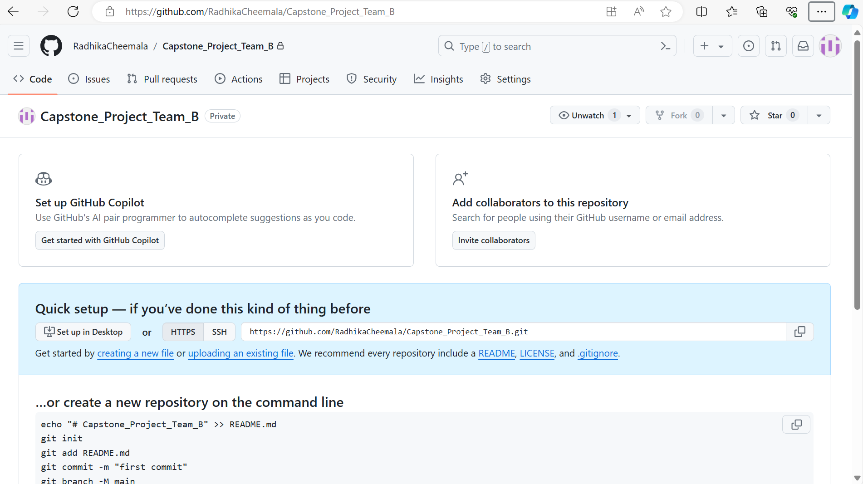
GitHub Repository
GitHub Link: https://github.com/RadhikaCheemala/Capstone_Project_Team_B.git

Slide 3
Introduction
The primary objective of this project is to develop a predictive model to forecast the outcomes of football matches, specifically classifying the results into three categories: Home win, Away win, or Draw.
This project involves a classification task, where the machine learning model will be trained to predict the outcome of a match based on various features and data inputs.
Additionally, we aim to explore several related use cases, including: Goals Prediction: A regression task to predict the total number of goals scored in a match. Half-Time and Full-Time Results Prediction: A classification task to predict the outcomes at both half-time and full-time. Corners Prediction: A regression task to predict the number of corners awarded in a match.

Slide 4
Dataset Overview
The dataset for this project comprises comprehensive data from multiple sources, including:
Historical Match Data: Match results, goals, corners, and other relevant statistics from top football leagues such as England, Spain, Germany & Italy spanning from the year 2008 to the present.
Team Attributes: Data on team and player attributes sourced from the Electronic Arts (EA) sports website.
Betting Data: Odds and other betting-related information from various betting websites.
The dataset consists of almost 30,400 rows and 60+ columns.
The primary task is a multi-class classification problem, with three categories: Home win, Away win, and Draw.
Additionally, regression tasks will be performed for goal prediction and corner prediction

Slide 5
Methodology
1. Data Collection: Aggregate data from FootyStats, EA, and betting websites. Ensure data accuracy and completeness through paid subscriptions and validation checks.
2. Data Preprocessing: Clean and preprocess data to handle missing values, normalize attributes, and create relevant features.
3. Feature Engineering: Extract and engineer features such as recent team performance, head-to-head statistics, and betting odds.
4. Model Building: Use machine learning algorithms such as Decision Tree, Random Forest, XGBoost, and Neural Networks for classification and regression tasks. Train and validate models using historical data.
5. Evaluation: Evaluate models based on metrics like accuracy, precision, recall, F1 score, and ROC-AUC for classification. Use mean squared error (MSE) and root mean squared error (RMSE) for regression tasks.
6. Deployment: Develop a dashboard for real-time predictions and insights using Streamlit. Implement feature importance analysis to understand key predictors.

Slide 6
Research Questions
1. How does the integration of real-time team attributes and betting odds improve the accuracy of predicting match outcomes compared to models relying solely on historical match data?
2. Which machine learning algorithms or ensemble methods perform best for predicting different aspects of a football match (e.g., match outcome, number of goals, corners, half-time/full-time results)?
3. What are the most significant features or predictors for accurately forecasting match outcomes, goals, corners, and other match events?
4. How can the prediction models be integrated into real-time decision-making processes for teams, coaches, or betting platforms?

Slide 7
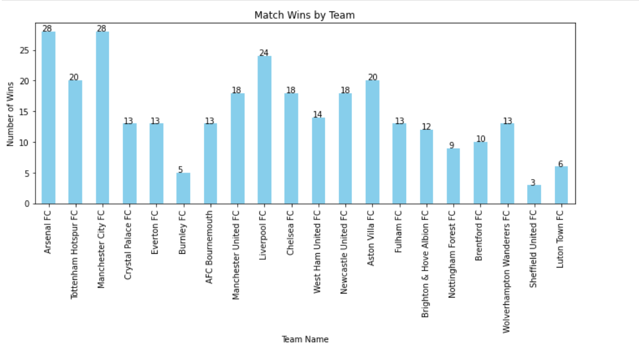
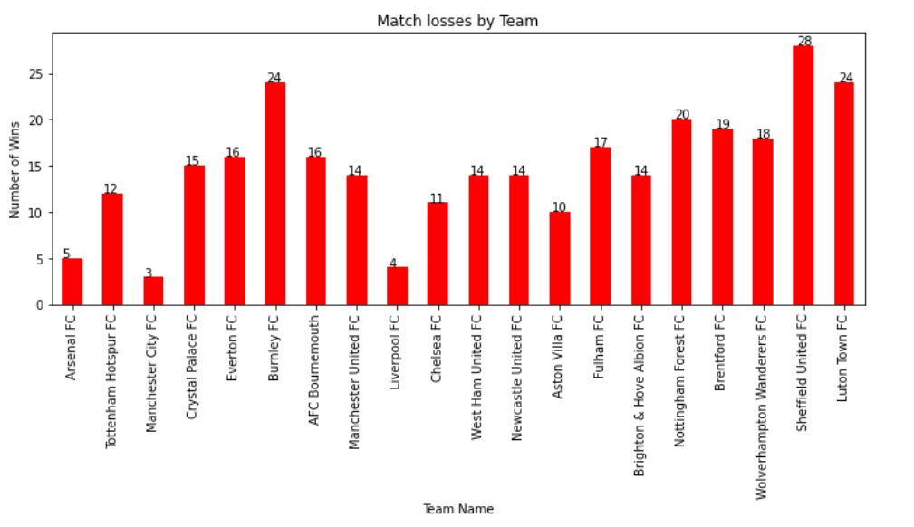
Basic EDA

Slide 8
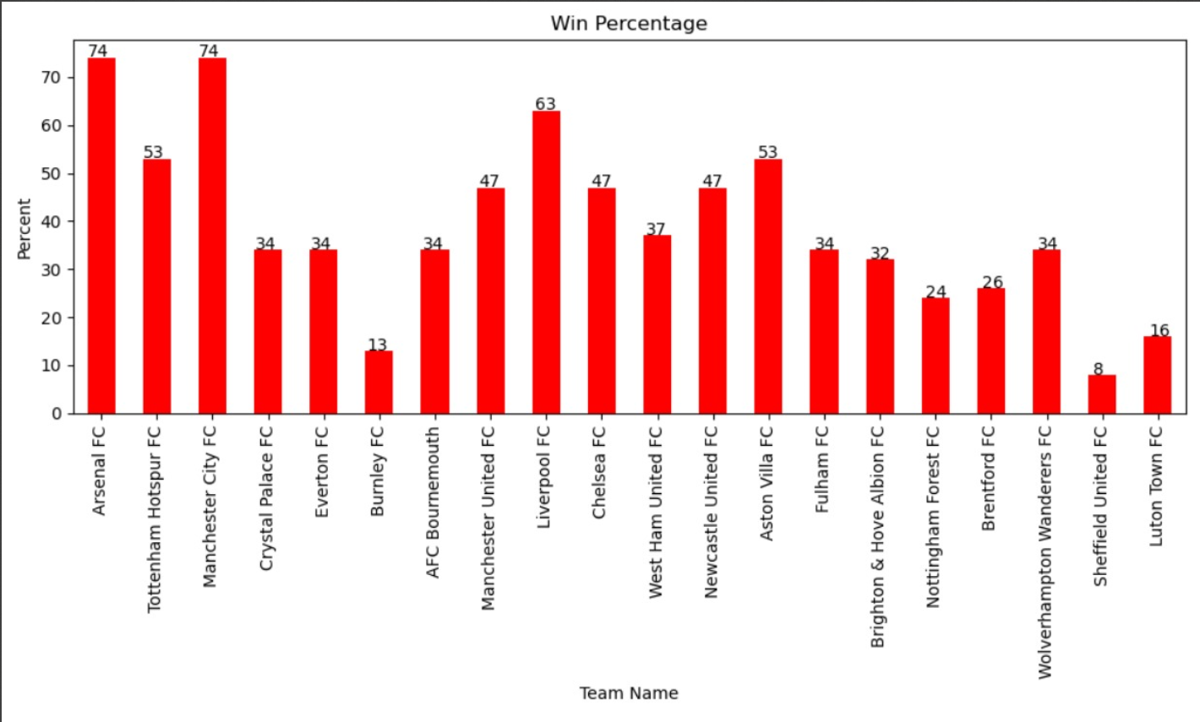
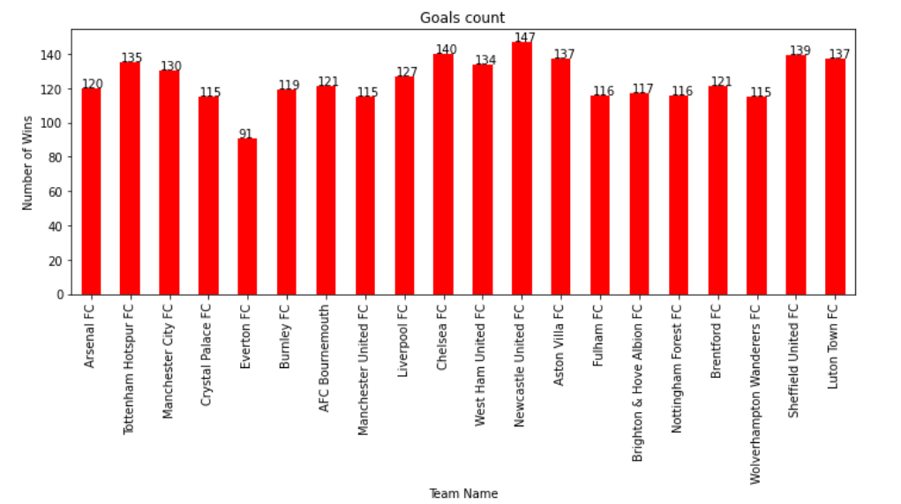
Match and Goals Count

Slide 9
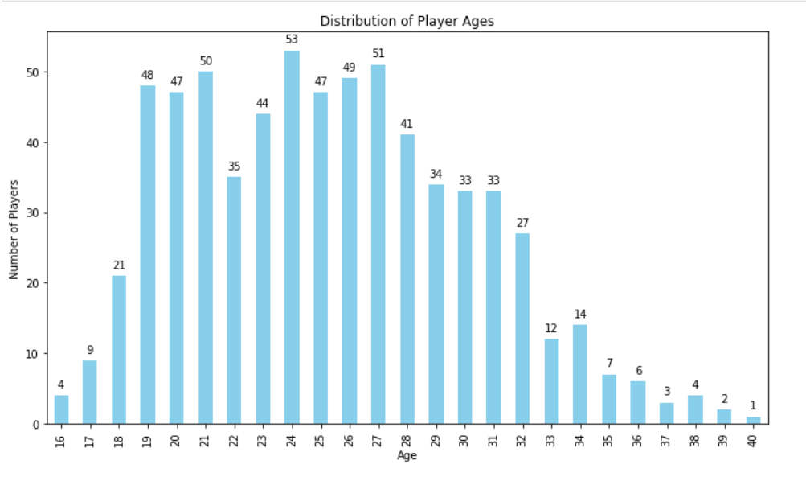
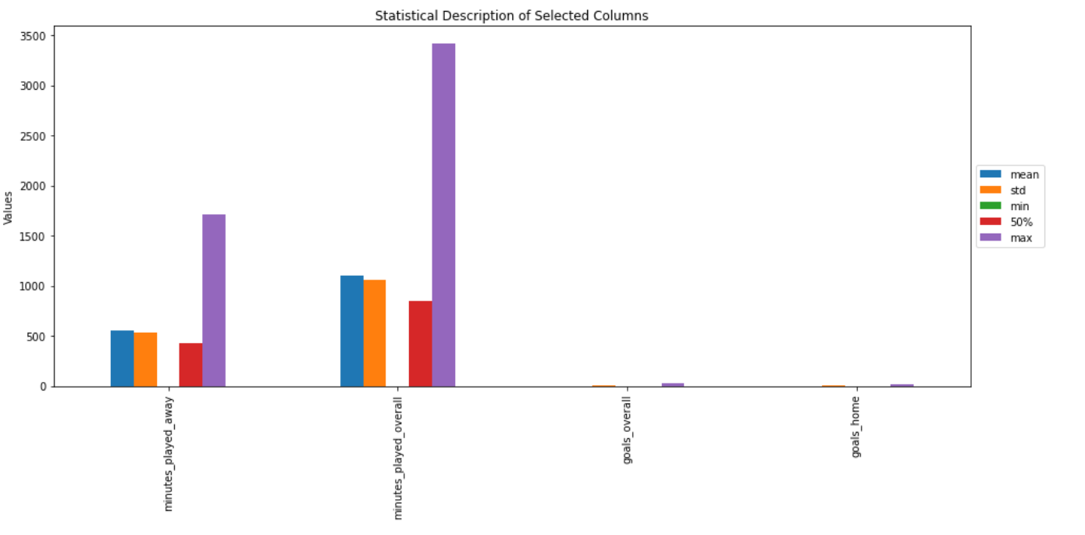
Age and Statistical Analysis

Slide 10
Literature Review and Related Work
1. Previous Studies: Various studies have focused on predicting football match outcomes using historical data alone. Studies have utilized machine learning techniques for prediction tasks but often lack real-time data integration.
2. Differentiation: This project integrates real-time team attributes and betting odds, which are dynamic and can significantly impact match outcomes. The approach aims to improve prediction accuracy compared to models relying solely on historical data.

Slide 11
Expected Outcomes
A predictive model capable of accurately forecasting match outcomes (home win, away win, draw).
Additional models for predicting the number of goals, half-time/full-time results, and corners.
A comprehensive dashboard for visualization and analysis of predictions and feature importance.

Slide 12
References
FootyStats: https://footystats.org/leagues
Player Attributes: FIFA 23 Ratings Hub - EA SPORTS Official Site
Prediction of Football Matches Results: Decision Forest against Neural Networks | IEEE Conference Publication | IEEE Xplore

Slide 13
THANK YOU

