Slide 1
DATA 606 Team B Football Match Prediction
Prof. Unal ‘Zak’ Sakoglu
Presented by-
Radhika Cheemala
Anurag Kunchi
Suhana Shaik

Slide 2
Project Overview
Goal: Predict football match winners using machine learning algorithms
Data sources: Combined league data (England, Spain, UEFA Champions League, Italy)
Task: Multi-class classification (home win, away win, draw)
Models: CatBoost, Random Forest, XGBoost, LightGBM
GitHub Link: https://github.com/RadhikaCheemala/Capstone_Project_Team_B.git

Slide 3
DataSet Details
Dataset shape
Combined_League (64,72)
Combined_Matches (21792,67)
Combined_Players (58803,278)
Combined_Teams (2144,294)
Final Dataset Shape used for Model Building:
(29995,70)

Slide 4
Literature Review
• Previous Studies: Relied on historical data, limited real-time integration
• Our Approach: Integrates real-time team attributes and betting odds
• Key Advantage: Captures recent dynamics, adapts to pre-match changes
• Challenge: Balancing historical data with real-time information

Slide 5
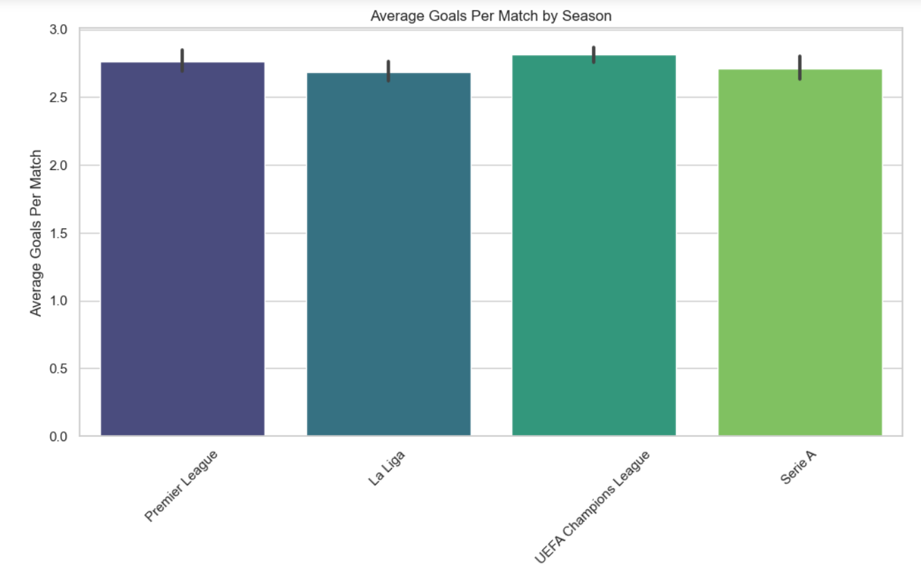
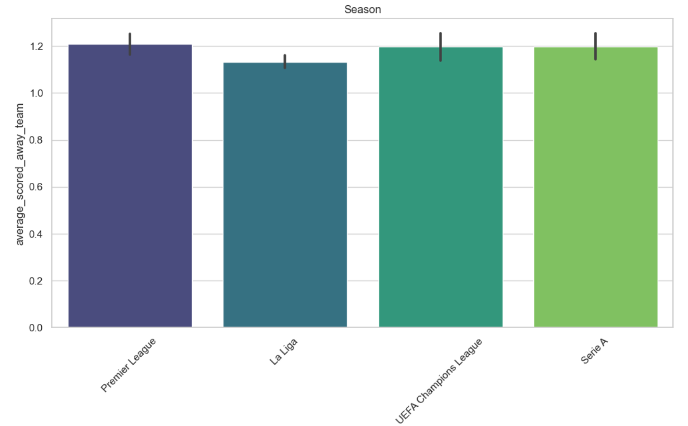
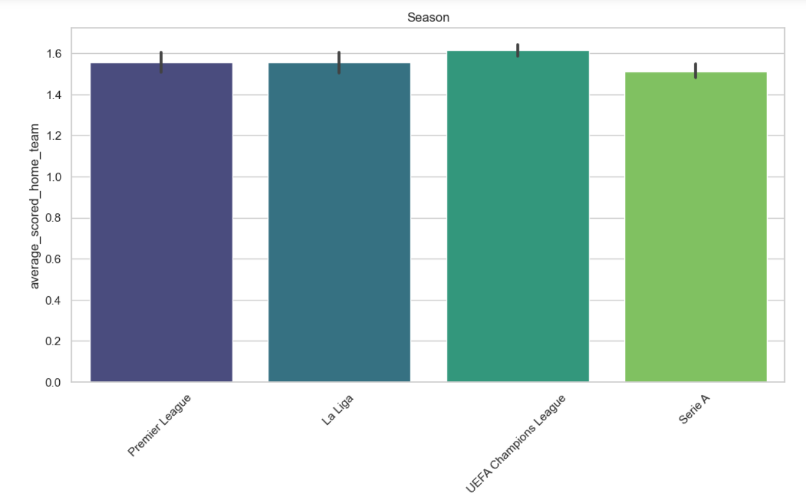
EDA

Slide 6
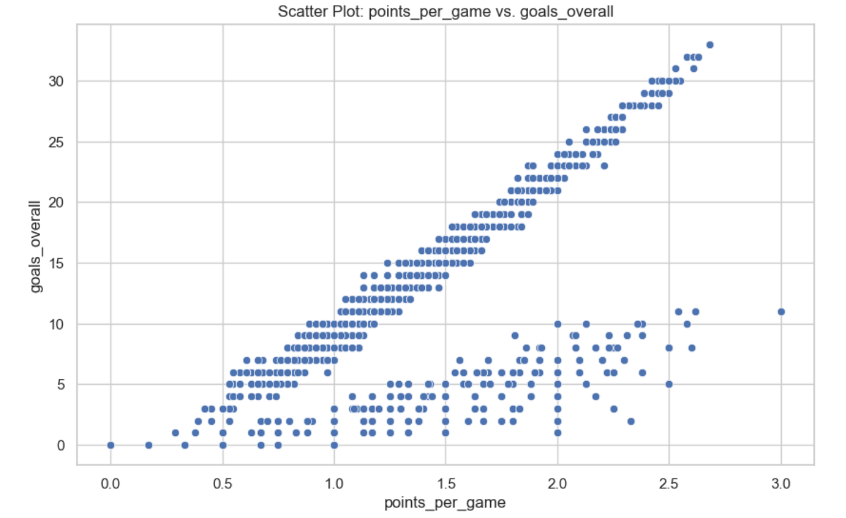
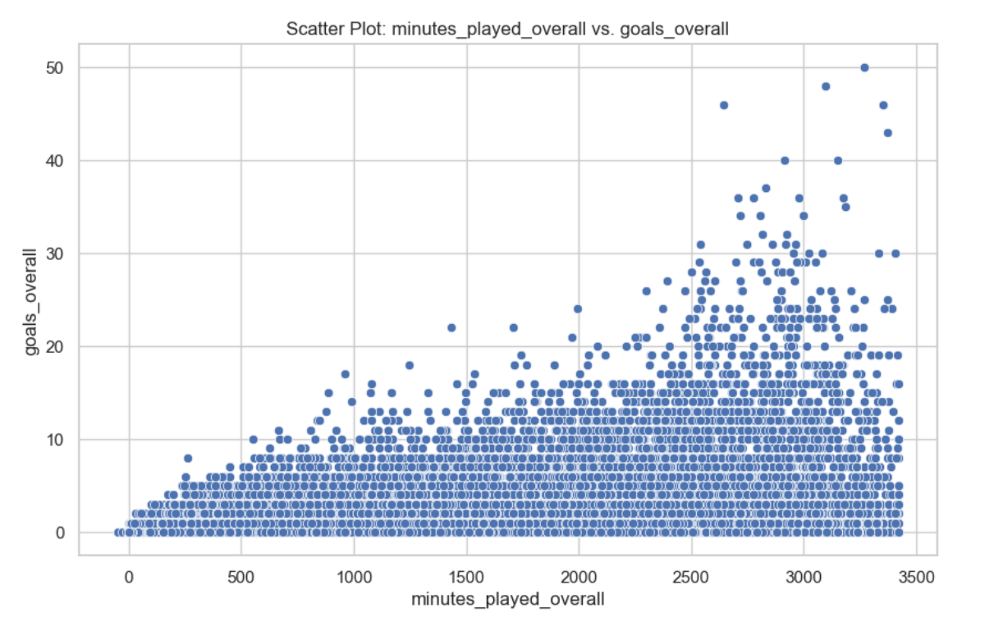
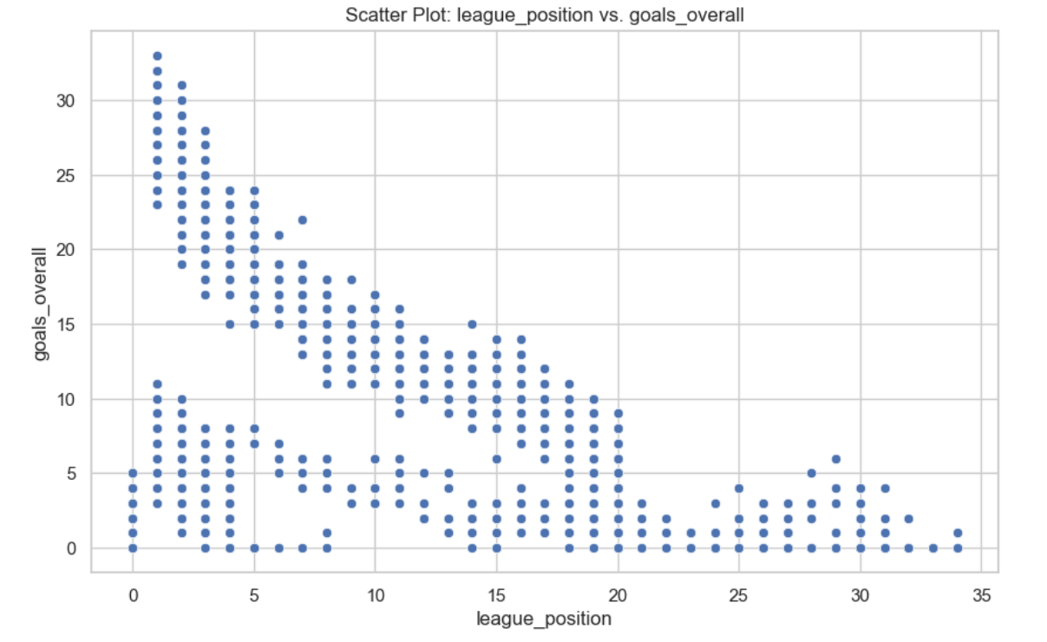

Slide 7
Feature Engineering
Replaced -1, 0 with NaN
Filled NaN values with mean and median for numerical columns
Created a 'winner' column based on goal counts
Aggregated player statistics by team and season
Data Splitting:
Training: Matches before 2022 (25059,70)
Validation: Matches in 2022 (1865,70)
Testing: Matches from 2023 onwards (3071,70)

Slide 8
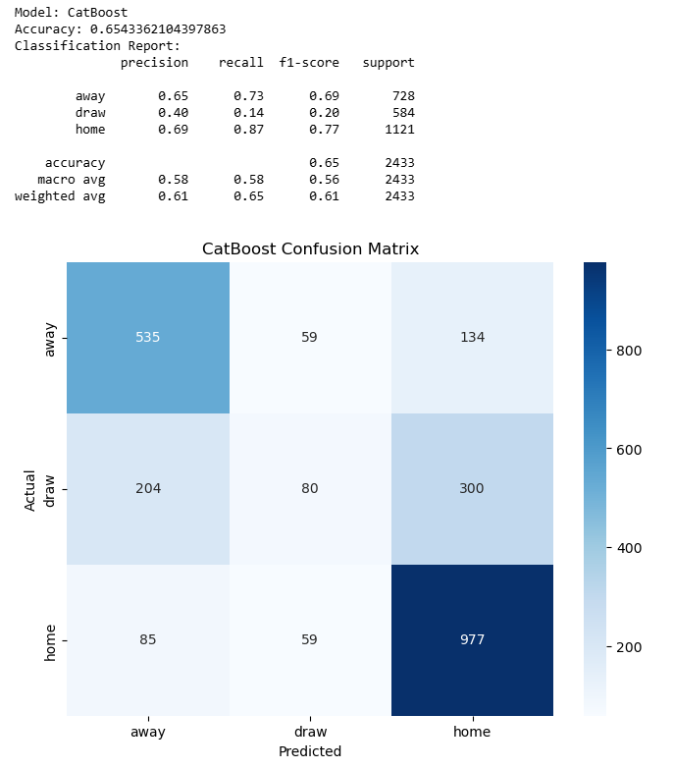
CatBoost
• CatBoost is a gradient boosting library that efficiently handles categorical features, reduces overfitting, and performs highly for machine learning tasks.
Overall Accuracy: 65.43%
Performance by Outcome:
Home: Best (F1: 0.77)
Away: Moderate (F1: 0.69)
Draw: Poor (F1: 0.20)
Strengths:
High recall for home wins (0.87)
Balanced away win prediction
Weakness: Poor draw prediction

Slide 9
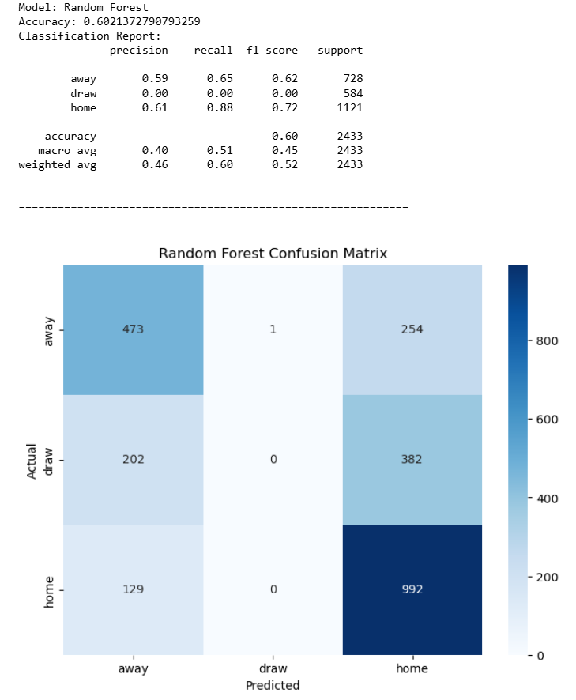
Random Forest
Random Forest is an ensemble learning method that constructs multiple decision trees and combines their outputs for improved prediction accuracy and reduced overfitting.
• Overall Accuracy: 60.21% (lower than CatBoost's 65.43%)
• Performance by Outcome:
Home: Best (F1: 0.72)
Away: Moderate (F1: 0.62)
Draw: Failed to predict (F1: 0.00)
• Strengths:
High recall for home wins (0.88)
Moderate performance on away wins
• Major Weakness:
- Complete failure to predict draws

Slide 10
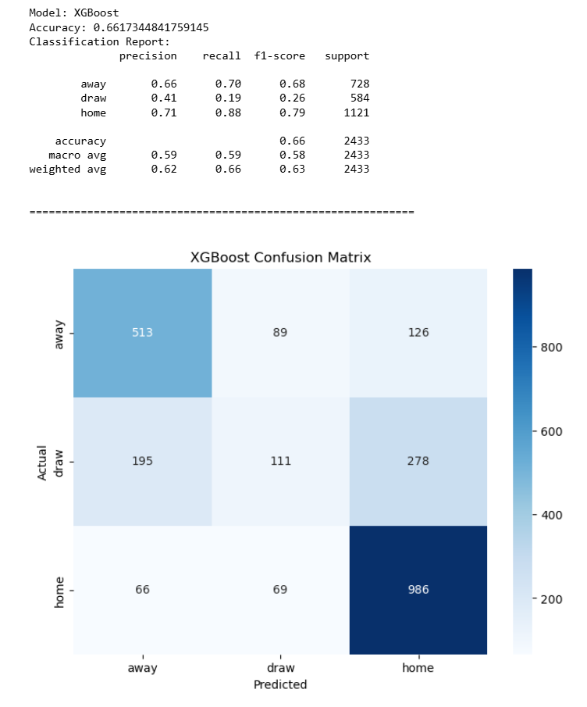
XGBoost
• An efficient and scalable gradient-boosting library that optimizes model performance through regularization and parallel processing.
• XGBoost Overall Accuracy: 66.17% (highest among the three models)
• Performance by Outcome:
Home: Best (F1: 0.79)
Away: Good (F1: 0.68)
Draw: Poor, but better than Random Forest • Strengths:
High recall for home wins (0.88)
Good balance of precision and recall for away wins
Improved prediction of draws compared to Random Forest
• Weakness:
Still struggles with drawing predictions, though better than Random Forest

Slide 11
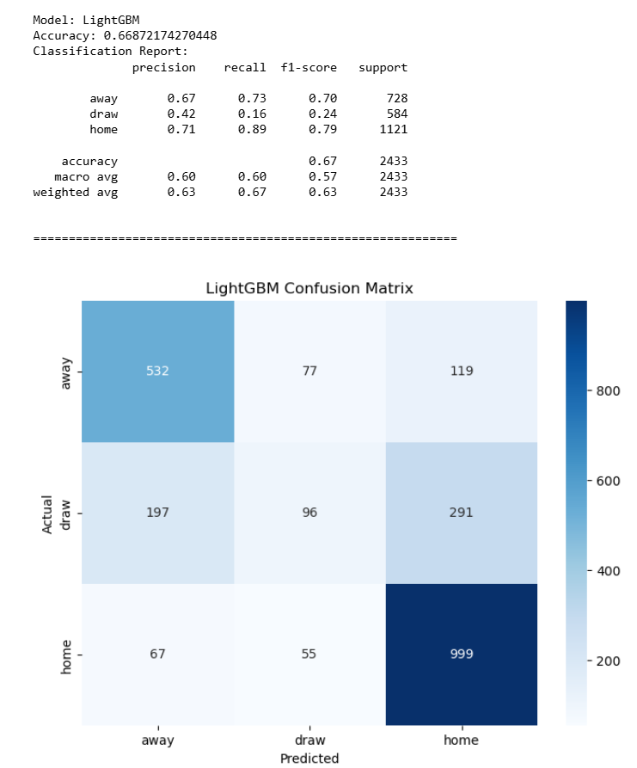
LightGBM
A fast, distributed, high-performance gradient-boosting framework that uses tree-based learning algorithms and leaf-wise tree growth for improved efficiency and accuracy.
• LightGBM Overall Accuracy: 66.87% (slightly higher than XGBoost, best among all models)
• Performance by Outcome:
Home: Best (F1: 0.79)
Away: Good (F1: 0.70)
Draw: Poor, but slightly better than XGBoost (F1: 0.24)
• Strengths:
Highest recall for home wins (0.89)
Best precision and recall balance for away wins
Slightly improved overall accuracy compared to other models
• Weakness:
Still struggles with draw predictions, though marginally better than previous models

Slide 12
Conclusion
• LightGBM performed best overall (67% accuracy)
• All models excel at predicting home wins
• Away wins predicted with moderate success
• Draws remain challenging for all models
• Gradient boosting methods (LightGBM, XGBoost, CatBoost) outperformed Random Forest

Slide 13
References
FootyStats: https://footystats.org/leagues
Player Attributes: FIFA 23 Ratings Hub - EA SPORTS Official Site

Slide 14
THANK YOU

