Slide 1

Data Science and Big Data – Project I
Analysis of Gender-based Wage Gap
TEAM – 05
Radhika Govindarajan, Yuchan Guo

Slide 2
Key Findings
A significant wage gap exists between men and women across industries
Differences in education level, years of experience, racial disparities influence the wage gap, they do not fully account to it
On average men to spend more time at work than women. However, differences in time were disproportionate to the wage gap and this has reduced over the years.

Slide 3
Dataset
Gender Pay Gap Dataset
Obtained from Kaggle - https://www.kaggle.com/datasets/fedesoriano/gender-pay-gap-dataset
Contains 344287 records with 234 features
Utilized around 70 relevant features for the analysis

Slide 4
Question 1 Does a significant wage gap exist between men and women ? How does it vary between industries ?

Slide 5
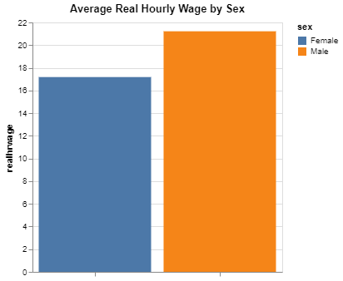
Wage Difference
On average men earn around $21/hour
While women earn around $17/hour
We observed an overall wage difference of $4/hour between men and women

Slide 6
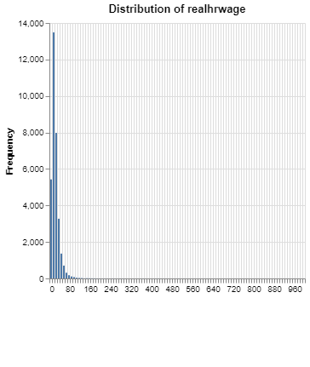
Distribution of Hourly Wage
- The descriptive statistics showed a substantial disparity in hourly wage through the wide range between minimum wage of $2/hour and maximum value of $1000/hr.
- Maximum wage is way higher than 75th percentile indicating the presence of extreme outliers
- Hence, we removed outliers to proceed with further analysis

Slide 7
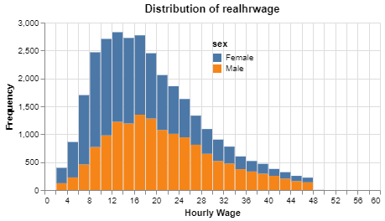
Distribution of Hourly Wage
The average female wage is $15.3/hr while for male it is $19.6/hr
It can be clearly observed that the female wage is more right skewed than the male distribution.
The median wage for female is $22.1/hr while for male it is $27.1/hr

Slide 8
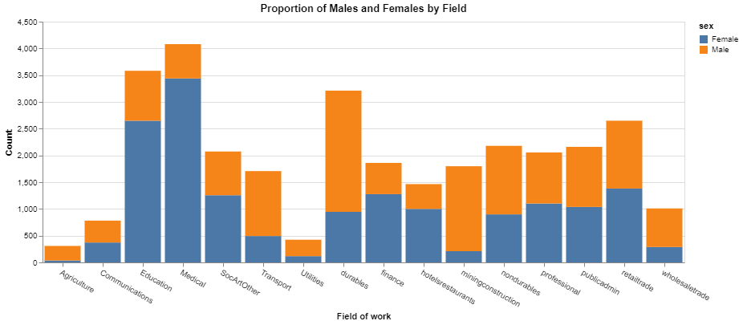
Gender Proportion across industries

Slide 9
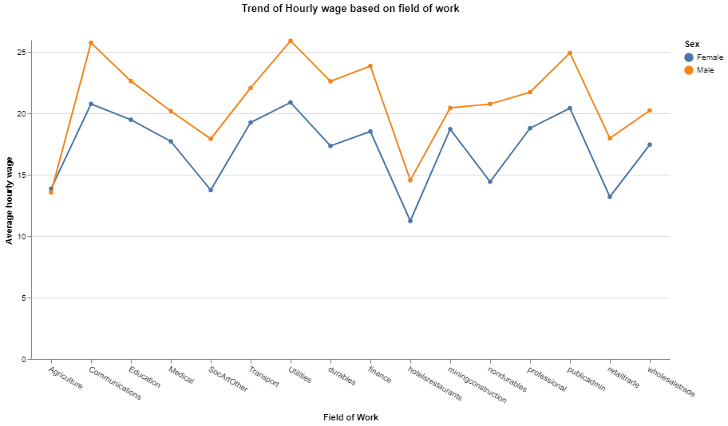
The Hourly wage irrespective of industry is higher for men than women The wage gap is less in industries dominated by women such as Education, Medicine

Slide 10
Question 2 What are the underlying causes that contribute to this wage disparity ? - Education - Work Experience - Racial Disparities - Working Hours

Slide 11
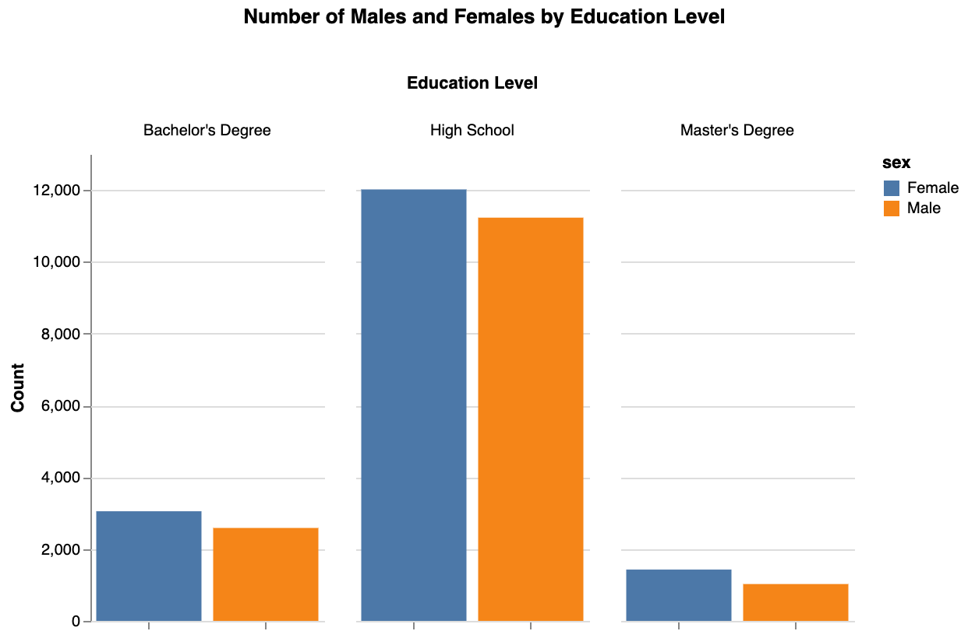
Education
Categories
High School
Bachelor's Degree
Master's Degree

Slide 12
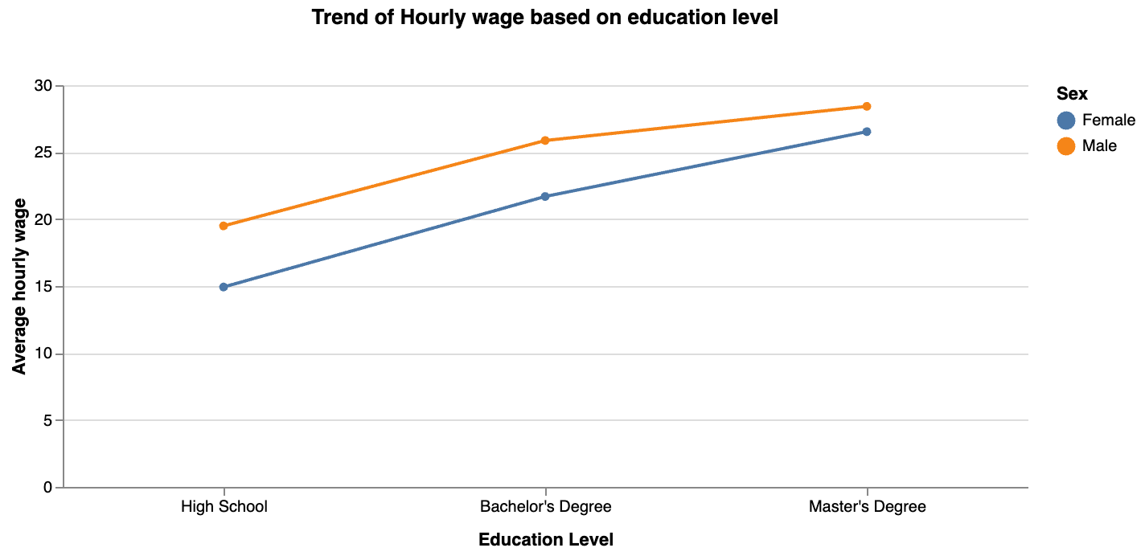
Increase in education level, minimizes the wage gap

Slide 13
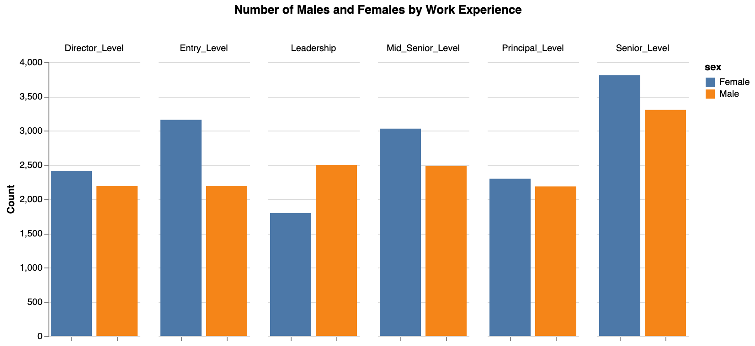
Years of Experience
Entry Level
Senior Level
Mid-Senior Level
Director Level
Principal Level
Leadership

Slide 14
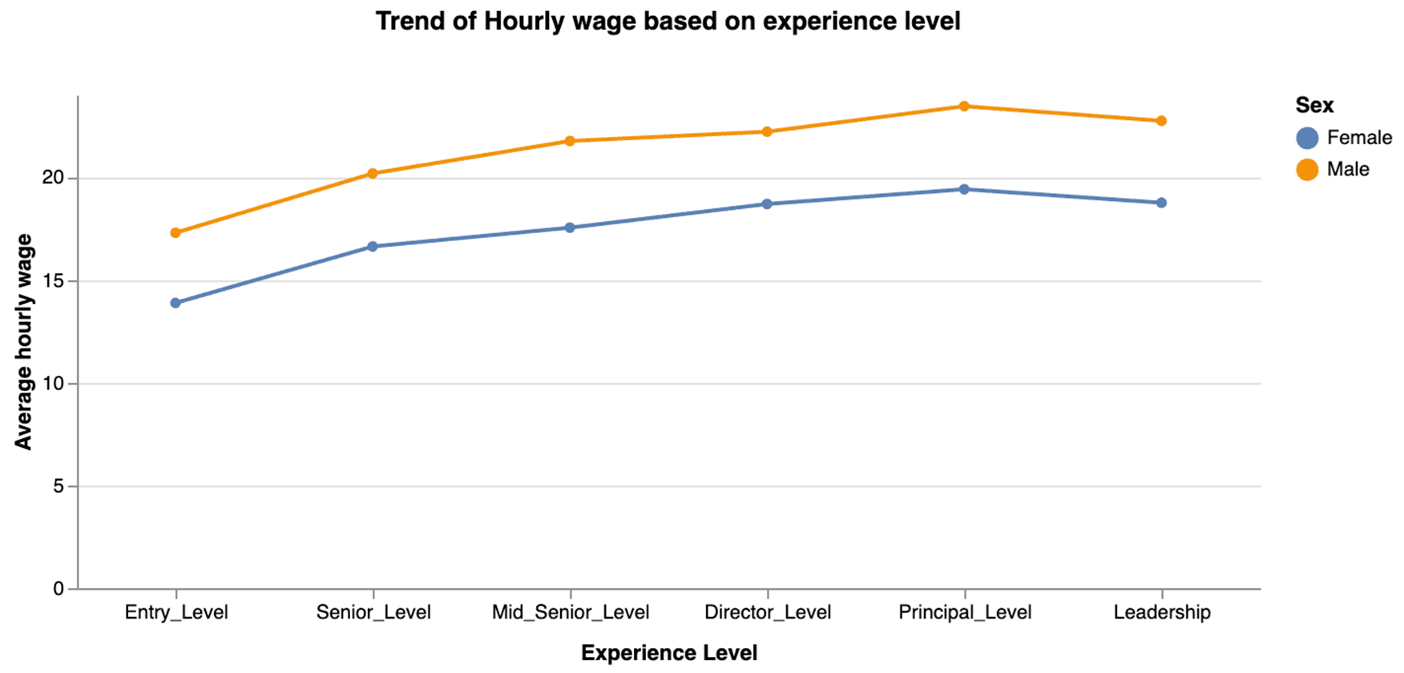
Longer Experience Leads to Higher Wages

Slide 15
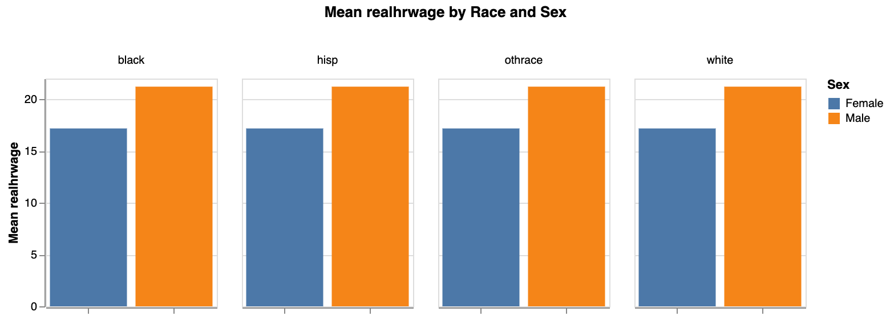
Racial Differences

Slide 16
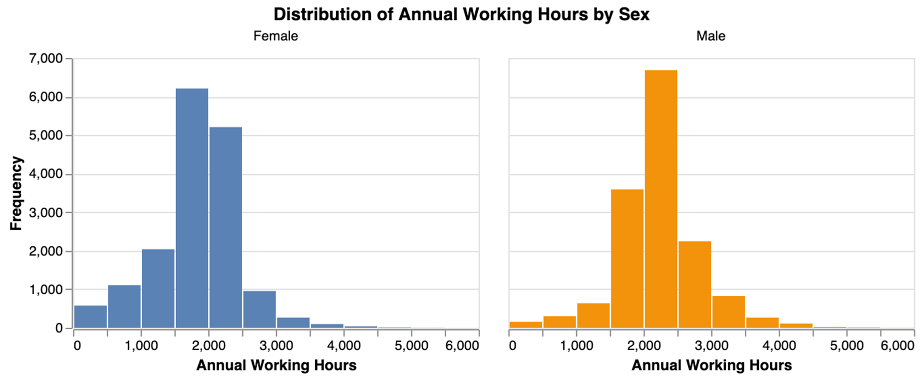
Working Hours

Slide 17
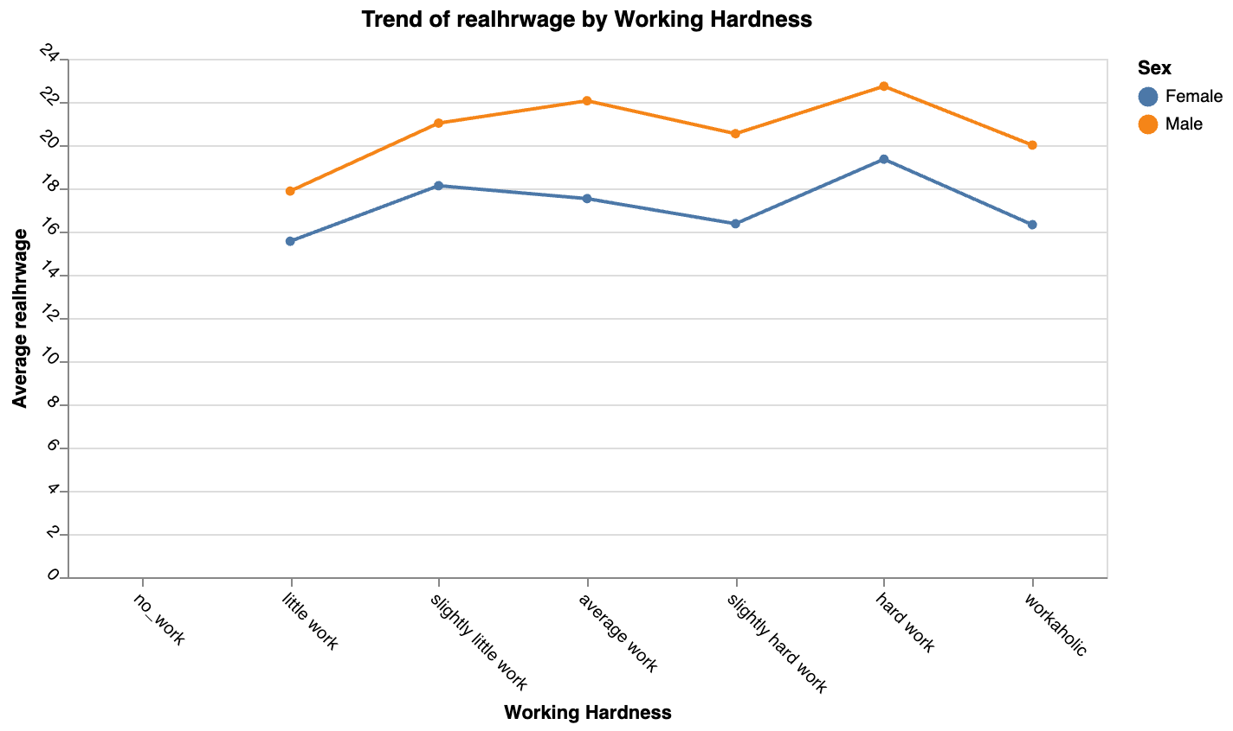
Working Hours
Even among men and women falling under similar work hour category, men still earn higher than women

Slide 18
Question 3 Are the differences in factors proportionate to wage difference and how has the wage gap evolved over the years ?

Slide 19
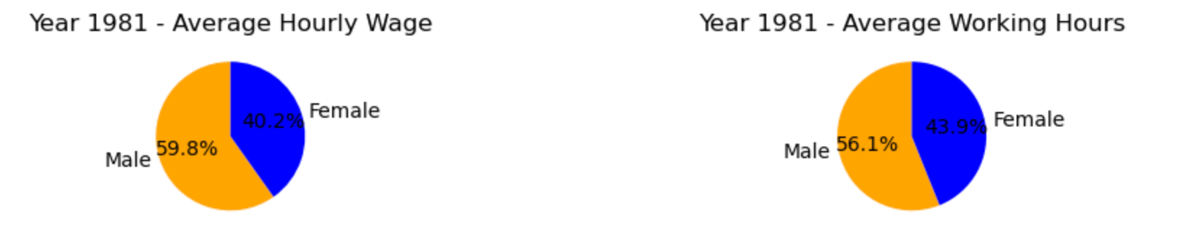
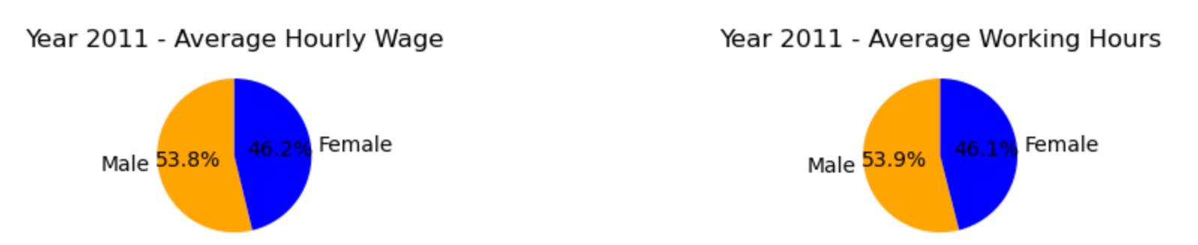
The wage gap has reduced from 19.6% in 1981 to 7.6% in 2011 A difference of 12.6% in working hours corresponded to a wage gap of 19.6%. However, in 2011, 7.8% corresponds to 7.6% wage difference.

Slide 20
Call for Action/Policy Recommendations
Promote Gender-Neutral Recruitment and Advancement Practices
Encourage Industry-Specific Wage Equity Initiatives
Support Flexible Work Arrangements and Work-Life Balance
Blind Resume Screenings
Unconscious Bias training for managers
Regular pay audits
Clear Wage Guidelines
Industry-wide benchmarks
Telecommuting
Flexible work hours
Affordable childcare options
Paid parental leave

Slide 21
Overall Summary
Persistent gender wage gap, its multifaceted determinants and has evolved over time
Working Experience
Education
Races
Working Hours

Slide 22
Future Work
Conducting in-depth studies
Specific industry policies
Flexible work arrangements
Gender-neutral recruitment practices
Cultural and societal factors

