Slide 1

Process Mining Virtual Internship
by
Radhika M
Roll No. 224G1A3376
Department of Computer Science and Engineering (Data Science)
Srinivasa Ramanujan Institute of Technology
(Affiliated to JNTUA & Approved by AICTE) (Accredited by NAAC with ‘A’ Grade & Accredited by NBA (EEE, ECE & CSE)
Rotarypuram Village, B K Samudram Mandal, Ananthapuramu – 515701.
2024 - 2025

Slide 2

Contents
Course Objective
Introduction
Technology
Modules
Real-Time Applications
Learning outcomes
GitHub Link
Queries

Slide 3
Course Objective
Understand the fundamentals of process mining and its importance in process improvement.
Learn how to extract and prepare data from different sources for process mining.
Find and fix problems in business processes using data.

Slide 4
Introduction
What is Process Mining?
Process Mining is a technique to analyze, improve, and track processes.
Celonis Process Mining is a powerful tool for analyzing and optimizing business processes.
It helps companies gain real-time visibility into their operations, identify bottlenecks, and uncover hidden opportunities.
Process mining reveals hidden inefficiencies and opportunities to streamline processes, reducing costs and boosting productivity

Slide 5
Technology
Data-Driven Approach
Process Mining uses data from IT systems to create a detailed picture of how a process is actually executed, rather than relying on assumptions or manual observations.
Identify Bottlenecks
It helps pin point areas of process that are causing delays, errors, or inefficiencies, enabling targeted improvements.
Continues Optimization
Process Mining enables an ongoing cycle of analysis, optimization, and monitoring to continuously enhance business operations.

Slide 6
Modules
Steps in Process Mining.
Celonis Process Mining Fundamentals
Rising Star – Technical
PQL Queries
Get Data into EMS

Slide 7
Modules
Steps in Process Mining
Step-1:Identify the problem of importance to the business that can realistically be addressed with process mining. Determine the business value of solving the problem and what metrics to use to measure success.
Step-2:Identify the data sources that need to be fully understood to address the business process issues under consideration. Identify the applications and systems that need to provide feeds of event data for continuous visibility into end-to-end processes.
Step-3:Set up a pilot project to prove the potential value of a process mining solution. Ensure that the project can be executed relatively quickly and deliver specific, measurable results that everyone in the organization can understand.
Step-4:Accepting the results of the analysis, as process mining provides, among other things, a clear picture based on facts.

Slide 8
Modules
Celonis Process Mining Fundamentals
This training track provides both the theoretical and applied foundations around Process Mining.
Process mining reads this data, converts it into an event log, and then creates visualizations of the end-to-end process, along with insightful analytics.
Process mining is a set of techniques used for obtaining knowledge and extracting insights from processes.
An event log contains each step performed during the process , the time at which the event occurred , and for which instance of the process.
Using this event log, algorithms generate a process model that shows the process

Slide 9
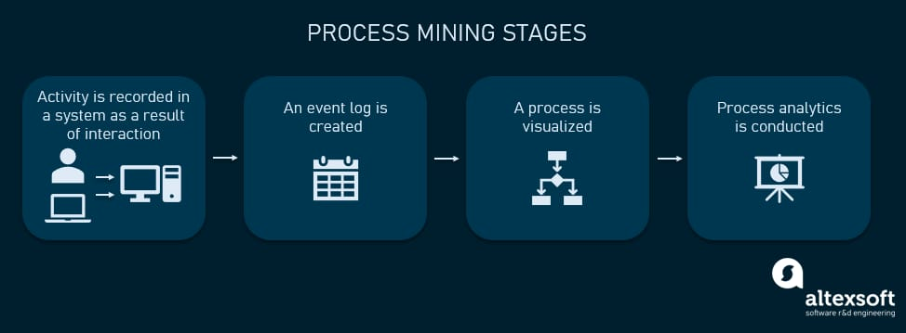
Modules
Main Stages in Process Mining:
Activity or interaction.
Event Log.
Visualized.
Process Analytics.

Slide 10
Modules
RISING STAR- TECHNICAL
This refers to emerging trends and advancements in process mining, such as new algorithms, techniques, and tools that enhance the capabilities and applications of process mining.
Under this we mainly learn about two topics:
PQL Queries
Get Data into Ems

Slide 11
Modules
PQL Queries:
PQL (Process Query Language) is a specialized language used to query process mining tools. It allows users to retrieve specific information from event logs and process models
With PQL, you can ask questions about process performance, identify deviations from expected behavior, or extract patterns and trends from the process data.

Slide 12
Modules
Get Data into EMS:
To import data into an EMS, you can collect event logs from various sources, such as system logs, databases, or other applications.
These event logs serve as the input for process mining analysis.
These sources may include transactional systems, databases, application logs, or any other system that generates event data.
Once the event logs are imported into the EMS, they can be used as input for process mining analysis.

Slide 13
Real - Time Applications
Supply Chain Management
Use Case: Monitor and analyze supply chain processes like inventory management, logistics, and order fulfillment.
Benefit: Enhanced visibility into supply chain operations, reduced delivery times, and better supplier collaboration.
Customer Service Improvement
Use Case: Analyze service desk and call center interactions to understand customer behavior and agent performance.
Benefit: Improved customer satisfaction, faster issue resolution, and optimized service processes

Slide 14
Learning Outcomes
Process Understanding and Analysis:
Ability to interpret and analyze complex business processes using real-time data logs.
Data Integration and Management:
Skills in integrating and preparing data from multiple sources for process analysis.
Enhanced Decision-Making:
Improved decision-making through data-driven insights and visual analytics.

Slide 15
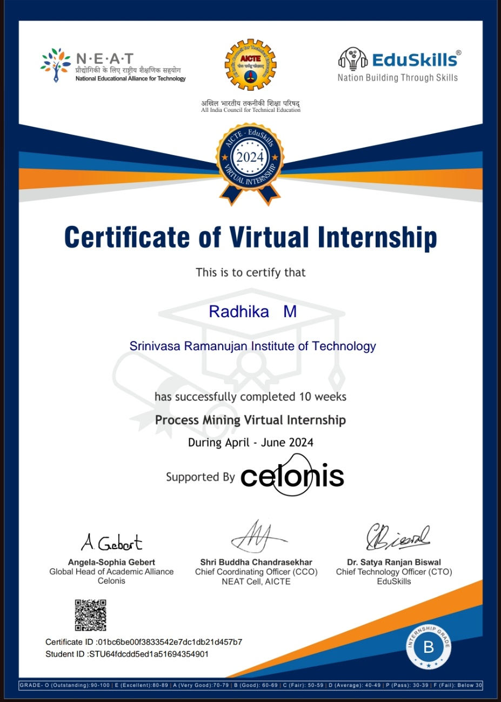
Certificate

Slide 16
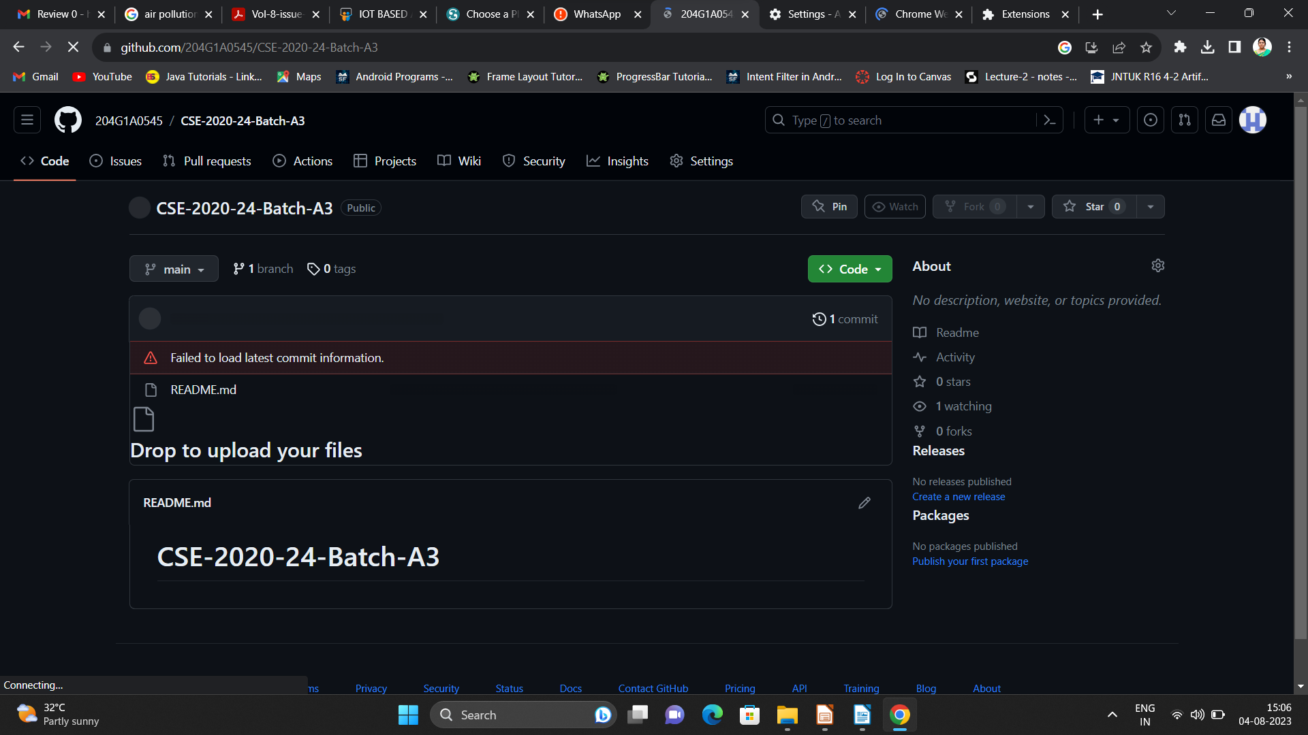

Git Hub Dashboard
Repository Name Like: Summer Internship - I
Under that include document, presentation and Certificate(Pdf).

Slide 17
Any Queries?

Slide 18
Thank You!!!

