Slide 1
Last Time
Color and Color Spaces
01/31/02
(C) 2002, UNiversity of Wisconsin, CS 559

Slide 2
Today
Image file formats
  GIF
  JPEG
Color Quantization
  Uniform
  Populosity
  Median Cut
  Optimization
01/31/02
(C) 2002, UNiversity of Wisconsin, CS 559

Slide 3
Image File Formats
How big is the image?
  All files in some way store width and height
How is the image data formatted?
  Is it a black and white image, a grayscale image, a color image, an indexed color image?
  How many bits per pixel?
What other information?
  Color tables, compression codebooks, creator information…
01/31/02
(C) 2002, UNiversity of Wisconsin, CS 559

Slide 4
The Simplest File
0_{r,g,b}
1_{r,g,b}
2_{r,g,b}
Assumes that the color depth is known and agreed on
Store width, height, and data for every pixel in sequence
This is how you normally store an image in memory
Unsigned because width and height are positive, and unsigned char because it is the best type for raw 8 bit data
Note that you require some implicit scheme for laying out a rectangular array into a linear one
3_{r,g,b}
4_{r,g,b}
5_{r,g,b}
6_{r,g,b}
7_{r,g,b}
8_{r,g,b}
class Image {
unsigned int width;
unsigned int height;
unsigned char *data;
}
0_{r}
0_{g}
0_{b}
1_{r}
1_{g}
1_{b}
2_{r}
2_{g}
2_{b}
3_{r}
3_{g}
01/31/02
(C) 2002, UNiversity of Wisconsin, CS 559

Slide 5
Indexed Color
24 bits per pixel (8-red, 8-green, 8-blue) are expensive to transmit and store
It must be possible to represent all those colors, but not in the same image
Solution: Indexed color
  Assume k bits per pixel (typically 8)
  Define a color table containing 2^{k} colors (24 bits per color)
  Store the index into the table for each pixel (so store k bits for each pixel)
  Once common in hardware, now rare (256 color displays)
01/31/02
(C) 2002, UNiversity of Wisconsin, CS 559

Slide 6
Indexed Color
Color Table
Pixel Data
Image
0
4
3
0
2
1
1
7
4
5
2
3
7
6
5
3
2
2
1
1
4
5
6
Only makes sense if you have lots of pixels and not many colors
7
01/31/02
(C) 2002, UNiversity of Wisconsin, CS 559

Slide 7
Image Compression
Indexed color is one form of image compression
  Special case of vector quantization
Alternative 1: Store the image in a simple format and then compress with your favorite compressor
  Doesn’t exploit image specific information
  Doesn’t exploit perceptual shortcuts
Two historically common compressed file formats: GIF and JPEG
  GIF should now be replaced with PNG, because GIF is patented and the owner started enforcing the patent
01/31/02
(C) 2002, UNiversity of Wisconsin, CS 559

Slide 8
GIF
Header – Color Table – Image Data – Extensions
Header gives basic information such as size of image and size of color table
Color table gives the colors found in the image
  Biggest it can be is 256 colors, smallest is 2
Image data is LZW compressed color indices
To create a GIF:
  Choose colors
  Create an array of color indices
  Compress it with LZW
01/31/02
(C) 2002, UNiversity of Wisconsin, CS 559

Slide 9
LZW Compression
Compresses a stream of “characters”, in GIF case they are 1byte color indices
Stores the strings encountered in a codebook
  When compressing, strings are put in the codebook the second time they are encountered
  Subsequent encounters replace the string with the code
  Decoding reconstructs codebook on the fly
  Advantage: The code does not need to be transmitted
01/31/02
(C) 2002, UNiversity of Wisconsin, CS 559

Slide 10
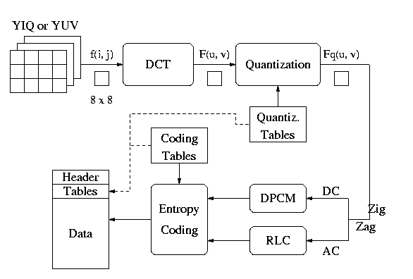
JPEG
Multi-stage process intended to get very high compression with controllable quality degradation
Start with YIQ color
  Why? Recall, it’s the color standard for TV
01/31/02
(C) 2002, UNiversity of Wisconsin, CS 559

Slide 11
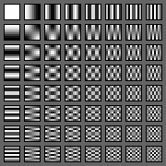
Discrete Cosine Transform
A transformation to convert from the spatial to frequency domain – done on 8x8 blocks
Why? Humans have varying sensitivity to different frequencies, so it is safe to throw some of them away
Basis functions:
01/31/02
(C) 2002, UNiversity of Wisconsin, CS 559

Slide 12
Quantization
Reduce the number of bits used to store each coefficient by dividing by a given value
  If you have an 8 bit number (0-255) and divide it by 8, you get a number between 0-31 (5 bits = 8 bits – 3 bits)
  Different coefficients are divided by different amounts
  Perceptual issues come in here
Achieves the greatest compression, but also quality loss
“Quality” knob controls how much quantization is done
01/31/02
(C) 2002, UNiversity of Wisconsin, CS 559

Slide 13
Entropy Coding
Standard lossless compression on quantized coefficients
  Delta encode the DC components
  Run length encode the AC components
    Lots of zeros, so store number of zeros then next value
  Huffman code the encodings
01/31/02
(C) 2002, UNiversity of Wisconsin, CS 559

Slide 14
Lossless JPEG With Prediction
Predict what the value of the pixel will be based on neighbors
Record error from prediction
  Mostly error will be near zero
Huffman encode the error stream
Variation works really well for fax messages
01/31/02
(C) 2002, UNiversity of Wisconsin, CS 559

Slide 15
Color Quantization
The problem of reducing the number of colors in an image with minimal impact on appearance
  Extreme case: 24 bit color to black and white
  Less extreme: 24 bit color to 256 colors, or 256 grays
Why do we care?
Sub problems:
  Decide which colors to use (if there is a choice)
  Decide which of those each original color maps to
01/31/02
(C) 2002, UNiversity of Wisconsin, CS 559

Slide 16
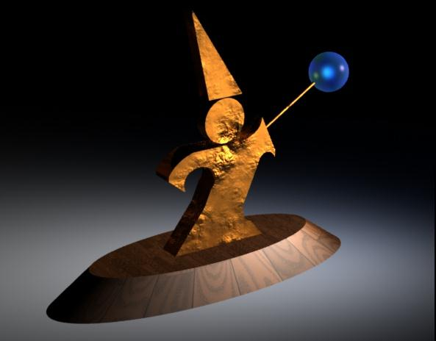
Example (24 bit color)
01/31/02
(C) 2002, UNiversity of Wisconsin, CS 559

Slide 17
Quantization Error
A way of measuring the quality of our approximation
Define an error for each color, c, in the original image: d(c,c’), where c’ is the color c maps to under the quantization
  Common is to use squared distance in RGB space
  Should really use distance in CIE u’,v’ space
Sum up the error over all the pixels
01/31/02
(C) 2002, UNiversity of Wisconsin, CS 559

Slide 18
Uniform Quantization
Break the color space into uniform cells
Find the cell that each color is in, and map it to the center
Generally does poorly because it fails to capture the distribution of colors
  Some cells may be empty, and are wasted
Equivalent to dividing each color by some number and taking the integer part
  Say your original image is 24 bits color (8 red, 8 green, 8 blue)
  Say you have 256 colors available, and you choose to use 8 reds, 8 greens and 4 blues (8 × 8 × 4 = 256 )
  Divide original red by 32, green by 32, and blue by 64
01/31/02
(C) 2002, UNiversity of Wisconsin, CS 559

Slide 19
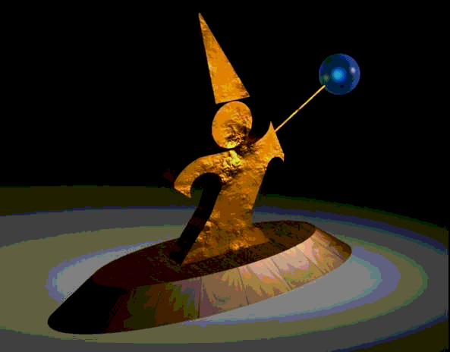
Uniform Quantization
8 bits per pixel in this image
Note that it does very poorly on smooth gradients
Normally the hardest part to get right, because lots of similar colors appear very close together
01/31/02
(C) 2002, UNiversity of Wisconsin, CS 559

Slide 20
Populosity Algorithm
Build a color histogram: count the number of times each color appears
Choose the n most commonly occurring colors
  Typically group colors into small cells first
Map other colors to the closest chosen color
Problem: May completely ignore under-represented but important colors
01/31/02
(C) 2002, UNiversity of Wisconsin, CS 559

Slide 21
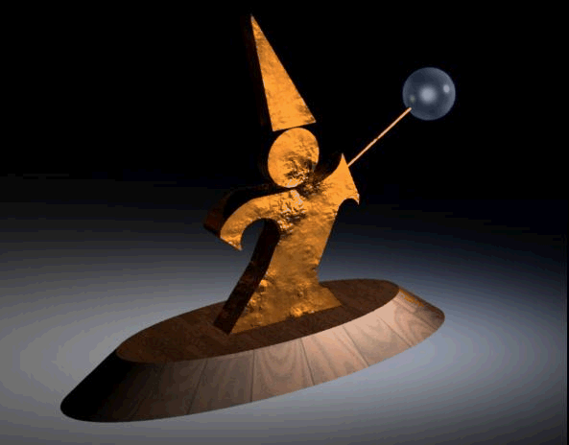
Populosity Algorithm
8 bit image, so the most popular 256 colors
Note that blue wasn’t very popular, so the crystal ball is now the same color as the floor
01/31/02
(C) 2002, UNiversity of Wisconsin, CS 559

Slide 22
Median Cut
Look at distribution of colors
Recursively:
  Find the “longest” dimension (r, g, b are dimensions)
  Choose the median of the long dimension as a color to use
  Split along the median plane, and recurse on both halves
Works very well in practice
This algorithm is building a kD-tree, a common form of spatial data structure
  Also used in nearest neighbor computations and many other areas of computer graphics
01/31/02
(C) 2002, UNiversity of Wisconsin, CS 559

Slide 23
Median Cut in Action
Original colors in color space
Median in long dimension
Recurse
Put median color in color table
01/31/02
(C) 2002, UNiversity of Wisconsin, CS 559

Slide 24

Median Cut
8 bit image, so 256 colors
Now we get the blue
Median cut works so well because it divides up the color space in the “most useful” way
01/31/02
(C) 2002, UNiversity of Wisconsin, CS 559

Slide 25
Optimization Algorithms
The quantization problem can be phrased as optimization
  Find the set of colors and mapping that result in the lowest quantization error
Several methods to solve the problem, but of limited use unless the number of colors to be chosen is small
  It’s expensive to compute the optimum
  It’s also a poorly behaved optimization
01/31/02
(C) 2002, UNiversity of Wisconsin, CS 559

Slide 26
Perceptual Problems
While a good quantization may get close colors, humans still perceive the quantization
Biggest problem: Mach bands
  The difference between two colors is more pronounced when they are side by side and the boundary is smooth
  This emphasizes boundaries between colors, even if the color difference is small
  Rough boundaries are “averaged” by our vision system to give smooth variation
01/31/02
(C) 2002, UNiversity of Wisconsin, CS 559

Slide 27
Mach Bands in Reality
The floor appears banded
01/31/02
(C) 2002, UNiversity of Wisconsin, CS 559

Slide 28
Mach Bands in Reality
Still some banding even in this 24 bit image (the floor in the background)
01/31/02
(C) 2002, UNiversity of Wisconsin, CS 559

Slide 29
Mach bands Emphasized
Note that each bar on the left appears to have color variation across it
  Left edge appears darker than right
The effect is entirely due to Mach banding
01/31/02
(C) 2002, UNiversity of Wisconsin, CS 559

Slide 30
Next Lecture
How to avoid Mach banding. The solution is dithering
01/31/02
(C) 2002, UNiversity of Wisconsin, CS 559

