Slide 1



Welcome to Urban Sprouts
Urban Sprouts is your one-stop-shop for all your indoor and outdoor gardening needs. We offer a curated selection of beautiful plants, as well as expert plant care guides to help you keep your greenery thriving.

Slide 2
Our Mission: Bringing Nature to Your Home
Reconnect with Nature
Improve Your Space
Sustainable Lifestyle
Surround yourself with the calming presence of plants, and enjoy the physical and mental benefits of living with greenery.
Enhance your home or office decor with eye-catching plants that breathe life into any setting.
Embrace a more eco-friendly way of living by growing your own plants and reducing your carbon footprint.

Slide 3
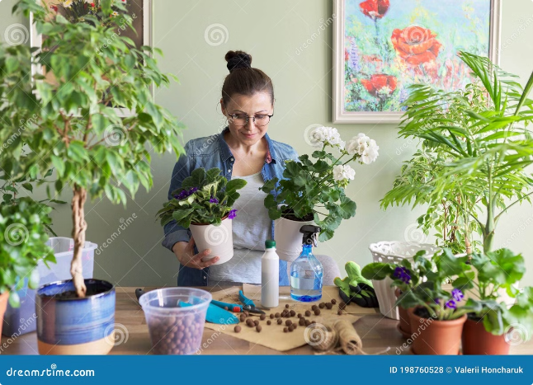
Our Plant Care Guides
1
Watering Tips
2
Sunlight Requirements
Learn the optimal watering schedules and techniques for different plant varieties.
Discover the ideal lighting conditions for your plants to thrive.
3
Fertilizing Schedules
4
Pruning and Grooming
Ensure your plants get the nutrients they need with our feeding recommendations.
Keep your plants looking their best with our expert pruning and maintenance advice.

Slide 4


Our Online Plant Shop
Houseplants
Outdoor Plants
Browse our curated selection of low-maintenance indoor plants that thrive in any space.
Discover vibrant and hardy outdoor plants to beautify your garden or patio.
Accessories
Plant Subscriptions
Find the perfect planters, tools, and other accessories to support your plant-filled oasis.
Never worry about forgetting to water again with our convenient plant subscription service.

Slide 5



Conclusion
Grow Your Green Thumb
Let Urban Sprouts be your guide to cultivating a thriving indoor and outdoor oasis.
Enhance Your Space
Discover the perfect plants to elevate the style and ambiance of your living or work space.
Reconnect with Nature
Surround yourself with the calming presence of plants and enjoy the mental and physical benefits.

