Slide 1

Topic - UrbanSprouts “Grow with Care”
Sr. no. | Name | PRN No. | Roll No.
1. | Radhika J. Thale | 22310794 | 221036
2. | Pranita P. Bhor | 22311344 | 221047
3. | Janhvi R. Mishra | 22311352 | 221048
BRACT’S, Vishwakarma Institute of Information Technology, Pune-48
(An Autonomous Institute affiliated to Savitribai Phule Pune University)
(NBA and NAAC accredited, ISO 9001:2015 certified)

Slide 2

Introduction
UrbanSprouts is your go-to destination for comprehensive plant care, offering personalized solutions to ensure your plants thrive. We provide expert guidance on the right fertilizers, watering schedules, and care routines, all tailored to your specific plants. Our service extends beyond care, offering customized design and suggestions for your balcony, terrace, or garden to create a green space that reflects your style. As we grow and secure sponsorships, we plan to expand our offerings with a shopping section, making it easier for you to access all the tools and products you need for a flourishing garden.

Slide 3
Literature Survey

Slide 4
Objective
Expert Plant Care Guidance: Receive tailored advice on fertilizers, watering schedules, and maintenance routines to keep your plants healthy and vibrant.
Personalized Design Solutions: Get customized recommendations and design ideas for your balcony, terrace, or garden to suit your style and preferences.
Future Shopping Section: Look forward to an expanded shopping section as we secure sponsorships, providing easy access to essential gardening tools and products.
Comprehensive Care Calendar: Benefit from a detailed calendar that helps you manage plant care tasks efficiently, ensuring timely watering and feeding.

Slide 5
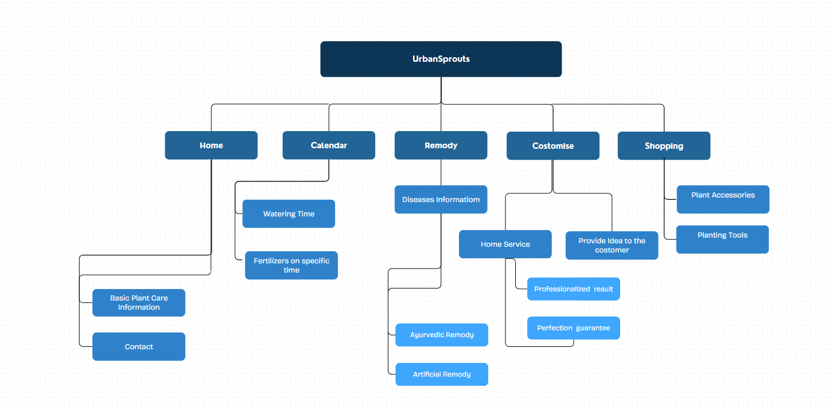
Diagram

