Slide 1
chemiformatics

Slide 2
high-throughput screening → hit to lead (H2L) → lead optimization (LO) → preclinical drug development → clinical drug development.
A pharmacophore is “a set of structural features in a molecule that is recognized at a
receptor site and is responsible for that molecule's biological activity”.

Slide 3
Commonly used terms in drug discovery
High throughput screen: an optimised, miniaturised assay format that enables the testing of > 100,000 chemically diverse compounds per day.
Assay: a test system in which biological activity can be detected.
Hit: a molecule with confirmed concentration-dependent activity in a screen, and known chemical structure. The output of most screens. (SAR)
Lead: a compound with potential (as measured by potency, selectivity, physico-chemical properties, absence of toxicity or novelty) to progress to a full drug development programme

Slide 4
compound library
A compound library is a collection of real stored chemicals and/or virtual chemical compounds. The compound library or chemical library can contain stored chemicals each of them has associated data with information such as the chemical structure, purity, quantity, and physiochemical characteristics of the compound. The virtual compound libraries consist of 2D or 3D representations of chemical compounds that are used for diverse purposes using computational methods.

Slide 5
Which strategy is best for hit identification?
When a target is identified, a decision has to be made about which chemicals to screen, in order to identify potential lead compounds.
Random screening (BLAST)
All possible drug molecules screened against target.
Estimated no. of possible drug molecules is ± 10⁴⁰!!!
This is simply not possible.
Focussed screening
A limited number of compounds are pre-selected for screening.
Has proved successful as a hit generation strategy.
Useful when 3D structure of target is known (e.g. crystal structure of a receptor)
- use computer modelling to predict optimal structure to interact with target
- use known ligand to construct 3D pharmacophore
In either case, select compounds from library or design new compounds and screen.

Slide 6
1-Natural Compound Library--A comprehensive chemical database shall be established at DZIF for the purpose of screenings, allowing to develop their active agents.
2-Queensland Compound Library “Open” collection-Screen small, diverse compound subsets.
3-ChemmineR: a compound mining framework for R
4- http://www.ncbi.nlm.nih.gov/guide/chemicals-bioassays/
Tool--- DeepView - Swiss-PdbViewer

Slide 7
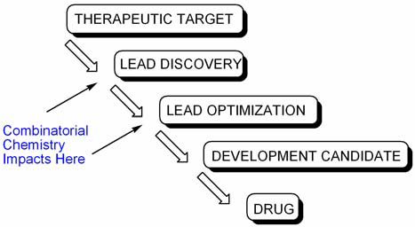
Combinatorial chemistry The aim of combinatorial chemistry (“CombiChem”) is the generation of (large) numbers of compounds very quickly. (“combinatorial”: of, relating to, or involving combinations).

Slide 8
Combinatorial chemistry
Combinatorial chemistry comprises chemical synthetic methods that make it possible to prepare a large number (tens to thousands or even millions) of compounds in a single process. These compound libraries can be made as mixtures, sets of individual compounds or chemical structures generated in silico.
The basic principle of combinatorial chemistry is to prepare libraries of very large number of compounds then identify the useful components of the libraries.

Slide 9
How lead identified
Combinatorial chemistry – a technology for creating molecules en masse and testing them rapidly for desirable properties.
Combinatorial chemistry is a technique by which large numbers of structurally distinct molecules may be synthesised at a time and submitted for pharmacological assay. The key of combinatorial chemistry is that a large range of analogues is synthesised using the same reaction conditions, the same reaction vessels. In this way, the chemist can synthesise many hundreds or thousands of compounds in one time instead of preparing only a few by simple methodology.
(Conventional- one molecule at a time discovery.)
Saves time and costs and increase accuracy.
Use to screen for novel bioactivities.
produce effective ,marketable and competitive new drug.
Aim- to produce large population of molecules or libraries that can screen efficiently enmass that increases probability to find novel compound of significant therapeutic and commercial value.

Slide 10
Combi Chem is used to synthesize large number of chemical compounds by combining sets of building blocks. Each newly synthesized compound's composition is slightly different from the previous one. A traditional chemist can synthesize 100-200 compounds per year. A combinatorial robotic system can produce in a year thousands or millions compounds which can be tested for potential drug candidates in a high-throughput screening process.

Slide 11
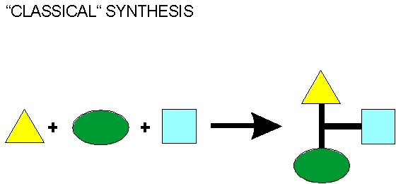
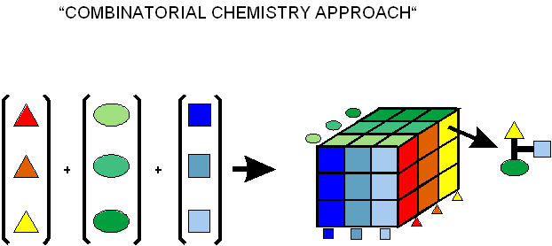
combinatorial synthesis approach

Slide 12
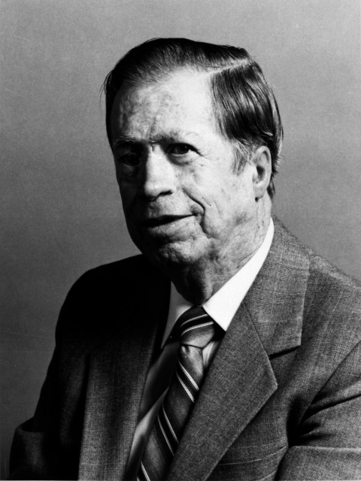
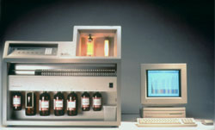
Combinatorial Chemistry method: 1)Solid phase synthesis/parallel synthesis: is rapid and efficient
amino
acid
AA³
AA²
AA¹
AA³
AA²
AA³
AA¹
AA²
AA³
coupling &
deprotection
coupling &
deprotection
coupling &
deprotection
polystyrene
bead
cleavage
AA¹
AA²
AA³
• Reactions can be driven to completion using excess reagents and multiple couplings
• Intermediates do not need to be purified
• Final compounds are cleaved from the beads and purified by HPLC as necessary
• Some procedures can be machine automated
Professor R. Bruce Merrifield
The Rockefeller University
Nobel Prize, 1984
Notes:
How do we synthesize these in the lab?
Bruce Merrifield Nobel Prize
Solid phase synthesis
DISTRIBUTE BEADS
couple amino acids
can wash off all of the side products
cleave final product
one purification
automated - when we send out for peptides, done with a machine now

Slide 13
Combinatorial Chemistry Any modular structure can be combinatorialized
• A fully combinatorial library includes all possible combinations of building blocks
Each position can be 1 of 20 possible amino acids
Gly
Ala
Val
Leu
AA¹
AA²
20 x 20
= 20² =
400
combinations
Ile
Ser
Thr
Cys
20 x 20 x 20
= 20³ =
8,000
combinations
AA¹
AA²
AA³
Met
Lys
Phe
Tyr
His
Trp
Arg
Asp
AA¹
AA²
AA³
AA⁴
= 20⁴ =
160,000
combinations
Glu
Asn
Gln
Pro
AA¹
…
…
AA²⁰
= 20²⁰ =
1.0 x 10²⁶
combinations
Notes:
Combinatorial chemistry
Many different possible peptides
Combinatorial library involves making all of them
Other molecules - I made 2 million compounds in grad school
We can do this EFFICIENTLY
Ages 5 and up can do combinatorial chemistry

Slide 14
Combinatorial Chemistry Mixture synthesis is rapid but products must be deconvoluted
Peptide Library Example:
Limit to 3 possibilities at 2 positions
→ 3 x 3 = 9 possible dipeptides
Mixture Synthesis
• Must compensate for different rates of coupling for different amino acids due to steric effects – [Val] > [Gly]
Gly
Gly
Gly
Gly
Ile
Gly
Gly
Gly
Gly
Val
Gly
usually many beads per product instead of just one as shown
Ile
Ile
Ile
Gly
Ile
2 positions
x 2 rxns each
= 4 reactions
Val
Val
Ile
Ile
Ile
Ile
Val
Ile
Val
Gly
Val
mixture of
9 products
Val
Ile
Val
Val
Val
Val

Slide 15
Combinatorial Chemistry Split–Pool Synthesis Split–Pool synthesis combines the advantages of mixture and parallel synthesis
• Large libraries of individual compounds can be synthesized efficiently
Gly
Gly
Gly
Gly
SPLIT
Gly
POOL
SPLIT
Gly
Gly
Ile
Gly
Ile
Gly
Val
Gly
Val
Ile
Gly
Ile
Gly
Ile
Ile
Ile
Ile
Ile
Ile
Ile
Val
Ile
Val
many beads
Val
Gly
Val
Gly
Val
Val
Val
3 possibilities
x 2 couplings
+ 2 deprotections
= 8 reactions
Ile
Val
Ile
Val
Val
Val
Val
3 reaction vessels
Each bead exposed to only a single reaction sequence, thus each has only a single product!
• Furka, Á.; Sebestyén, F.; Asgedom, M.; Dibó, G. Int. J. Pept. Protein Res. 1991, 37, 487-493.
• Lam, K. S.; Salmon, S. E.; Hersh, E. M.; Hruby, V. J.; Kazmierski, W. M.; Knapp, R. J. Nature 1991, 354, 82-84

Slide 16
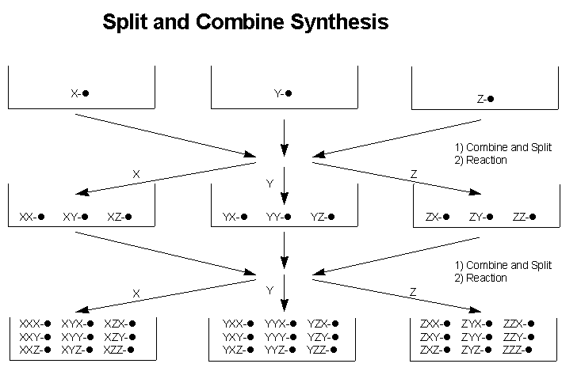

Slide 17
Combinatorial Chemistry Comparison of techniques
Larger Example:
All 20 possibilities at 4 positions
→ 20 x 20 x 20 x 20 = 160,000 possible tetrapeptides
• Mixture Synthesis
4 positions x (1 coupling + 1 deprotection) = 8 reactions
1 mixture of 160,000 products
• Parallel Synthesis
160,000 products x (4 couplings + 4 deprotections) = 1,280,000 reactions
160,000 individual products
• Split–Pool Synthesis
split–pool
reaction arrow
(20 possibilities x 4 couplings) + 4 deprotections = 84 reactions
160,000 individual products

Slide 18
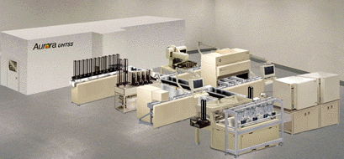
High-Throughput Screening
Screening perhaps millions of compounds in a corporate collection to see if any show activity against a certain disease protein

Slide 19
high-throughput screening
HTS is the process of assaying a large number of potential effectors of biological activity against targets (a biological event). The methods of HTS are applied to the screening of combinatorial chemistry, genomics, protein, and peptide libraries.
The goal of HTS is to accelerate drug discovery by screening large libraries often composed of hundreds of thousands of compounds (drug candidates) at a rate that may exceed 20,000 compounds per week.
Ultra highthroughput screening (UHTS) issues (testing of 100,000 compounds/day)

Slide 20
High throughput screening for drug discovery
FACT 1: recent understanding of disease mechanisms has dramatically increased no. of protein targets for new drug treatment
FACT 2: new technologies have increased the no. of drugs that can be tested for activity at these targets.
➔high throughput screening (HTS) is 1° tool for early-stage drug discovery
HTS is process by which large nos. of compounds are rapidly tested for their ability to modify the properties of a selected biological target.
Goal is to identify ‘hits’ or ‘leads’
- affect target in desired manner
- active at fairly low concs (∴ more likely to show specificity)
- new structure
The greater the no. and diversity of compounds screened, the more successful screen is likely to be.HTS = 50,000-100,000 cpds screened per day!!!

Slide 21
The key to HTS is to develop a test, or assay, in which binding between a compound and a protein causes some visible change that can be automatically read by a sensor. Typically the change is emission of light by a fluorophore in the reaction mixture. The time required for reactions varies with the substances involved, and may range from several minutes to several hours. Fast robotic systems combined with rapid reactions can screen 10,000 or more compounds in a single day.

Slide 22
Method –HTS
1) 1) suitable libraries of compounds
Source of chemicals for screen:
- combinatorial chemistry allows synthesis of large no of diverse molecules.
2) assay method configured for automation
--The key labware or testing vessel of HTS is the microtiter plate: a small container, usually disposable and made of plastic, that features a grid of small, open divots called wells. In general, modern (circa 2013) microplates for HTS have either 384, 1536, or 3456 wells. These are all multiples of 96, reflecting the original 96-well microplate with spaced wells of 8 x 12 9 mm .
*Use multi-well plates: 96, 192, 384, 864, d) robust signal-to-noise ratio.
* ideally be non-radioactive
Often express target genes in appropriate host systems
e.g. bacterial, yeast, viral, invertebrate and mammalian cells
Most of the wells contain experimentally useful matter, depending on the nature of the experiment. This could be an aqueous solution of dimethyl sulfoxide (DMSO) and some other chemical compound, the latter of which differs for each well across the plate. It could also contain cells or enzymes of some type. (The other wells may be empty or contain untreated samples, intended for use as experimental controls.)

Slide 23
3) Reaction observation
To prepare for an assay, the researcher fills each well of the plate with some logical entity that he wishes to conduct the experiment upon, such as a protein, cells, or an animal embryo. After some incubation time has passed to allow the biological matter to absorb, bind to, or otherwise react (or fail to react) with the compounds in the wells, measurements are taken across all the plate's wells, either manually or by a machine. a specialized automated analysis machine can run a number of experiments on the wells (such as shining polarized light on them and measuring reflectivity, which can be an indication of protein binding A high-capacity analysis machine can measure dozens of plates in the space of a few minutes like this, generating thousands of experimental data points very quickly.

Slide 24
4) robotics workstation
• Robots handle assays in multi-well formats.
- sample dilutions
- sample dispensing
- plate washing (more problematic with higher well density (844- and 1536-well plates))
Hard to automate cell lysis or permeabilisation steps (necessary for many 2nd messenger responses).
• Full automation allows 24 h continuous operation without requiring shift work.
• More efficient and economical.
HTS robots that can test up to 100,000 compounds per day currently exist.Automatic colony pickers pick thousands of microbial colonies for high throughput genetic screening. The term uHTS orultra-high-throughput screening refers (circa 2008) to screening in excess of 100,000 compounds per day.

Slide 25
Automation systems
5) computerised data handling system
•A great deal of data is generated. Must be accurate and reproducible.
➔ Need good computerised data handling systems.

Slide 26
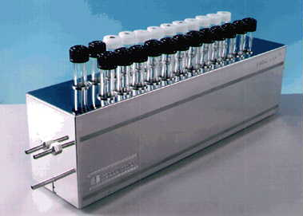
Multireactor vessels

Slide 27
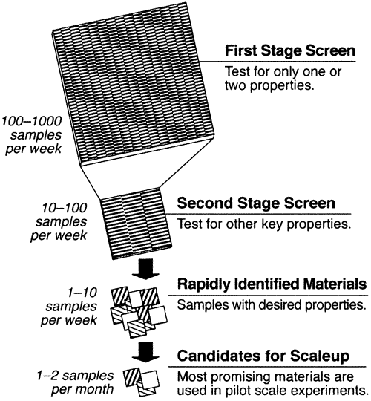
Multistage screening

Slide 28
HTS is a scientific experimentation especially used in drug discovery & relevant to the field of bio & chem.through a combination of modern robotics , data processing and control software, liquid handling deviceand sensitive detector, HTS screening allow to conduct million exp. In short time.thr. This method we can find active comp., Ab, or gene which modulate a particular pathway.

Slide 29
HTS equipment is a plate made of plastic has a grid of small open divots called wells. Most well contain soln. of DMSO (unfolding of protein) or other in different well.
For assay , fill each well with biological entity (protein, cell,embroy). Keep for incubation.

Slide 30

Yeast-based screen and selection for identification of agonists for a human orphan GPCR
(a) In yeast, normal GPCR-initiated pathway results in cell cycle arrest in response to agonist
(b) Substitution of human orphan GPCR and human Gα protein yields a strain that only grows if receptor is stimulated
Yeast
ligand
human
ligand
Yeast
receptor

human
receptor

Yeast G
protein
human G
protein
⬇
⬇
arrest
growth
Spot individual cpds onto lawn of modified yeast. Detect agonists by growth of yeast on the plate around the site of cpd application

Slide 31
(c) alternatively, introduce a random peptide expression library; cells will only grow if the peptide stimulates the receptor
growth
⬅
orphan
receptor
peptide
peptide
ligand

peptide
expression
library

Slide 32
Drug companies now have millions of samples of chemical compounds
High-throughput screening can test 100,000 compounds a day for activity against a protein target
Maybe tens of thousands of these compounds will show some activity for the protein
The chemist needs to intelligently select the 2 - 3 classes of compounds that show the most promise for being drugs to follow-up

Slide 33
Virtual screening
in-silico screening, is a new branch of medicinal chemistry that represents a fast & cost effective tool for computationally screening database in search for the novel drug leads.
Virtual screening uses computer based methods discover new ligand on the bases of biological structure.
first part of the visual screening evaluates the drug likeness of the same molecules most independent of their intended drug target

Slide 34
drug like molecules exhibit favorable absorption, distribution, metabolism, excretion, toxicological (ADMET) parameters. Using following types of method currently assesses Druglikness □ Simple counting method □ Functional group filter □ Topological filter □ Pharmacophore filter

Slide 35
Counting scheme ---Database collections of known drug are typically used to extract knowledge about structure properties of potential drug molecules. Molecular weight, lipophilicity, charge are profiled to extract simple counting rules for relevant description of ADMET- related parameter

Slide 36
Functional group filters --- Reactive, toxics, or otherwise unsuitable compounds, such as natural product derivatives, are removed using specific filters. Typical reactive functional groups include, for the example, reactive alkyl halide peroxide, and carbazide, Unsuitable leads may include crown ethers, disulfide, and aliphatic methylene chain seven or more long and Screening out the compound that contain certain atom groups are associated with toxicity provide a practical and fast way to reduce large database.

Slide 37
Topological drug classification -- It is generally assumed that compound those having the structure similarity with known drug may exhibit drug like properties themselves, such as oral bioavailability, low toxicity membrane permeability and metabolic stability.

Slide 38
An Ideal compound cluster will have:
Ideal compound cluster will:
have compound members that exhibit a high affinity towards the target (less than 1 µM)
Moderate molecular weight and lipophilicity (usually measured as cLogP). Affinity, molecular weight and lipophilicity can be linked in single parameter such asligand efficiency and lipophilic efficiency to assess druglikeness
show chemical tractability
not interfere with the P450 enzymes nor with the P-glycoproteins
not bind to human serum albumin
be soluble in water (above 100 µM)

Slide 39
have a good druglikeness
exhibit cell membrane permeability
show significant biological activity in a cellular assay
not exhibit cytotoxicity
not be metabolized rapidly

Slide 40
Lipinski's rule of five
The “rule of 5” states that: poor absorption or permeation is more likely when:
A. There are more than 5 H-bond donors (expressed as the sum of Ohs and NHs);
B. The MW is over 500;
C. The LogP is over 5 (or MlogP is over 4.15); partition-coefficient (P) or distribution-coefficient (D) is the ratio of concentrations of a compound in a mixture of two immiscible phases at equilibrium.
D. There are more than 10 H-bond acceptors (expressed as the sum of Ns and Os).”

Slide 41
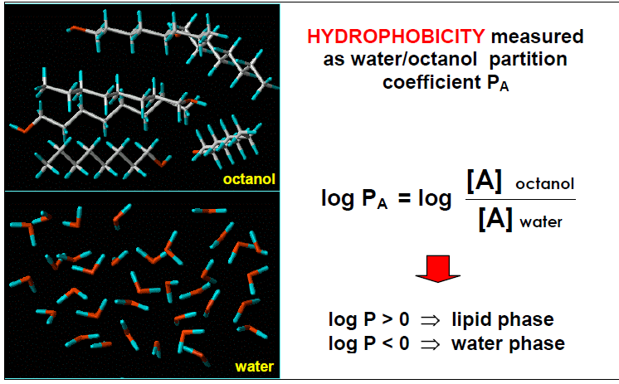

Slide 42
Add docking in virtual screening

