Slide 1
Answering Last Week's Questions
Last week's question | This week's answer
Does IFC carry B-Rep? | Yes. Main models have B-Rep → exact geometry, no CSG kernel needed
Can the KB move from“find articles” to “real judging”? | Yes. Extractor upgrade → door–room link 6/100 → 98/100
Search style? | Keywords first, semantic as fallback

Slide 2
Line 1 · Model Reading & Processing
Door–Room Link 6/100 → 98/100
Method
bbox footprint → every room gets a floor area
placement matrix includes rotation
boundary data first, geometry fills gaps
Result
escape distance: 6 → 98 rooms judged
door width & exits: 98/100 judged
found 2 real violations (rooms 3.04 / 6.04)
Fire Hydrant Spacing (MEP-009)
Method
fire-pipe centroid → nearest-neighbor spacing
Meaning
reading upgraded: attributes → geometry + distance
Result
office_3f: 6 pipes, spacing 13.0m ≤ 30m

Slide 3
Line 2 · Rules vs Code: 21 → 47 per Region
Rules now hold real thresholds from GB 55037 / GB 50016 / GB 50974 / FC23 / PUB / SS
Principle — every rule can be judged, precise, traceable
① real fields only — match extractor output, no dead rules
② scope by condition — judge only matching elements (e.g. pipe_type==fire)
③ cite the code — code_ref → exact clause; thresholds verified (door 0.9m / spacing 30m)
Effect
question → clause → rule → real judgement on the model
KB: from ‘search' to ‘basis for judgement'

Slide 4
Line 3 · B-Rep Survey: Built-In, Ready for Exact Geometry
Survey · IfcFacetedBrep count in 4 samples
Sample | Schependomlaan | office_3f | FZK_Haus | Duplex_MEP
B-Rep count | 4202 | 362 (whole) | 140 | 0
Original plan: CSG + Boolean
keeps modelling history, but needs a self-built solid kernel — high cost
CSG vs B-Rep (both common in IFC)
CSG: parametric build, keeps history (Boolean tree)
B-Rep: explicit shells — surfaces close into a solid
What we do
B-Rep is built-in → use it directly, no kernel
divergence theorem → exact volume
verified on column / beam / slab
Step 3 = B-Rep / mesh mix + precision note (no CSG kernel)

Slide 5
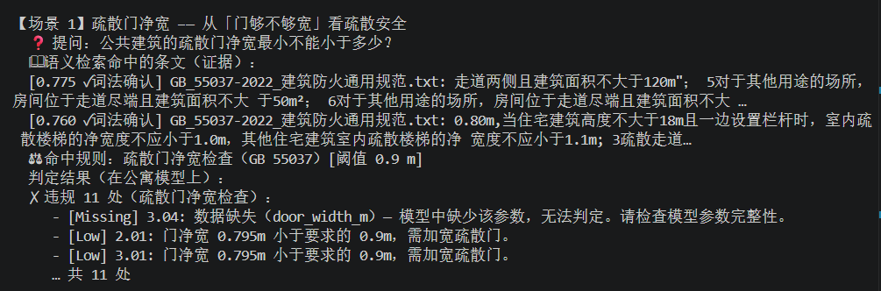

Apartment — Full Chain, Honest Reporting
- Door width: 11 real violations — door 2.01 is 0.795 m, below the 0.9 m minimum
- No electrical equipment → emergency lighting reports "not checked"
- 60 pipes but no fire pipes → hydrant spacing reports "no condition match"

Slide 6
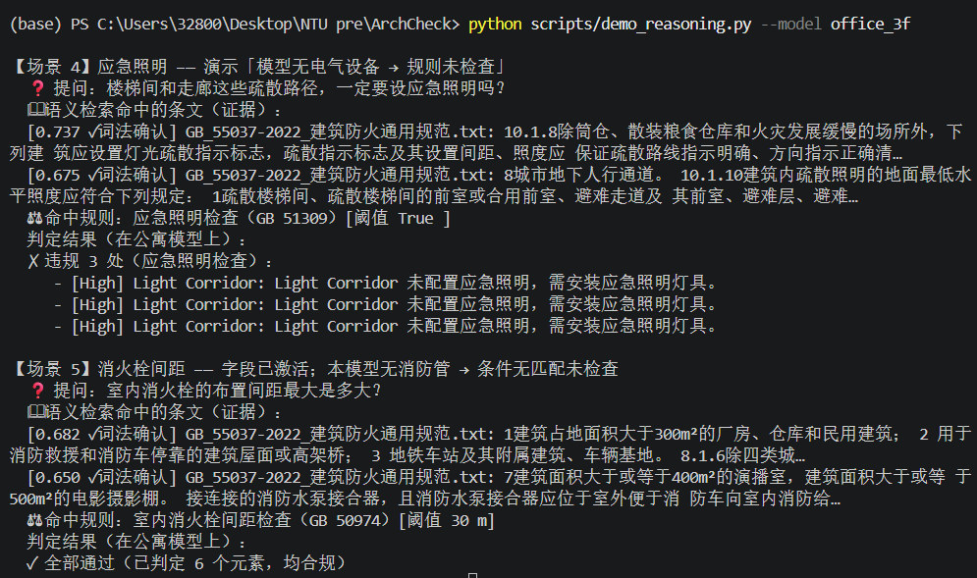
Office — Same Questions, Data Complete
- Emergency lighting: 3 real violations (corridor without emergency lights)
- Fire hydrants: 6 pipes, spacing 13.0 m ≤ 30 m → all pass

Slide 7
This Week's Extractor Upgrade in Action
Scenario | last week | Now
Door width | data missing | 11 violations found
Escape distance | only 6 rooms | 100 rooms judged
Exit count | 2 false alarms | clean (false positives fixed)

