Slide 1
REST APIs, SQL, Injection Attacks
Kathy Moss
ECS
8/7/2023

Slide 2
RESTful APIs
Application Programming Interface
  Defines rules to follow to communicate from one system to another – like a gateway between clients + resources
Representational State Transfer
  Organizes resources into a set of URIs, such as
    http://localhost:8080/pet_store/9
    http://localhost:8080/pet_store

Slide 3
How RESTful APIs Work
Makes Request to Client via HTTP endpoints
Requests for Resources/Data:
  C: Create / POST
  R: Read / GET
  U: Update / PUT
  D: Delete / DELETE
  For these requests, we will use ARC (Advanced Rest Client), but could use
  Postman, Hopscotch, etc

Slide 4
Other API Styles (if interested)
https://youtu.be/4vLxWqE94l4

Slide 5
Create Maven Proj + Add Dependencies
Maven: application build tool, but we are using it to manage app dependencies (Spring Boot Starter, JPA, etc)
Maven manages our project with the POM in our
pom.xml file

Slide 6
MySQL Database
We can connect to a DB using JDBC or JPA
  JDBC connects to the DB directly, but there is a lot of boilerplate code to use
  JPA allows you to map between objects in code and database objects, and it also allows you to not use as much boilerplate

Slide 7
Spring Boot
Interestingly enough, VMWare developed Spring
It helps us connect to a DB
Allows us to work with many features including: POJOs and Dependency Injection, and hibernate

Slide 8
Create Maven Proj + Add Dependencies
Use https://start.spring.io/ to create the POM
  - add Web, MySQL, JPA and H2 (in memory database for testing) to our dependencies

Slide 9
Main App Class
Our top-level main package:
  Add the @SpringBootApplication annotation which allows SpringBoot to auto configure itself and component scan which manages beans through life cycle management
  (if you wanted to know about beans – it’s a java class that has private getters/setters, a no-args constructor) and is commonly referred to as POJO

Slide 10
ERD (Entity Relationship Diagram) and Entities
Entity Relationships
  1-to-1
  Many-to-Many
  1-to-Many
  Many-to-One

Slide 11
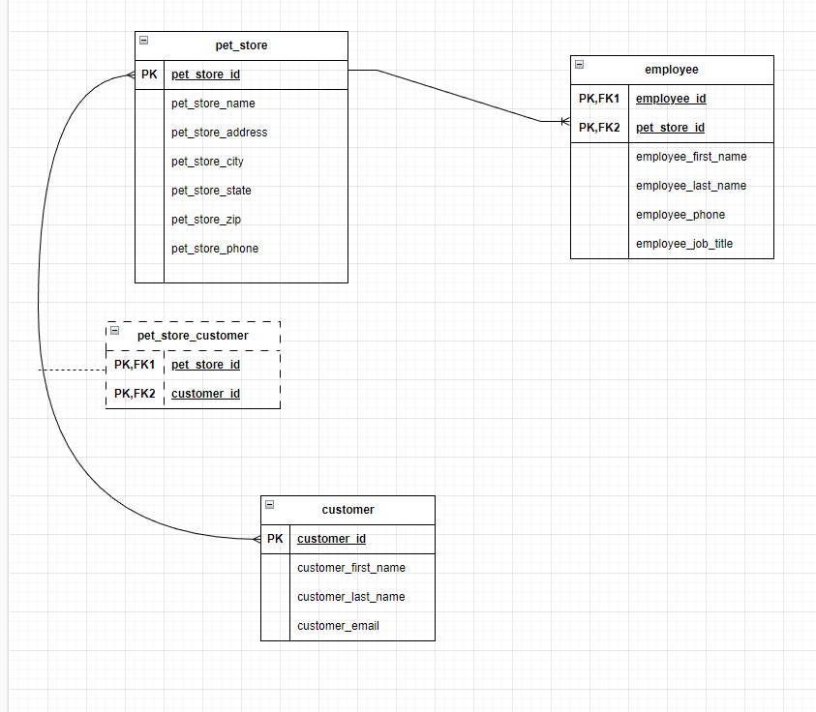
and Entities

Slide 12
ERD
Create ERD (Entity Relationship Diagram)
Create Schema, User, PW, and Privileges in MySQL Workbench

Slide 13
This work is licensed under a Creative Commons Attribution-ShareAlike 3.0 Unported License.
It makes use of the works of Mateus Machado Luna.

