Slide 1


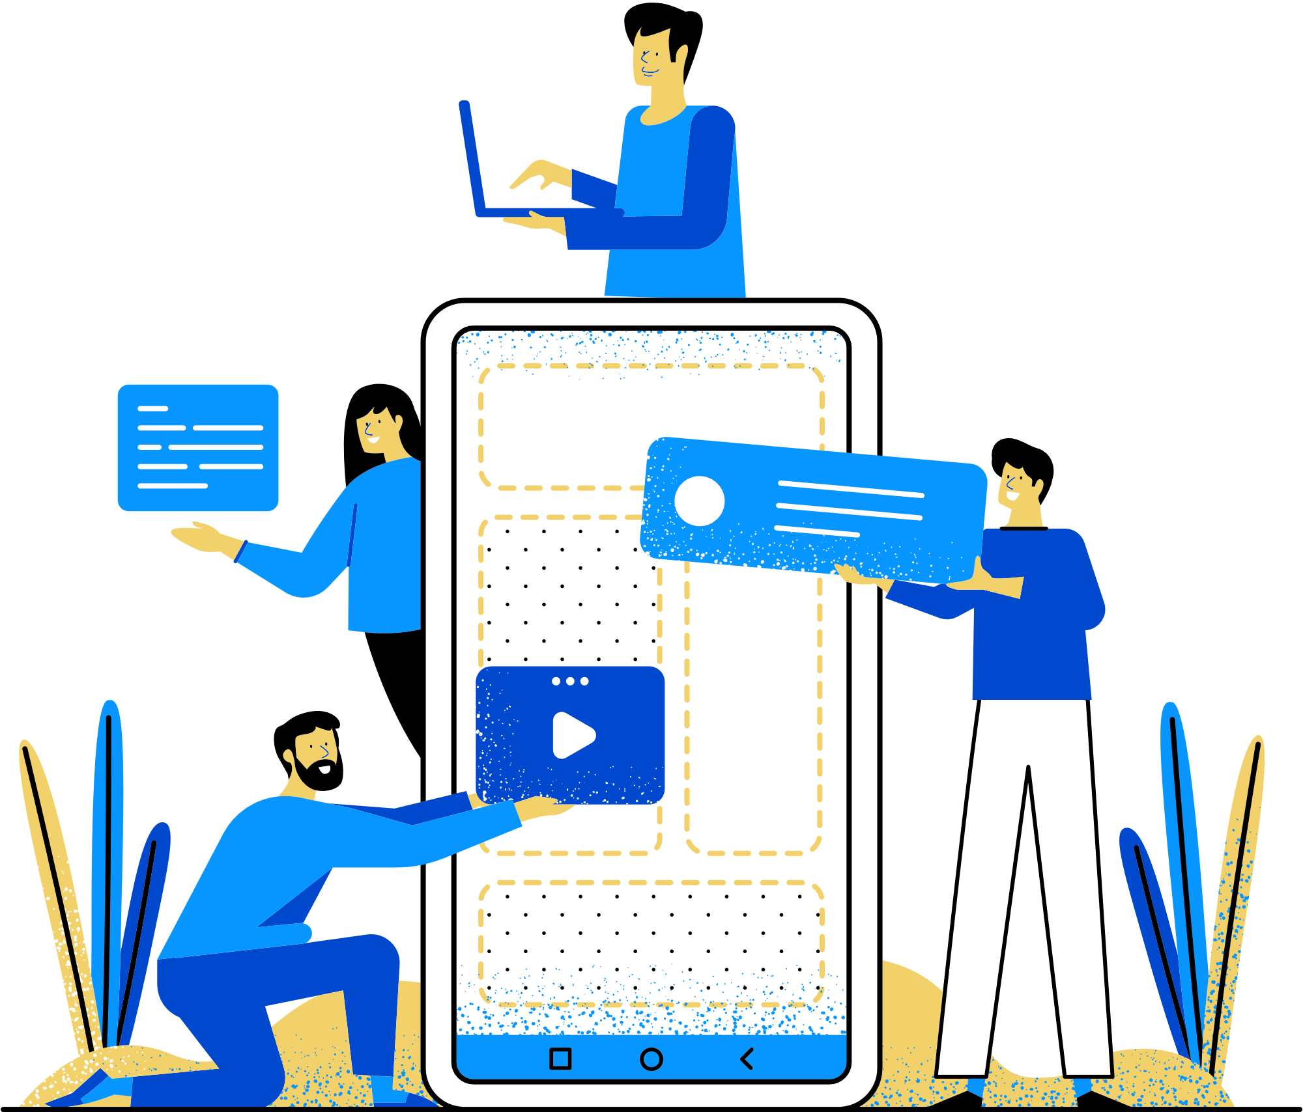
Text Analytics Laboratory (III Year)
Project Title: REAL TIME DISASTER ANALYSIS USING WORD CLOUD
Presented By: Bavya(E0323055)

Slide 2
Problem statement
THE PROBLEM:
A huge earthquake hit Turkey and Syria in 2023. Buildings fell, thousands got trapped under rubble, and many died. It nearly killed 59,000 people in the time, where nobody could afford any help. People were crying for help on social media, but it was hard to know who needed help most and where. It was really difficult to sort the datas among the positive, negative & help needed data, neutral comments & posts/tweets etc.
OUTCOME:
No faster rescues
Authorities were unable to plan, no enough equipments
Large amount of death rate
OUR SOLUTION:
This project analyses the data from various social media sites and draw the results based on positive, negative, neutral sections of posts that were posted duing the crisis happened. This creates a use of Word cloud that helps to filter the words that require help and the visualizations on
the location where the posts are maximum posted,
data on how much posts that contains help needed ones,
a pie chart for better understanding.
OUTCOME:
Help authorities to plan well & rescue people who got trapped
Tends to faster rescues, reduce death rates

Slide 3
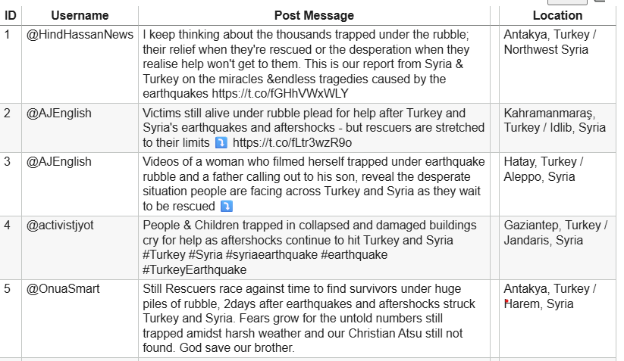
About the dataset
Person ID:
Unique ID for each person.
Not used for analysis — only for record tracking.
Username:
It tells from what account the post has come.
Post messages:
Most-used social media (e.g., Instagram, YouTube, Twitter, Facebook).
The comments along with hashtags are provided.
Location:
Helps to fetch the location to help the needy accordingly.

Slide 4
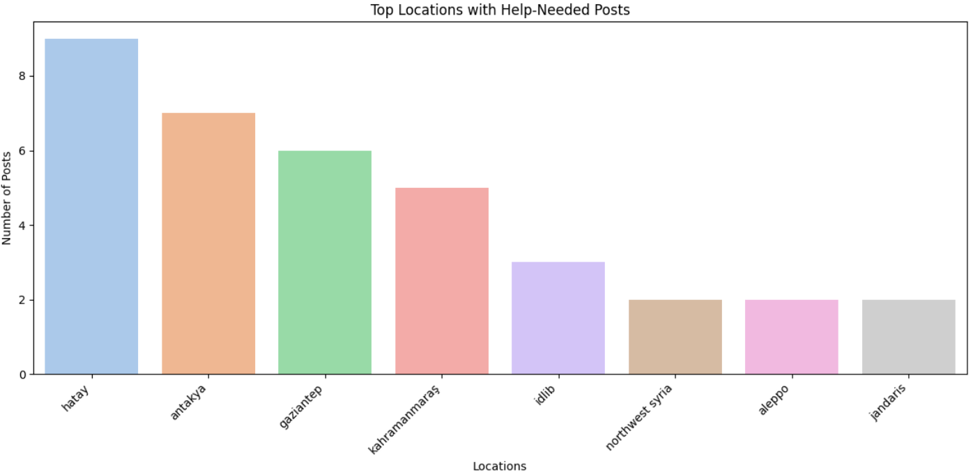
LOCATIONS WITH HELP NEEDED POSTS
Insights:
Hatay city got the highest help needed posts and needed to rescued sooner.

Slide 5
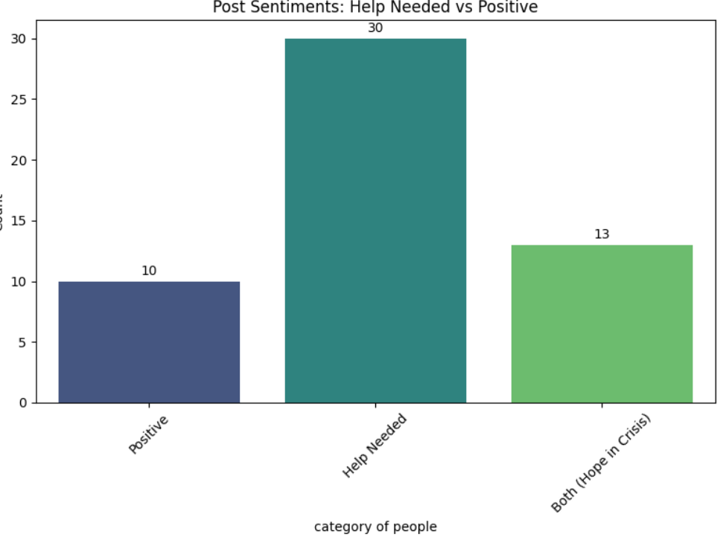
Plot on help needed vs +ve comments
Insights
During the time of the crisis in the year 2023, the posts from turkey & Syria urged having a huge prospect on help needed posts. This insight helps us to understand how critical the situation was at the time of earthquake that broke out 59,000 people.

Slide 6
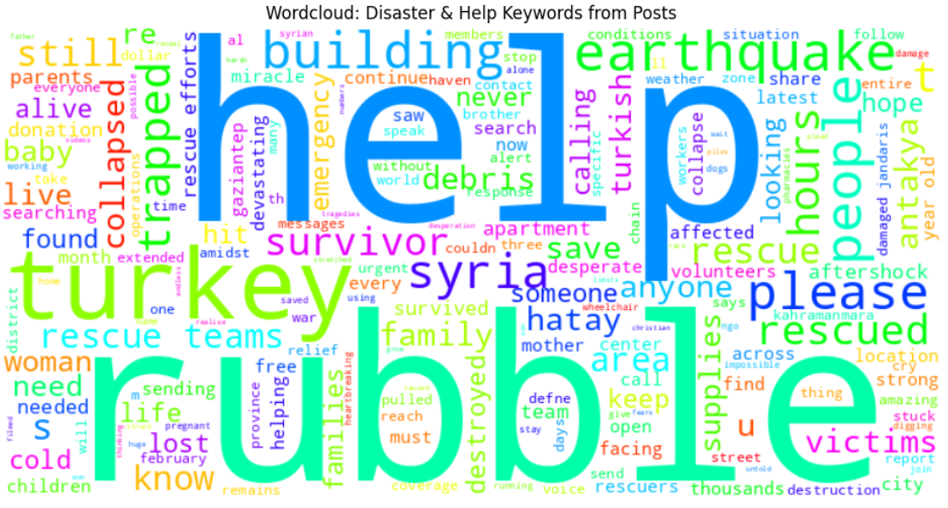
WORD CLOUD for the help needed messages
Insights
This word cloud identifies the the word that are related to the word “help”, inorder to help/rescue the people who are trapped inside building, Rubble, needed instant treatment/first aid etc.
The ones that are most relevant to the word “help” is highlighted by blue, cyan, green etc etc.

Slide 7
Workflow of the project
Load data
1. Load Data: Ingesting raw data from its source.
2. Data Cleaning: Preparing the data by handling missing values, removing duplicates, correcting errors, etc.
3. Text Preprocessing: Preparing text data for analysis (e.g., tokenization, stemming, lemmatization, stop-word removal).
4. Keyword Filtering: Selecting or extracting relevant keywords from the preprocessed text.
5. Model: Word Cloud: Applying the Word Cloud model to generate frequency-based visual representations of keywords.
6. Visualization & Results: Presenting the generated word cloud and any other relevant analytical results.
Data cleaning
Text preprocessing
Keyword filtering
Model: word cloud
Visualization & results

Slide 8
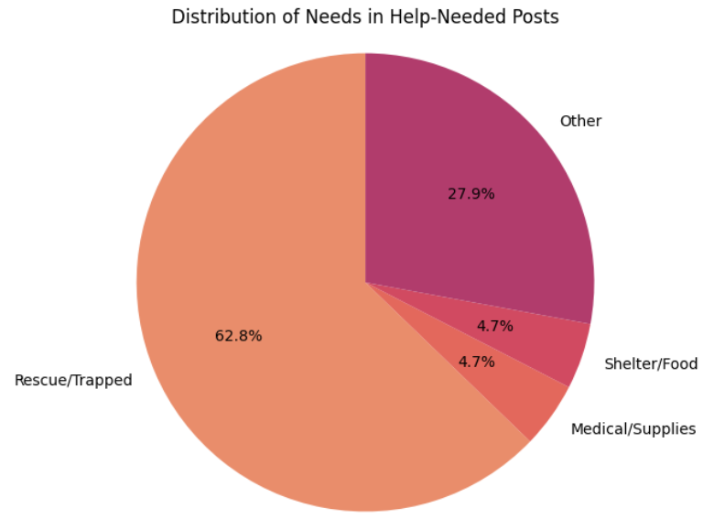
PIE CHART FOR distribution of needs
with respect to
help-needed posts
This pie chart concludes the categories of help needed for the people like:
Trapped & needed help
Need of shelter
Needed medical supplies
Any other
Insight conclusion:
Henceforth nearly 62.8% are trapped and needed to be rescued immediately accoding to the posts that are posted recently

Slide 9
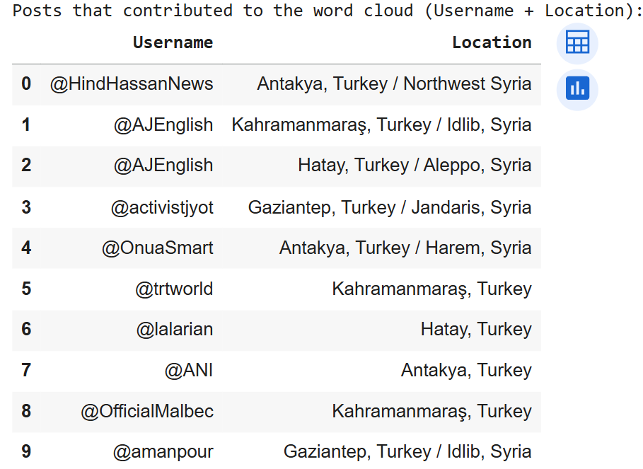
Final summary
After recognizing the words extracted from the word cloud, the final report says all the details about the person(username) and their location who needed help & needs to be rescued asap
KEY IDEA:
This insight can be in the form of CSV for all the usernames who falls under that category.

Slide 10
FUTURE IMPLEMENTIONS:
SOS Heatmap Generator: Instantly creates a heatmap of who are under a pattern of rescue, help etc
Automated Alert Bot: creates an alert bot where the help required from one single building will be consolidated and alerted

Slide 11
THANK YOU

