Slide 1


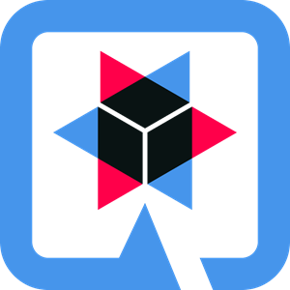



fremdverwaltet
VM23 / lokal
PV-Anlage MQTT Broker
(Mosquitto)
Backend
(Quarkus)
Zeitreihen-DB
(InfluxDB)
Kiosk/Dashboard
(Angular)
Graphenplotter
(Grafana)

