Slide 1
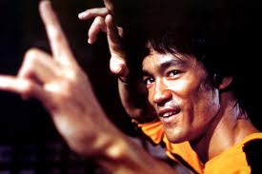
Terminal App: ‘Game of Death’
By Conrad Close

Slide 2
What is ‘Game of Death’?
A colourful, interactive and light-hearted text-based adventure based on the unreleased version of the movie ‘Game of Death’, written by Bruce Lee.
It’s a game which takes a single player on a brief adventure into enemy territory to save their girlfriend from 5 evil bosses.
It allows the player to make direct choices which have a direct impact on the other characters’ physicality and ability to fight.
It will be challenging!

Slide 3
How is it structured?
Core functionality is split up into 4 files:
classes.rb – handles the player and opponent classes with their various attributes
methods.rb – stores the primary methods for executing gameplay and handling user input
data.rb – stores data and arrays which hold large amounts of data (e.g. verbose taunts and location descriptions)
game_of_death.rb – stores the main function and player/enemy class initializations

Slide 4
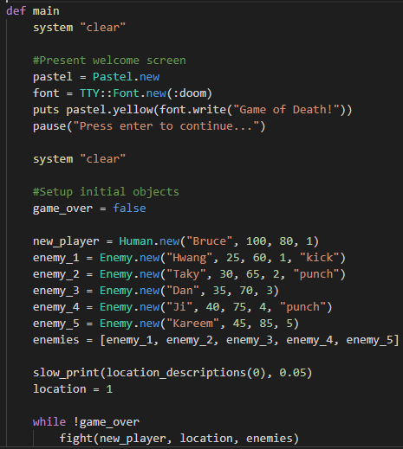
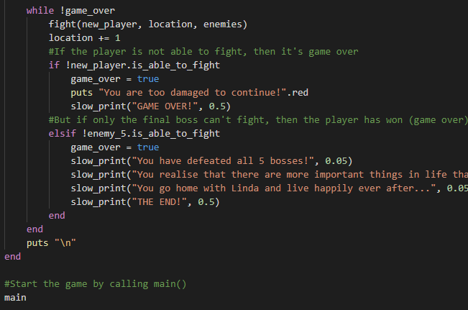

Slide 5
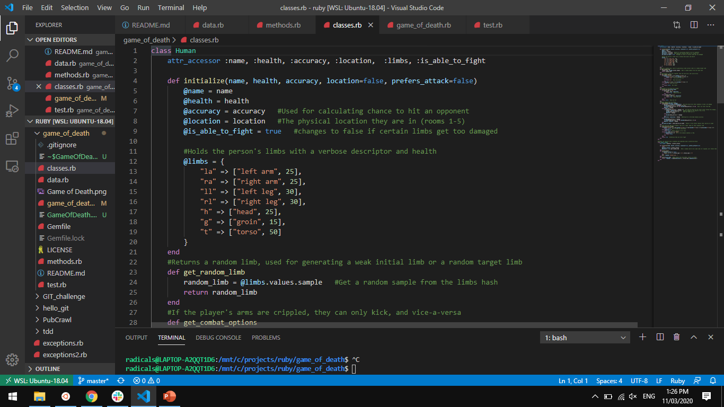

Slide 6
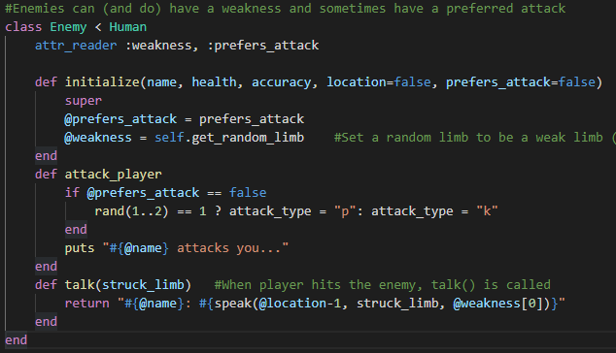

Slide 7
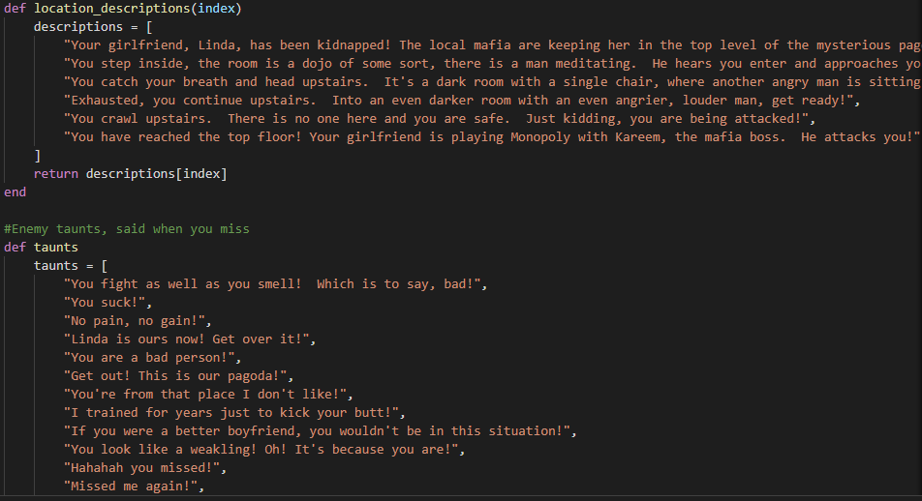

Slide 8
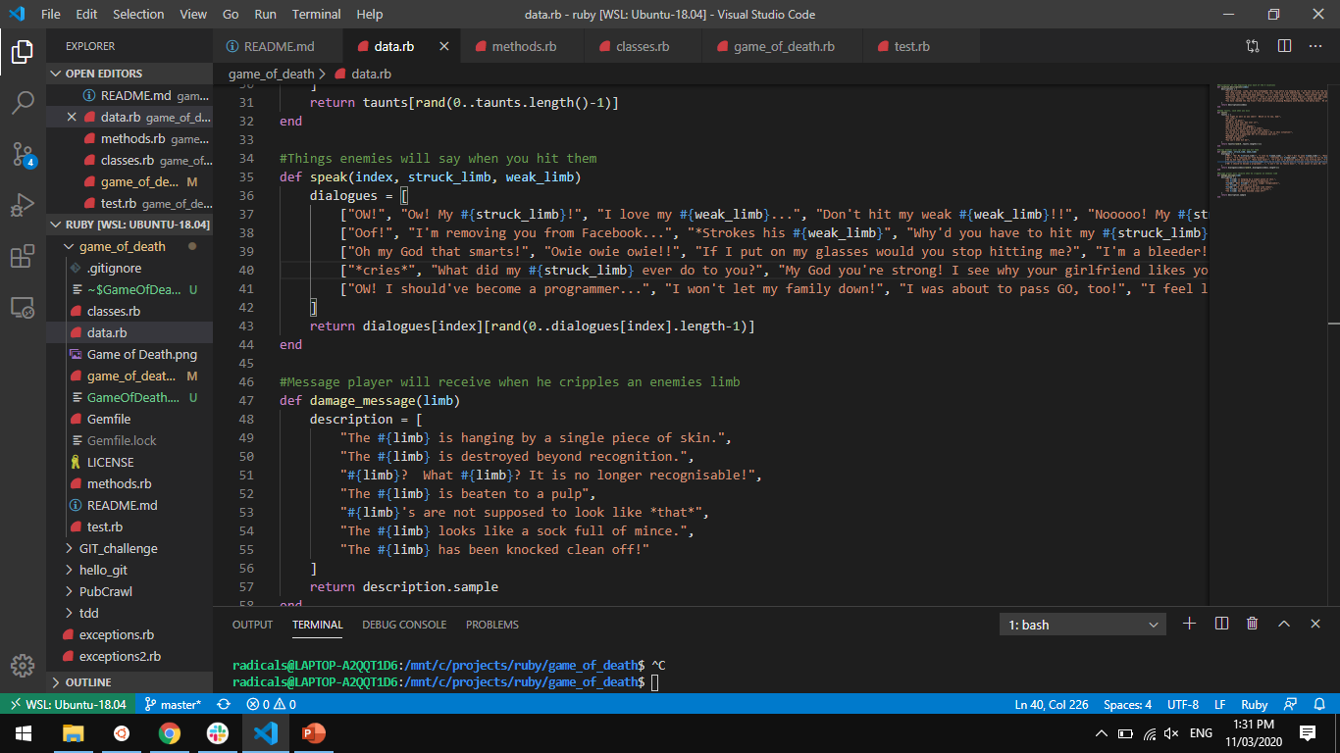
My favourite part of the code.
The random speech generator for the 5 enemies. Sometimes they reveal their “weak_limb” and sometimes they refer to the limb you just struck.
Adds some fun to the game.

Slide 9
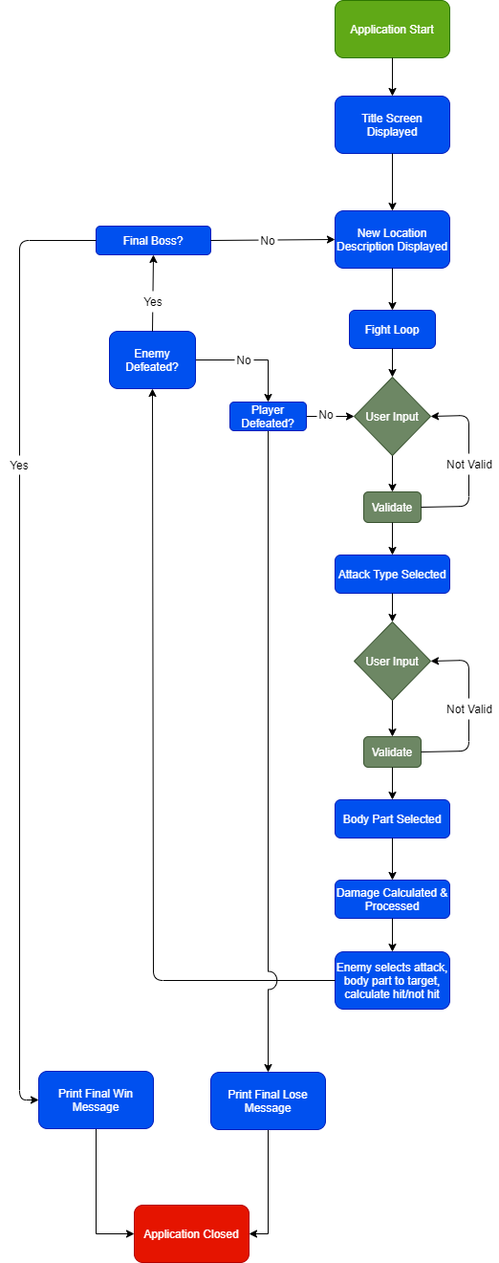
Code Overview

Slide 11
Let’s Play!

