Slide 1
Orange Queen
Price and Volume prediction models

Slide 2
Data analysis – price & volume data
Conventional type per region
Organic type per region
Average price
Price spikes in the Oct-Nov period in the more recent years
Significant increase in the recent months
All regions seem to fit within approx. 1 USD range during the past
Volumes
significant peaks in Feb and May across all major regions
TotalUS is the biggest "region" so despite of the other regions are majority we should still include TotalUS in our models
slight upward trend in total volumes
Average price
less structured than the price of conventional oranges
San Francisco gets often high peaks which aren't followed in other regions
it seems to be less seasonal driven than conventional orange prices
Volumes
magnitude smaller volumes than conventional oranges
significant upward trend in the past, though flattened in 2019
less pronounced seasonal trends
similar to the conventional type the TotalUS is the region with the largest volumes
the whole US total volumes are driven mostly by a few regions (TotalUS, West, Northeast, New York, Great Lakes) and these regions aren't all the same as in the conventional type

Slide 3
Data analysis – Google searches data
"Orange" search appears to be have seasonal trend with a significant drop from Sep till early Dec, one extraordinary peak in Mar-19
"organic" search shows also seasonality trend with lows in Jun-Aug and Nov-Dec periods, hitting its lowest point regularly in Dec
"Orange recipe" following similar trend to "Orange", however with a greater week-to-week volatility
"Orange smoothie" also shows minor seasonal trend with its lows in Q4s but with a clear upward trend since 2016
"Orange salad" follow the "Orange" search too (similarly to "Orange recipe"), with a greater week-to-week volatility
"organic orange" doesn't seem to have a clear seasonality pattern, there's slight decrease in Q4 similar to the other searches, however, it's not as profound as in the other cases. On the other hand it shows high week-to-week volatility and a slight upward trend
only "Orange" and "organic orange" got the extraordinary peak in Mar-19 which doesn't show in the other searches

Slide 4
Forecasting Model & Error metric
Forecasting model:
Prophet
Developed by Facebook research team
Curve-fitting algorithm taking into consideration seasonality, trend, holidays etc.
Does not utilise the features of the dataset, i.e. the feature extraction and analysis needs to be done separately
Error metric:
Mean Absolute Percentage Error (MAPE) used for comparing the models’ performance due to its simple impretentation in both volume and price
Another suitable alternative, especially for Volume models, could be Mean Squared Error (MSE) as that one would amplify the larger prediction errors, therefore the model could help avoiding waste/loss from unsold products due to significant over-supply and in opposite cases missed sales and upset customers due to significant under-supply

Slide 5
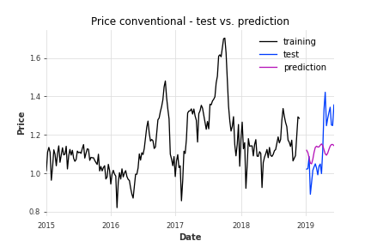
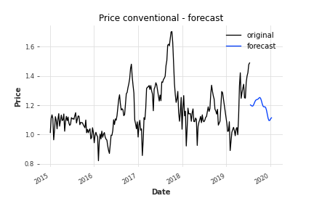
Price of conventional – prediction and forecast
The model seems to be fine in the 1st half of the prediction but completely misses the upswing in the middle of the prediction period
Default model MAPE: 18.27
Tuned model MAPE: 11.14

Slide 6
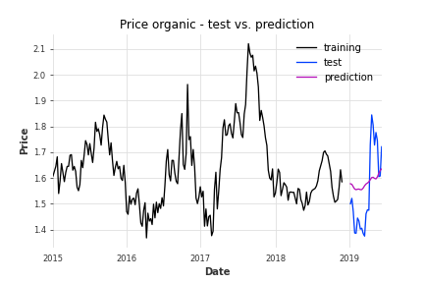
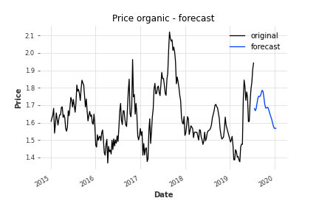
Price of organic – prediction and forecast
The model seems to be following the tested data trend correctly, however in much more flattened way avoiding the sharp swings
Default model MAPE: 19.01
Tuned model MAPE: 8.35

Slide 7
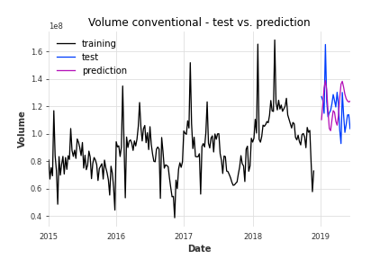
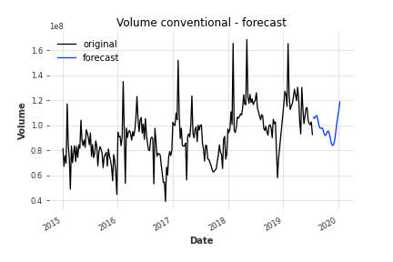
Volume of conventional – prediction and forecast
The model’s prediction is following the test data well, even predicting the peaks, just not going all the way in the extremes
Default model MAPE: 13.46
Tuned model MAPE: 13.70

Slide 8
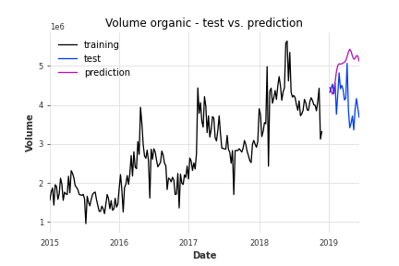
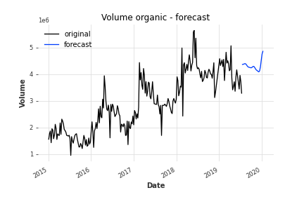
Volume of organic – prediction and forecast
The model follows the test data well in its 1st part but misses the downswing in its middle (similarly to the conventional price model)
Default model MAPE: 27.94
Tuned model MAPE: 23.18

Slide 9
Potential data sourcing improvements
The current model is too general, covering the U.S. market as whole. Therefore not utilising the maximum potential of the data split per region
Google search per region could bring important benefit to Orange Queen as it might help to increase local volume prediction accuracy
In times where estimated demand > potential max. supply, Orange Queen could utilise the price per region predictions and allocate its supplies to maximise its benefit (profit margin, key customer satisfaction, etc.)

Slide 10
Future steps to utilise the current data further
Testing other time series algorithms (e.g. ARIMA, LSTM) to clarify if the prediction accuracy of the model could be improved even further
Feature importance extraction to help Orange Queen with understanding which of the data points are driving the prices and volumes values
The volume models’ performance might benefit from changing their “growth” parameter to “logistic”, for this purpose we would need to estimate the saturation point of the markets

