Slide 1
Problem Statement
Everywhere there are many devices which have integrated Bluetooth and Wi-Fi. People have Bluetooth devices in their smart watches, Mobile phones and Car. By detecting these device’s Bluetooth target, a major problem of traffic volume prediction and Also due to uniqueness of Bluetooth Mac Id location tracking of these devices also be done.
The task at hand involves developing a codebase capable of detecting these Bluetooth devices, particularly those integrated into cars. This detection aims to leverage the presence of such devices for various applications, with a primary focus on urban road intersections. The objective is to integrate this code onto a Raspberry Pi platform, thereby enabling the collection of data from diverse urban intersections. However, the challenge extends beyond mere data collection; it also encompasses the management of incoming data streams and the subsequent processing required to derive meaningful insights. By tackling this multifaceted challenge, the project aims to facilitate advancements in traffic analysis, volume prediction, and location tracking, thus contributing to the optimization of urban transportation systems.

Slide 2
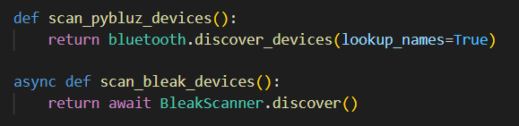
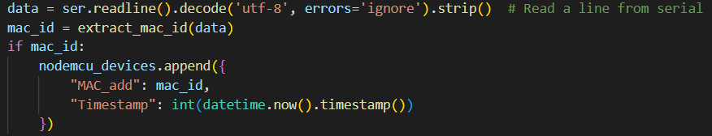
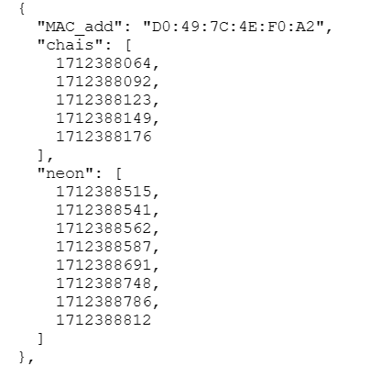
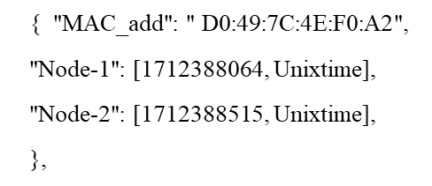
2. Our Solution
1. Utilization of BleakScanner for Bluetooth Low Energy (BLE) devices and PyBluez for classic Bluetooth devices.
2. Integration of NodeMCU for Wi-Fi scanning.
ESP8266 NodeMCU Wi-Fi Scanner allows you to easily locate visible wireless networks and its corresponding information. This program obtains the network name (SSID), signal strength (RSSI) and MAC Address, security.
Bluetooth Python extension module to allow Python developers to use system Bluetooth resources. PyBluez works with GNU/Linux, macOS, and Windows.
Bleak is an acronym for Bluetooth Low Energy platform Agnostic client.
3. Comprehensive data collection and storage with MongoDB and local storage options.
4. Use of Raspberry Pi Model 4 for data collection.
Here we got Mac-Addresses of Devices and there time of detection in Unix timestamp. JSON file is used for such non relational Data. MongoDB is database used to store non-relational data and data operations (find, insert update and delete)
The Raspberry Pi 4 is the 4th generation of the mainline series of Raspberry Pi Model 4

Slide 3
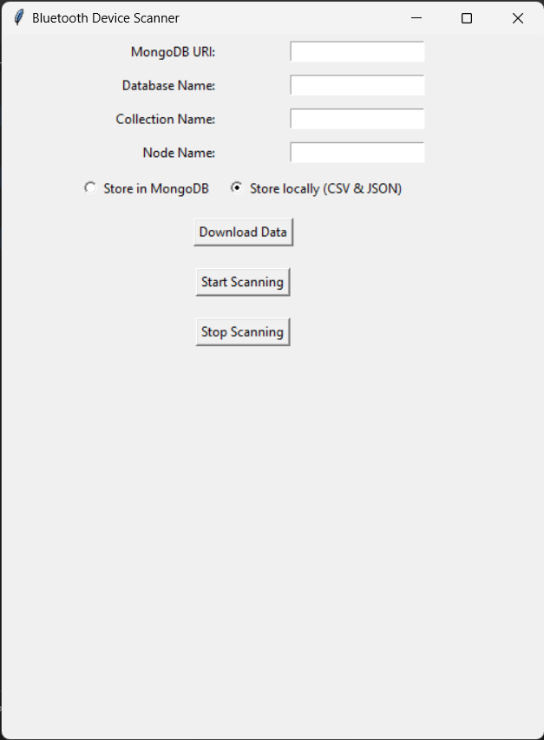
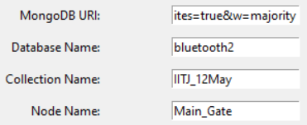
5. User-friendly interface development with Tkinter for easy configuration and interaction
6. To Store Locally (Memory Card)
It is for those nodes where there is no Internet connection
Steps:
Choose to Store locally (CSV & JSON)
Click on “Start Scanning”
Choose the folder to save data in pop up window (Example : Data12)
And its start storing all devices of each scan
Then you can see data files in that folder (devices.json & devices.csv)
Note : Don’t open files till you click “Stop Scanning”
The application features a user-centric interface with Tkinter, facilitating easy configuration of MongoDB URI, database name, and collection name. It provides enhanced control, allowing users to start/stop scanning, select storage options (MongoDB or local), and download data for analysis, ensuring adaptability to various operational needs.
7. To Store in MongoDB (Database)
MongoDB is database used to store non-relational data and data operations (find, insert update and delete)
It is for those nodes with Internet connection
Steps:
Fill MongoDB Credentials (Example :
Choose to Store in MongoDB
Click on “Start Scanning”
Now Go to MongoDB Compass or Atlas ( For Data)
Now You can perform MongoDB operation to handle Data such as (find, insert update and delete). (Example : find({MAC_add:"0A:ED:2C:62:AC:18"}))
Note : You can perform any mongodb operation and can export both query and raw data in both csv and json format.

Slide 4
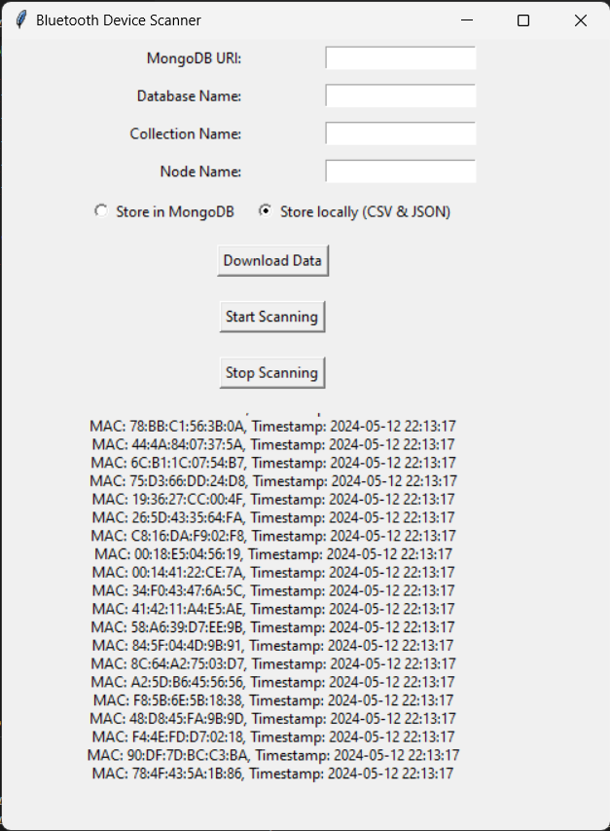
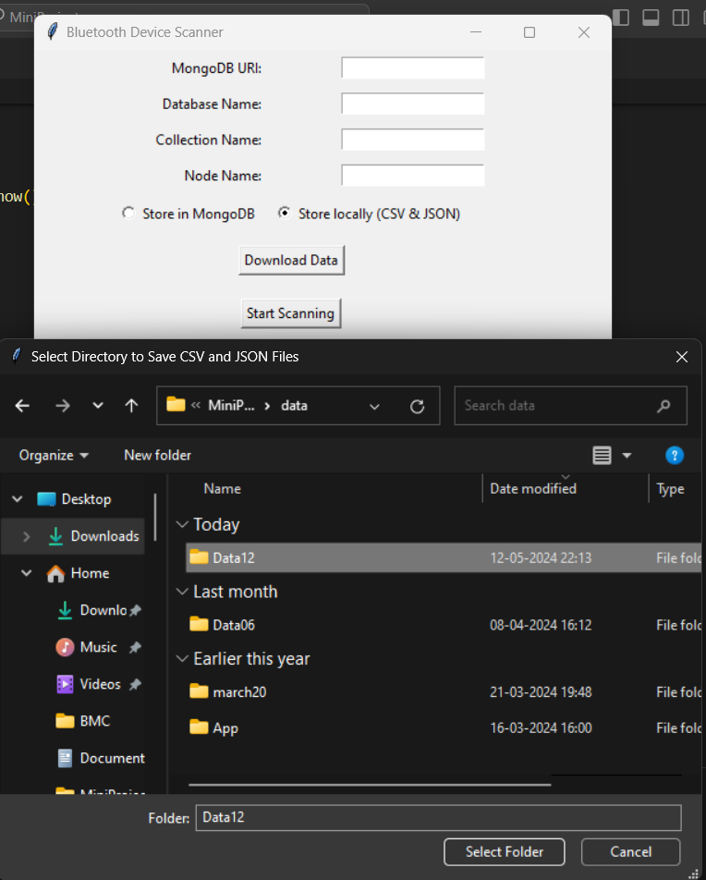
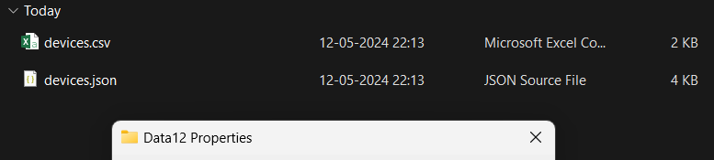
3. To Store Data Locally
2. Click on “Start Scanning”
3. Save data in pop up window
1. Choose to Store locally (CSV & JSON)
4. Choose the folder to
5. Then you can see data files in that folder

Slide 5
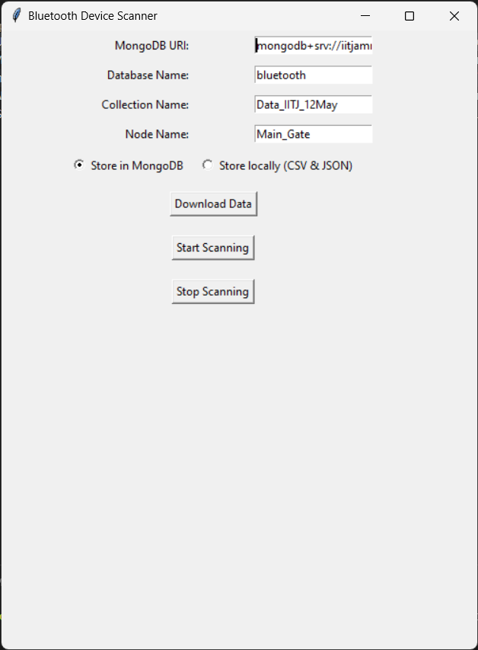
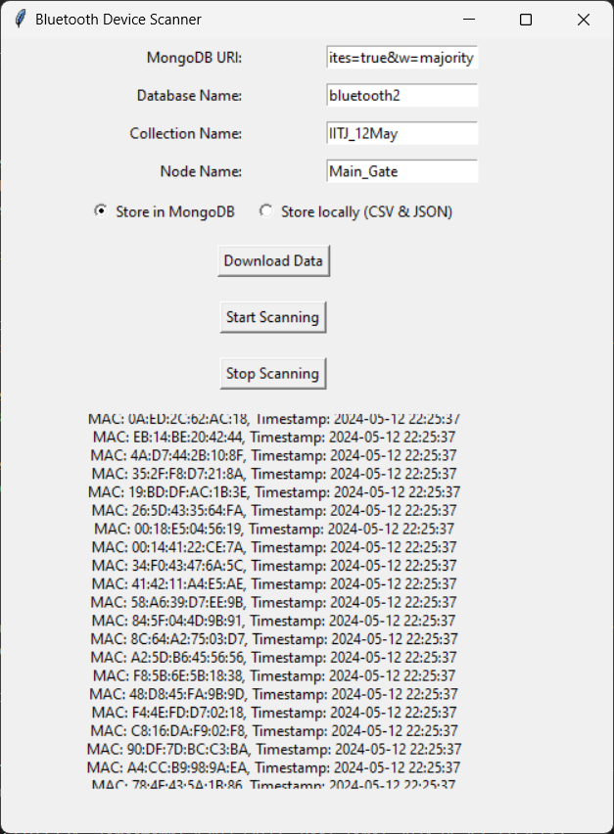
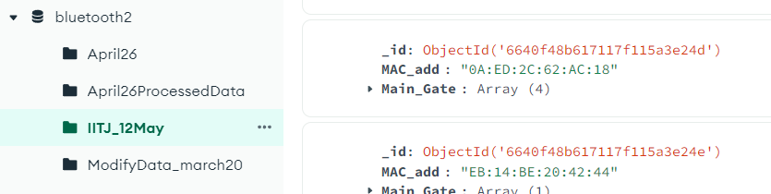
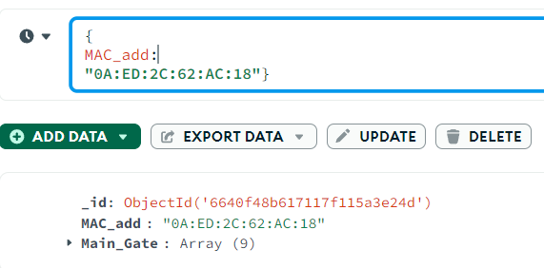
4. To Store Data in MongoDB
1. Fill MongoDB Credentials
1.
4.
2. Choose to Store in MongoDB
3. Click on “Start Scanning”
5.

