Slide 1
Programmable Communication Group Concatenated Forward Error Correction in Amateur Radio Satellite Telemetry
Category 2 – Project with active research agenda
SD1 Team:
Brandon Keith (ECE)
Cedric Destin (EE)
Brian Thibodeau (EE)
SD1 Advisor:
Professor Dennis Silage, PhD (ECE)

Slide 2
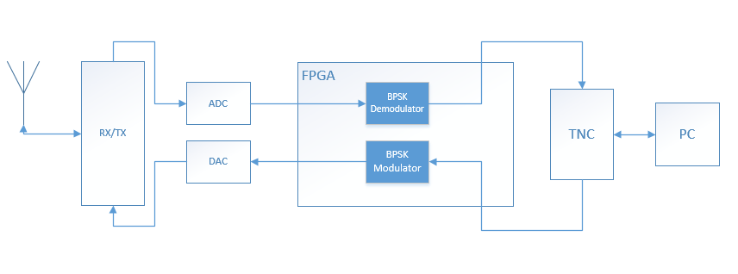
Change to Overall Objective

Slide 3

Change to Overall Objective

Slide 4
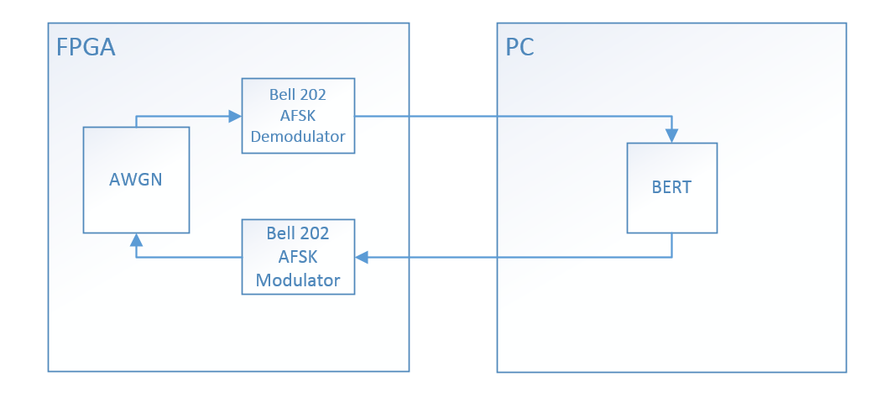
Change to Overall Objective
System A – 1200 bit/s Bell 202 AFSK

Slide 5
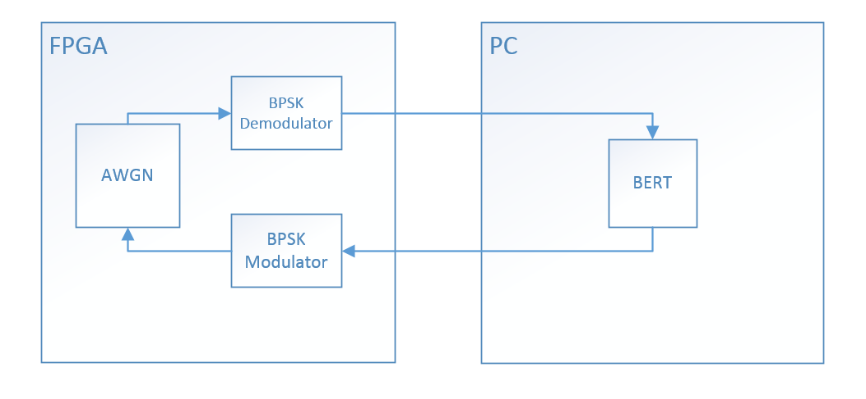
Change to Overall Objective
System B – 1200 bit/s BPSK

Slide 6
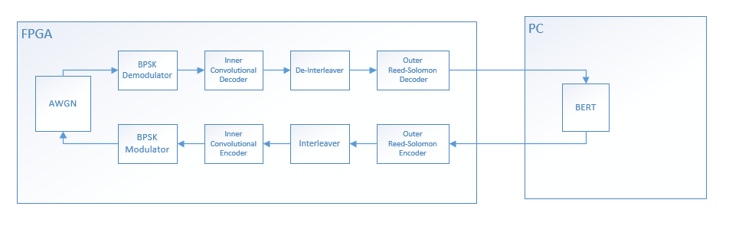
Change to Overall Objective
System C – 1200 bit/s BPSK with Concatenated Forward Error Correction

Slide 7
Programmable Communication Group Concatenated Forward Error Correction in Amateur Radio Satellite Telemetry
Category 2 – Project with active research agenda
SD1 Team:
Brandon Keith (ECE)
Cedric Destin (EE)
Brian Thibodeau (EE)
SD1 Advisor:
Professor Dennis Silage, PhD (ECE)

